Slide 1
Assessment of long term safety and efficacy of clotting factor concentrates
Alfonso Iorio, MD, PhD Health Information Research Unit & Hemophilia Program McMaster University Canada
Notes:
(May 12 2014 4:15PM – 20 minutes)

Slide 2
Alfonso Iorio
Baxter (Bayer, Biogen Idec, NovoNordisk, Pfizer - No conflicts)
CHESS/CHR/CHARMS, WFH Data & Demographics Committee
Bayer, Baxter, Biogen Idec, CSL, NovoNordisk, Octapharma, Pfizer – No conflicts
Bayer, Baxter, Biogen Idec, CSL, NovoNordisk, Octapharma, Pfizer – No conflicts
Bayer (NovoNordisk – No conflicts)

Slide 3
Assessment of long term safety and efficacy of clotting factor concentrates
Vision
A few key technical aspects
State of the art
Future perspectives

Slide 4
Assessment of long term safety and efficacy of clotting factor concentrates
Vision
Safe, effective, convenient and affordable treatment for as many patients as we can wherever they happen to be born
Technical aspects
State of the art

Slide 5
Assessment of efficacy and safety
Setting the stage:
Efficacy and effectiveness
Long versus short term
Absolute versus relative
Concentrates versus regimens
Individuals versus populations
Notes:
Long term would mean long in individual patients – long for the cohort – larger cohort.
Uncommon side effects or long term side effects require large cohorts and long follow up time.
Sometimes they end in drug withdrawals (thalidomiede and rosiglitazone (2011)
Some other time they lead to issuing warnings (beta-agonists in chidren, some opiates
The background question is: in a broadly defined population of hemophilia patients, what is the net clinical benefit (the balance of safety and efficacy) of the use of a given factor concentrate?
The net clinical benefit is comparative concept by nature

Slide 6
Haemophilia Product Development
HIV screening
rFIX available
Low-purity pd concentrates
High-purity concentrates
Cryoprecipitate
Intermediate-purity concentrates
rFVIII available
Manufacturing changes for rFVIII product
Mid
1960s
1970s
Early
1980s
Mid
1980s
Late
1980s
Early
1990s
Late
1990s
Early
2000s
Late
2000s
Today
Viral inactivation through heat treatment
HCV screening
Donor/plasma screening for HBV
Viral partitioning
via chromatography steps
Nanofiltration
Modified concentrates
Heat-treated concentrates widely available
Solvent/ detergent available
Adapted with permission from Key NS, et al. 1. Key NS, et al. Lancet. 2007;370:439–448.
Notes:
6
6
From the subsitution paradigm to the true therapeutics concept
Surveillance was introcuced with the infections and safer concentrates, and it is even more needed with engeneeres model

Slide 7
A more realistic representation..
Hemophilia treatment progress
progress
effort
progress
effort

Slide 8
Notes:
Study size
Outcome measure
Setting
Comparators

Slide 9
The reality is slightly different..
Study design
Study setting
Study size
Outcome measure(s)
Comparator(s)

Slide 10
Study design
Administrative databases
National health care systems / insurance databases
Disease registry
Dedicated research databases
Prospective targeted research projects
Comprehensiveness
Risk of bias reduction techniques
Notes:
Norway, denmark Medicare, Veterans adminsitration
The first group is retrospective, the last prospective
Blinded outcome measurement, collelction and analysis – multivariaible or propensity score analysis

Slide 11
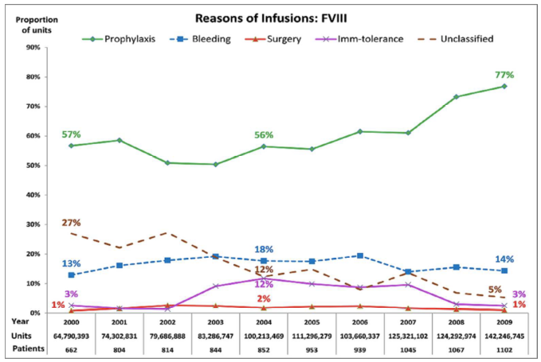
Canadian Hemophilia Assessment Resource Management System (CHARMS)
Over 10 years
2260 patients
FC units tracked
FVIII: 1 009 097 765
FIX: 272 406 859
Traore, A et al. First analysis of 10 years trends in national factor concentrate utilization in Canada. Hemophilia, 2014, accepted
Notes:
Example of the first category
Similarly UK, italy, CDC

Slide 12
The EUHASS study
Strengths
Prospective, very large inception cohort
Controlled (parallel, head-to-head)
Limitations
Minimal information collected
No multivariable approach
Confounding still possible
Dynamic cohort not always at steady-state
Notes:
Example of the second type – Rodin is another. PASS another as well
They have a protocoll

Slide 13
EUHASS: Inhibitors in PTPs
Product | Inhibitors | Pt/yr | Rate | (95% C.I.)
1 | 5 | 4656 | 0.11 | (0.03-0.25)
2 | 1 | 1987 | 0.05 | (0.00 - 0.28)
3 | 6 | 3519 | 0.17 | (0.06 - 0.37)
4 | 3 | 2338 | 0.13 | (0.03 - 0.37)
Data from the EUHASS annual reports to the Investigators
Notes:
From Oct 1st, 2008 to Dec 31st, 2012 68 Centers reported 108 inhibitors in 417 PUPs (26%; CI 22-30%) PUPs with severe hemophilia A and 26 inhibitors developed in17,667 treatment years in PTPs.
Clinical inhibitors - safe; denominator: pts or py? switches? cancellation of random errors
is 1in 2000 different from 2 in 1000?

Slide 14
Inhibitor rates, selected recombinant FVIII
Product | Studies | Rate (x 100 py) | 95% CI
Advate | 9 | 0.10 | 0.05-0.18
Kogenate | 9 | 0.12 | (0.04-0.33)*
Refacto | 8 | 0.19 | 0.11-0.34
PD factor VIII | 4 | 0.09 | 0.02-0.45
* 0.26 (0.16 - 0.44) at fixed effect model
Xi, M et al. Journal of Thrombosis and Haemostasis : JTH, 2013; 11(9), 1655–62.
Notes:
This slide to show the variability and consequent imprecision of estimates for individual molecules; the analysis has to be considered hypothesis generating, and no formal statistical test is possible, being the cohorts completely unrelated.
The effect of adding Peerlink, invoke the importance of full data collection

Slide 15
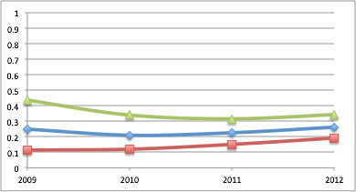
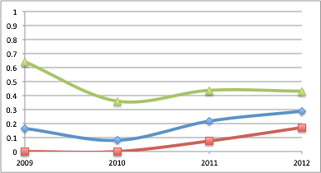
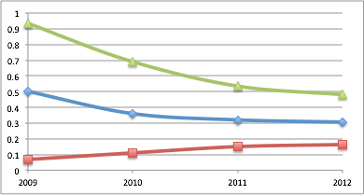
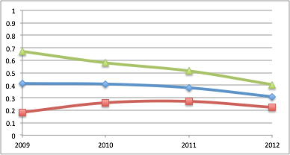
Year | 2009 | 2010 | 2011 | 2012
Inhib | 8 | 34 | 63 | 96
Exposed | 59 | 121 | 221 | 336
Proportion | 0.31 | 0.28 | 0.29 | 0.29
Data from the EUHASS annual reports to the Investigators
Notes:
The overall rate did not change - the figure is slightly different from the one of the final analysis, because this are non validated data. Data for individual studies converged. This suggests cancelling of random errors in the initial estimates. Also, it looks like PUPs are not so bad to this scope..

Slide 16
 | EUHASS |  |  |  | EUHASS -RODIN
 | P | LCI | UCI |  | P | LCI | UCI
Plasma D | 0.22 | 0.11 | 0.35 |  | 0.21 | 0.10 | 0.37
Recomb | 0.26 | 0.22 | 0.31 |  | 0.24 | 0.19 | 0.29
A | 0.26 | 0.19 | 0.34 |  | 0.26 | 0.17 | 0.36
B | 0.32 | 0.18 | 0.50 |  | 0.33 | 0.18 | 0.52
C | 0.30 | 0.22 | 0.40 |  | 0.22 | 0.13 | 0.33
D | 0.29 | 0.17 | 0.43 |  | 0.27 | 0.15 | 0.43

Slide 17
Stakeholders and barriers
Manufacturers
Accessibility to data – comparative effectiveness
Patients
“Disease” denial – burden of data generation
Treaters
Time commitment – applied science
Researchers
Small return
Notes:
Manufactures: willingeness of profit for effective care
Patients: quest for effective treatment

Slide 18
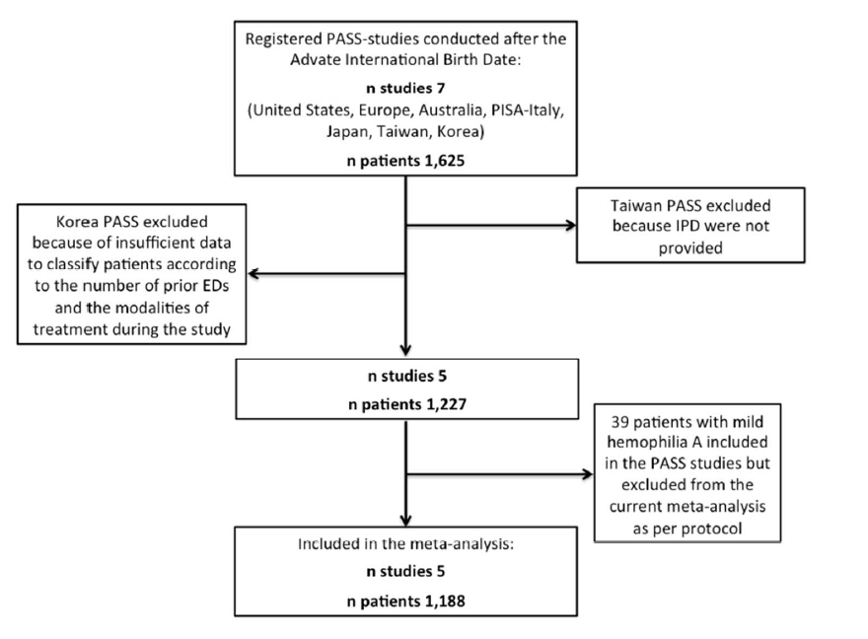
Patient data meta-analysis of Post Authorization Safety Surveillance (PASS) studies of hemophilia A patients treated with rAHF-PFM
Iorio, Marcucci, Cheng,
Romanov, Thabane.
Hemophilia, submitted.
Study |  | Patients (n 1,188)
Australia-PASS Europe-PASS Japan-PASS Italy-PASS US-PASS |  | 34 (2.9) 419 (35.3) 361 (30.4) 281 (23.6) 93 (7.8)

Slide 19
Patient Characteristics & ABR
Characteristics, n (%) | Num (%) | ABR
>150 previous EDs | 1016 (85.5)
Prophylaxis at enrolment | 743 (62.6)
≥ twice/week during the study | 587 (49.4)
Characteristics, n (%) | Num | Median (Q1, Q3)
All patients | 1,140 | 3.83 (0.60, 12.90)
On demand at enrolment | 421 | 10.38 (2.27, 27.29)
On prophylaxis (on study, any frequency) | 710 | 2.00 (0, 6.73)
On prophylaxis (on study, ≥twice/week) | 557 | 1.66 (0, 4.78)
Median dose per infusion of 27 IU/kg (Q1 20, Q3 34).
Notes:
median dose per infusion of 27 IU/kg (Q1 20, Q3 34).

Slide 20
Stakeholders and barriers
Manufacturers
Accessibility to data – comparative effectiveness
Patients
“Disease” denial – burden of data generation
Treaters
Time commitment – applied science
Researchers
Small return
Notes:
Manufactures: willingeness of profit for effective care
Patients: quest for effective treatment

Slide 21
Effectiveness outcomes
Cure (as a synonym for normal life)
Healthy functional joints
Bleeding (annualized bleeding rate)
Pain
Working capability
School attendance

Slide 22
Ways to higher effectiveness
Improving concentrates
Improving adherence
Reducing cost
Tailoring dose
Simplifying treatment
Investigating social and cultural components

Slide 23
Safety outcomes
Inhibitor development
Laboratory variability
Blood borne infections
Unexpected events
Long term toxicity of modified molecules
Drug interactions
“Clots”?
Notes:
World Health Organisation. Global policy report on the prevention and control of viral hepatitis in WHO member states. 2013; 1.

Slide 24
Safety outcomes
Inhibitor event rate in PTPs – so what?
As a result of our systematic review, we identified:
•39 de novo inhibitors reported in 19 publications.
Individual patient data has been collected for:
•29 (74%) inhibitor cases overall
•14 (36%) from CRFs completed by study investigators
•15 (39%) extracted from patient-level information available in the published reports.
Notes:
ISTH SSC project on harmonization of reporting of inhibitors in PTPs

Slide 25
Interim results – inhibitor characteristics
Characteristic (n = 29) | Estimate
Age at inhibitor diagnosis (years) | ?
Peak titre level (BU/ml) | ??
Last know titre level (BU/ml) | ???
Patient follow-up (mo) | ????
Barbara,A. Care until Cure grant competition, CHS
Notes:
Age: 2-67
Peak 0.5 – 75
Last titre 0-10.4
Follow up 1-143

Slide 26
Paradigm shift in trial design
Powell, J et al. Thrombosis and Haemostasis, 2012; 108(5), 913–22
Efficacy and safety of prophylaxis with once-weekly BAY 79-4980 compared with thrice-weekly rFVIII-FS in haemophilia A patients. A randomised, active-controlled, double-blind study..
Valentino, L et al. JTH. 2012; 10(3), 359–67.
A randomized comparison of two prophylaxis regimens and a paired comparison of on-demand and prophylaxis treatments in hemophilia A management.
Manco-Johnson, MJ et al. JTH, 2013; 11, 1119–1127.
Randomized , controlled , parallel-group trial of routine prophylaxis vs . on-demand treatment with sucrose-formulated recombinant factor VIII in adults with severe hemophilia A (SPINART).
Valentino, L et al. Haemophilia. 2014; 20(3), 398–406.
Multicentre, randomized, open-label study of on-demand treatment with two prophylaxis regimens of recombinant coagulation factor IX in haemophilia B subjects.
Antunes, SV et al. Haemophilia, 2014; 20(1), 65–72.
Randomized comparison of prophylaxis and on-demand regimens with FEIBA NF in the treatment of haemophilia A and B with inhibitors.

Slide 27
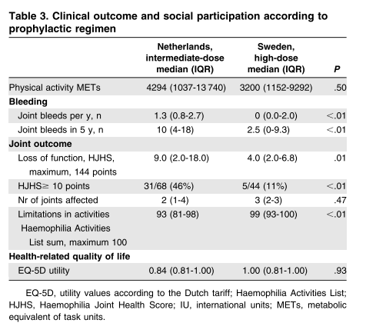
Long term comparison of different regimens
 | NL Median (IQR) | SW, Median (IQR) | P
Joint bleeds, 5 yr | 10 (4 -18) | 2.5 (0.-9.3) | <.01
Nr joints | 2 (1-4) | 3 (2-3) | .47
HJHS (max144) | 9.0 (2.0 – 18.) | 4.0 (2.0 – 6.0) | <.01
Activity (max 100) | 93 (81-98) | 99 (93-100) | <.01
EQ-D5 utility | 0,04 (0.81 – 1.00) | 1.00 (0.81 – 1.00) | .93
Factor cost | 851 (647-1048) | 1474 (1154-1778) | <.01
Lost production | 0 (0-0) | 0 (0-0) | .82
Fischer, K et al. Intermediate-dose versus high-dose prophylaxis for severe hemophilia: comparing outcome and costs since the 1970s. Blood, 2013; 122(7), 1129–36.

Slide 28
New study design
Interrupted time series
Ramsay, C. R. et al. Int J Technol Assess Health Care, 2003;19(4), 613–23.
Paired availability design
Baker, S. G. et al. BMC Med Res Method, 2001;1, 9.
Randomized registry trial
Lauer & D’Agostino NEJM 2013;369(17), 1579–81.

Slide 29
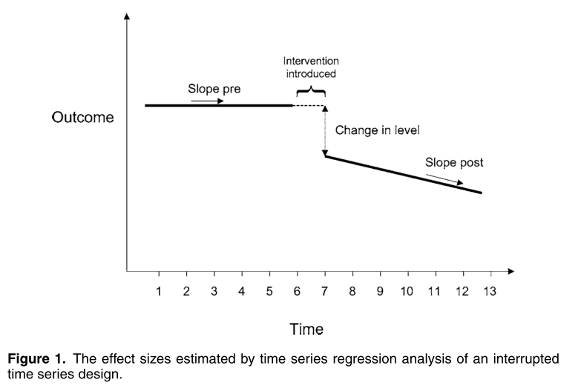

Slide 30
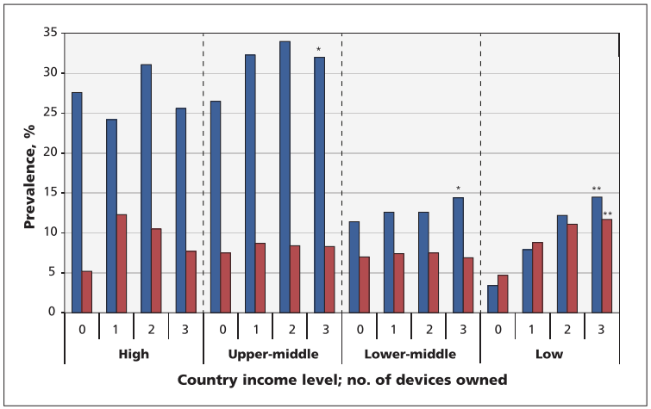
Prospective urban rural epidemiology (PURE) study
Lear, S. A. CMAJ, 2014 186(4), 258–66.

Slide 31
Innovation
Bailey, SD. Diabetologia, 2014,57;4:738-45
Huffman, MD and Yusuf, S. JAMA. 2014,63;14:1368-70

Slide 32
Conclusions
Clear need for surveillance
Clear evidence of progress
Need for harmonization
Need for guidance

Slide 33
Thanks
hemophilia.mcmaster.ca

