Slide 1
Real-World Prophylaxis Experience: Perspectives from Clinical Practice
Alfonso Iorio MD, PhD McMaster University Canada
BeneFix® (nonacog alfa) is not currently approved for once-weekly prophylaxis treatment
Notes:
(May 12 2014 13:05PM – 20 minutes)

Slide 2
Alfonso Iorio
Bayer, Biogen Idec, NovoNordisk, Pfizer - No conflicts
–
–
Bayer, Baxter, Biogen Idec, CSL, NovoNordisk, Octapharma, Pfizer – No conflicts
Bayer, Baxter, Biogen Idec, CSL, NovoNordisk, Octapharma, Pfizer – No conflicts
Bayer, NovoNordisk – No conflicts

Slide 3
Goals of the presentation
Review usage of prophylaxis in adult haemophilia B patients
Indications and uptake
Frequency of administration
Dosing

Slide 4
Question 1
How do you define prophylaxis started in adulthood?
Secondary
Tertiary

Slide 5
Prophylaxis in adult patients
Tertiary prophylaxis
Definition
Regular continuous treatment started after the onset of joint disease
Source
Srivastava A, Brewer AK, Mauser-Bunschoten EP et al. Guidelines for the management of hemophilia. Haemophilia 2013;19:e1–47.

Slide 6
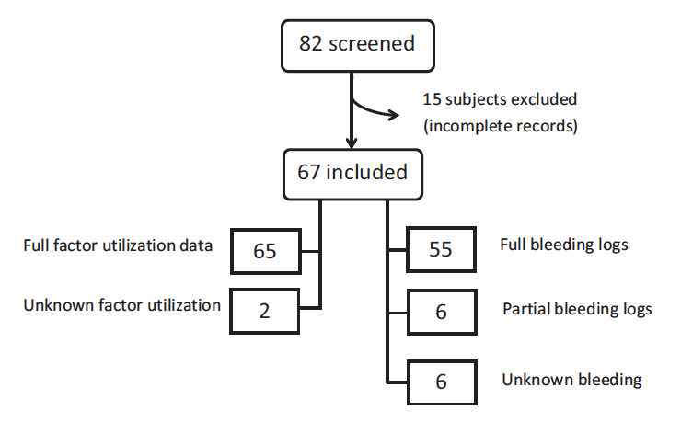
Jackson SC et al. Haemophilia 2014; 20(3), e199–204.

Slide 7
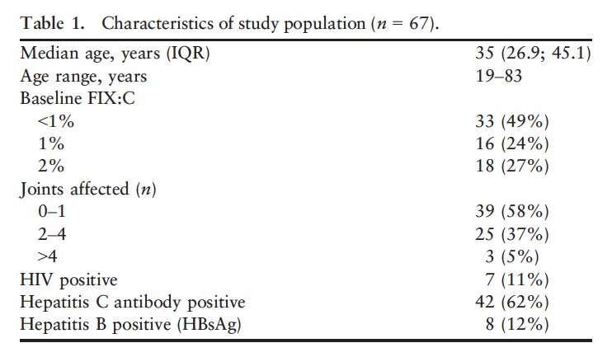

Slide 8
Question 2
How many adult patients do you expect to be on prophylaxis?
>50%
<50%

Slide 9
If green wins: Question 3
How many adult patients do you expect to be on prophylaxis?
>75%
<75%

Slide 10
If red wins: Question 4
How many adult patients do you expect to be on prophylaxis?
>25%
<25%

Slide 11
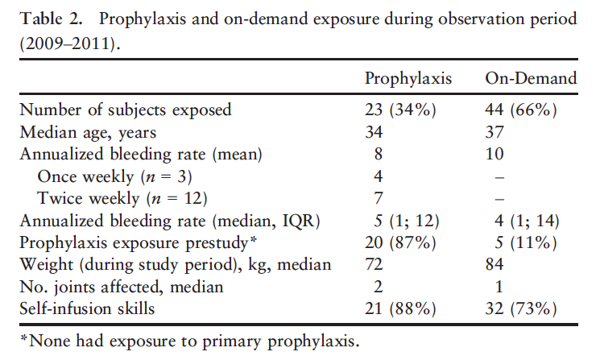
BeneFix® (nonacog alfa) is not currently approved for once-weekly prophylaxis treatment
Jackson SC et al. Haemophilia 2014; 20(3), e199–204.

Slide 12
Prophylaxis in adult patients in Canada
Previous large Canadian survey in 2006¹
17/86 (20%) adults ≥18 with severe hemophilia B were on prophylaxis (≥45 w/year)
Current 2014 study: 34/67 (34%)
Factor concentrate utilisation (U/Kg/year):
Pre-2009: prophylaxis: 2148; on-demand: 812
Observation period: prophylaxis: 2936; on-demand: 611
1. Biss TT. Haemophilia 2008; 14: 923–30.

Slide 13
Once-weekly dosing with rFIX
2/3 subjects treating weekly with 33–36 U/kg/week
ABR = 0
1/3 subjects treating weekly with 39 U/kg/week
ABR = 12
Jackson SC et al. Haemophilia 2014; 20(3), e199–204.

Slide 14
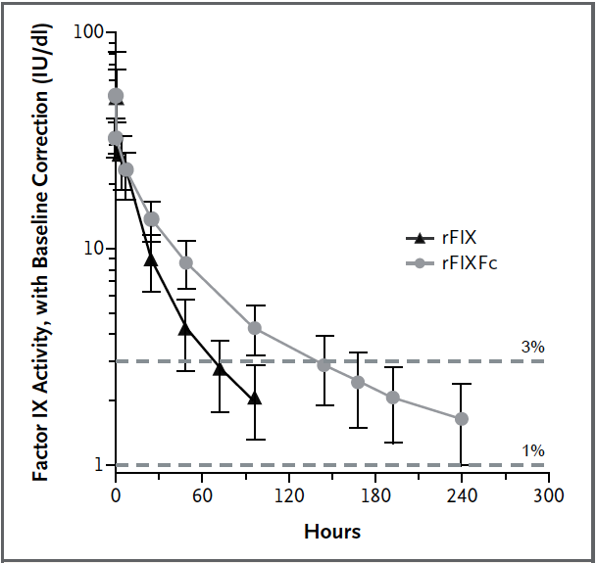
PK estimation of rFIX half-life
Powell JS et al. NEJM 2013; 369(24), 2313–23.
Phase III study of recombinant factor IX Fc fusion protein in hemophilia B

Slide 15
PK estimates 96 vs 48 hrs sampling
2-comp model analysis following injection of 50 IU/kg (*) IU/dl per IU/kg using one-stage clotting assay for FIX measurement
Powell JS et al. NEJM 2013; 369(24), 2313–23.

Slide 16
Question 5
Are you surprised to see a longer than expected half-life rFIX?
Not at all
Yes, a lot

Slide 17
Recombinant FIX vs pdFIX
Parameter | AlphaNine®† (n = 25) | BeneFix® (n = 22)
Recovery IU/dL per IU/Kg | 1.30 +/- 0.4 | 1.00 +/- 0.3
Half-life (h) | 32.7 +/- 7.4 | 36.0 +/- 12.8
VDss (dl/Kg) | 1.34 +/- 0.42 | 1.75 +/- 0.52
VDss: Volume of distribution
†AlphaNine® is not approved in Australia
Lissitchkov T. Haemophilia 2013;19(5):674–8, Berntorp E. Haemophilia 2013;19(6), 805–7.

Slide 18
Question 6
How do you dose rFIX? Do you use a conversion factor (e.g. 1.2 or higher?)
No / don’t understand
Yes, for sure

Slide 19
Interpatient variability in dosing HB patients
Study | Pts & Age (years) | Prophylaxis (U/Kg) | On-demand (U/Kg)
 | N° mean (range) | Median (range) | Median (range)
Roth¹ (*) | 56 23 (4–56) | 35.1 (9.7–170.6) | 42.8 (6.5–224.6)
Shapiro² | 56 9 (0–14) | 60.6 (8.7–230.4) | 62.7 (82–292.0)
Lambert³ | 34 28 (12–68) | 51.7 (13.9–184.2) | 87.4 (30.3 –147.2)
Monahan⁴ | 25 2 (0–4) | 57.6 (27.9–187.2) | 58.2 (27.5–115.2)
(*) 43% of 46 patients did not require dose increase
1. Roth D Blood 2001; 98: 3600-6; 2. Shapiro A, et al. Blood. 2005;105:518–525; 3. Lambert T, et al. Haemophilia. 2007;13:233–243; 4. Monahan PE et al. Haemophilia 2010;16:460-468

Slide 20
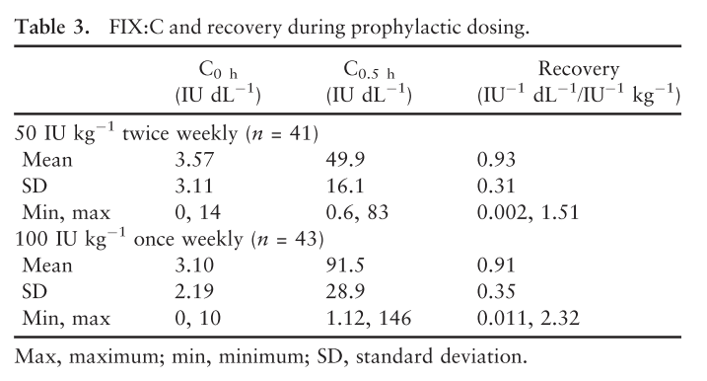
Recovery data from study 400
Valentino L. Haemophilia 2014;20(3), 398–406.

Slide 21
Survey flow chart
293
35/47 centres
249
44
26
5: no severe HB pts
6: no answer
= 83.1% (tot)
207
233
29/35 centres
67
= other F IX
Study population
139
138
= BeneFix® patients
= 66,7% (pop)
1 (ITI)
= 55,4% (tot)
Rocca A et al. Blood Transfus 2011; 9: 60–69.

Slide 22
Conversion factor estimate
Mean ± standard deviation | 95% Confidence interval
1.10 ± 0.36 | 0.39 – 1.83
Median | Range
1 | 0.51 – 2.08
XX Congresso Nazionale SISET – FIRENZE 24-28 settembre 2008

Slide 23
Mean recovery for rFIX: 0.98 ± 0.19 IU/dL/IU/kg
(32 samples
from 23 patients)

Slide 24
Summary
Increasing use of prophylaxis in hemophilia B
Once-weekly treatment with rFIX might be reasonable in selected cases and with optimal dosage
Half-life longer than it was thought
Recovery does not need correction
BeneFix® (nonacog alfa) is not currently approved for once-weekly prophylaxis treatment
Disclaimer: These conclusions reflect literature evidence as interpreted by the speaker and not necessarily the opinion of the sponsor

