Slide 1
ADVATE [Antihemophilic Factor (Recombinant), Plasma/Albumin-Free Method] Safety and effectiveness: 10 years of clinical experience
Alfonso Iorio, MD, PhD Health Information Research Unit & Hemophilia Program McMaster University, Canada
Notes:
May 11 2014 13:00 -14:15 PM – 15 minutes

Slide 2
Alfonso Iorio
Baxter (Bayer, Biogen Idec, NovoNordisk, Pfizer - No conflicts)
Bayer, Baxter, Biogen Idec, CSL, NovoNordisk, Octapharma, Pfizer – No conflicts
Bayer, Baxter, Biogen Idec, CSL, NovoNordisk, Octapharma, Pfizer – No conflicts
Bayer, NovoNordisk – No conflicts
Notes:
McMaster has been contracted by Baxter to run a meta-analysis of PASS Advate Data
Peer-reviewed co-funding: MITACS (www.mitacs.ca)
for 12 months salary of a MSc/PhD student
Grant No. IT02516

Slide 3
DISCLAIMER
This symposium may include the opinions of the speakers, which do not necessarily reflect the views of Baxter. This symposium may also contain factual information on products and/or indications that are not approved in Australia. Baxter does not recommend the use of any of its products outside of their country specific labelling.

Slide 4
Safety Data From Multiple Sources
Interventional Clinical Trials (Phase I-IV)
-Controlled environment
-Protocol that select its population
Spontaneous Reports
-Real-world setting
-Collected from variety of sources (HCPs, patients, literature)
-Limited details
Post-Authorization Safety Studies
-Real-world setting
-Non-interventional studies ]
Safety
Efficacy
Effectiveness

Slide 5
A three-components assessment
1) The First Review of Global Spontaneous Adverse Event Reports for a Third
Generation Recombinant Factor VIII Concentrate (Octocog Alfa): 10 Years of Safety
Experience - Berg R, Gringeri A, Reininger AJ
REAL WORLD ADVERSE EVENTS REPORTS FROM ALLSOURCES (e.g. CLINICIANS, PATIENTS, PUBLISHED CASE STUDIES)
2) Integrated Analysis of Safety Data from 12 Clinical Interventional Studies of a
Plasma- and Albumin-free Recombinant Factor VIII in Persons with Hemophilia A
Shapiro A, Romanov V, Silvati-Fidell L, Matovinovic E, Wong WY, Schoenig-Diesing C
CONTROLLED CLINICAL STUDY DATA FROM Phase I-IV
3) Meta-analysis of Post Authorization Safety Studies (PASS): Worldwide post-marketing surveillance of hemophilia A patients treated with antihemophilic factor recombinant plasma/albumin-free method rAHF-PFM - Marcucci M, Cheng J, Oldenburg J, Schoenig-Diesing C, Matovinovic E, Romanov V, Thabane L, Iorio A
REAL WORLD DATA COLLECTED FROM GLOBAL NON-INTERVENTIONAL CLINICAL STUDIES

Slide 6
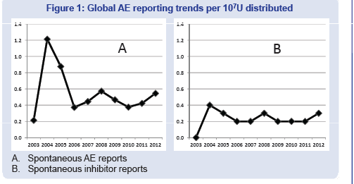
1. Spontaneous Adverse Event Reports
Global PV safety database - July 2003-Sept 2012
>13 BU, corresponding to an estimated 87,000 patient-years of exposure
Reporting rate of FVIII inhibitors was stable over time
Berg, R et al. Poster presented at XXIV Congress of the ISTH, 2013, Netherlands.

Slide 7
Working Summary: Spontaneous AE Reports
Spontaneous AE Reports
No detection of previously unrecognized risks
Berg, R et al. Poster presented at XXIV Congress of the ISTH, 2013, Netherlands.

Slide 8
2. Interventional Studies: Overview
Comprising of 12 studies: Phase I through IV interventional trials, totaling 418 unique subjects
Surgery
N=59
Dose-Response
N=25
Bonn Switch
Study N=9
PUP
N=55
Pivotal
N=108
Ped. PTP
N=53
2000
2005
2010
Continuation
N=82
2-mL Dose-Reconst. BE
N=42
High Potency
N=23
Japanese Registry
N=15
Continuation Canadian Ped.
N=4
Prophylaxis
N=73
Shapiro A et al. Poster presented at the XXIV Congress of the ISTH, 2013, Netherlands.

Slide 9
2. Interventional Studies: Patient Flow and Analysis Sets
Shapiro A et al. Poster presented at the XXIV Congress of the ISTH, 2013, Netherlands.
Pediatric PTP
N=53 ( u=53)
4
Canadian
Pediatric
N=4 (u=0)
Pivotal
N=108 (u=106)
9
Surgery
N=59 (u=34)
1
2
2
2 mL Reconstitution Bioequivalence
N=42 (u=33)
1
74
8
4
16
4
Continuation
N=82 (u=0)
2
Dose-Response
N=28 (u=17)
4
PUP
N=55 (u=55)
Bonn
N=9 (u=9)
Japanese
Registry
N=15 (u=15)
Prophylaxis
N=73 (u=73)
High Potency
N=23 (u=23)

Slide 10
2. Interventional Studies: Patient Flow and Analysis Sets
Safety Analysis Set
N=418: 363 PTPs, 55 PUPs/MTPs
Median age: 18.7 yr (0.07-72.3)
Median EDs: 97.0 (1-709)
INHIBITOR ANALYSIS SET
N=276: PTPs ≥ 10 EDs to rAHF-PFM during study
N=55: PUPs/MTPs
Shapiro A et al. Poster presented at the XXIV Congress of the ISTH, 2013, Netherlands.
Pediatric PTP
N=53 ( u=53)
4
Canadian
Pediatric
N=4 (u=0)
Pivotal
N=108 (u=106)
9
Surgery
N=59 (u=34)
1
2
2
2 mL Reconstitution Bioequivalence
N=42 (u=33)
1
74
8
4
16
4
Continuation
N=82 (u=0)
2
Dose-Response
N=28 (u=17)
4
PUP
N=55 (u=55)
Bonn
N=9 (u=9)
Japanese
Registry
N=15 (u=15)
Prophylaxis
N=73 (u=73)
High Potency
N=23 (u=23)
Notes:
122,281,528 IU of rAHF-PFM from 1,276 lots administered through 63,188 infusions
Median 118,778 IU/subject (range: 467-1,572,194)
Median infusions/subject: 98 (range: 1-711)
88.5% infusions were for prophylaxis

Slide 11
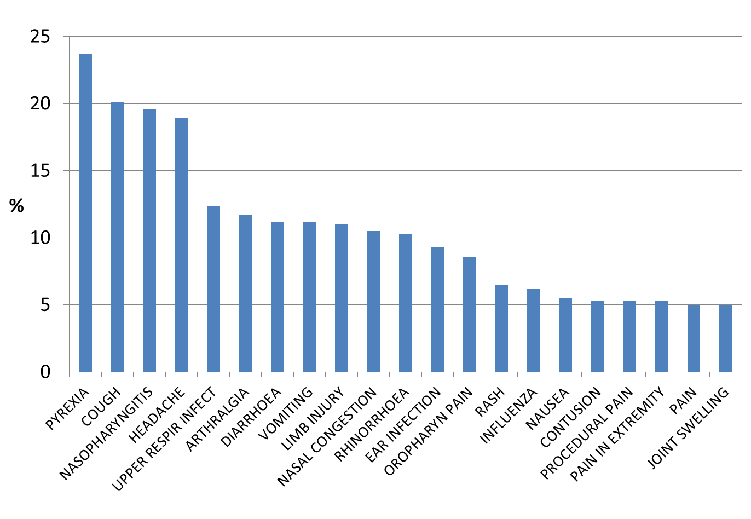
2. IS Results: AEs and SAEs >5% (Full Analysis N=418)
Common AEs: pyrexia, cough, nasopharyngitis, headache
No hypersensitivity, anaphylaxis reactions, or anaphylactoid reactions (N=418, 95% CI 0.000, 0.879)
Shapiro A et al. Poster presented at the XXIV Congress of the ISTH, 2013, Netherlands.

Slide 12
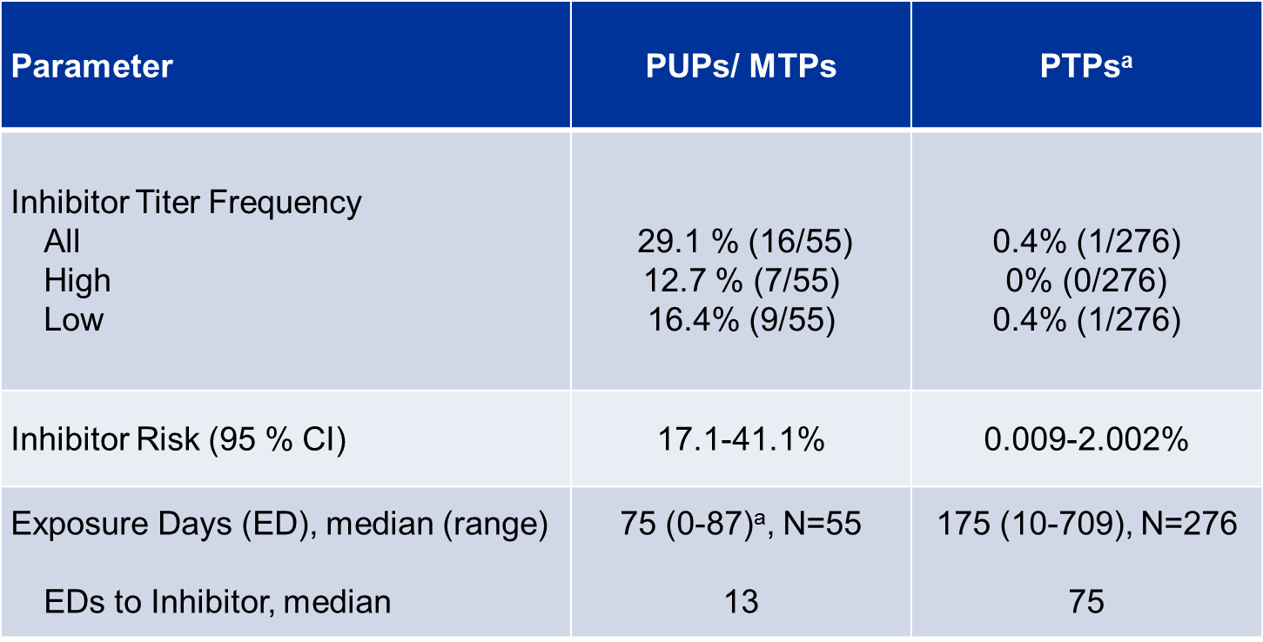
2. IS Results: Inhibitor Development
a= Excluding exposure during ITI for subjects who developed inhibitors. 11 out 16 subjects who developed inhibitors went on to receive ITI
Shapiro A et al. Poster presented at the XXIV Congress of the ISTH, 2013, Netherlands.

Slide 13
Working Summary: Spontaneous AE Reports and IS
Spontaneous AE Reports
No detection of previously unrecognized risks
Integrated Safety Studies
418 Subjects from 12 interventional studies were analyzed
0.4% inhibitor risk in PTPs >50 EDs (1 out of 276); 95 % CI 0.009-2.002
No hypersensitivity, anaphylaxis, or anaphylactoid reactions
No withdrawal due to AEs
No new safety signals revealed
Berg, R et al. Poster presented at XXIV Congress of the ISTH, 2013, Netherlands ; Shapiro A et al. Poster presented at the XXIV Congress of the ISTH, 2013, Netherlands.

Slide 14
3.Post Authorization Safety Studies
Marcucci M et al. Poster presented at XXIV Congress of the ISTH, 2013, Netherlands
Notes:
Inclusion/exclusion criteria of the original PASS studies
Inclusion criteria
Moderate or severe haemophilia A (baseline factor VIII < 5%)
Newly prescribed ADVATE by his/her treating physician
Provided written informed consent, where locally required
Exclusion criteria
Known hypersensitivity to the active substance or to any of the excipients
Known allergic reaction to mouse or hamster proteins

Slide 15
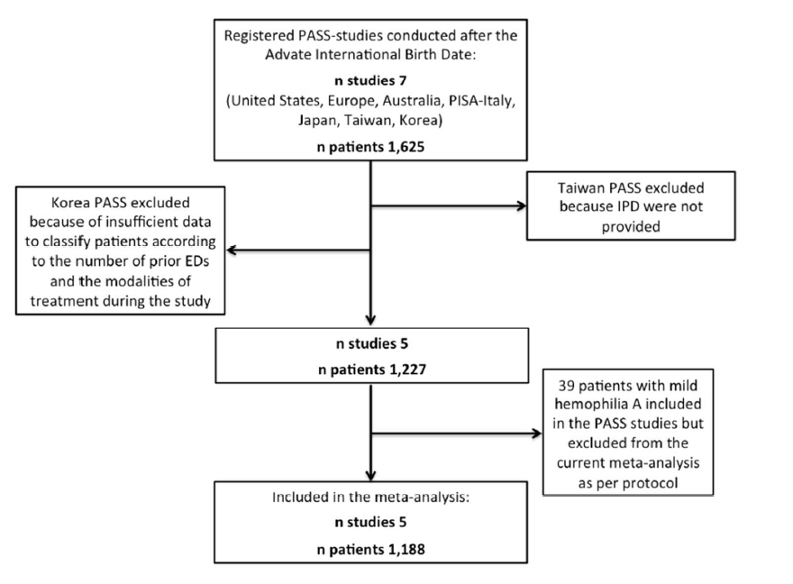
0/43
5/358
1. Marcucci M et al. Poster presented at XXIV Congress of the ISTH, 2013, Netherlands. 2. Data on File, Vienna Austria.

Slide 16
3. PASS Patient Characteristics
Characteristics, n (%) |  | Patients (n 1,188)
Previous Exposure Days (EDs) 0-50 50-150 >150 Unknown |  | 96 (8.1) 73 (6.1) 1016 (85.5) 3 (0.3)
Regimen at enrolment On demand Prophylaxis Unknown/Other* |  | 434 (36.5) 743 (62.6) 11 (0.9)
Marcucci M et al. Poster presented at XXIV Congress of the ISTH, 2013, Netherlands

Slide 17
3. PASS Overall Safety Outcomes
Secondary analyses | At risk | events (patients)
Adverse Events (AEs)
Total AEs, any severity | 1,188 | 726 (254)
Total Serious AEs | 1,188 | 83 (59)
Product-related AEs, any severity | 1,188 | 37 (22)
Product-related Serious AEs | 1,188 | 5 (5)
Marcucci M et al. Poster presented at XXIV Congress of the ISTH, 2013, Netherlands
Notes:
Overall, 83 adverse events judged as serious (SAEs) by the treating physicians occurred in 59 patients; most of them were bleedings at different sites, catheter-related infections and malignancy (hepatic and lung).
Five SAEs in 5 patients were judged as product-related;
2 of them were “hypersensitivity” reactions (edema and exanthema),
1 a “cerebral hemorrhage”,
1 “anemia and abnormal hepatic function”, and
1 “anxiety”.
Two product-related AEs (“asthenia” and “decreased drug effect”) were judged by the treating physicians as “significant” but “non-serious”.
PISA: retroperitoneal hematoma, cholecystitis and seizures, unrelated

Slide 18
3. PASS Inhibitors development
Outcome and population
 | Inhibitors All/HR*/at risk | Incident rate (%, 95% CI)
Primary
De novo severe PTPs >150 EDs | 1/0/669 | 0.15 (0.02, 1.06)
Secondary
De novo, severe PTPs >50 EDs | 1/0/717 | 0.14 (0.02, 0.99)
De novo, moderate-severe PTPs >150 EDs | 1/0/799 | 0.13 (0.02, 0.89)
*HR=high responding
Marcucci M et al. Poster presented at XXIV Congress of the ISTH, 2013, Netherlands

Slide 19
3. PASS Effectiveness Outcomes
Secondary Analyses | Patient Number | Bleeding Events (patients)
Annualized Bleeding Rate |  | median (Q1, Q3)
All patients | 1,140 | 3.83 (0.60, 12.90)
Patients prescribed OD at enrolment | 421 | 10.38 (2.27, 27.29)
Prophylaxis (on study, any frequency) | 707 | 2.00 (0, 6.73)
Prophylaxis (on study, ≥twice/week) | 560 | 1.67 (0, 4.80)
Marcucci M et al. Poster presented at XXIV Congress of the ISTH, 2013, Netherlands
Notes:
ABR (IQR)
AUS 1.1 (0, 4.0),
EU 3.2 (0, 10.5),
Japan 9.2 (2.9, 30.1),
IT 1.0 (0, 5.0),
USA 2.7 (0, 6.8).

Slide 20
Working Summary: Spontaneous Reports, IS, PASS
Spontaneous AE Reports¹
No detection of previously unrecognized risks
Integrated Safety Studies²
418 Subjects from 12 interventional studies were analyzed
0.4% inhibitor risk in PTPs >50 EDs; 95 % CI 0.009-2.002
Post Marketing Surveillance Studies³
1188 patients
0.14% Inhibitor risk in PTPs > 50 EDs; 95; % CI 0.002, 0.099
ABR 1.66 in 560 patient on => BW prophylaxis 95; % CI 0, 4.78
1. Berg, R et al. Poster presented at XXIV Congress of the ISTH, 2013, Netherlands; 2. Shapiro A et al. Poster presented at XXIV Congress of the ISTH, 2013, Netherlands; 3. Marcucci M et al. Poster presented at XXIV Congress of the ISTH, 2013, Netherlands.

Slide 21
Future developments
PASS patient characteristics, n (%) |  | Patients (%) (n 1,188)
History of inhibitors Yes No Unknown |  | 131 (11.0) 1047 (88.1) 10 (0.8)
Inhibitors detected at baseline Yes No Unknown |  | 18 (1.5) 1070 (90.1) 100 (8.4)
Unpublished Data, McMaster University and Baxter - Poster presented at Melbourne 2014 WFH Meeting

Slide 22
Thank you
Baxter and Advate are registered trademarks of Baxter International Inc.
All other product names, brands or trademarks that appear herein are the property of their respective owners.
May 2014 Baxter Healthcare Corporation, Westlake Village, CA
GBL 1881

