Slide 1
Using pharmacokinetics to individualize hemophilia therapy
Alfonso Iorio, MD,PhD
McMaster University, Canada

Slide 2
Disclosures
McMaster University has received research, consultancy and educational funding for Population PK projects from Bayer, Grifols, NovONordisk, Octapharma, Pfizer
I am the co-PI of the WAPPS-Hemo project

Slide 3
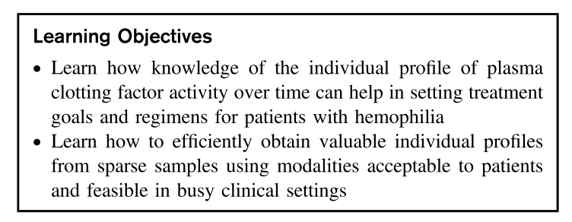

Slide 4
Hemophilia treatment
Clinical Management
Scenario (bleeding, surgery, prophylaxis)
Patient History/ Lifestyle
Presence of Inhibitors
Patient needs
Pharmaco-kinetics (PK)
Comprehensive care is the cornerstone of effective hemophilia treatment
Prophylactic factor replacement therapy
1960s, Sweden
non-severe hemophilia patients do not bleed spontaneously
Many guidelines, no consensus on optimal treatment regimen

Slide 5
Pharmacokinetics and Hemophilia
Regulatory level
Concentrates approved by proving their bio-equivalence
Formal PK studies
Clinical level
Prophylaxis “empirically” managed by targeting a (0.01 IU/mL) target level
Peri-surgical management based on longitudinal factor level measurements
ITI success/failure judged upon by ”normalization” of half-life

Slide 6
Pharmacokinetics of factor concentrates
Terminal half-life (time taken to reduce activity by half)
mean 10-14 hours for FVIII (>12 yrs)
mean 18 hours for FVIII extended half-life
Little difference between plasma-derived and recombinant FVIII
In vivo recovery (IVR) =
(Cpost – Cpre)/Dose
Volume of distribution similar to plasma volume (3-4 L)
Does not predict half-life or trough
McEneny-King et al. Expert Opin Drug Meta Toxicol. 2016. 19: 1-9.
Factor Activity (% of normal)
Targeted trough: historically 1-2%
Goal of drug therapy to keep activity above targeted trough
1%
Time (h)

Slide 7
Determining individual PK – e.g. FVIII
New ISTH guidelines
(popPK + sparse sampling)
Historical ISTH guidelines
(dense sampling)
Focus on individual PK estimation
2-3 samples for one patient
Use a population pharmacokinetic model & individual samples to derive individual PK estimates
Designed to understand the average PK of a concentrate
10 or 11 blood samples over a period of 32-72 h after infusing 25-50 IU/kg at baseline
12-15 patients with a crossover design
Lee M et al. 2001. The design and analysis of pharmacokinetic studies of coagulation factors. ISTH Website, Scientific and Standardization Committee Communication p. 1–9.
Iorio A, Blanchette V, Blatny J, Collins P, Fischer K, Neufeld E
J Thromb Haemost. 2017 Oct 12. doi: 10.1111/jth.13867.

Slide 8
Determining individual PK – e.g. FVIII
Historical ISTH guidelines
(dense sampling)
Designed to understand the average PK of a concentrate
10 or 11 blood samples over a period of 32-72 h after infusing 25-50 IU/kg at baseline
12-15 patients with a crossover design
Washout
Time
Lee M et al. 2001. The design and analysis of pharmacokinetic studies of coagulation factors. ISTH Website, Scientific and Standardization Committee Communication p. 1–9.

Slide 9
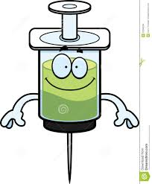
Determining individual PK – e.g. FVIII
New ISTH guidelines
(popPK + sparse sampling)
Washout
Fixed dose
Focus on individual PK estimation
2-3 samples for one patient
Use a population pharmacokinetic model & individual samples to derive individual PK estimates
4
4
24
24
48
48
Time
Iorio A, Blanchette V, Blatny J, Collins P, Fischer K, Neufeld E
J Thromb Haemost. 2017 Oct 12. doi: 10.1111/jth.13867.

Slide 10
Determining individual PK – e.g. FVIII
New ISTH guidelines
(popPK + sparse sampling)
Historical ISTH guidelines
(dense sampling)
Washout
Washout
Lee M et al. 2001. The design and analysis of pharmacokinetic studies of coagulation factors. ISTH Website, Scientific and Standardization Committee Communication p. 1–9.
Iorio A, Blanchette V, Blatny J, Collins P, Fischer K, Neufeld E
J Thromb Haemost. 2017 Oct 12. doi: 10.1111/jth.13867.

Slide 11
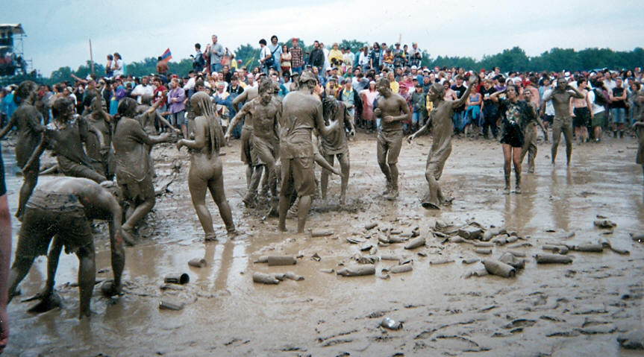
Woodstock 1969

Slide 12
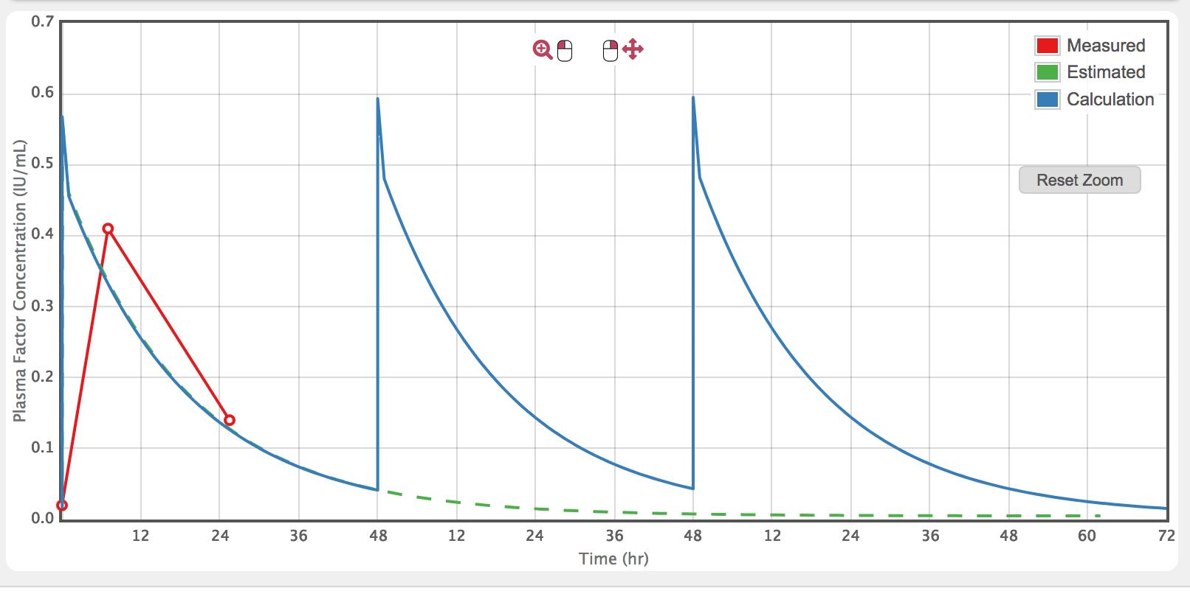
Two basic concept to understand tailoring
Understanding variability
Applying population averages vs individualized PK profiles
Drug A: 12+/-3 hrs
Drug B: 16+/-3 hrs

Slide 13
Understanding variability to define a dosing strategy
Infusion 1
Infusion 2
Maximum concentration
Concentration
Minimum effective concentration
Patients have similar PK
Individual PK similar over time
Generic population dose
(e.g. 10 mg/kg)
Subject

Slide 14
Understanding variability to define a dosing strategy
Infusion 1
Infusion 2
Maximum concentration
Concentration
Minimum effective concentration
Patients have different PK
Individual PK varies over time
Can’t define a regimen
Subject

Slide 15
Understanding variability to define a dosing strategy
Infusion 1
Infusion 2
Maximum concentration
Concentration
Minimum effective concentration
Patients have different PK
Individual PK similar over time
Individualized dose
Subject

Slide 16
PK variability: why we cannot use population estimates

Slide 17
PK variability: why we cannot use population estimates

Slide 18
PK variability: why we cannot use population estimates
10
1
Individual variability in the response to treatment
Inter subject variability
Log [plasma activity]
(Terminal) HL
0 12 24 36 48 60 72 84 96
Time (hrs)

Slide 19
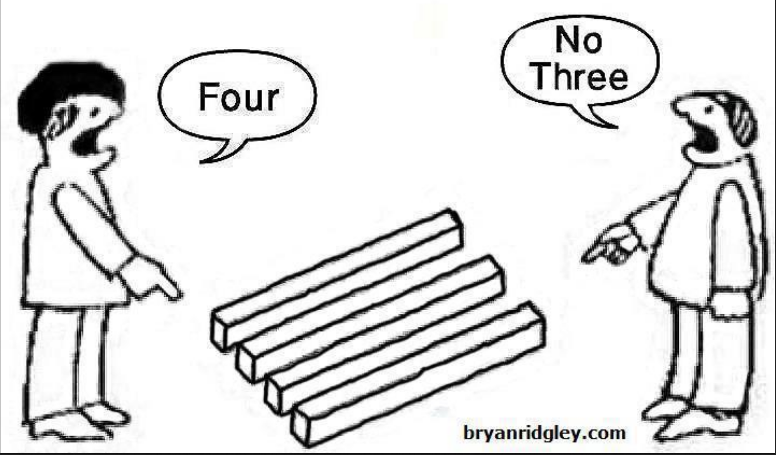
Back-of-napkin individual PK profiling?

Slide 20
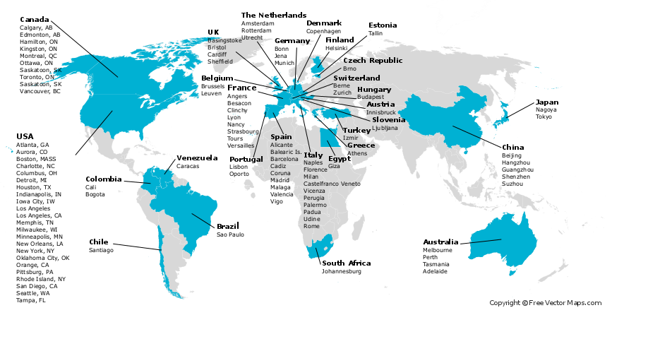
The WAPPS-Hemo co-investigator network
The WAPPS-Hemo network:
114 registered HTC
32 different countries
1550 patients
2459 infusions
www.wapps-hemo.org

Slide 21
Single patient data
Web-application
Estimating PK for single individuals on the base of 2-4 samples
Single patient report

Slide 22
Single patient data
Web-application
Estimating PK for single individuals on the base of 2-4 samples
Single patient report

Slide 23
Single patient data
Web-application
Estimating PK for single individuals on the base of 2-4 samples
Online PPK engine
(NONMEM)
Single patient report

Slide 24
Brand specific Source individual PK data
Single patient data
Estimating PK for single individuals on the base of 2-4 samples
Control files for bayesian individual estimation
Web-application
Online PPK engine
(NONMEM)
Offline PPK modeling
Product 1
Product 2
Product 3
Product 4
Product 5
Others..
Brand specific PPK models
Single patient report

Slide 25
Brand specific Source individual PK data
Single patient data
patients
patients
patients
Control files for bayesian individual estimation
Interactive simulator
Web-application
Online PPK engine
(NONMEM)
Offline PPK modeling
Product 1
Product 2
Product 3
Product 4
Product 5
Others..
Brand specific PPK models
Single patient report

Slide 26
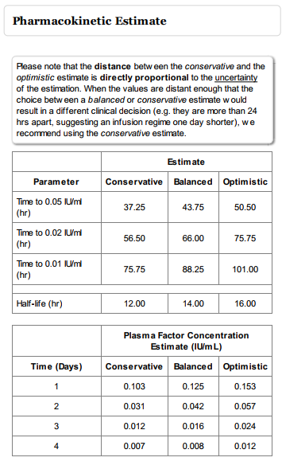
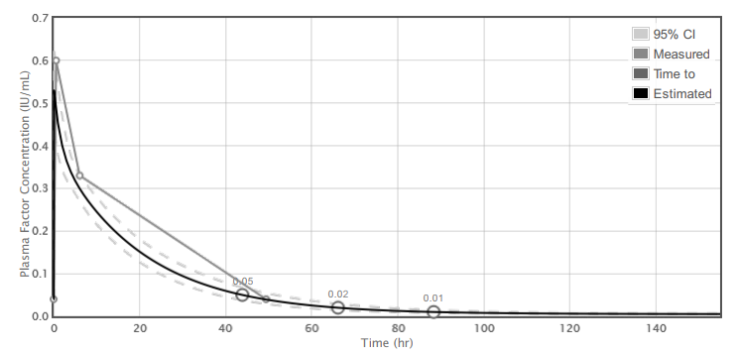
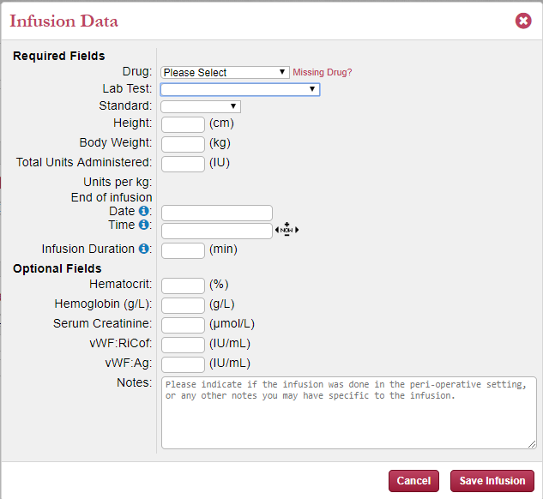
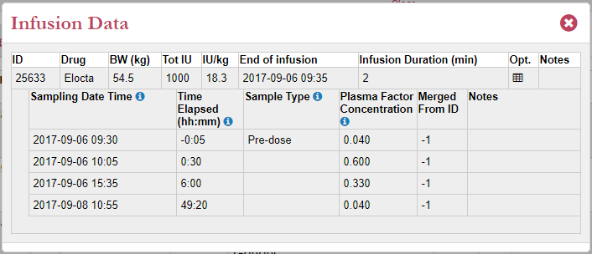
WAPPS inputs and outputs

Slide 27
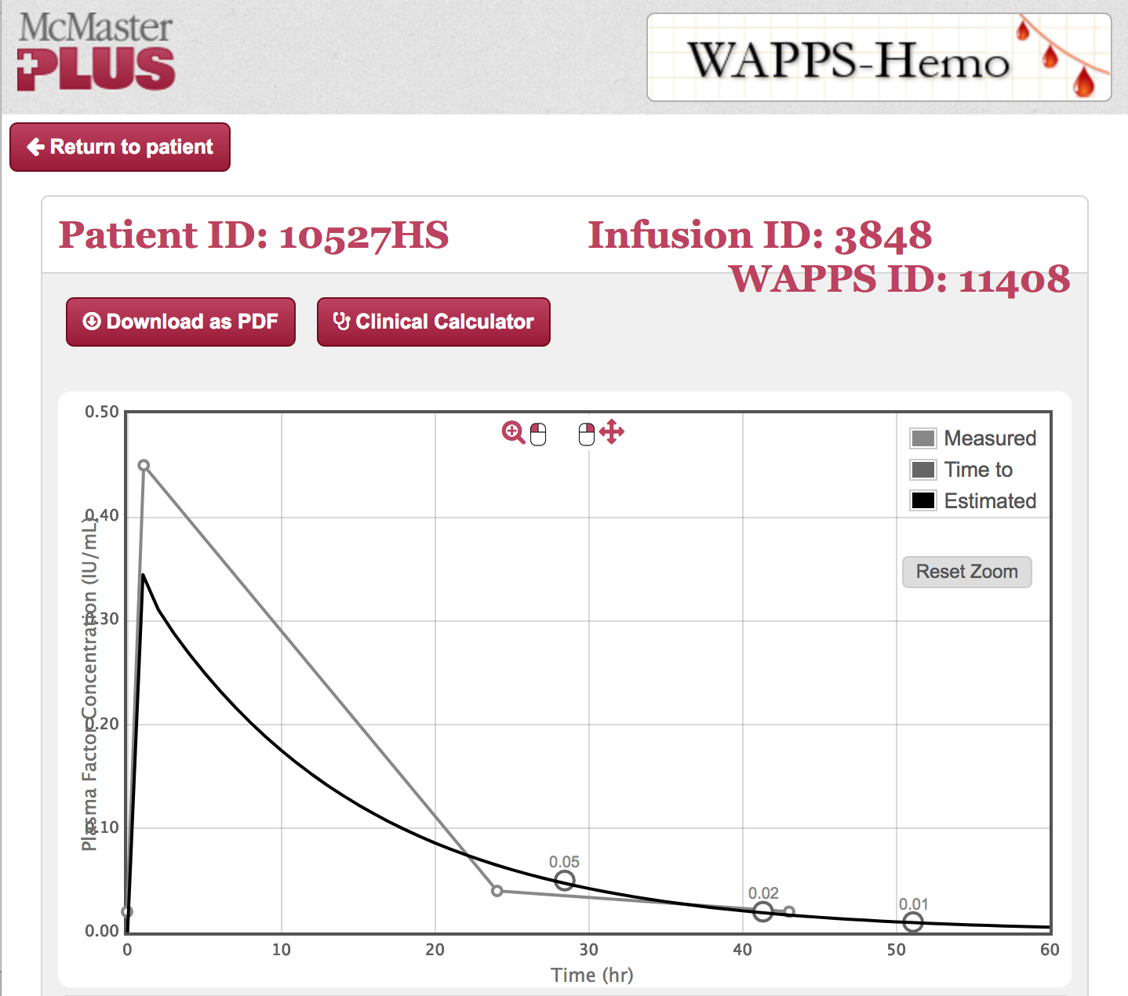
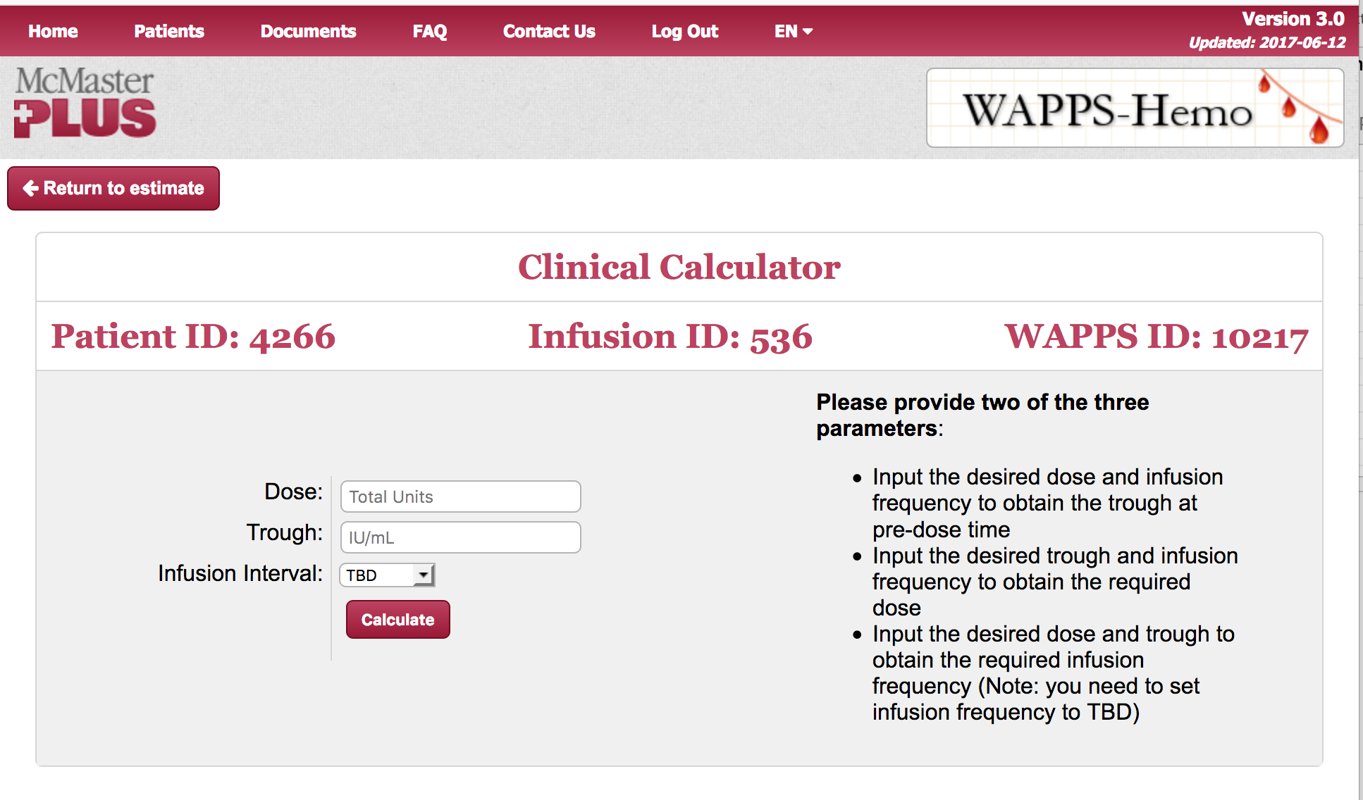
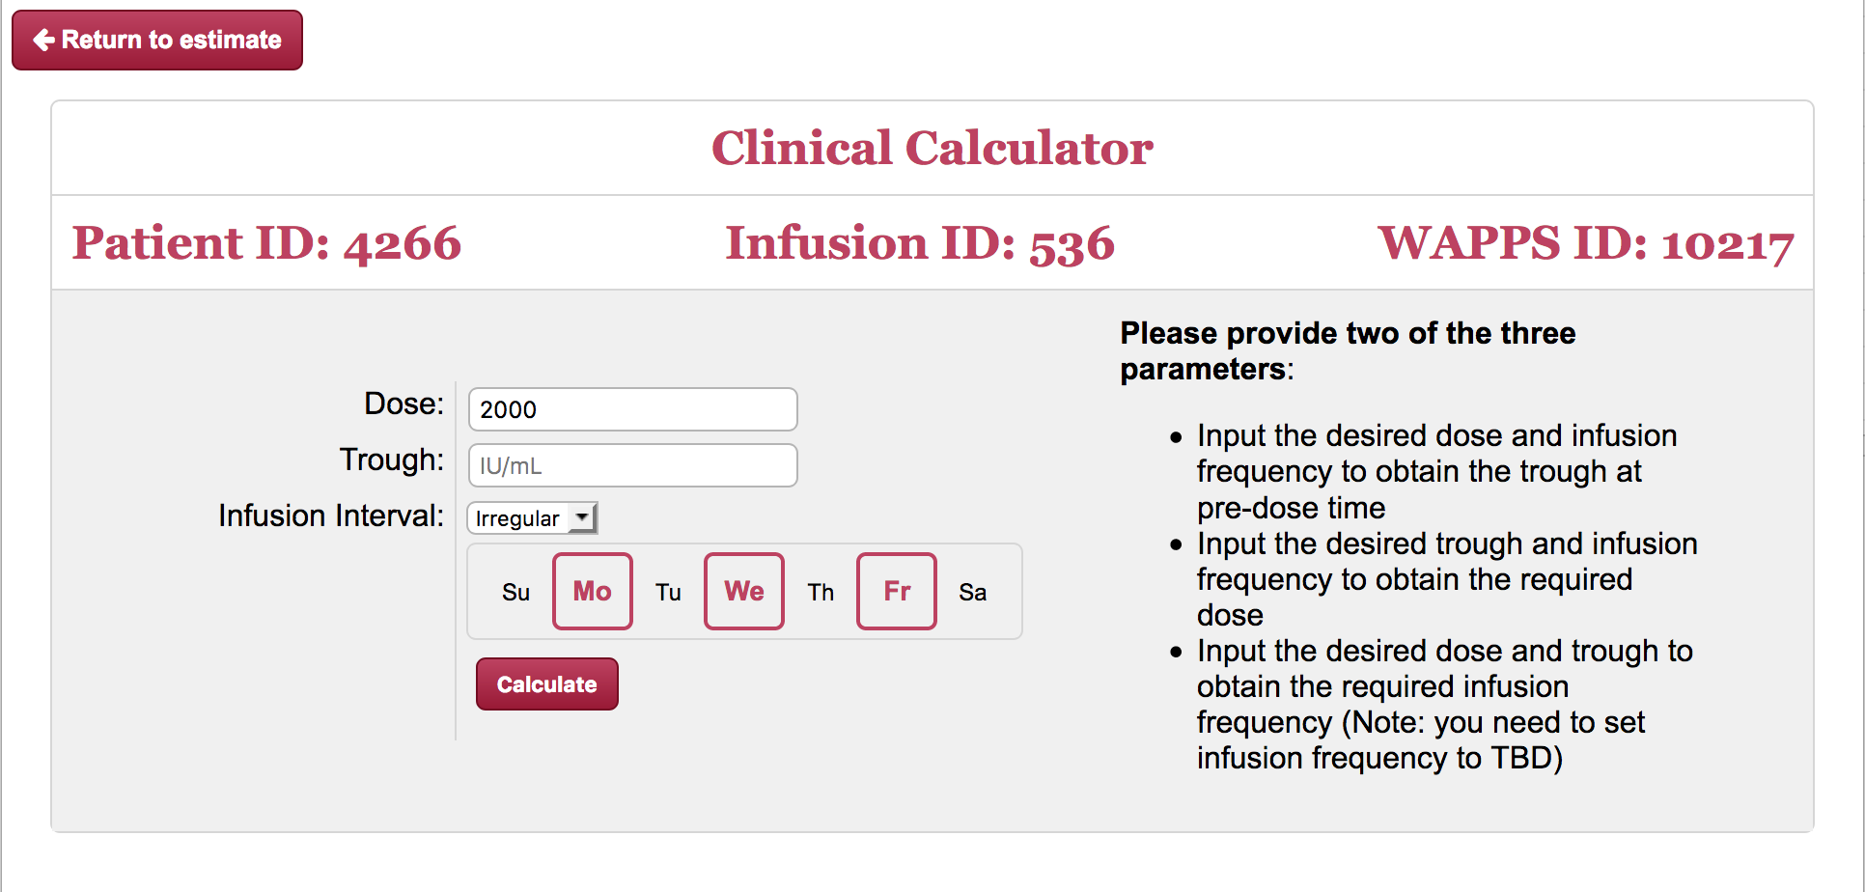
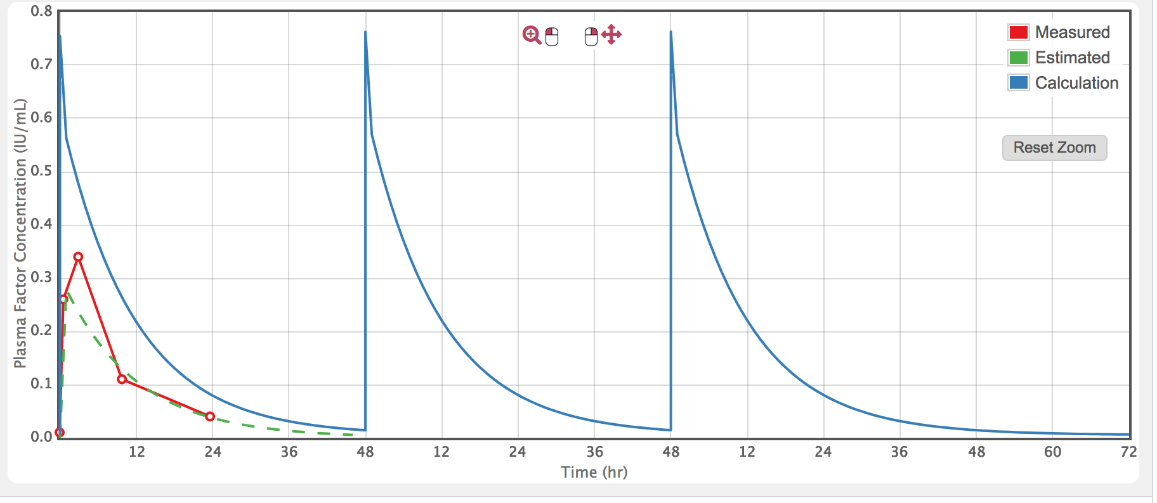

Slide 28
Thanks – and questions welcome

