Slide 1
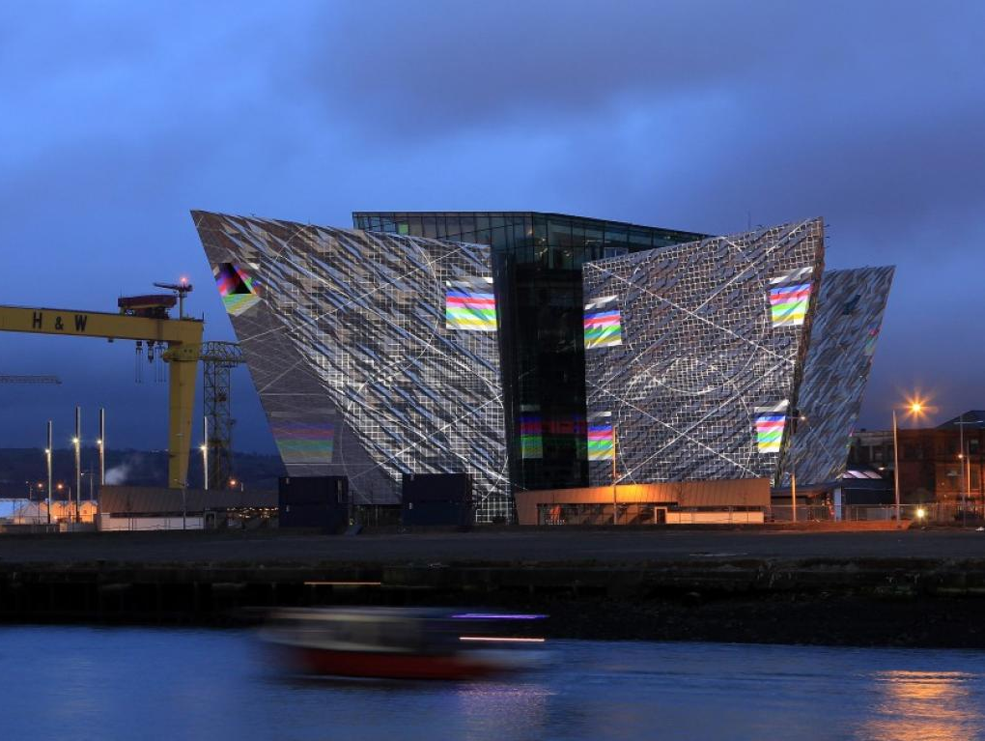
Study design: a critical aspect of research
Alfonso Iorio
Karen Strike
Kathy Mulder
Belfast
XIV MSK congress
May 8, 2015

Slide 2
Disclosures
Disclosures
Alfonso Iorio
Research funding from multiple sponsor – none in association with this talk
Employee by an Institution teaching research methodology
Karen Strike
Research funding from multiple sponsors – none in association with this talk
Employee of Hamilton Health Sciences Corp.
Kathy Mulder
Research funding from multiple sponsors – none in association with this talk
Retired after 40 years of clinical practice with Manitoba Bleeding Disorders program
Notes:
10 seconds → 10 sec

Slide 3
Learning objectives
The 3 critical components of a clinical study
What and why
Is this relevant and feasible in MSK research?
Examples from a Cochrane Review on physiotherapy effects in hemophilia
What has been done
How it has been done
What we could do better
Notes:
30 seconds → 40 sec

Slide 4
1 – Clarify your question
 | Diagnosis | Treatment | Prognosis
[P]opulation | In patient with a suspected acute joint bleed | In patient with established active target joint
[I]ntervention | How does POC US compare | Does tertiary prophylaxis + standardized physical therapy
[C]omparator | With clinical assessment | Compared with prophylaxis alone
[O]utcome | For detection of bleeding | Improve velocity and completeness of recovery of ROM
(T)ime |  | At 3 months
 | Diagnosis | Treatment | Prognosis
[P]opulation | In patient with a suspected acute joint bleed
[I]ntervention | How does POC US compare
[C]omparator | With clinical assessment
[O]utcome | For detection of bleeding
(T)ime
 | Diagnosis | Treatment | Prognosis
[P]opulation | In patient with a suspected acute joint bleed | In patient with established active target joint | In patients with HA undergoing first TKA
[I]ntervention | How does POC US compare | Does tertiary prophylaxis + standardized physical therapy
[C]omparator | With clinical assessment | Compared with prophylaxis alone
[O]utcome | For detection of bleeding | Improve velocity and completeness of recovery of ROM | What is the rate of revisions
(T)ime |  | At 3 months | At 10 year?
 | Diagnosis | Treatment | Prognosis
[P]opulation
[I]ntervention
[C]omparator
[O]utcome
(T)ime
Notes:
1:20 → 2 min

Slide 5
2 and 3
Do not reinvent the wheel
Read good literature, and not only in the specific disease field
Ask experts in the field and in methodology
Write your protocol
following a validated template
Doing reverse use of an appraisal check-list
Equator network (PLoS Med 2008;5:e139)
Notes:
40 sec → 2:40

Slide 6
Diagnostic studies
Purpose is to assess the properties of a test.
Inclusion of a spectrum of participants, some with and some without the disease.
≥ 100 patients, (≥ 50 with and ≥ 50 without disease).
Each participant must receive both the new test and some form of the diagnostic (gold) standard.
Assessment/interpretation of new test and diagnostic standard blinded to diagnostic standard result.
Notes:
30 sec → 3:10
Can be implementation – staging
Objective diagnostic standard (e.g., laboratory test not requiring interpretation) or current clinical standard for diagnosis (e.g., venography for deep venous thrombosis),
For golden standard preferably with documentation of reproducible criteria for subjectively interpreted diagnostic standard (i.e., report of statistically significant measure of agreement beyond chance among observers)
(blinding met if test is objective or was done before diagnostic standard)

Slide 7
Our diagnostic example
Critical points:
A gold standard (MRI? Standard US?)
Triple blind
In patient with a suspected acute joint bleed
How does POC US compare
With clinical assessment
For detection of bleeding
Checklist:
QUADAS2
Ann Intern Med 2011;155:529–36.
Notes:
20 sec →3:30

Slide 8
Treatment studies
Purpose is to assess positive or adverse effects of an intervention
Random or unbiased allocation of participants to comparison groups
(time series, paired availability, waiting list).
≥ 1 clinically important outcome
≥ 10 per group completing outcome assessment.
≥ 1 outcome assessed in ≥ 80% of included pts.
Subgroup analyses must be pre-planned
Blinding as much as possible
Notes:
30 sec →4:00

Slide 9
Our treatment example
In patient with established active target joint
Does tertiary prophylaxis + standardized physical therapy for 3 months
Compared with tertiary prophylaxis for 3 months alone
Improve velocity and completeness of recovery of ROM
At 3 months
Critical points
Standardize treatment
Blind the assessors
Create comparable groups
Checklist:
CONSORT
Lancet 2001;357:1191e4
Notes:
30 sec → 4;30

Slide 10
Prognostic studies
Purpose is to assess the natural history of a disease over time.
Prospective, standardized data collection.
Inception cohort of individuals with a disease at a similar (early) point in the disease
All participants initially free of the outcome of interest.
Follow-up of ≥ 80% of patients until a major study endpoint or end of study
Checklist:
STROBE
J Clin Epidemiol 2008;61:323
Notes:
20 sec →4:50

Slide 11
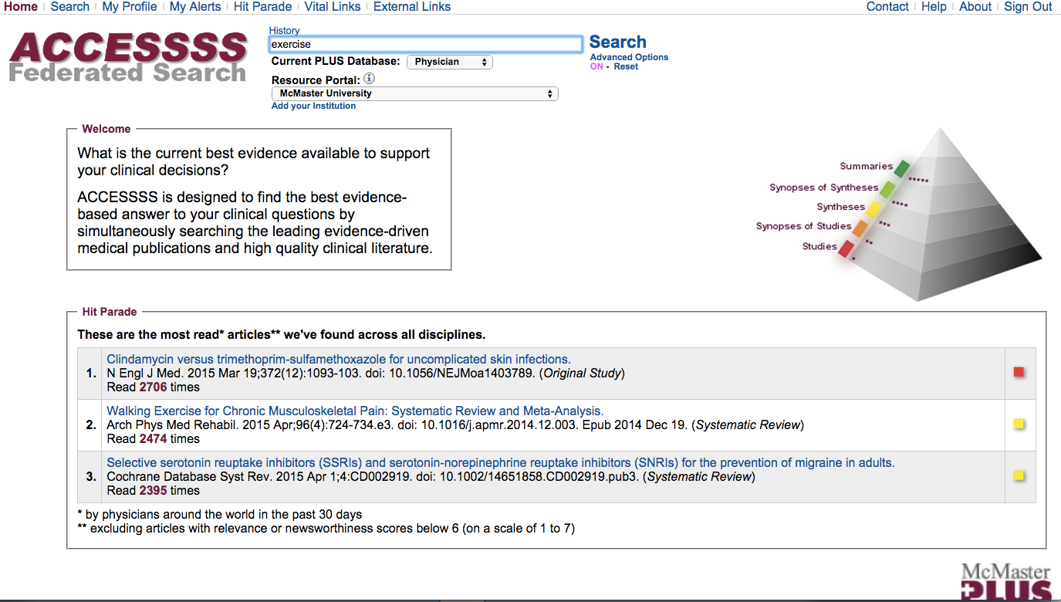
Plus.mcmaster.ca/ACCESSSS

Slide 12
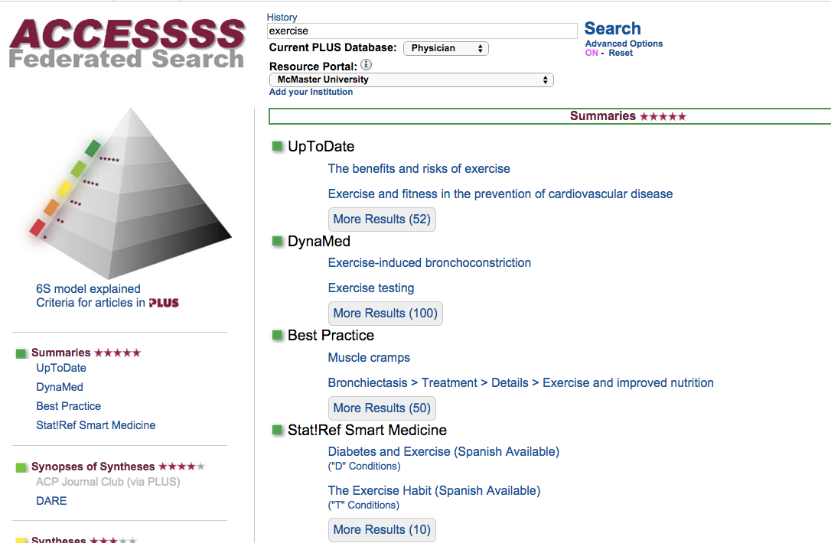
Online textbooks

Slide 13
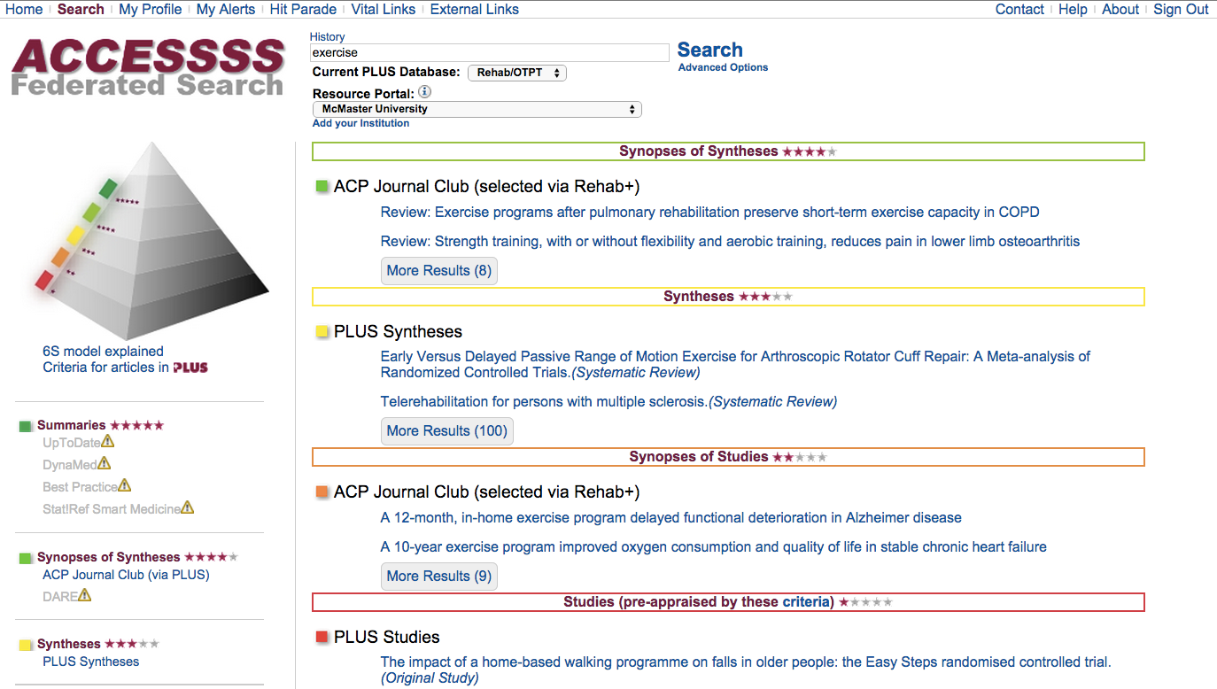
Pre-appraised evidence

Slide 14
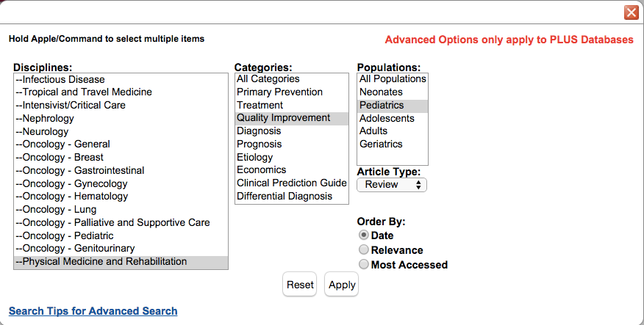
Manually indexed for you

Slide 15
Pre-appraised evidence

Slide 16
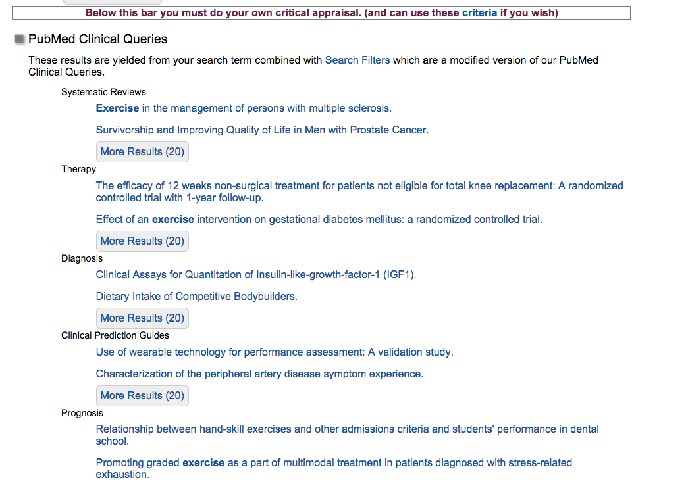
PubMed Results
Systematic reviews
Treatment
Diagnosis
Clinical Prediction G
Prognosis

Slide 17
Some good examples
Diagnosis
SR/MA: US for rotator cuffs tears
Ottenheijm RP. Arch Phys Med Rehabil 2010;91:1616–25
Study: ultrasound-detected bone erosions for rheumatoid arthritis
Zayat AS. Ann Rheum Dis 2015;74:897–903.
Treatment
RCT: intra-articular Tranexamic acid
Gomez-Barrena E. J Bone Jt Surg Am 2014;96:1937–44
Lin S-Y. J Arthroplasty 2014;:10–4
Prognosis
SR: Natural history of hip pain
Lievense AM. Arthritis Rheum 2007;57:1368–74
SR: TKA in obese patients
Paz L. J Orthop Surg 2015;23:107–10
Notes:
10 sec -> 5 min

Slide 18
Some good examples
Hemophilia.mcmaster.ca
Diagnosis
SR/MA: US for rotator cuffs tears
Ottenheijm RP. Arch Phys Med Rehabil 2010;91:1616–25
Study: ultrasound-detected bone erosions for rheumatoid arthritis
Zayat AS. Ann Rheum Dis 2015;74:897–903.
Treatment
RCT: intra-articular Tranexamic acid
Gomez-Barrena E. J Bone Jt Surg Am 2014;96:1937–44
Lin S-Y. J Arthroplasty 2014;:10–4
Prognosis
SR: Natural history of hip pain
Lievense AM. Arthritis Rheum 2007;57:1368–74
SR: TKA in obese patients
Paz L. J Orthop Surg 2015;23:107–10
Notes:
10 sec -> 5 min

Slide 19
Cochrane Review: Exercise in Hemophilia
Objective:
To systematically review the available evidence on the safety and effectiveness of exercise interventions for people with hemophilia.
Inclusion Criteria:
Randomized or quasi-randomized controlled trials
Males of any age with hemophilia A or B, any severity
Interventions:
Any exercise intervention relevant to the management of hemophilia

Slide 20
Exercise in Hemophilia: Study Flow Diagram
Notes:
Search Methods:
Using the search terms “hemophilia and exercise” we searched:
Cochrane Coagulopathies Trials Register (Date of last search: 12 Dec 2014)
PubMed, OVID/Embase, CINAHL (Date of last search: 30 Nov 2014)
Hand searches were conducted of the abstracts from
World Federation of Hemophilia Congresses (1996-2014)
WFH Musculoskeletal Congresses (2005-2013)
European Hematology Association Congresses (2002-2013)
Reference lists from relevant articles found by these methods were also searched.

Slide 21
Mohamed et al (2014)
Bicycle ergometer versus treadmill on balance and gait parameters in children with hemophilia
3 month study period
Outcomes: balance (Biodex Stability System), gait parameters (Biodex Gait Trainer)
30 boys with mild or moderate hemophilia, ages 10-14 years
Randomization via closed envelopes
PT program + Bicycle ergometry
PT program + Treadmill

Slide 22
Mazloum et al. (2014)
Effects of therapeutic exercise and hydrotherapy on pain severity and knee range of motion in patients with hemophilia
4 week study period
Outcomes: pain (VAS), knee ROM (goniometry)
40 subjects Hemophilia A, < 50 years, all severities
Randomization
Exercise n=13
Hydrotherapy n=14
Control n=13
Notes:
Method of randomization not described

Slide 23
Safety of Exercise
Safety of exercise has been established
Low power, small studies
No adverse events reported
Variable use of factor prophylaxis and some studies limited to subjects with moderate hemophilia
Application to persons with severe hemophilia should still be approached with caution
Notes:
Positive effect of exercise with no reports of adverse events was demonstrated. These findings are consistent with the many non-controlled interventions reported in the hemophilia literature.^{9,10}
While no adverse effects (bleeds) were reported due to any of the interventions, it should be noted that some groups used prophylactic factor prior to exercise and other groups studied only subjects with moderate hemophilia. Therefore, application of these techniques to persons with severe hemophilia should still be approached with caution.

Slide 24
Efficacy of Exercise
Analysis of effects of interventions was difficult due to:
Variations in study design
Heterogeneity of outcome measures
Small numbers of subjects
Few RCT’s
Exercise programs which include functional movement patterns, such as walking, weight-bearing, and movement through range, appear to be more effective than static exercises in non-weight bearing positions.
Notes:
Outcome Measures used: heterogeneity and ?incorrect use:for example the Colorado score was designed for children but was used for adults. BIceps perimeter is not a good indicator of strength or function...... etc. Should that be here or in quality of evidence?
Exercise programs which include functional movement patterns, such as walking, weight-bearing, and movement through range, appear to be more effective than static exercises in non-weight bearing positions.

Slide 25
Discussion
Many articles are “snapshots”
“current status of……”
case reports or case series
Studies started and not finished:
registered as trials
abstracts submitted
but then not completed or published
Notes:
Many articles are “snapshots” i.e. baseline assessment of a population. This is interesting but so what and now what??
We found 233 abstracts to start, 26 were snapshot descriptions of a group, 3 were case studies, 44 interventions with pre and post but not controlled, 12 RCT’s.
Several case studies – these are OK but need many more to make conclusions
Some studies were registered as trials, abstracts published, sounded fantastic but then were either not completed or not published
Choose keywords so people can find your work, e.g. resistance training does not show up if you search exercise; aquatic exercise vs. hydrotherapy etc.

Slide 26
Discussion
Do not limit searches to English language
Choose validated outcome measures
use them appropriately
Importance of key words
Use basic words that your intended audience will look for
E.g. hydrotherapy vs aquatic exercise
Resisted training vs exercise

Slide 27
Conclusions
Hints for clinicians:
Clinically relevant questions are important!
Use students/residents for literature searches
Good training for them
Link with a university or seasoned researcher
Use faculty expertise re: study design
Involve statistician early
At the very least: participate in surveys when you are asked
Notes:
Clinically relevant vs theoretical research questions!

Slide 28
THANK YOU Slides available for download at: hemophilia.mcmaster.ca

