Slide 1
Balancing risk factors for inhibitors development in clinical practice
Hemophilia Research Study Update
Berlin, 12-14 march 2015
Alfonso Iorio
Health Information Research Unit & Hamilton-Niagara Hemophilia Program
McMaster University

Slide 2
Overview
- Removable risk factors
- Risks profiles for treatment selection
Considerations on available data
Stepping back: what is the problem?
Implication for practice
Implications for research
Notes:
Will introduce starting from 2, then 1 and 3

Slide 3
Overview
Considerations on available data
Stepping back: what is the problem?
Implication for practice
Implications for research
Notes:
Will introduce starting from 2, then 1 and 3

Slide 4
Inhibitors, inhibitors, inhibitors….
Study | Design | Year, patients | CR | RD | interpretation | Contribution
RODIN | P, R, IC, MC | 2000-2010 340 (574) | 28.2 | 9.0 | Post hoc | Hypothesis generation
UKHCDO | R, IC, SC | 2000-2010 300 (407) | 23.8 | 11.3 | Time effect, B-DD f-VIII, RODIN effect | Generate alternative hypothesis
France C | R, IC, SC | 2000-2010 234 (303) | 30.0 | 15.0 | Strong “center” effect RODIN effect ?? | Generate a second alternative hypothesis
Vezina | S, SC | 2005-2010 86 (99) | 36.0 | 6.0 | Higher rate with Advate | You cannot “export” results?
EUHASS | P, DC, MC | 2009-2013 284 (417) | 26.2 | 4.5 | RODIN effect | Non-confirmatory
EAHAD IPD | MA, MC | 1994-2003 80 (761) | 40.0 | 6.6 | Any of the previous | Non confirmatory Direction of effect Inconsistency
P = prospective; R = registry; MC = multiple centers/countries, IC = inception cohort, SC = single country; S = survey; DC = dynamic cohort; MA = meta-analysis
Notes:
8/20 – 40
28/60 – 46.6
Design: P = prospective R = registry MC = multicountry IC= inception cohort, SC – single country DC dynamic cohort
RODIN: you comment on the different objective of the study upfront; the non inclusion of the significant variable in the blood analysis
Advate: 42/172 24.4
Kogenate: 45/128 35.2
Refacto: 15/44 34%
RODIN (33/88 (37.5%) vs 85/319 (26.7%), P=0.05.
Advate nR 29/114
Advate R 13/48
Kogenate nR 35/107
Kogenate R 10/21
There was a trend for the incidence of low titre inhibitors to increase and for high titre inhibitors to decrease with time. Between 2000 and 2006, there were 25 low titre inhibitors in 205 PUPs (12.2%) compared with 33/202 (16.3%) during 2007-2013 (P=0.23). In 2000-2006 there were 37/205 high titre inhibitors (18.1%) compared with 23/202 (11.4%) in 2007-2013, (P=0.06).
EUHASS – risk without RODIN 0.99 (18 centers excluded)
During these three years of overlap between the two studies, the relative risk of inhibitor development in Kogenate Bayer/Helixate NextGen compared to Ad- vate in the overlapping subgroup of the sample was very similar to the HR observed in RODIN: 1.67 (CI 0.95–2.95), while no differ- ence was seen in the not overlapping subgroup (0.99, CI 0.62–1.61;see ▶ Table 3 for number of events and patients at risk).

Slide 5
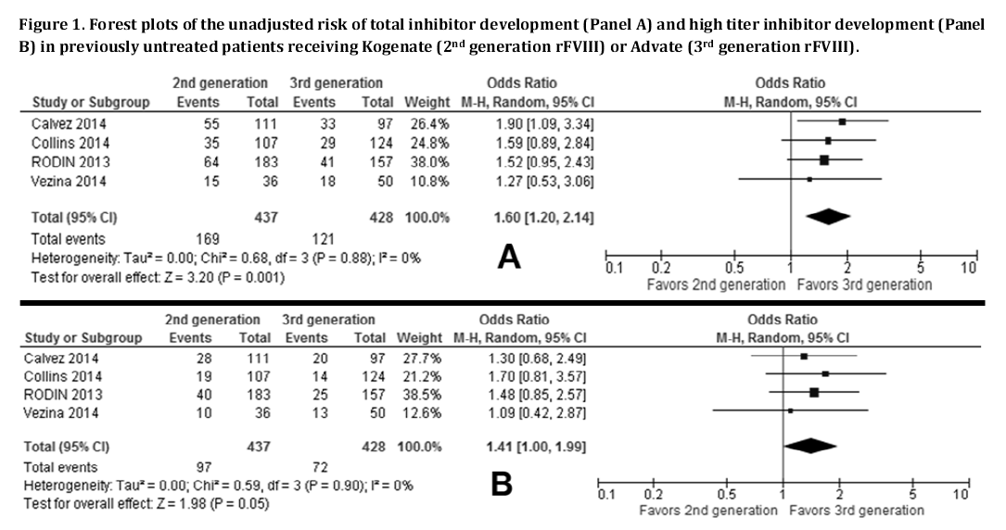
Systematic review? Meta-analysis? Pooled analysis?
Di Minno et al, accepted, Blood
Notes:
Solution 2: a meta-analysis
Aggregate data: useless
IPD: useless, unless maybe an independent brand new analysis
Principal determinant / Cluster analysis / CART of a specific subset of patients
Exposure balanced
Enrolled after 2004
Enrolled in centers who used similar proportion of kogenate and advate or enrolled only one patient

Slide 6
Kreuz W, Gill JC, Rothchild C et al.
Thrombosis and Haemostasis 2005; 93:457-467
15% inhibitor rate with Kogenate (1997-2001)
Notes:
741 boys with severe HA born between 1991 and 2013 were recruited to the FranceCoag Network by 37 HTCs. The PUP cohort criteria were met by 492 of these boys, 52 (17.6%) of those born in 1991-1999 (n=296), and 440 (98.9%) of those born in 2000-2013 (n=445). Among these 492 eligible patients, 189 were excluded from the analyses: 12 had not started treatment at the last clinical visit; 110 received pdFVIII at the first infusion; 17 had insufficient data for the first EDs; and 50 also participated in the RODIN study. No patients were excluded because of their follow-up in a particular HTC. Finally, 303 patients followed in 33 HTCs were observed until ED75 and were included in the analyses (Figure 1).
Accounting for centre-effects
marginal (or population averaged) approach
conditional (or centre specific) approach.
Kahan, B. C. (2014). Accounting for centre-effects in multicentre trials with a binary outcome – when , why , and how ? BMC Medical Research Methodology, 14(1), 1–11.
Split in three slides to interrogate point by point
alfonso

Slide 7
UKHCDO cohort: effect of time and … RODIN?
Kogenate
Advate
RODIN = Dashed
Not RODIN = Solid
RODIN vs not RODIN
P = 0.08
Advate 3/12 | 26/117 | 13/43
Kogenate 24/65 | 16/31 | 5/32
Notes:
Also comment that many patients when to Refacto, and got inhbitors

Slide 8
 |  | EUHASS |  |  | EUHASS without RODIN
 | N | P | 95% CI |  | N | 95% CI
Plasma D | 51 | 0.22 | 0.11 | 0.35 | 0.21 | 0.10 | 0.37
Recomb | 366 | 0.26 | 0.22 | 0.31 | 0.24 | 0.19 | 0.29
Advate | 141 | 0.26 | 0.19 | 0.34 | 0.26 | 0.18 | 0.36
Helixate | 37 | 0.32 | 0.18 | 0.50 | 0.33 | 0.18 | 0.52
Kogenate | 106 | 0.30 | 0.22 | 0.40 | 0.22 | 0.13 | 0.34
Refacto AF | 52 | 0.29 | 0.17 | 0.43 | 0.27 | 0.15 | 0.43
Relative risk, Kogenate vs Advate
57 centers (284 pts)
1.17 (CI 0.81–1.70)
18 RODIN ctrs (94)
1.67 (CI 0.95–2.95)
39 Non RODIN (190)
0.99 (CI 0.62–1.61)

Slide 9
EUHASS subgroups - unpublished
Group / Subgroup | Advate | % | Kogenate Helixate | % | RR
EUHASS - all | 37/141 | 26.2 | 44/142 | 30.8 | 1.17 (0.81 – 1.70)
RODIN centers | 15/56 | 26.8 | 17/38 | 44.7
FranceC centers | 5/13 | 38.5 | 7/21 | 33.3
UKDCDO ctrs | 4/13 | 30.8 | 2/9 | 22.2
EUHASS only | 13/59 | 22.0 | 18/75 | 24.0 | 1.09 (0.58 – 2.04)
EUHASS only (HR) | 7/59 | 11.9 | 14/75 | 18.7 | 1.57 (0.68 – 3.60)
OR (EUHASS only): All 1.12 (0.49 – 2.52)
HR 1.70 (0.64 – 4.52)
Courtesy of Kathelijn FIscher

Slide 10
Take home messages - I
Kogenate has been associated with a higher rate of inhibitor (and so Refacto/Xyntha)
The size and strength of the association is still unclear
There is not robust evidence for causation

Slide 11
Overview
Considerations on available data
Stepping back: what is the problem?
Implication for practice
Implications for research
Notes:
Will introduce starting from 2, then 1 and 3

Slide 12
Two critical concepts
Association versus causation
Residual confounding
Bradford Hill criteria
Assessing adverse effects
Rare/Common
Anticipated/Unexpected/Anticipated
Unlinked to efficacy mechanism/Linked
??? Almost never comparative assessment
Notes:
On side effect
– the argument for observational studies is made inappropriately
- the nature of the assessment of side effect is never comparative – you conclude the side effect is there or not, almost never that is higher with one molecule than another – this is a completely different game to play

Slide 13
MULTIVARIABLE
ANALYSIS
Brand
Gene mutation
Family history

Slide 14
MULTIVARIABLE
ANALYSIS
Brand
Gene mutation
Family history
?
??Unknown
??

Slide 15
MULTIVARIABLE
ANALYSIS
Brand
Gene mutation
Kogenate/Advate
Family history
?
??Unknown
??

Slide 16
Unmeasured confounding
Selection by indication
The ideal patient profile for molecule x….
Center effect
The effect of center is a proxy for what you cannot measure
it is constantly checked even in randomized trials
Methods exists for small centers
Center effect and “center size” effect ARE NOT the same
McGilchrist, CA et al. Regression with frailty in survival analysis. Biometrics, 1991 47, 461-6.
Hougaard, P. Frailty models for survival data. Lifetime Data Analysis, 1995, 1, 255-273.

Slide 17
Evidence suggesting RCTs are superior to observational studies
Observational study results | RCT results
Extracranial to intracranial bypass: > 200 case series showed benefit | RCT (n=1377) RR increase of 14% for stroke
HRT for post-menopausal women: M-A of 16 cohort and 3 X-sectional studies: RRR of 0.5 for CAD | RCT (n=16,608): HRT increased risk of CAD HR=1.29
Cohort study (n=5133): signif decrease in CAD death with vit E | RCT (n=9541): no effect of vit E (harm from hi doses)
Notes:
That’s the theory behind why RCTs are powerful and here are some examples of studies in which randomization made a big difference.
Surgeons developed an elegant and technically feasible method to bypass blocked arteries in the brain that were associated with stroke. The extracranial-intracranial arterial bypass was widely praised as a beneficial procedure for stroke victims in over 200 case series before a multicentre RCT was conducted. The RCT compared patients, all of whom received best medical therapy, and a random half of whom received EC-IC bypass. Those who received EC-IC bypass were shown to have a 14% increased risk of stroke compared with those who did not receive surgery.
Hormonal replacement therapy, in a meta-analysis of observational studies, was reported to be associated with a 50% decrease in coronary artery disease events, leading to widespread prescription into the postmenopausal period. Eventually, however, a large RCT was performed among over 16000 women, followed for several years, which showed a Hazard Ratio of 1.29, that is, a 29% increase in coronary artery disease among post-menopausal women receiving HRT.
In the third example, a large observational study found vitamin E to be associated with a significant decrease in coronary artery disease deaths – but an even larger RCT showed no such effect, and in fact found harm from higher doses.

Slide 18
CART ANALYSIS

Slide 19
Take home messages - II
Carrying matches does not cause cancer
Multivariable analysis (and so propensity score analysis) are not a cure (neither a resuscitation measure) for fatally flawed studies
Randomization might be necessary

Slide 20
Overview
Considerations on available data
Stepping back: what is the problem?
Implication for practice
Implications for research
Notes:
Will introduce starting from 2, then 1 and 3

Slide 21
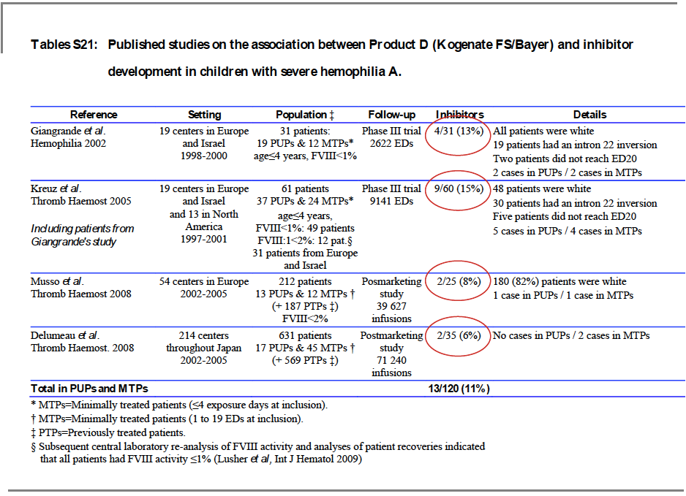
Courtesy of
Jenny Goudemand

Slide 22
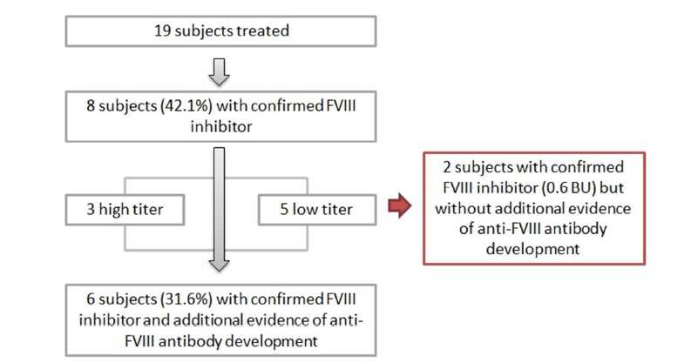
EPIC: another learning lesson
Courtesy of
Gunther Auerswald
Accepted on Hemophilia

Slide 23
Take home messages - III
Clear: type of concentrate is a weak risk factor
Clear: if you can, don’t use Kogenate
Less clear: what do I do then?
what do I use then?
Plasma derived?
Human cell line recombinant factor VIII?
Advate?
Long acting factor VIII?
Investigational molecules?

Slide 24
ARS - Question
What will I use to treat my next PUP?
Kogenate
Plasma derived FVIII
Human cell line recombinant factor VIII
Advate
Long acting factor VIII
Investigational molecules

Slide 25
Overview
Considerations on available data
Stepping back: what is the problem?
Implication for practice
Implications for research
Notes:
Will introduce starting from 2, then 1 and 3

Slide 26
Facts
RODIN, FranceCoag, UKHCDO showed that you can measure differences in immunogenicity with about 300 PUPs
EUHASS showed you can accrue a similar number in half the time

Slide 27
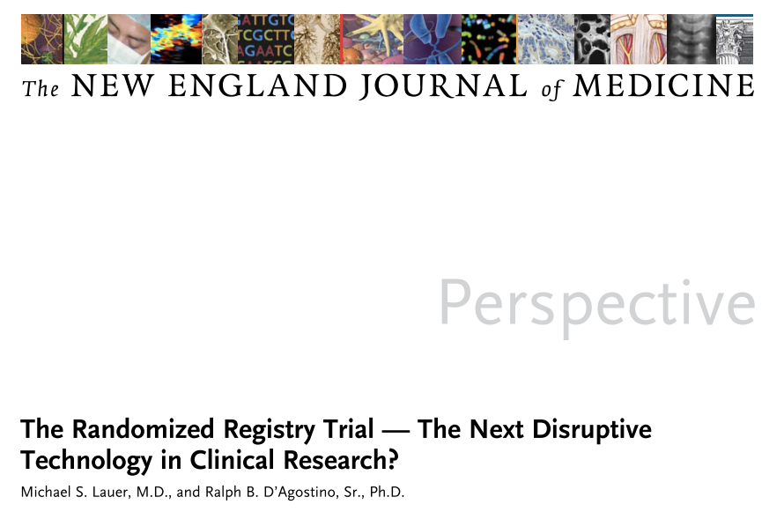

Slide 28
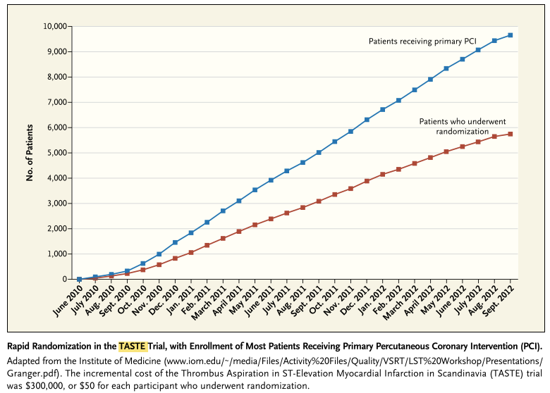
PCI cases enrolled in administrative registry
Number of patients
Randomized within registry
Year

Slide 29
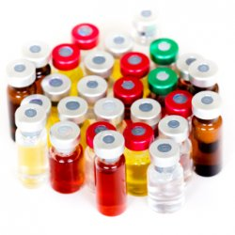
The randomized trial design - hemophilia
1
4
3
2
Notes:
Each participant center continuously updates the list of concentrates they are can/want to use
This info is tracked all along
Each participant center register all the newborn PUPs into the registry
Whenever a new PUPs is to be started on treatment, consent to randomization AND/OR data collection is chosen
Inhibitor events are collected on both the randomized and not randomized subjects

Slide 30
ARS - Question
If such a trial was available, would you participate?
YES
NO

Slide 31
Barriers to such a study
Need to use the “best possible product to match the unique individual profile”
OTHERS REASONS
Physician preference
Patient preference
Enrollment in studies on investigational molecules
“Relationships” with manufactures

Slide 32
ARS - Question
If such a trial was available, what would be the main barrier to your participation?
I have only one recombinant in my center
I don’t trust the factor-related inhibitor risk
I don’t like randomly choosing (among equivalent products)
Other barriers

Slide 33
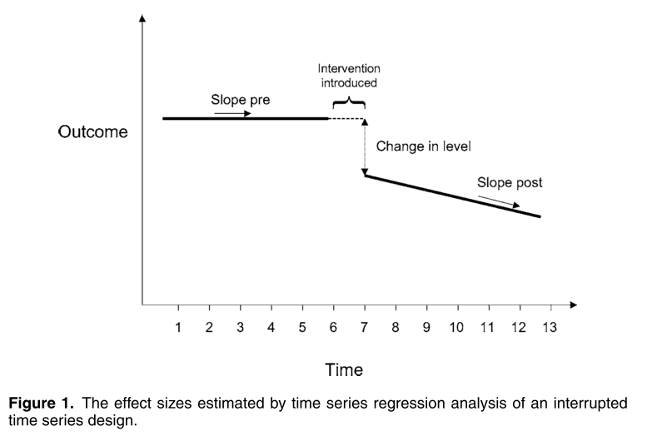

Slide 34
Paired availability
Requirement | Criteria
Stable population | Single hospital serves the area No in- out- migration Constant eligibility criteria No change in prognosis
Stable treatment | 1. Rest of management stable
Stable evaluation | 1. No change in criteria
Stable preference | No publicized credible report No direct-to-consumer advertising
Stable treatment effect | Intervention effect independent on disease stage No learning curve required

Slide 35
Take home messages - IV
We’d better focus on important risk factors, not molecule-related risk
As to concentrate related risk
It is not a matter of better or larger data collection, we need a different way for data collection and analysis
….. together we can

Slide 36
Thank you !!!
Download these slides at:
Hemophilia.mcmaster.ca
Join the Web Application for Population Pharmacokinetic
Service (WAPPS) network at:
www.wapps-hemo.org

Slide 37
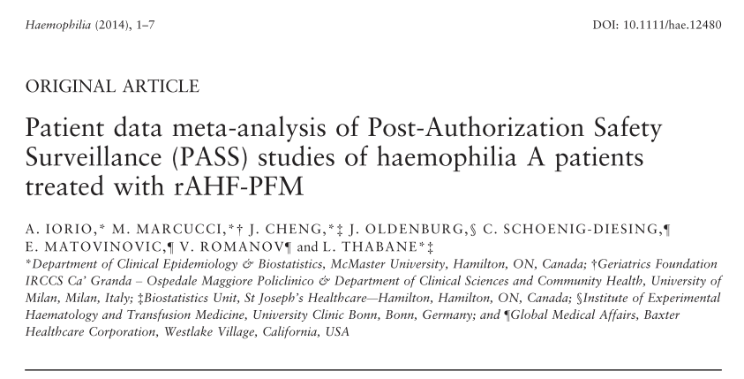

Slide 38
Evaluation of Safety and Effectiveness of factor VIII treatment in Hemophilia A patients with low titer inhibitors or a personal history of inhibitor. Patient Data Meta-analysis of rAFH-PFM Post-Authorization Safety Studies
V. Romanov , M. Marcucci, J. Cheng,
L. Thabane, A. Iorio
Thrombosis and Haemostasis 2015, accepted

Slide 39
Inhibitors in hemophilia A patients with low titer inhibitors or a personal history of inhibitor
V. Romanov et al. Thrombosis and Haemostasis 2015, accepted

Slide 40
Thank you !!!
Download these slides at:
Hemophilia.mcmaster.ca
Join the Web Application for Population Pharmacokinetic
Service (WAPPS) network at:
www.wapps-hemo.org

Slide 41
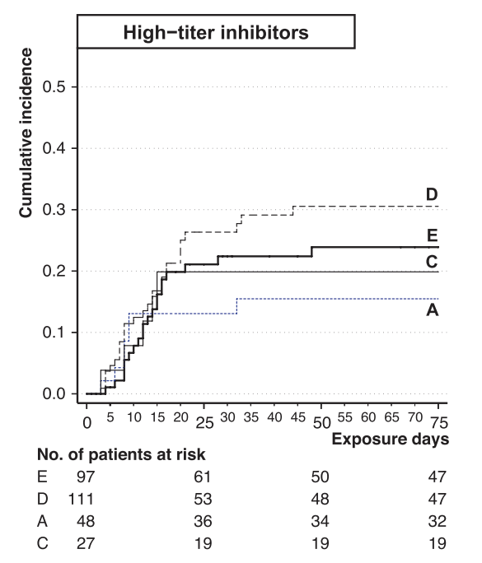
EUHASS – PTPs
Advate 0.11 (0.03 – 0.25)
Kogenate 0.17 (0.06 - 0.37)
OR = 1.54 (0.24 – 12)
Xi, PTP meta-analysis
Advate 0.10 (0.05 – 0.18)
Kogenate 0.26 (0.16 - 0.44)
Kogenate 0.11 (0.05 - 0.23)
OR = 2.6 (0.88 – 8.8)
Kogenate
Advate
Aledort BDD meta-analysis
Kogenate vs Advate
High titer
HR = 1.75 (0.05 – 65.5)
All inhibitors
HR, 2.43 (0.31–19.2)

