Slide 1
What Is an Achievable Trough with Current Products and at What Cost?
Alfonso Iorio, MD, PhD, Professor of Medicine
Department of Health Research Methods, Evidence, and Impact
McMaster University, Canada

Slide 2
Disclosures
Alfonso Iorio’s Institution
has received project based funding via
research or service agreements with
Bayer,
Pfizer.

Slide 3
Once upon a time…
“Ten of the 33 patients originally wheel chair and bed-bound began to walk and function independently in their daily lives.”
Where does this come from?
The Holy Gospel
The NEJM, a trial on gene therapy in muscular dystrophy
A yet unpublished study on long acting factor VIII
Hua B, Lian X, Li K, et al.
Low-dose tertiary prophylactic therapy reduces total number of bleeds and improves the ability to perform activities of daily living in adults with severe haemophilia A.
Blood Coagul. Fibrinol. 2016;27(2):136–140.
Verma SP, Dutta TK, Mahadevan S, et al. A randomized study of very low-dose factor VIII prophylaxis in severe haemophilia - A success story from a resource limited country.
Haemophilia. 2016;22(3):342–348.
Notes:
Strart with this non-randomized study
Continue with the randomized one in India
1. Hua B, Lian X, Li K, et al. Low-dose tertiary prophylactic therapy reduces total number of bleeds and improves the ability to perform activities of daily living in adults with severe haemophilia A. Blood Coagul. Fibrinolysis. 2016;27(2):136–140.

Slide 4


Slide 5
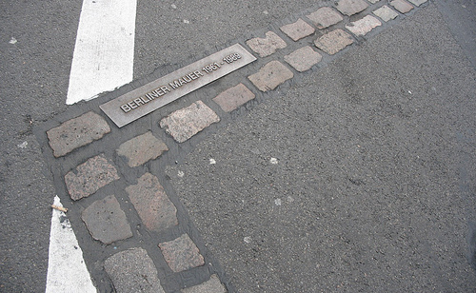
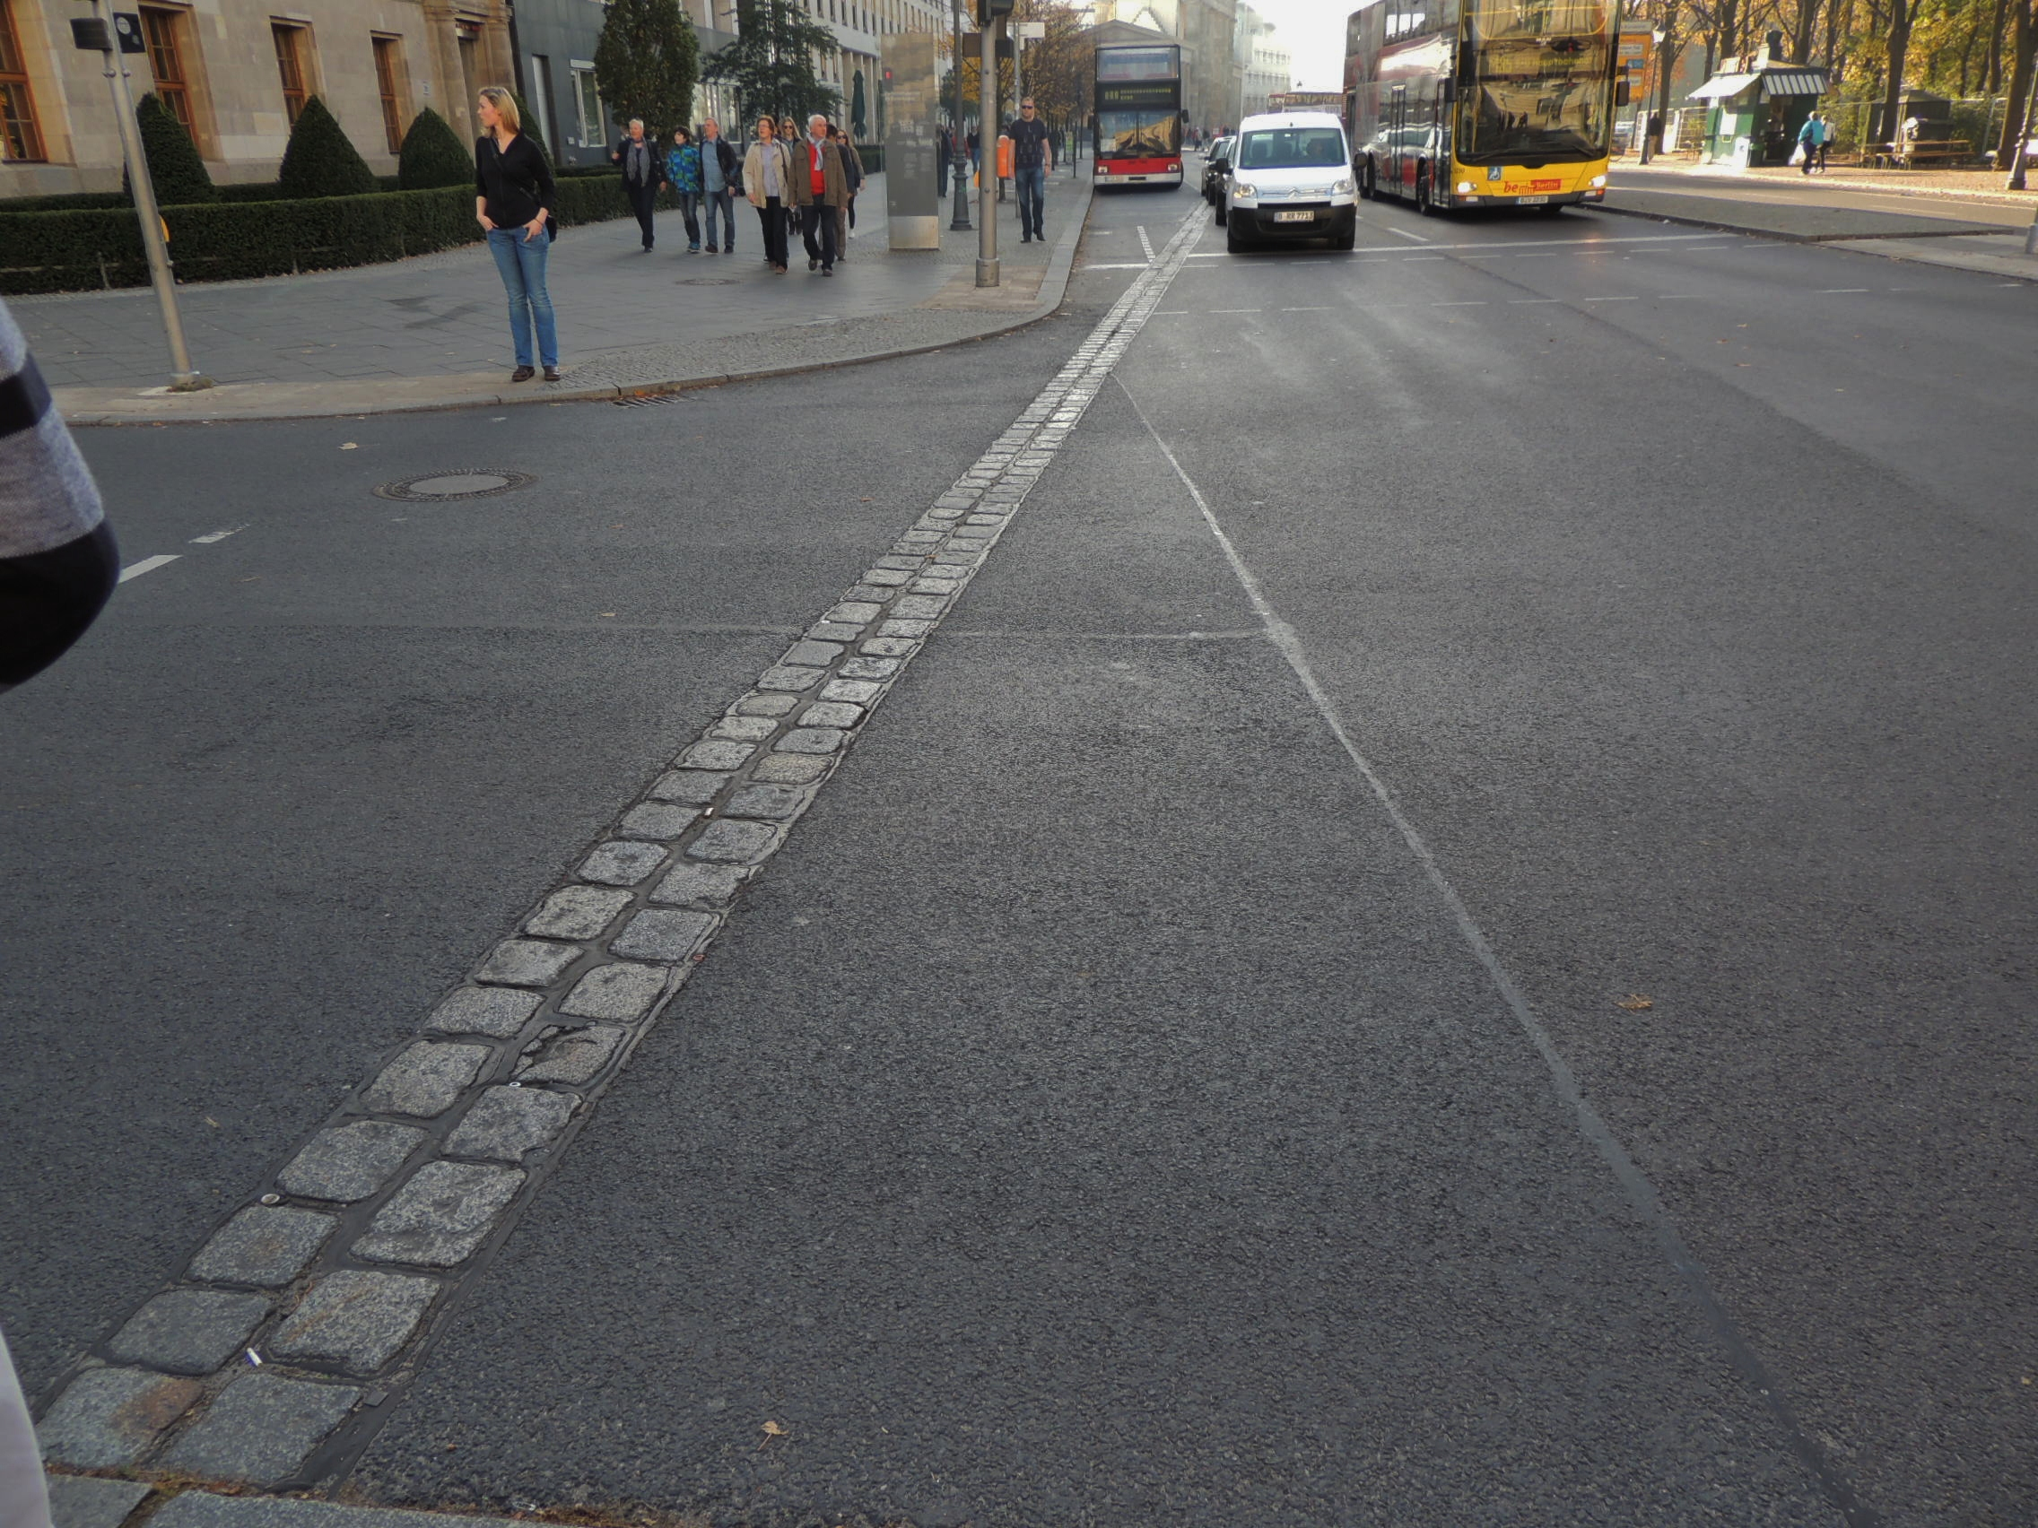
Learning objectives
Notes:
Goal of the presentation:
Discuss evidence about objectives attainable with current concentrates
Clarify categories and definitions for the terms in our question
(ultimately) Expand the scope of science

Slide 6
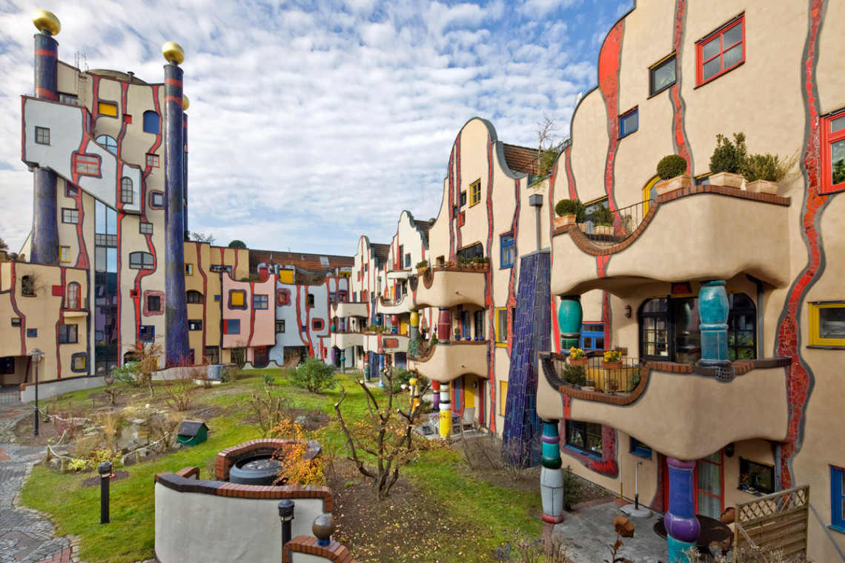
Notes:
The concept of trough cannot be separated by the concept of variation, repeated infusions, varying levels.
“Dopo aver vinto il concorso Heinz M. Springmann pianificato insieme con Siegfried Kaltenbach lo sviluppo di South Market Street a Plochingen. Come soluzione a mentire all'incrocio di strade zona hanno sviluppato un complesso residenziale con cortile e spazio commerciale integrato. Su richiesta del sindaco e il client Friedensreich Hundertwasser è stato invitato progettato il cortile interno compreso di prendere sulle facciate interne. Hundertwasser trasformato la facciata rettilinea in un ordine organico e cambiando la forma e la disposizione delle finestre. Con la torre, ha aggiunto, il sistema, si mise un accento urbano e ha dato alla città Plochingen un nuovo punto di riferimento. compito speciale è stato quello di affrontare il mondo mentale di Hundertwasser e implementare la sua creatività artistica in realtà costruita. Questi progetti di cooperazione sono stati realizzati in seguito ulteriormente l'architettura Hundertwasser in patria e all'estero.”

Slide 7
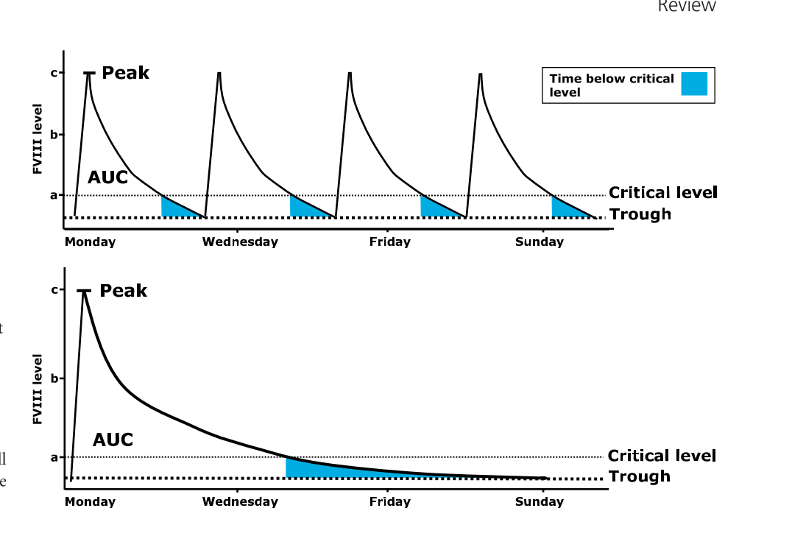
Peaks, troughs, and AUCs..
Mahdi AJ, Obaji SG, Collins PW. Role of enhanced half-life factor VIII and IX in the treatment of haemophilia. Br. J. Haematol. 2015;169(6):768–776.

Slide 8
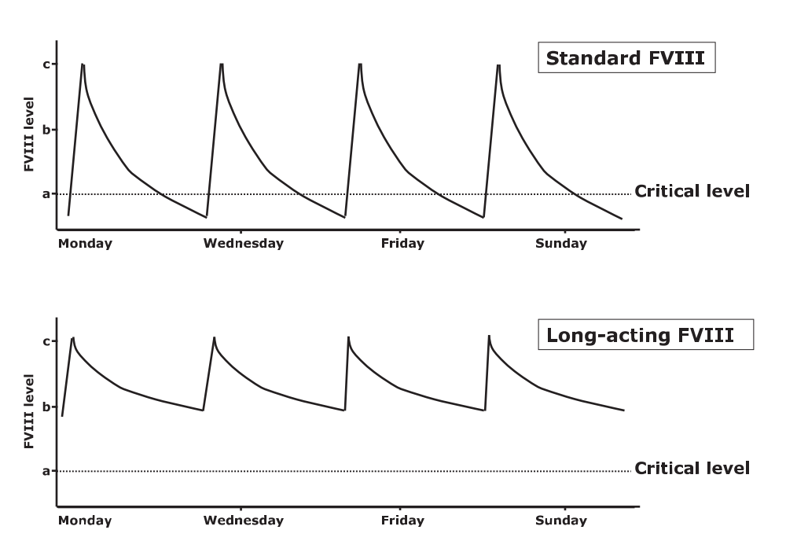
Peaks, troughs, and AUCs..
Mahdi AJ, Obaji SG, Collins PW. Role of enhanced half-life factor VIII and IX in the treatment of haemophilia. Br. J. Haematol. 2015;169(6):768–776.

Slide 9
Table with average half-life
Product | Technology | Terminal HL | Reference
Novoeight | BD truncated | 11.2 +/- 4.2 | Jiménez-Yuste V. Thromb Haemost 2015;13:370–9.
Kovaltry | HSP-70 | 13.9 +/- 3.7 | Shah A. Clin. Pharmacokinet. 2016, in press.
Adynovate | PEG | 14.3 +/- 3.8 | Konkle BA. Blood 2015;126(9):1078–1086.
Afstyla | BBD trunc - SC | 14.5 +/- 3.8 | Klamroth,R. Haemophilia. 2016;22(5):730–738.
Nuwiq | BDD - HC | 15.1 +/- 4.7 | Lissitchkov T. Haemophilia. 2017; in press.
Bay-94-9027 | BDD - PEG | 18.5 +/- ?? | Coyle TE, J. Thromb. Haemost. 2014;12(4):488–496.
Novoeight-GP | BD trunc - PEG | 19.0 +/- 5.5 | Tiede A. J. Thromb. Haemost. 2013;11(4):670–678.
Eloctate | Fc conjugated | 19.7 +/- 2.3 | Mahlangu J, Blood. 2014;123(3):317–325.

Slide 10
PK variability

Slide 11
PK variability

Slide 12
WAPPS network - unpublished
O Standard FVIII concentrates O EHL Factor VIII
Measurements:
  SHL FVIII: 3038 points
  EHL FVIII: 2113 points
Plasma factor activity IU/mL
Dose: median (25-75%):
  SHL FVIII: 33.2 (20.2-48.8)
  EHL FVIII: 44.0 (33.7-52.6)
Time post-infusion (days)
Notes:
Data from 614 patients on standard FVIII and 223 on EHL

Slide 13
Inter subject variability
10
1
Individual variability in the response to treatment
Log [plasma activity]
AUC
(Terminal) HL
0 12 24 36 48 60 72 84 96
Time (hrs)

Slide 14
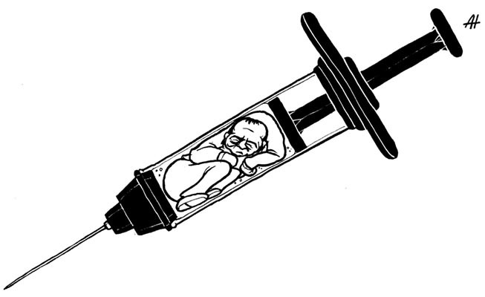

Slide 15
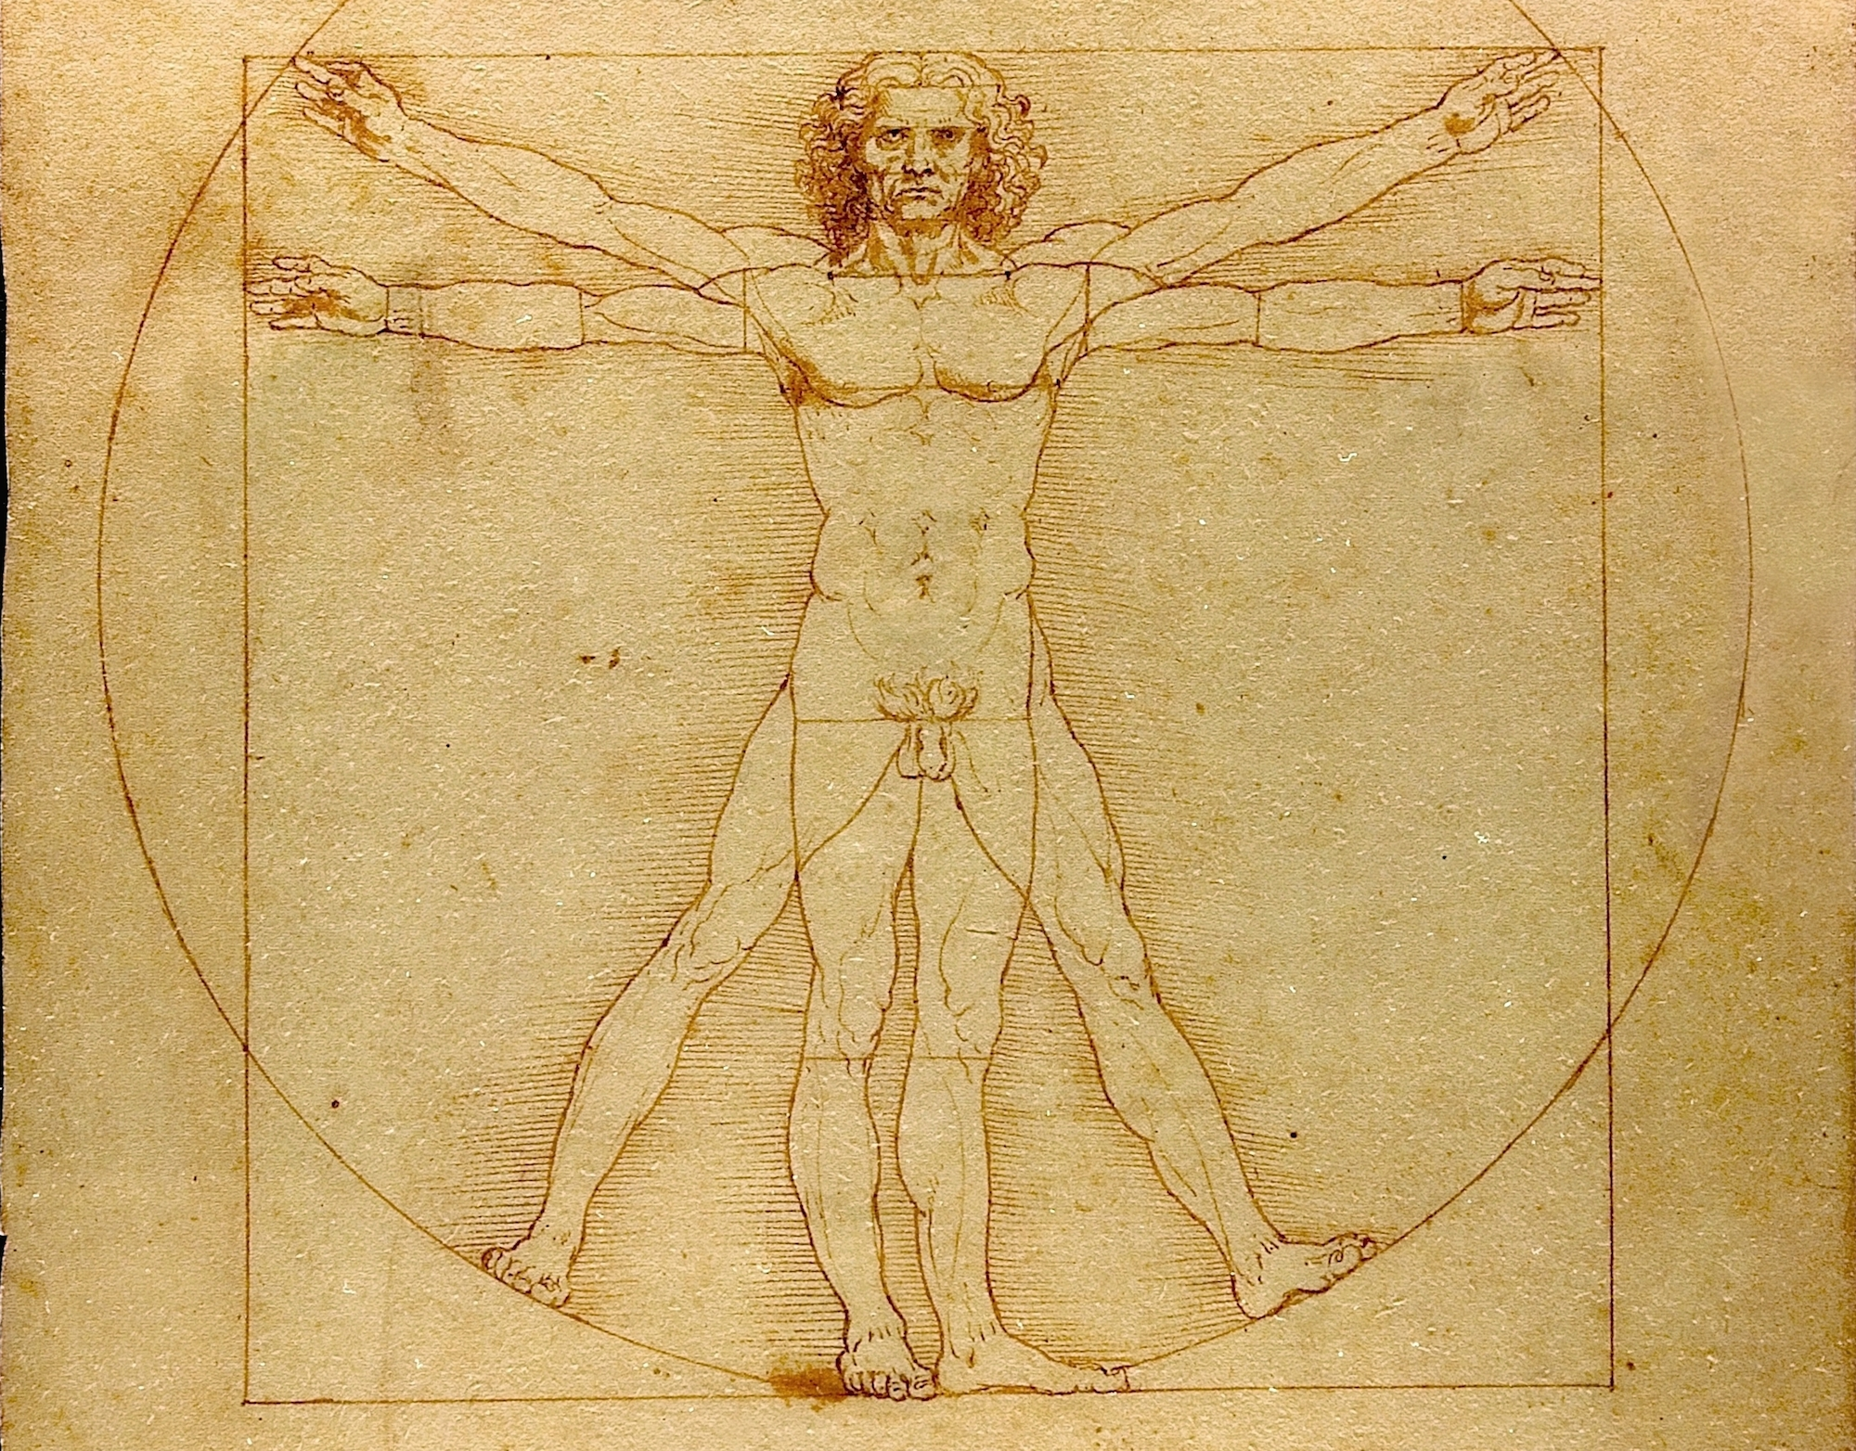
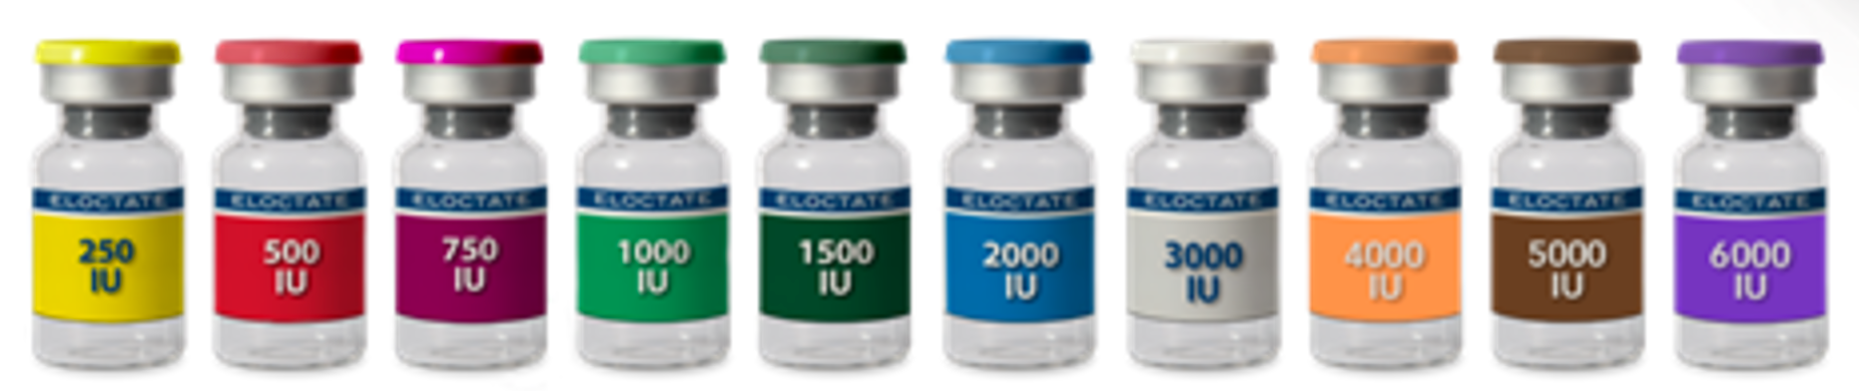

Slide 16
Everyone, none, or someone?
Individual variability in the response to treatment
+50%
Case 1
Case 2
Half-life 12.5 hrs
+20 h
+50%
Half-life 9 hrs
+12 h
0 12 24 36 48 60 72 84 96
Time to target value
Notes:
Is there a better factor for anyone?
Or a better molecule on average is better for each individual?

Slide 17
A moving target (level) ..
10
1
Individual variability in the response to treatment
Log [plasma activity]
Bleed
Activity
Bleed
Bleeding threshold
Rest
0 1 2 3 4 5 6 7 8
Time (days)

Slide 18
Conclusions (provisional)
EHL have introduced options and expanded variability
There is no one size fits all
What Is an Achievable Trough with Current Products and at What Cost does depends
  Less on the specific concentrate
  more on critical factors like:
    COST per UNIT
    WILLINGNESS TO PAY
    REGIMEN DESIGN

Slide 19
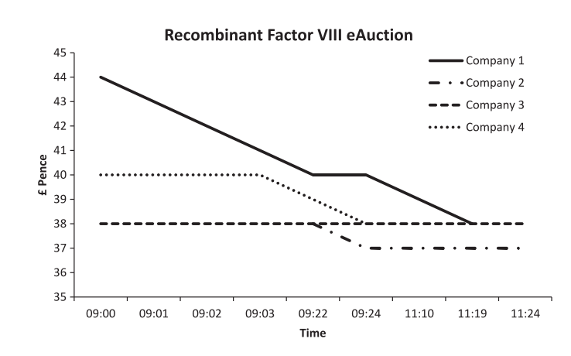
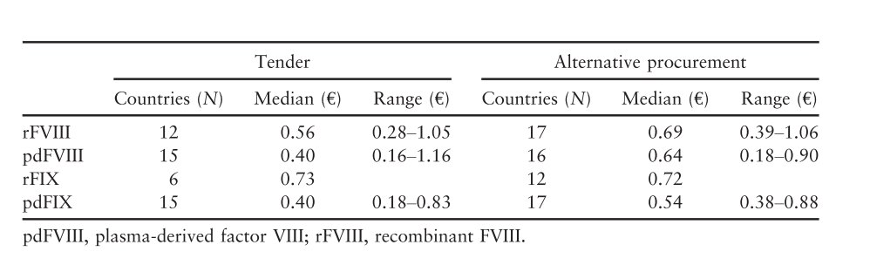
Cost consideration
Payment Allowance Limits for Medicare Part B Drugs Effective July 1, 2017 through September 30, 2017
HCPCS Code | Short Description | HCPCS Code Dosage | Payment Limit
J7182 | Factor viii recomb novoeight | 1 IU | 1.312
J7186 | Antihemophilic viii/vwf comp | PER FACTOR VIII IU | 0.940
J7187 | Humate-p, inj | 1 IU | 1.088
J7190 | Factor viii | 1 IU | 0.981
J7192 | Factor viii recombinant nos | 1 IU | 1.222
J7205 | Factor viii fc fusion recomb | 1 IU | 2.026
1. Hay CRM. Purchasing factor concentrates in the 21st century through competitive tendering. Haemophilia. 2013;19(5):660–667.
2. O’Mahony B, Noone D, Prihodova L. Survey of coagulation factor concentrates tender and procurement procedures in 38 European Countries. Haemophilia. 2015;21(4):436–443.

Slide 20
Cost-effectiveness
Italy (1): 40,000 euros for primary/secondary prophylaxis
Italy (2): 54,000 euros for late prophylaxis
International (3): from cost savings to 1 M
Colombia (4): 55,000 USD using plasma derivatives
1. Colombo GL Clin. Outcomes Res. 2011;3(1):55–61.
2. Coppola A Haemophilia. 2017;23(3):422–429.
3. Miners AH. Haemophilia. 2013;19(2):174–180.
4. Castro Jaramillo HE, Int. J. Technol. Assess. Health Care. 2016;32(5):337–347.
Notes:
What you can afford depends on where you are
The estimation of the QALY was the same in UK, Italy and Colombia (around 50 K x QALY); however, in Colombia that is > 3x the GDP, and not affordable (Nb it would be 90K for recombinants)

Slide 21
Budget impact analysis
Population of 1,000,000 people with private insurance, including 20 PWH
2 year budget for switching to EHL
Variable | Cost (USD)
Cost per patient | 11,869
Cost per member | 0.23
Impact on budget | 234,233
Impact on budget | 1.4%
McMullen S, Buckley B, Hall E, Kendter J, Johnston K. Budget Impact Analysis of Prolonged Half-Life Recombinant FVIII Therapy for Hemophilia in the United States. Value Heal. 2017;20(1):93–99.

Slide 22
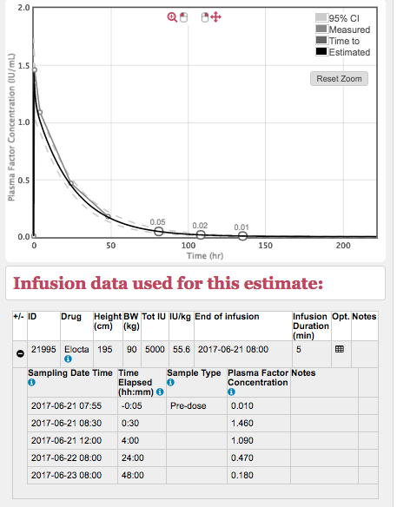
Infusion interval
For any target trough level, exponentially more concentrate will be required as the time between infusions increases and this will dramatically impact on the cost effectiveness of the regimen
Collins P, Chalmers E, Chowdary P, et al. The use of enhanced half-life coagulation factor concentrates in routine clinical practice: guidance from UKHCDO. Haemophilia. 2016;22(4):467-498.

Slide 23
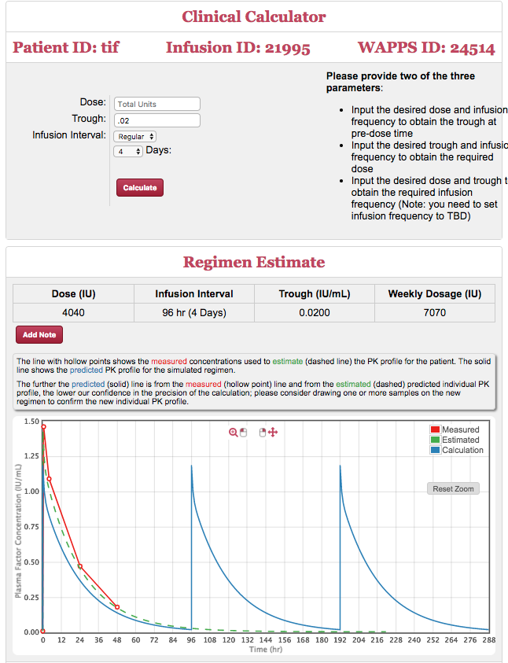
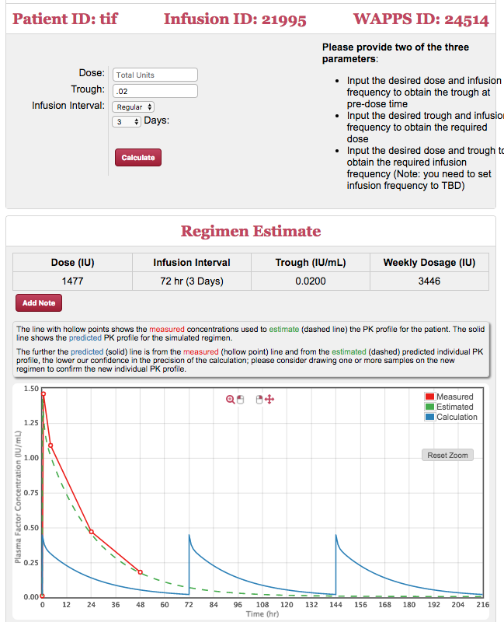
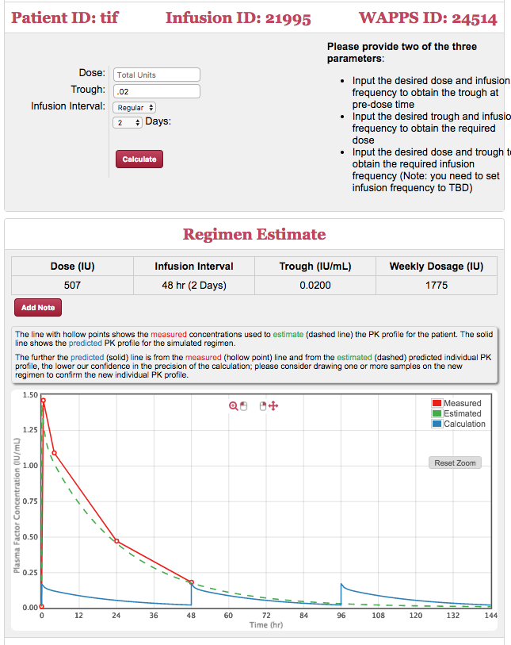
Less infusions >> more concentrate >> more cost
Lindvall K, Astermark J, Björkman S, et al. Daily dosing prophylaxis for haemophilia: A randomized crossover pilot study evaluating feasibility and efficacy. Haemophilia. 2012;18(6):855–859.

Slide 24
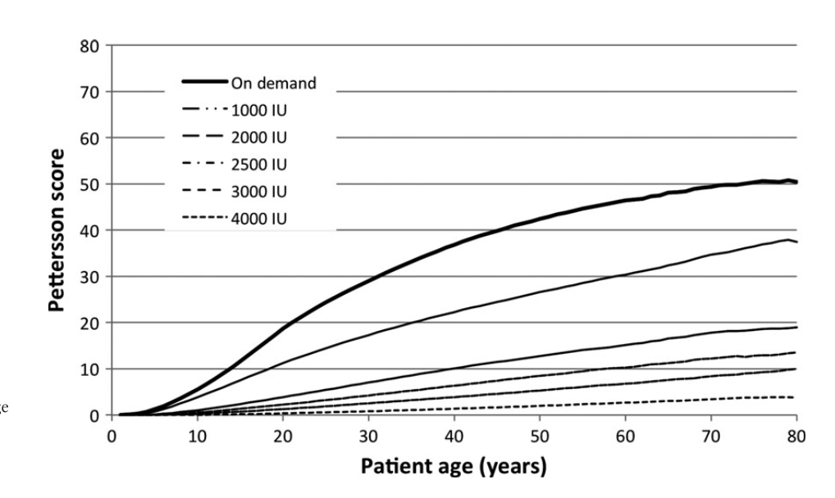
Treatment intensity
Fischer K, Lewandowski D, Janssen MP. Modelling lifelong effects of different prophylactic treatment strategies for severe haemophilia A. Haemophilia. 2016;22(5):e375–e382.

Slide 25
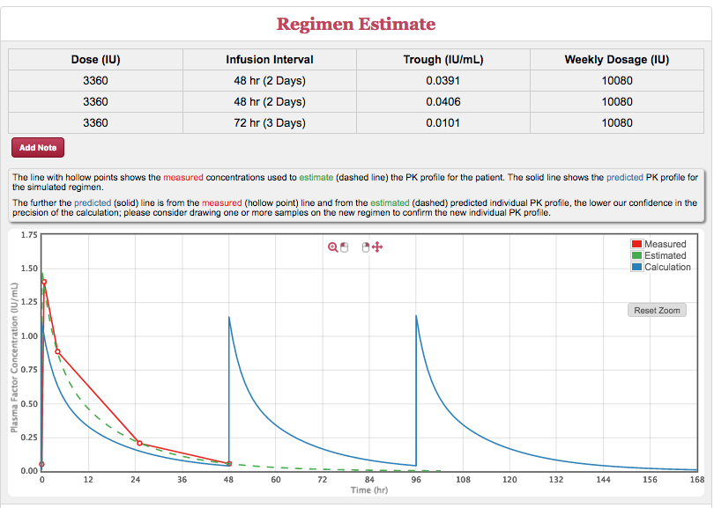
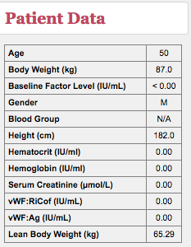
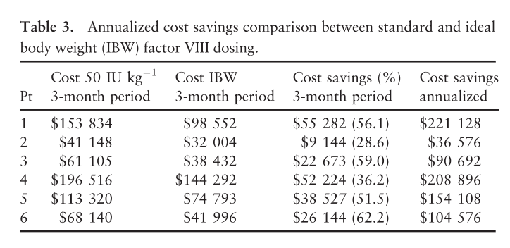
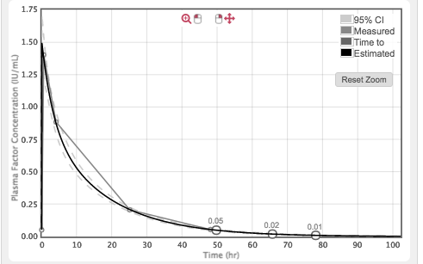
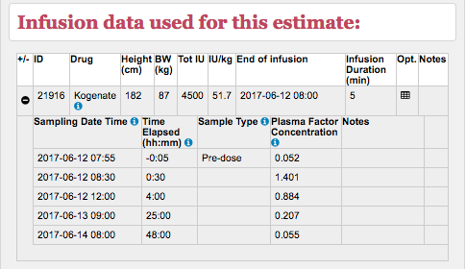
Lean body weight dosing
Graham A, Jaworski K. Pharmacokinetic analysis of anti-hemophilic factor in the obese patient. Haemophilia. 2014;20(2):226–229.

Slide 26
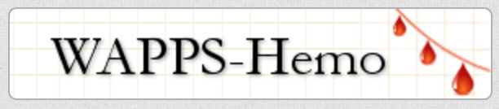
Shaping the future
Notes:
Vial size is a significant limiting step
What does it take to get a desired trough in any of your patients
Leave alone there might not be a safe through for everyone, let alone higher is better, but how to ensure that everyone achieves the thorugh he wants?
PK dosing
PopPK dosing
LBW adjusting

Slide 27



CoreHĒM Project
Goal is to establish a “core set” of outcomes to
  Measure
  Demonstrate
  Differentiate
the effectiveness and value of gene therapy in hemophilia
  relative to current standard of care.

Slide 28

Thank you !!!
Join the WAPPS network at:
www.wapps-hemo.org
Download these slides at:
Hemophilia.mcmaster.ca

