Slide 1

Population-based PK in haemophilia A
Alfonso Iorio
(Hamilton, Kanada)

Slide 2

Disclosures Alfonso Iorio
Research funds (last 3 years, funds to McMaster University)
Bayer, Baxalta, Biogen, NovoNordisk, Pfizer
Clinical trial participation (last 3 years)
Octapharma
Consultation fees (last 3-years, funds to McMaster University)
Bayer, NovoNordisk

Slide 3
Outline
Variability of Pharmacokinetics in haemophilia patients
Basic of PK analysis
The Population based PK approach
WAPPS
Strength and weaknesses of each approach
how the approaches can complement each other

Slide 4

Notes:
any algorithms, influencing factors or art of dosing tools which predict bleeding outcomes in severe hemophilia A and help to cluster patients according to their characteristics and treatment requirements.

Slide 5
Classical PK estimation
patient |  |  | 1 | 2 | 3 | 4 | 5
dose/kg |  |  | 55 | 59 | 56 | 53.1 | 50.9
dose |  |  | 3405 | 4086 | 5448 | 4767 | 4920
one-comp |  | V | 2985.97 | 2629 | 4217.305 | 3887.61 | 3676.66
 |  | k | 0.001052 | 0.001309 | 0.001089 | 0.001238 | 0.000796
 |  | HL (min) | 659 | 529 | 636 | 559 | 871
 |  | HL (h) | 10.98 | 8.82 | 10.60 | 9.32 | 14.52
 |  | C(0) approx D/V | 1.14 | 1.55 | 1.29 | 1.23 | 1.34
two-comp |  | A | 0.486937 | 1.274402 | 0.476461 | 0.934315 | 0.987822
 |  | B | 0.726386 | 0.302367 | 0.8767 | 0.303577 | 0.379788
 |  | alpha | 0.004996 | 0.001823 | 0.004597 | 0.001656 | 0.001333
 |  | beta | 0.000532 | 0.000315 | 0.000645 | 0.000528 | 0.000207
 |  | alphaHL | 138 | 380 | 150 | 418 | 519
 |  | betaHL | 1302 | 2197 | 1074 | 1312 | 3342
 |  | Hlbeta (h) | 21.70 | 36.62 | 17.90 | 21.87 | 55.70
{data on file, Alfonso Iorio)
Notes:
These are five random samples analized by one and two compartment model

Slide 6
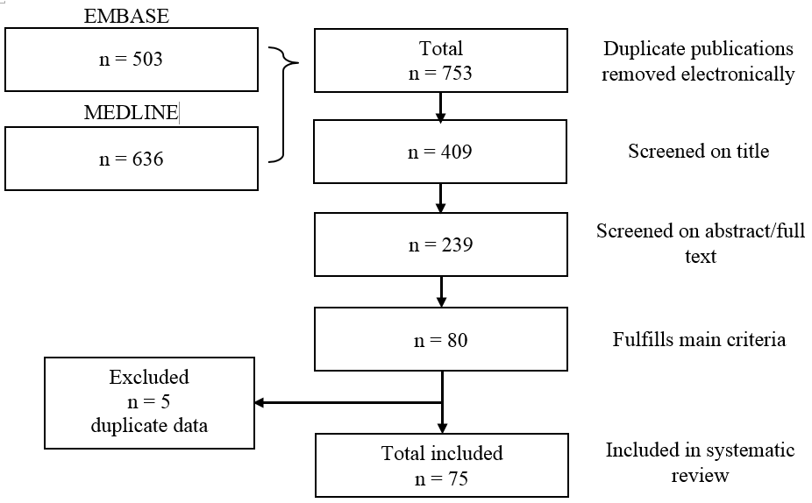
Systematic Review of the Published Evidence on the Pharmacokinetic Characteristics of Factor VIII and IX Concentrates
Xi M et al. Blood 2014; 124 (21) Abs.

Slide 7
SR of the Published Evidence on the Pharmacokinetic Characteristics of Factor VIII and IX Concentrates
Factor | Class | Studies | Patients | Half-life (h)
FVIII | Wild type | 30 | 790 | 7.82- 19.2
 | BDD | 12 | 339 | 7.5 – 17.7
 | EHL | 3 | 106 | 11.5 – 23.8
FIX | Wild type | 22 | 492 | 12.9 - 36
 | EHL | 6 | 106 | 53.5 – 110.4
Xi M et al. Blood 2014; 124 (21) Abs.

Slide 8
PK analysis: Classical study design
Concentration (linear scale)
Time (linear scale)

Slide 9
Plasma Drug Disposition after a Single IV bolus
Peak, C_{max}, Recovery
CL 1.725
V1 9.560
k 0.055
Half-life (h) 12.5
Concentration (%)
AUC
Half-life
Trough
Time (hours)

Slide 10
Basic Pharmacokinetics
MEASURED
AUC_{last} = measured until the last data point
k = estimated on the last (sole) monotonic curve (C_{t} = C₀ * e^{-kt})
CALCULATED
AUC_{inf} = Calculated starting from AUC_{last} and k
Clearance = Dose / AUC_{inf}
V_{d(ss)} = Clearance/k
MRT=V_{d(ss)}/Cl
T_{1/2}= 0.693/k

Slide 11
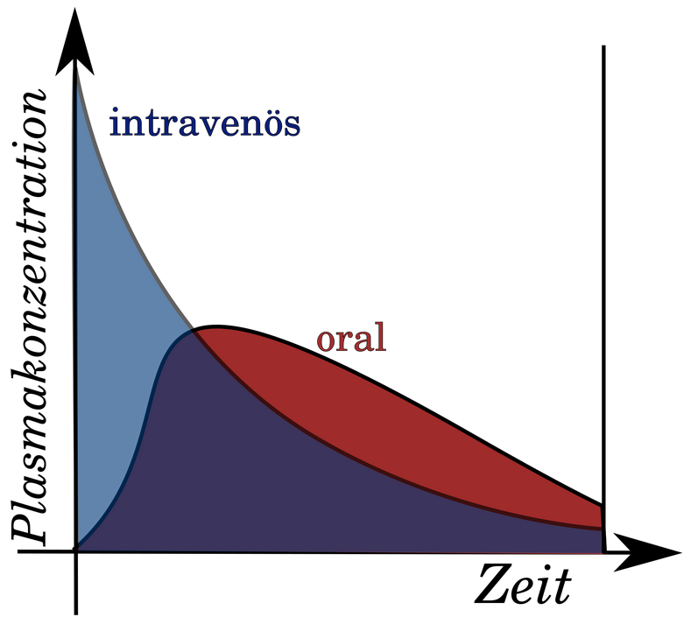
AUC
Bioavailability =
(AUC oral/AUC iv)*100
Intravenous
Plasma concentration
Plasma concentration
Oral
Time (hours)
Time
AUC: Area under the curve

Slide 12
Key concepts for green molecule:
1. Green molecule: Longer terminal half-life
2. Green molecule: Earlier start of terminal phase
3. Green molecule: Earlier time to critical concentration
Log plasma concentration
Time (hours)

Slide 13
Individual PK can be estimated by using popPK based structural model and variability information
Concentration (linear scale)
Time (linear scale)

Slide 14
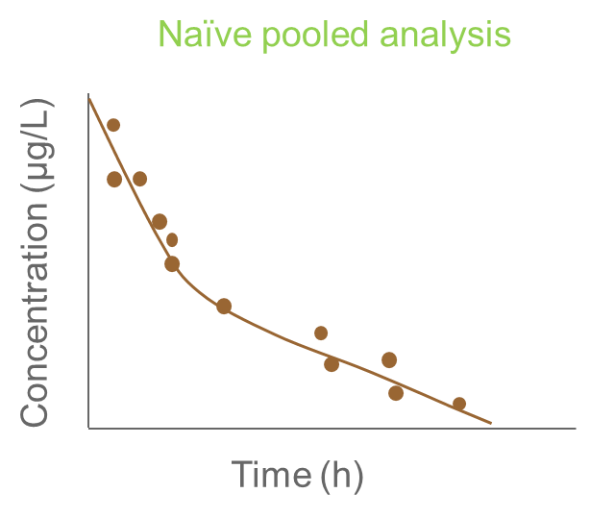
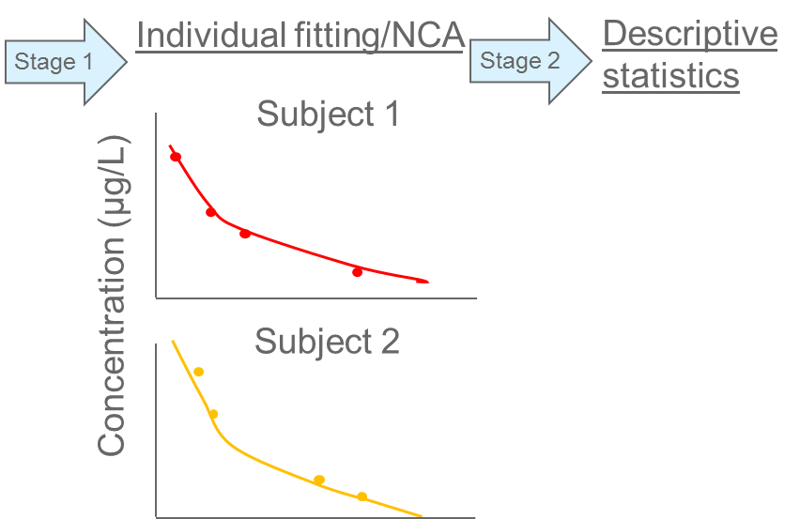

Classical Pharmacokinetics analysis
Two-stage analysis | Naive pooled analysis
1.) Each individual is modeled 2.) Parameters are summarized | All individuals are modeled as if they were one individual
1 sample per subject
Population PK parameter
Individual PK parameter
Sparse Sampling
Estimated Variability
Population PK parameter
Individual PK parameter
Sparse Sampling
Estimated Variability
Notes:
Using population Pharmacokinetics (popPK) the variability in the observed drug concentration within and between subjects can be quantified to help us understanding the PK of a drug, i.e. how fast and to what extent a drug is absorbed, distributed and eliminated.
We can distinguish the variability within a subject or population, which can be described using a structural PK model. In this example, the trend of decreasing concentration after iv dosing can be described by a one-compartmental model, assuming that body can be reflected/modelled by one compartment with an apparent volume of disttribution Vd and is eliminated by a first order elimination / clearance process, defined by the Clearance (CL). As can be seen in the example, the structural variability within this subject can be described adequately.
However, if we look at the structural variability from other subjects, we can observe that there is also variability between subjects, as the concentration versus time profiles differ among subjects. This between subject variability can be described by assuming that the structural PK parameters, CL and Vd in this example, differ between subjects. It is assumed that these difference occur at random, i.e. we do not know why these parameters differ among subjects. The distribution of this random process is described with a statistical/stochastic model.

Slide 15
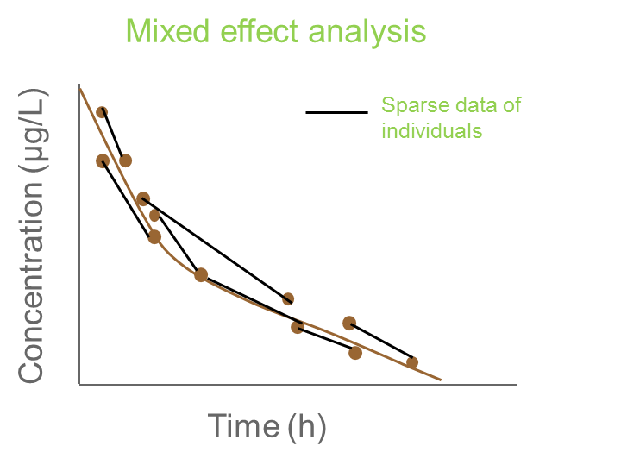
Population PharmacoKinetics
Mixed effect analysis (popPK)
One population model is fit to data Data sampled within individuals are considered to be correlated Variation between and within subjects are explained using statistical parameters
Population PK parameter
Individual PK parameter
Sparse Sampling
Estimated Variability
Technical complex
Notes:
Using population Pharmacokinetics (popPK) the variability in the observed drug concentration within and between subjects can be quantified to help us understanding the PK of a drug, i.e. how fast and to what extent a drug is absorbed, distributed and eliminated.
We can distinguish the variability within a subject or population, which can be described using a structural PK model. In this example, the trend of decreasing concentration after iv dosing can be described by a one-compartmental model, assuming that body can be reflected/modelled by one compartment with an apparent volume of disttribution Vd and is eliminated by a first order elimination / clearance process, defined by the Clearance (CL). As can be seen in the example, the structural variability within this subject can be described adequately.
However, if we look at the structural variability from other subjects, we can observe that there is also variability between subjects, as the concentration versus time profiles differ among subjects. This between subject variability can be described by assuming that the structural PK parameters, CL and Vd in this example, differ between subjects. It is assumed that these difference occur at random, i.e. we do not know why these parameters differ among subjects. The distribution of this random process is described with a statistical/stochastic model.

Slide 16
Population PK
Classical approach
Mixed approach
Population approach
Derivation
Rich data in a
limited sample of
individuals
Average of iPK
Derivation
Rich data in a
large sample of
Individuals
Population model
Derivation
Sparse data in a
large sample of
individuals
Population model
Estimation
Full study (rich data)
of the individual of interest
Individual PK
Estimation
Bayesian estimation
individual sparse data population priors
Individual PK

Slide 17
Published models
Drug | Refs | Comp
FVIII | Bjorkmann, Eur J Clin Pharm, 2009; Blood, 2013; JTH 2010 | 2
 | Karafoulidou, Eur J Clin Pharmacol 2009 | 2
 | Nestorov, Clin Pharm in Drug Devel 2014 | 2
 | Nestorov, Clin Pharm in Drug Devel 2014 | 2
FIX | Brekkan, J Thromb Haemost 2016 | 3
 | Diao, Clin Pharmacokinet, 2014 | 3

Slide 18
The Bayesian approach to individual PK estimates – step 1
According to the Bayesian principle,
The best assumption about an individual PK, before any FVIII:C data have been measured is:
taking the values calculated from the population model, using any covariates if applicable
E.g., the most likely CL for FVIII is calculated from BW and age.

Slide 19
The Bayesian approach to individual PK estimates – step 2
Information from measurements shifts the estimate
from the most likely (population based)
towards the individuals actual values.
As biological measurements are imprecise, a probabilistic approach is adopted:
few measurements
compromise between the model prediction and the best fit to the data
more measurements
weight given to the individual increases.
Statistically, this balance is handled by comparing
the variability of PK parameters between individuals
with the residual variance in the estimation process

Slide 20
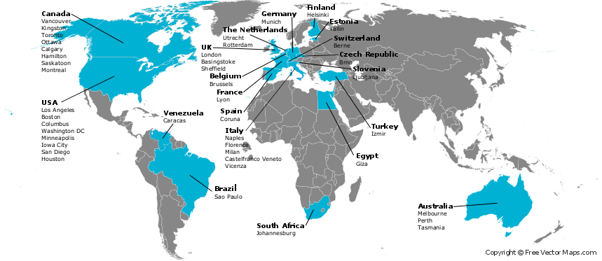
The WAPPS network
The Development of the Web-based Application for the Population Pharmacokinetic Service – Hemophilia (WAPPS-Hemo) – Phase1.
ClinicalTrials.gov Identifier: NCT02061072. Available at: https://clinicaltrials.gov/ct2/show/NCT02061072.

Slide 21
Single patient data
Web-application
Estimating PK for single individuals on the base of 2-4 samples
Single patient report

Slide 22
Estimating PK for single individuals on the base of 2-4 samples
Single patient data
Web-application
Online PPK engine
(NONMEM)
Single patient report

Slide 23
Estimating PK for single individuals on the base of 2-4 samples
Brand specific Source individual PK data
Single patient data
Control files for bayesian individual estimation
Web-application
Online PPK engine
(NONMEM)
Offline PPK modeling
Product 1
Product 2
Product 3
Product 4
Product 5
Others..
Brand specific PPK models
Single patient report

Slide 24
Brand specific Source individual PK data
Single patient data
patients
patients
patients
Control files for bayesian individual estimation
Web-application
Online PPK engine
(NONMEM)
Offline PPK modeling
Product 1
Product 2
Product 3
Product 4
Product 5
Others..
Brand specific PPK models
Single patient report

Slide 25
On file PK studies
Cohort | Number of subjects | Number of PKs
Derivation | > 750 | > 1200
Validation | 240 | 275
On-going | 321 | 362
Total | >1200 | >1800

Slide 26
The WAPPS network
The Development of the Web-based Application for the Population Pharmacokinetic Service – Hemophilia (WAPPS-Hemo) – Phase1.
ClinicalTrials.gov Identifier: NCT02061072. Available at: https://clinicaltrials.gov/ct2/show/NCT02061072.

Slide 27
FVIII – WAPPS ESTIMATES N = 156
 | Median | Range
Age | 16 | (1 – 74)
Weight | 62.5 | (12-204)
Dose | 1500 | (250 – 6250)
{data on file, WAPPS investigators)

Slide 28
FVIII – WAPPS ESTIMATES N = 156
 | Median | Range
Clearance ml min-1 kg-1 | 0.18 | (0.04 – 0.52)
Terminal HL (hr) | 12 | (6-28)
Time to 0.05 IU/mL (hr) | 38 | (16-96)
Time to 0.02 IU/mL (hr) | 55 | (26-134)
Time to 0.01 IU/mL (hr) | 68 | (33-162)
{data on file, WAPPS investigators)

Slide 29
FIX – WAPPS ESTIMATES N = 38
 | Median | Range
Age | 19 | (2 – 66)
Weight | 64.5 | (13-132)
Dose | 3000 | (500 – 10000)
{data on file, WAPPS investigators)

Slide 30
FIX – WAPPS ESTIMATES N = 38
 | Median | Range
Clearance ml min-1 kg-1 | 0.34 | (0.13 – 0.58)
Terminal HL (hr) | 27 | (17-55)
Time to 0.05 IU/mL (hr) | 51 | (18 – 60)
Time to 0.02 IU/mL (hr) | 85 | (49-84)
Time to 0.01 IU/mL (hr) | 113 | (77-160)
{data on file, WAPPS investigators)

Slide 31
FVIII EHL – WAPPS ESTIMATES N = 26
 | Median | Range
Age | 30.5 | (7 – 65)
Weight | 69.5 | (26-100)
Dose | 3000 | (150 – 4000)
{data on file, WAPPS investigators)

Slide 32
FVIII EHL – WAPPS ESTIMATES N = 26
 | Median | Range
Clearance ml min-1 kg-1 | 0.15 | (0.02 – 0.46)
Terminal HL (hr) | 18 | (11-43)
Time to 0.05 IU/mL (hr) | 71 | (35–100)
Time to 0.02 IU/mL (hr) | 95 | (50-158)
Time to 0.01 IU/mL (hr) | 109 | (62-192)
{data on file, WAPPS investigators)

Slide 33
www.wapps-hemo.org

Slide 34
Practicalities: Optimal sampling time – Factor VIII
Recommended times
4, 24 and 48 h
Alternatives
8, 30 h
24 h alone
Re-analysis of data from 41 FVIII PK studies
sampling at 4, 24 and 48 h equivalent to 7–10 samples
for the design of alternate-day dosing schedules.
Sampling at
8 & 30 h
24 h alone
gave useful but less accurate results
Bjorkman S. Limited blood sampling for pharmacokinetic dose tailoring of FVIII in the prophylactic treatment of haemophilia A. Haemophilia 2010; 16: 597–605.

Slide 35
Notes:
Comment on one vs two compartment modelling

Slide 36
Practicalities: Optimal sampling time – Factor IX
Recommended times
48-54, 72-78 h
(anytime during day 2 and 3)
A population pharmacokinetic model and sparse factor IX (FIX) levels may be used in dose individualization.
FIX sampling schedules for dose individualization were explored and compared with fixed doses.
Individual FIX doses were acceptably predicted with only two samples drawn post dose (days 2 and 3).
Pharmacokinetic dose individualization resulted in better target attainment than a fixed-dose regimen.
1. Brekkan A, Berntorp E, Jensen K, et al. Population Pharmacokinetics of Plasma-Derived Factor IX: Procedures for Dose Individualization. J Thromb Haemost 2016; n/a – n/a.

Slide 37
1. Brekkan A, Berntorp E, Jensen K, et al. Population Pharmacokinetics of Plasma-Derived Factor IX: Procedures for Dose Individualization. J Thromb Haemost 2016; n/a – n/a.

Slide 38
Practicalities
FVIII washout is not needed for estimating pharmacokinetics.
Five FVIII half-lives would correspond to up to 5 days in prophylaxis patients.
The Bayesian analysis can be performed on data from practically any dosing schedule.
Doses and times of preceding infusions must be known for at least five half-lives (after which <3% of a dose remains in the body) before the study infusion.
Residual above baseline can be modeled as well
Three compartment models are needed to define the PK of both pdFIX and rFIX

Slide 39
Another tale of two cities?
Classical approach
Population approach
Pro
Individual compartmental modelling
Robust to “Laboratory” variability
Cons:
Many samples required
Pro
Sparse samples (2-3 samples)
Cons
Calculation intensive
Probabilistic approach

Slide 40

Bottom line
PK
Carcao, M. & Iorio, A. (2015) Individualizing Factor Replacement Therapy in Severe Hemophilia. Seminars in Thrombosis and Hemostasis, 41, 864–871.

Slide 41

Thank you !!!
Join the WAPPS network at:
www.wapps-hemo.org
Download these slides at:
Hemophilia.mcmaster.ca

