Slide 1
Critical appraisal of inhibitor in PUP data
Alfonso Iorio
Health Information Research Unit
McMaster University

Slide 2
Disclosures for Alfonso Iorio
In compliance with COI policy the following disclosures are provided to the session audience:
Shareholder | No relevant conflicts of interest to declare
Grant / Research Support | Bayer, Baxter, Biogen Idec, Novo Nordisk, Pfizer
Consultant | Bayer, Baxter, Novo Nordisk
Employee | No relevant conflicts of interest to declare
Paid Instructor | No relevant conflicts of interest to declare
Speaker bureau | No relevant conflicts of interest to declare
Honoraria | Bayer, Baxter, CSL, Octapharma, Pfizer
Presentation includes discussion of the following off-label use of a drug or medical device: <N/A>

Slide 3
Overview
Assessing causality: methodological notes
Appraising data on the concentrate dependent risk of inhibitors
Implications and perspectives
Notes:
Will introduce starting from 2, then 1 and 3

Slide 4
Overview
Assessing causality: methodological notes
Appraising data on the concentrate dependent risk of inhibitors
Implications and perspectives
Notes:
Will introduce starting from 2, then 1 and 3

Slide 5
Association and causation
Typical process:
Observation
→ simple association (univariate, unadjusted)
→ un-confounded association (multivariable, adjusted)
→ proof of causation
Randomized experiment
Bradford Hill criteria

Slide 6
Matching
Smoking and mortality
 | Mortality (%) per 1,000 persons-year
Stratification | Non- smokers | Cigarette | Pipe and cigar
1 | 13.5 | 13.5 | 17.4
Cochran 1968
Notes:
Non overlapping of marginal distribution
Propensity score matching
It works better for naturalistic data that for different data types
Can add a graphical display of the marginal distribution.

Slide 7
Matching
Smoking and mortality
 | Mortality (%) per 1,000 persons-year
Stratification | Non- smokers | Cigarette | Pipe and cigar
1 | 13.5 | 13.5 | 17.4
2 | 13.5 | 16.4 | 14.9
Cochran 1968
Notes:
Non overlapping of marginal distribution
Propensity score matching
It works better for naturalistic data that for different data types
Can add a graphical display of the marginal distribution.

Slide 8
Matching
Smoking and mortality
 | Mortality (%) per 1,000 persons-year
Stratification | Non-smokers | Cigarette | Pipe and cigar
1 | 13.5 | 13.5 | 17.4
2 | 13.5 | 16.4 | 14.9
3 | 13.5 | 17.7 | 14.2
10 | 13.5 | 21.2 | 13.7
Cochran 1968
Notes:
Non overlapping of marginal distribution
Propensity score matching
It works better for naturalistic data that for different data types
Can add a graphical display of the marginal distribution.

Slide 9
Causation
Typical example:
Carrying matches and risk of developing lung cancer

Slide 10
Guides for Assessing Causation
Plausibility | Is there a credible biological or physical mechanism that can explain the association?
Biological gradient | Are increasing exposures (ie dose duration) associated with increasing risks of the disease?
Experimental evidence | Is there any evidence from true experiments in humans?
Strength of association | How strongly associated is the putative risk with the outcome of interest?
Analogy | Is there a known relation between a similar putative cause and effect?
Consistency | Have the results been replicated by different studies, in different settings, by different investigators, and under different conditions?
Temporality | Did the exposure precede the disease?
Coherence | Is the association consistent with the natural history and epidemiology of the disease?
Specificity | Is the exposure associated with a very specific disease rather than a wide range of diseases?
Hill AB. Principles of Medical Statistics. New York: Oxford University Press, 1971
Notes:
(36) Common sense evidence but highly epidemiologically valid rules to assess causation

Slide 11
Evidence suggesting RCTs are superior to observational studies
Observational study results | RCT results
Extracranial to intracranial bypass: > 200 case series showed benefit | RCT (n=1377) RR increase of 14% for stroke
HRT for post-menopausal women: M-A of 16 cohort and 3 X-sectional studies: RRR of 0.5 for CAD | RCT (n=16,608): HRT increased risk of CAD HR=1.29
Cohort study (n=5133): signif decrease in CAD death with vit E | RCT (n=9541): no effect of vit E (harm from hi doses)
Notes:
That’s the theory behind why RCTs are powerful and here are some examples of studies in which randomization made a big difference.
Surgeons developed an elegant and technically feasible method to bypass blocked arteries in the brain that were associated with stroke. The extracranial-intracranial arterial bypass was widely praised as a beneficial procedure for stroke victims in over 200 case series before a multicentre RCT was conducted. The RCT compared patients, all of whom received best medical therapy, and a random half of whom received EC-IC bypass. Those who received EC-IC bypass were shown to have a 14% increased risk of stroke compared with those who did not receive surgery.
Hormonal replacement therapy, in a meta-analysis of observational studies, was reported to be associated with a 50% decrease in coronary artery disease events, leading to widespread prescription into the postmenopausal period. Eventually, however, a large RCT was performed among over 16000 women, followed for several years, which showed a Hazard Ratio of 1.29, that is, a 29% increase in coronary artery disease among post-menopausal women receiving HRT.
In the third example, a large observational study found vitamin E to be associated with a significant decrease in coronary artery disease deaths – but an even larger RCT showed no such effect, and in fact found harm from higher doses.

Slide 12
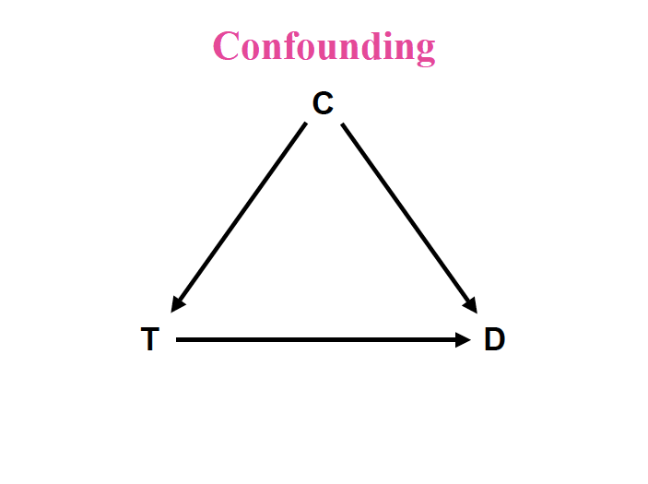

Slide 13
MULTIVARIABLE
ANALYSIS
Brand
Gene mutation
Family history

Slide 14
MULTIVARIABLE
ANALYSIS
Brand
Gene mutation
Family history
?
??Unknown
??

Slide 15
MULTIVARIABLE
ANALYSIS
Brand
Gene mutation
Kogenate/Advate
Family history
?
??Unknown
??

Slide 16
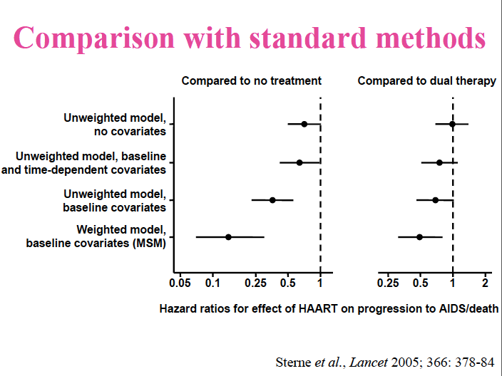
Marginal structural models
Assumption: no unmeasured confounders

Slide 17
Confounding
Most likely: selection by indication
Unbalanced risk of event at baseline
Surrogate marker: center effect
The effect of center is a proxy for what you cannot measure
it is constantly checked even in randomized trials
Methods exists for small centers
Center effect and “center size” effect ARE NOT the same
McGilchrist, CA et al. Regression with frailty in survival analysis. Biometrics, 1991 47, 461-6.
Hougaard, P. Frailty models for survival data. Lifetime Data Analysis, 1995, 1, 255-273.

Slide 18
Overview
Assessing causality: methodological notes
Appraising data on the concentrate dependent risk of inhibitors
Implications and perspectives
Notes:
Will introduce starting from 2, then 1 and 3

Slide 19
Evidence profiling
Study | CR | RD | RRI
RODIN | 28.2 | 9.0 | 31.9
UKHCDO | 23.8 | 11.3 | 47.4
France C | 30.0 | 15.0 | 50.0
Vezina | 36.0 | 6.0 | 16.7
EUHASS | 26.2 | 4.5 | 17.2
EAHAD IPD | 40.0 | 6.6 | 16.5
Notes:
RODIN: you comment on the different objective of the study upfront; the non inclusion of the significant variable in the blood analysis
Advate: 42/172 24.4
Kogenate: 45/128 35.2
Refacto: 15/44 34%
RODIN (33/88 (37.5%) vs 85/319 (26.7%), P=0.05.
Advate nR 29/114
Advate R 13/48
Kogenate nR 35/107
Kogenate R 10/21
There was a trend for the incidence of low titre inhibitors to increase and for high titre inhibitors to decrease with time. Between 2000 and 2006, there were 25 low titre inhibitors in 205 PUPs (12.2%) compared with 33/202 (16.3%) during 2007-2013 (P=0.23). In 2000-2006 there were 37/205 high titre inhibitors (18.1%) compared with 23/202 (11.4%) in 2007-2013, (P=0.06).

Slide 20
Evidence profiling
Study | Design | Year, patients | CR % | RD % | interpretation | Contribution
RODIN | P, R, IC, MC | 2000-2010 340 (574) | 28.2 | 9.0 | Post hoc | Hypothesis generation
UKHCDO
France C
Vezina
EUHASS
EAHAD IPD
P = prospective; R = retrospective; IC – Inception cohort; MC = Multisite
Notes:
RODIN: you comment on the different objective of the study upfront; the non inclusion of the significant variable in the blood analysis
Advate: 42/172 24.4
Kogenate: 45/128 35.2
Refacto: 15/44 34%
RODIN (33/88 (37.5%) vs 85/319 (26.7%), P=0.05.
Advate nR 29/114
Advate R 13/48
Kogenate nR 35/107
Kogenate R 10/21
There was a trend for the incidence of low titre inhibitors to increase and for high titre inhibitors to decrease with time. Between 2000 and 2006, there were 25 low titre inhibitors in 205 PUPs (12.2%) compared with 33/202 (16.3%) during 2007-2013 (P=0.23). In 2000-2006 there were 37/205 high titre inhibitors (18.1%) compared with 23/202 (11.4%) in 2007-2013, (P=0.06).

Slide 21
Rodin
Non transparently reported
Not one single mention of interactions
Designed to explore class, explored brand
Discrepancy between NEJM and Blood
Center variation not explored
(or not reported)

Slide 22
RODIN study: inter-center variation
inhibitor rate
Center
Unpublished RODIN data - WFH Global Forum Research Meeting, Montreal 2013.

Slide 23
Center effect
inhibitor rate
Center
Simulated data based on RODIN: Iorio A, EAHAD Brussel, 2014.

Slide 24
Center effect
inhibitor rate
Center
Simulated data based on RODIN: Iorio A, EAHAD Brussel, 2014.

Slide 25
Center effect
26% vs 38%
inhibitor rate
Center
Simulated data based on RODIN: Iorio A, EAHAD Brussel, 2014.

Slide 26
Evidence profiling
Study | Design | Year, patients | CR % | RD % | interpretation | Contribution
RODIN | P, R, IC, MC | 2000-2010 340 (574) | 28.2 | 9.0 | Post hoc | Hypothesis generation
UKHCDO | R, IC, SC | 2000-2010 300 (407) | 23.8 | 11.3 | Time effect, B-DD f-VIII, RODIN effect | Generate alternative hypothesis
France C
Vezina
EUHASS
EAHAD IPD
P = prospective; R = retrospective; IC – Inception cohort; MC = Multisite, SC = single country
Notes:
RODIN: you comment on the different objective of the study upfront; the non inclusion of the significant variable in the blood analysis
Advate: 42/172 24.4
Kogenate: 45/128 35.2
Refacto: 15/44 34%
RODIN (33/88 (37.5%) vs 85/319 (26.7%), P=0.05.
Advate nR 29/114
Advate R 13/48
Kogenate nR 35/107
Kogenate R 10/21
There was a trend for the incidence of low titre inhibitors to increase and for high titre inhibitors to decrease with time. Between 2000 and 2006, there were 25 low titre inhibitors in 205 PUPs (12.2%) compared with 33/202 (16.3%) during 2007-2013 (P=0.23). In 2000-2006 there were 37/205 high titre inhibitors (18.1%) compared with 23/202 (11.4%) in 2007-2013, (P=0.06).

Slide 27
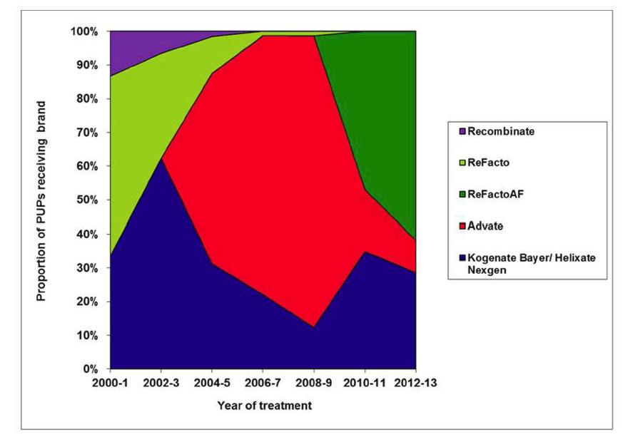
Proportion of recombinant FVIII used in UK PUPs by year
Collins et al, Blood 2014

Slide 28
UKHCDO cohort: effect of time and … RODIN?
Kogenate
Advate
RODIN = Dashed
Not RODIN = Solid
Advate 3/12 | 26/117 | 13/43
Kogenate 24/65 | 16/31 | 5/32
Notes:
Also comment that many patients when to Refacto, and got inhbitors

Slide 29
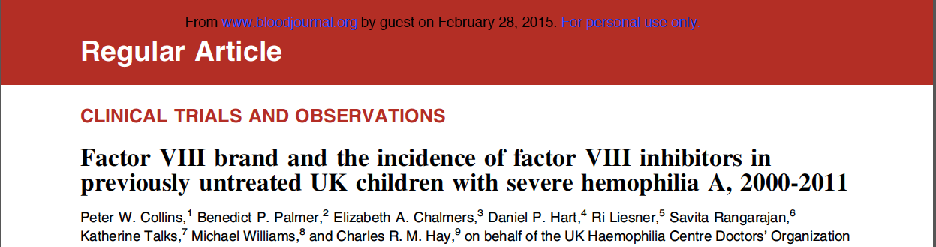
Kogenate AND Refacto
RODIN effect:
Significant more intensive treatment (p =.02)
HR (All): 1.75 → 1.82;
HR (HR): 2.14 → 2.36;
27 centers > 1 inhibitor (2-3)
Time instead of ED

Slide 30
Evidence profiling
Study | Design | Year, patients | CR | RD | interpretation | Contribution
RODIN | P, R, IC, MC | 2000-2010 340 (574) | 28.2 | 9.0 | Post hoc | Hypothesis generation
UKHCDO | R, IC, SC | 2000-2010 300 (407) | 23.8 | 11.3 | Time effect, B-DD f-VIII, RODIN effect | Generate alternative hypothesis
France C | R, IC, SC | 2000-2010 234 (303) | 30.0 | 15.0 | Strong “center” effect RODIN effect ?? | Generate a second alternative hypothesis
Vezina
EUHASS
EAHAD IPD
P = prospective; R = registry; MC = multiple centers/countries, IC = inception cohort, SC = single country
Notes:
RODIN: you comment on the different objective of the study upfront; the non inclusion of the significant variable in the blood analysis
Advate: 42/172 24.4
Kogenate: 45/128 35.2
Refacto: 15/44 34%
RODIN (33/88 (37.5%) vs 85/319 (26.7%), P=0.05.
Advate nR 29/114
Advate R 13/48
Kogenate nR 35/107
Kogenate R 10/21
There was a trend for the incidence of low titre inhibitors to increase and for high titre inhibitors to decrease with time. Between 2000 and 2006, there were 25 low titre inhibitors in 205 PUPs (12.2%) compared with 33/202 (16.3%) during 2007-2013 (P=0.23). In 2000-2006 there were 37/205 high titre inhibitors (18.1%) compared with 23/202 (11.4%) in 2007-2013, (P=0.06).

Slide 31
Kreuz W, Gill JC, Rothchild C et al.
Thrombosis and Haemostasis 2005; 93:457-467
15% inhibitor rate with Kogenate (1997-2001)
Notes:
741 boys with severe HA born between 1991 and 2013 were recruited to the FranceCoag Network by 37 HTCs. The PUP cohort criteria were met by 492 of these boys, 52 (17.6%) of those born in 1991-1999 (n=296), and 440 (98.9%) of those born in 2000-2013 (n=445). Among these 492 eligible patients, 189 were excluded from the analyses: 12 had not started treatment at the last clinical visit; 110 received pdFVIII at the first infusion; 17 had insufficient data for the first EDs; and 50 also participated in the RODIN study. No patients were excluded because of their follow-up in a particular HTC. Finally, 303 patients followed in 33 HTCs were observed until ED75 and were included in the analyses (Figure 1).
Accounting for centre-effects
marginal (or population averaged) approach
conditional (or centre specific) approach.
Kahan, B. C. (2014). Accounting for centre-effects in multicentre trials with a binary outcome – when , why , and how ? BMC Medical Research Methodology, 14(1), 1–11.
Split in three slides to interrogate point by point
alfonso

Slide 32
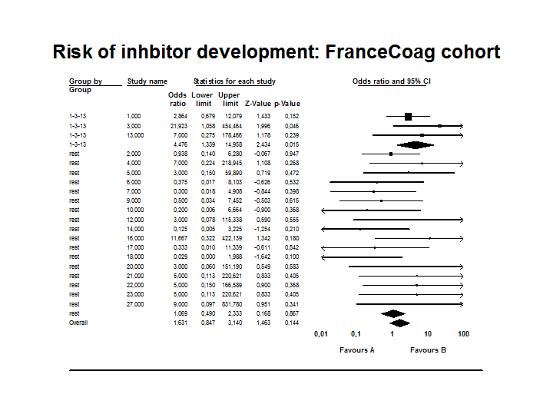
HR 1.61 (1.01 – 2.56) p = 0.046
OR 1.93 (1.12 – 3.32) p = 0.018
OR 1.63 (0.85 – 3.14) p = 0.144

Slide 33
Missed opportunity: RODIN data not reported
Center size effect, not center effect
Calendar period and prophylaxis associated with factor received
Interactions not explored

Slide 34
Evidence profiling
Study | Design | Year, patients | CR | RD | interpretation | Contribution
RODIN | P, R, IC, MC | 2000-2010 340 (574) | 28.2 | 9.0 | Post hoc | Hypothesis generation
UKHCDO | R, IC, SC | 2000-2010 300 (407) | 23.8 | 11.3 | Time effect, B-DD f-VIII, RODIN effect | Generate alternative hypothesis
France C | R, IC, SC | 2000-2010 234 (303) | 30.0 | 15.0 | Strong “center” effect RODIN effect ?? | Generate a second alternative hypothesis
Vezina | S, SC | 2005-2010 86 (99) | 36.0 | 6.0 | Higher rate with Advate | You cannot “export” results?
EUHASS
EAHAD IPD
P = prospective; R = registry; MC = multiple centers/countries, IC = inception cohort, SC = single country; S = survey
Notes:
RODIN: you comment on the different objective of the study upfront; the non inclusion of the significant variable in the blood analysis
Advate: 42/172 24.4
Kogenate: 45/128 35.2
Refacto: 15/44 34%
RODIN (33/88 (37.5%) vs 85/319 (26.7%), P=0.05.
Advate nR 29/114
Advate R 13/48
Kogenate nR 35/107
Kogenate R 10/21
There was a trend for the incidence of low titre inhibitors to increase and for high titre inhibitors to decrease with time. Between 2000 and 2006, there were 25 low titre inhibitors in 205 PUPs (12.2%) compared with 33/202 (16.3%) during 2007-2013 (P=0.23). In 2000-2006 there were 37/205 high titre inhibitors (18.1%) compared with 23/202 (11.4%) in 2007-2013, (P=0.06).

Slide 35
Evidence profiling
Study | Design | Year, patients | CR | RD | interpretation | Contribution
RODIN | P, R, IC, MC | 2000-2010 340 (574) | 28.2 | 9.0 | Post hoc | Hypothesis generation
UKHCDO | R, IC, SC | 2000-2010 300 (407) | 23.8 | 11.3 | Time effect, B-DD f-VIII, RODIN effect | Generate alternative hypothesis
France C | R, IC, SC | 2000-2010 234 (303) | 30.0 | 15.0 | Strong “center” effect RODIN effect ?? | Generate a second alternative hypothesis
Vezina | S, SC | 2005-2010 86 (99) | 36.0 | 6.0 | Higher rate with Advate | You cannot “export” results?
EUHASS | P, DC, MC | 2009-2013 284 (417) | 26.2 | 4.5 | RODIN effect | Non-confirmatory
EAHAD IPD
P = prospective; R = registry; MC = multiple centers/countries, IC = inception cohort, SC = single country; S = survey; DC = dynamic cohort;
Notes:
RODIN: you comment on the different objective of the study upfront; the non inclusion of the significant variable in the blood analysis
Advate: 42/172 24.4
Kogenate: 45/128 35.2
Refacto: 15/44 34%
RODIN (33/88 (37.5%) vs 85/319 (26.7%), P=0.05.
Advate nR 29/114
Advate R 13/48
Kogenate nR 35/107
Kogenate R 10/21
There was a trend for the incidence of low titre inhibitors to increase and for high titre inhibitors to decrease with time. Between 2000 and 2006, there were 25 low titre inhibitors in 205 PUPs (12.2%) compared with 33/202 (16.3%) during 2007-2013 (P=0.23). In 2000-2006 there were 37/205 high titre inhibitors (18.1%) compared with 23/202 (11.4%) in 2007-2013, (P=0.06).

Slide 36
 | EUHASS |  |  | EUHASS -RODIN
 | P | 95% CI |  | P | 95% CI
Plasma D | 0.22 | 0.11 | 0.35 | 0.21 | 0.10 | 0.37
Recomb | 0.26 | 0.22 | 0.31 | 0.24 | 0.19 | 0.29
Advate | 0.26 | 0.19 | 0.34 | 0.26 | 0.18 | 0.36
Helixate | 0.32 | 0.18 | 0.50 | 0.33 | 0.18 | 0.52
Kogenate | 0.30 | 0.22 | 0.40 | 0.22 | 0.13 | 0.34
Refacto | 0.29 | 0.17 | 0.43 | 0.27 | 0.15 | 0.43
Relative risk, Kogenate vs Advate
All centers (57)
1.17 (CI 0.81–1.70)
RODIN centers (18)
1.67 (CI 0.95–2.95)
Non RODIN (39)
0.99 (CI 0.62–1.61)

Slide 37
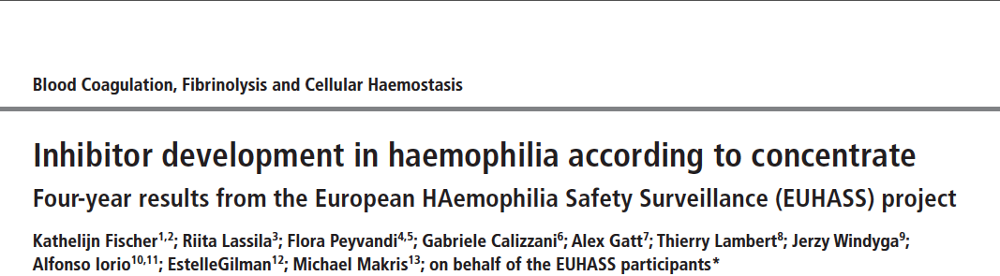
4 years to get power to distinguish 26/38
Center size: median 75 severe (IQR 34-131)

Slide 38
Evidence profiling
Study | Design | Year, patients | CR | RD | interpretation | Contribution
RODIN | P, R, IC, MC | 2000-2010 340 (574) | 28.2 | 9.0 | Post hoc | Hypothesis generation
UKHCDO | R, IC, SC | 2000-2010 300 (407) | 23.8 | 11.3 | Time effect, B-DD f-VIII, RODIN effect | Generate alternative hypothesis
France C | R, IC, SC | 2000-2010 234 (303) | 30.0 | 15.0 | Strong “center” effect RODIN effect ?? | Generate a second alternative hypothesis
Vezina | S, SC | 2005-2010 86 (99) | 36.0 | 6.0 | Higher rate with Advate | You cannot “export” results?
EUHASS | P, DC, MC | 2009-2013 284 (417) | 26.2 | 4.5 | RODIN effect | Non-confirmatory
EAHAD IPD | MA, MC | 1994-2003 80 (761) | 40.0 | 6.6 | Any of the previous | Non confirmatory Direction of effect Inconsistency
P = prospective; R = registry; MC = multiple centers/countries, IC = inception cohort, SC = single country; S = survey; DC = dynamic cohort;
Notes:
RODIN: you comment on the different objective of the study upfront; the non inclusion of the significant variable in the blood analysis
Advate: 42/172 24.4
Kogenate: 45/128 35.2
Refacto: 15/44 34%
RODIN (33/88 (37.5%) vs 85/319 (26.7%), P=0.05.
Advate nR 29/114
Advate R 13/48
Kogenate nR 35/107
Kogenate R 10/21
There was a trend for the incidence of low titre inhibitors to increase and for high titre inhibitors to decrease with time. Between 2000 and 2006, there were 25 low titre inhibitors in 205 PUPs (12.2%) compared with 33/202 (16.3%) during 2007-2013 (P=0.23). In 2000-2006 there were 37/205 high titre inhibitors (18.1%) compared with 23/202 (11.4%) in 2007-2013, (P=0.06).

Slide 39
CART ANALYSIS

Slide 41
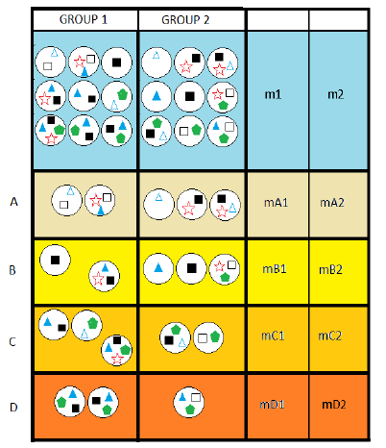
Matching on Propensity Score
Notes:
Reduced the waste of degree of freedom – increases power

Slide 42
Intensity and intensity*treatment interaction
AUC for full Cox model 0.802
Single analysis using
propensity score
CART (Zhang, Stat Med 1996;15;37-49)

Slide 43
Conclusions (part – II)
Products availability varied over time in the 3 studies
No difference in 2009-2013 in UKHCDO study
Higher inhibitor rates in RODIN centres
Higher rate for Refacto AF (Xyntha) in UK study
In FranceCoag 3 centres account for all the difference
EPIC: “safer” regimen with Advate → much higher rate
More recent and broader EUHASS data: discordant results
Deeper analysis in IPD-MA EAHAD: ranking of risks

Slide 44
Overview
Assessing causality: methodological notes
Appraising data on the concentrate dependent risk of inhibitors
Implications and perspectives
Notes:
Will introduce starting from 2, then 1 and 3

Slide 45
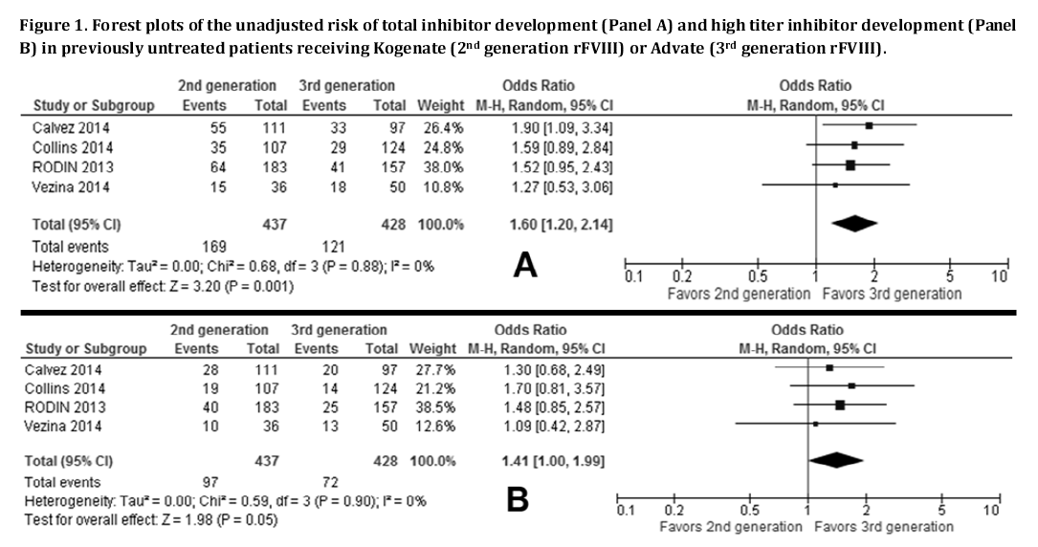
Systematic review and meta-analysis?
Analysis of non-overlapping centers does NOT CONFIRM
but rather SUGGESTS CONFOUNDING in the RODIN results
Notes:
Solution 2: a meta-analysis
Aggregate data: useless
IPD: useless, unless maybe an independent brand new analysis
Principal determinant / Cluster analysis / CART of a specific subset of patients
Exposure balanced
Enrolled after 2004
Enrolled in centers who used similar proportion of kogenate and advate or enrolled only one patient

Slide 46
Randomized controlled trial
. stpower logrank 0.43 0.26, onesided
Estimated sample sizes for two-sample
comparison of survivor functions
Log-rank test, Freedman method
Ho: S1(t) = S2(t)
Input parameters:
alpha = 0.0500 (one sided)
s1 = 0.4300
s2 = 0.2600
hratio = 1.5961
power = 0.8000
p1 = 0.5000
Estimated number of events and sample sizes:
E = 118
N = 180
N1 = 90
N2 = 90
Objective: ruling out OR 1.6
Sample size requirements?

Slide 47
New study designs
Randomized registry trial
Lauer & D’Agostino NEJM 2013;369(17), 1579–81.
Interrupted time series
Ramsay, C. R. et al. Int J Technol Assess Health Care, 2003;19(4), 613–23.
Paired availability design
Baker, S. G. et al. BMC Med Res Method, 2001;1, 9.

Slide 48
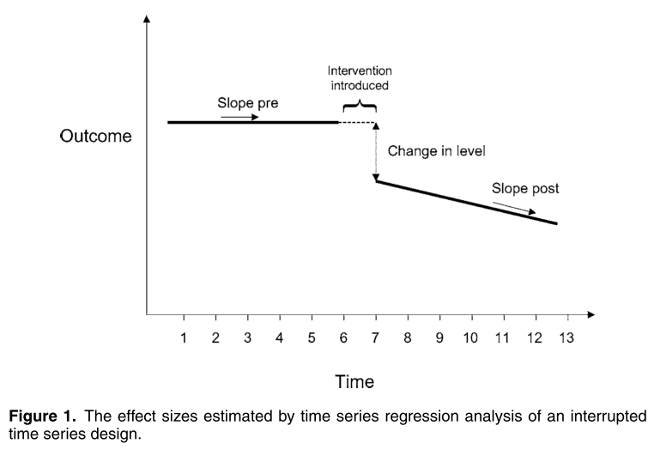

Slide 49
Paired availability
Requirement | Criteria
Stable population | Single hospital serves the area No in- out- migration Constant eligibility criteria No change in prognosis
Stable treatment | 1. Rest of management stable
Stable evaluation | 1. No change in criteria
Stable preference | No publicized credible report No direct-to-consumer advertising
Stable treatment effect | Intervention effect independent on disease stage No learning curve required

Slide 50
Implications
If we accept RODIN results we have to:
Consider extensive testing in at least 150 PUPs for 50 ED before “feeling” safe
Consider implications for PTPs

Slide 51
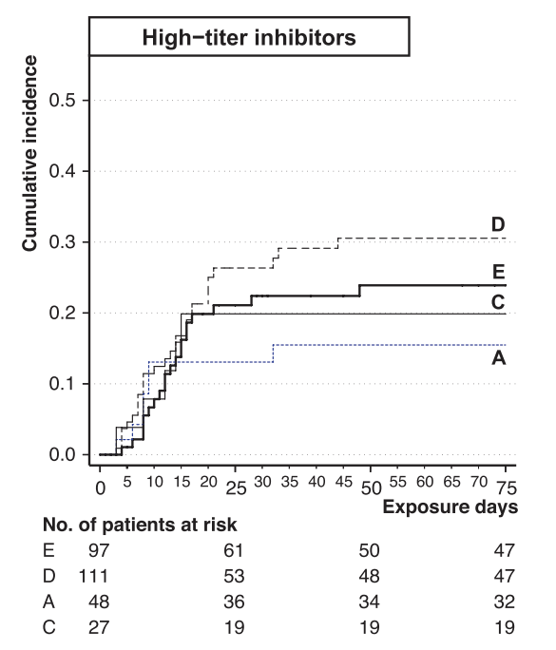
EUHASS – PTPs
Advate 0.11 (0.03 – 0.25)
Kogenate 0.17 (0.06 - 0.37)
OR = 1.54 (0.24 – 12)
Xi, PTP meta-analysis
Advate 0.10 (0.05 – 0.18)
Kogenate 0.26 (0.16 - 0.44)
Kogenate 0.11 (0.05 - 0.23)
OR = 2.6 (0.88 – 8.8)
Kogenate
Advate
Aledort BDD meta-analysis
Kogenate vs Advate
High titer
HR = 1.75 (0.05 – 65.5)
All inhibitors
HR, 2.43 (0.31–19.2)

Slide 52
Conclusion
Evidence for confounding increases study after study
Pooled analysis warranted only if
Completely different approach (CART)
Serious approach to confounding (propensity, interactions)
Either we accept to:
adopt better methods (RCT) for prospective assessment or
adapt to live with some uncertainty

Slide 53
Disclosures for Alfonso Iorio as a treater
In compliance with COI policy the following disclosures are provided to the session audience:
PUPs | Since I have alternatives, I don’t chose kogenate
PUPs | If requested by the family, I use kogenate
PUPs | If I had only Kogenate, I would certainly use it
PTPs | I don’t switch PTPs to kogenate
PTPs | I don’t actively switch PTPs away from kogenate
PTPs | If the patient fears inhibitors, I do switch him away
I practice in a North American setting where lawyers enjoy reading NEJM and Blood

