Slide 1
Assessing Innovation as Part of Stakeholder Communications
2018 Global Haemophilia Advocacy Leadership
Budapest, Hungary
22 January 2018
Learning from the coreHEM project
Alfonso Iorio, MD, PhD
Hamilton, ON, Canada

Slide 2
Disclosures
Alfonso Iorio’s Institution (McMaster)
has received project based funding via
research or service agreements from
Bayer
Grifols
NovoNordisk
Octapharma
Roche
Pfizer

Slide 3
Menu
The life cycle of an (innovative) treatment
Why we need convincing proofs of efficacy and safety?
The challenges of a rare disease setting
For the researcher
For the regulator
For the payer
The knowledge gap (we need to fill)
Health technology assessment
(Pharmaco)economical considerations
coreHEM – raising advocacy to the next level

Slide 4
Menu
The life cycle of an (innovative) treatment
Why we need convincing proofs of efficacy and safety?
The challenges of a rare disease setting
For the researcher
For the regulator
For the payer
The knowledge gap (we need to fill)
Health technology assessment
(Pharmaco)economical considerations
coreHEM – raising advocacy to the next level

Slide 5
Life cycle of a new treatment
Research & Development
Early clinical testing
Regulatory approval
Health Technology Assessment
Market Access
Late clinical testing

Slide 6
Life cycle of a new treatment
Research & Development
Early clinical testing
Regulatory approval
Health Technology Assessment
Market Access
Late clinical testing
Research steps: mostly pharma sponsored
(R&D and Clinical Operation of drug manufacturers)
Varies by country, different agencies and processes

Slide 7
Life cycle of a new treatment
Research & Development
Early clinical testing
Regulatory approval
Health Technology Assessment
Market Access
Late clinical testing
Regulators (FDA, EMA) offers guidance to applicants.
More and more often research protocols are discussed beforehand with regulators

Slide 8
Life cycle of a new treatment
Research & Development
Early clinical testing
Regulatory approval
Health Technology Assessment
Market Access
Late clinical testing
Maybe time consuming
Evolving peculiarities

Slide 9
July-August 2017

Slide 10
The outcome matrix
Stuyd/Outcome | Outcome 1 | Outcome 2 | Outcome 3 | Outcome 4
Study 1 | X
Study 2 | X |  | X
Study 3 | X
Study 4 |  | X
Study 5 |  |  |  | X
Kirkham JJ, Dwan KM, Altman DG, Gamble C, Dodd S, Smyth R, Williamson PR: The impact of outcome reporting bias in randomised controlled trials on a cohort of systematic reviews. BMJ 2010, 340:c365

Slide 11
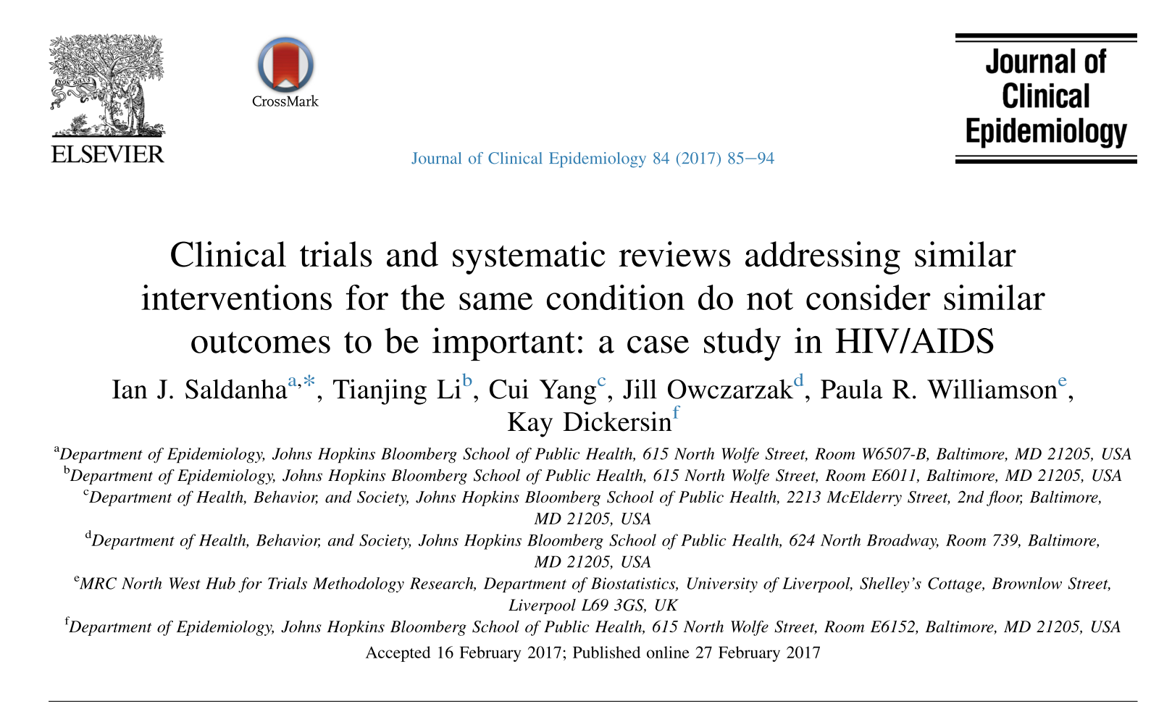
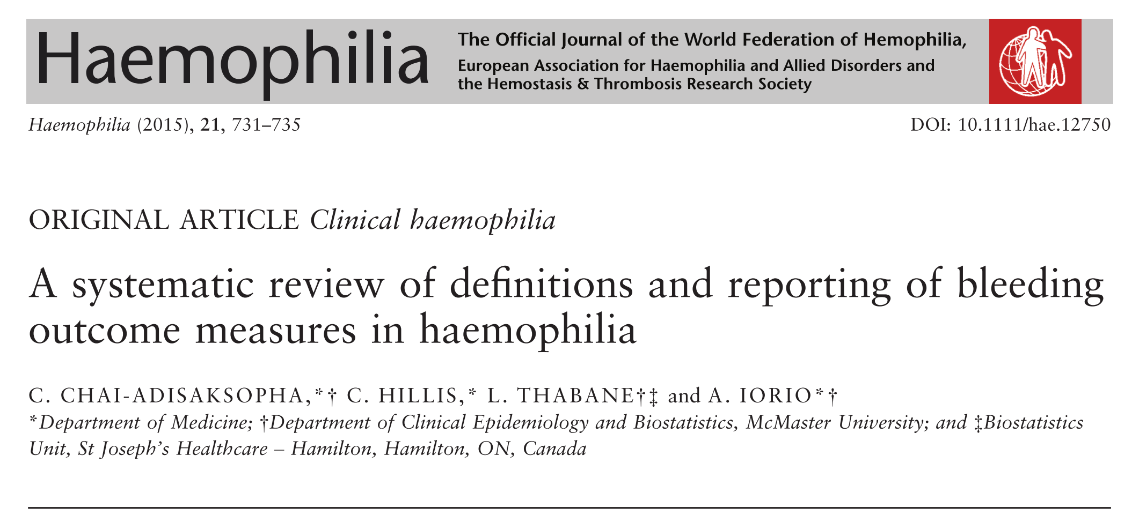
The COMET framework

Slide 12
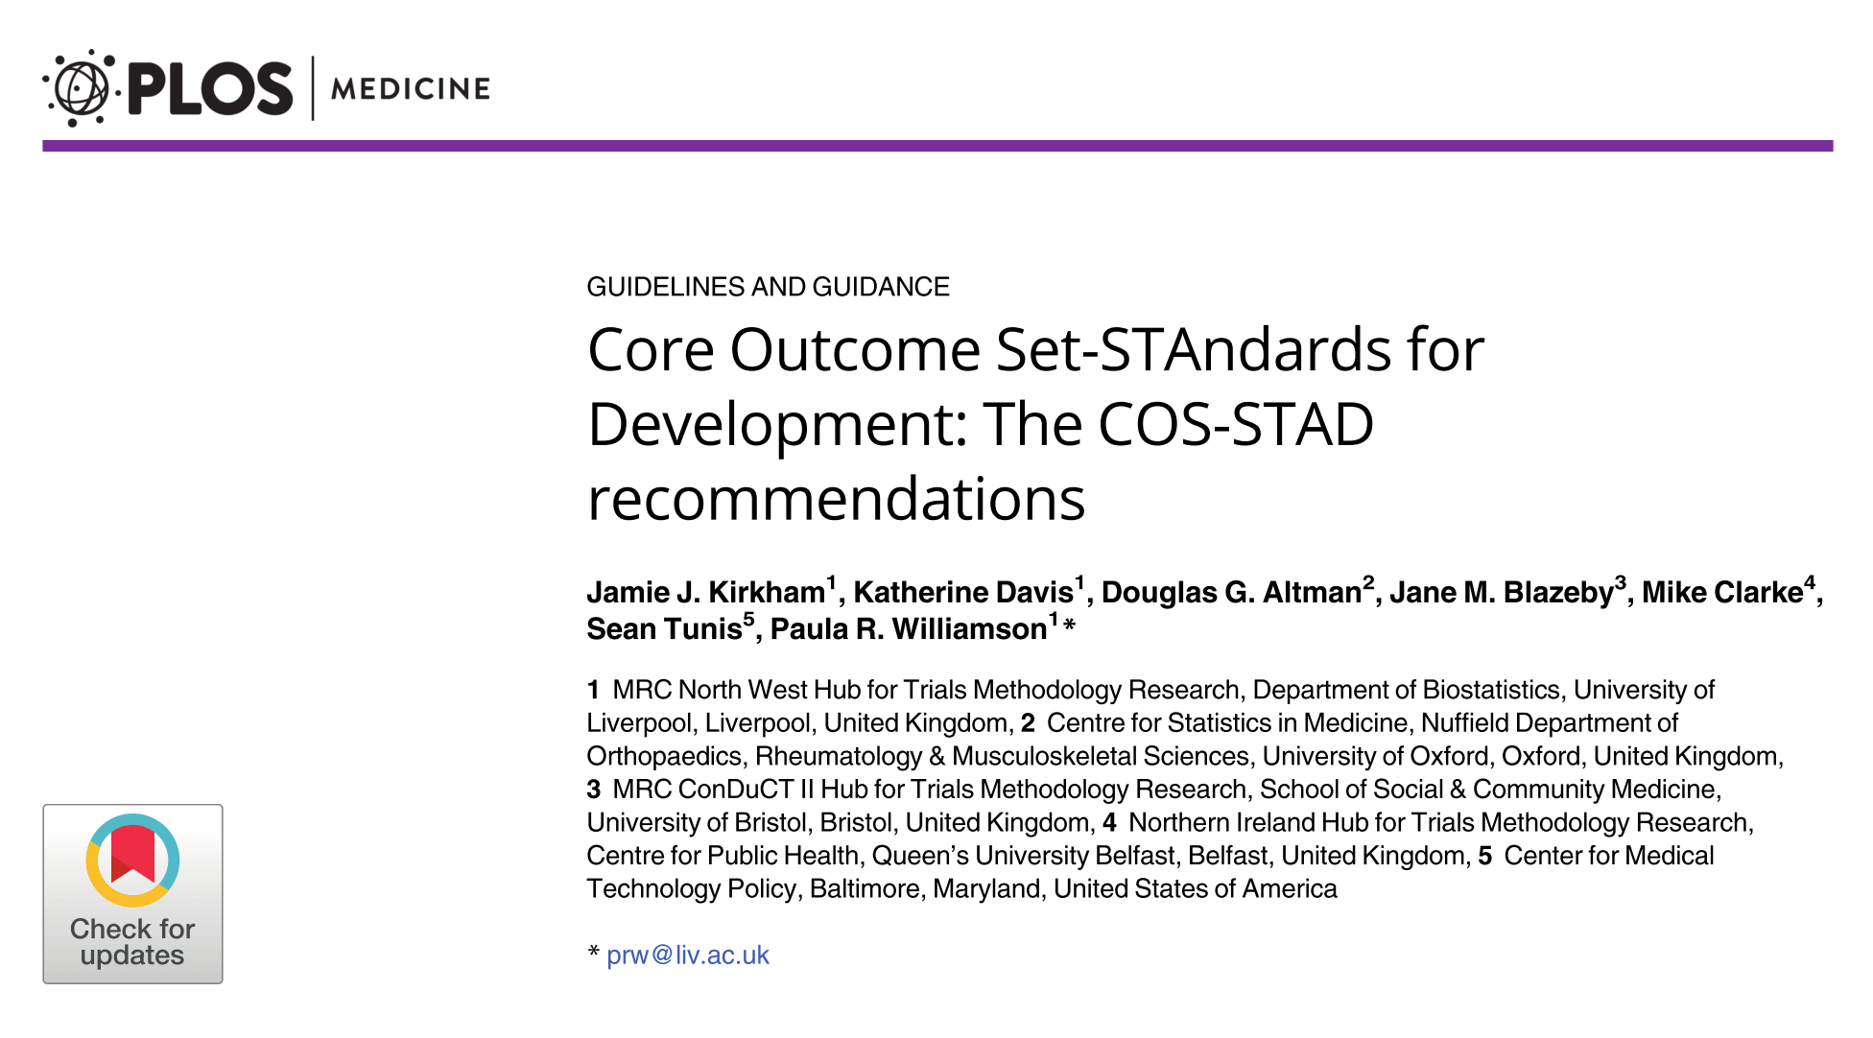

Slide 13
COS-STAD standards
Domain | Standard | Methodology
Scope | 1 | The research or practice setting(s) in which the COS is to be applied
 | 2 | The health condition(s) covered by the COS
 | 3 | The population(s) covered by the COS
 | 4 | The intervention(s) covered by the COS
Stakeholders | 5 | Those who will use the COS in research
 | 6 | Healthcare professionals with experience of patients with the condition
 | 7 | Patients with the condition or their representatives
Consensus | 8 | The initial list of outcomes considered both HC professionals’ and patients’ views.
 | 9 | A scoring process and consensus definition were described a priori.
 | 10 | Criteria for including/dropping/adding outcomes were described a priori.
 | 11 | Care was taken to avoid ambiguity of language used in the list of outcomes.
Kirkham JJ et al. PLOS Med 2017; 14: e1002447.

Slide 14
COS-STAD standards
Domain | Standard | Methodology
Scope | 1 | The research or practice setting(s) in which the COS is to be applied
 | 2 | The health condition(s) covered by the COS
 | 3 | The population(s) covered by the COS
 | 4 | The intervention(s) covered by the COS
Stakeholders | 5 | Those who will use the COS in research
 | 6 | Healthcare professionals with experience of patients with the condition
 | 7 | Patients with the condition or their representatives
Consensus | 8 | The initial list of outcomes considered both HC professionals’ and patients’ views.
 | 9 | A scoring process and consensus definition were described a priori.
 | 10 | Criteria for including/dropping/adding outcomes were described a priori.
 | 11 | Care was taken to avoid ambiguity of language used in the list of outcomes.
Kirkham JJ et al. PLOS Med 2017; 14: e1002447.

Slide 15
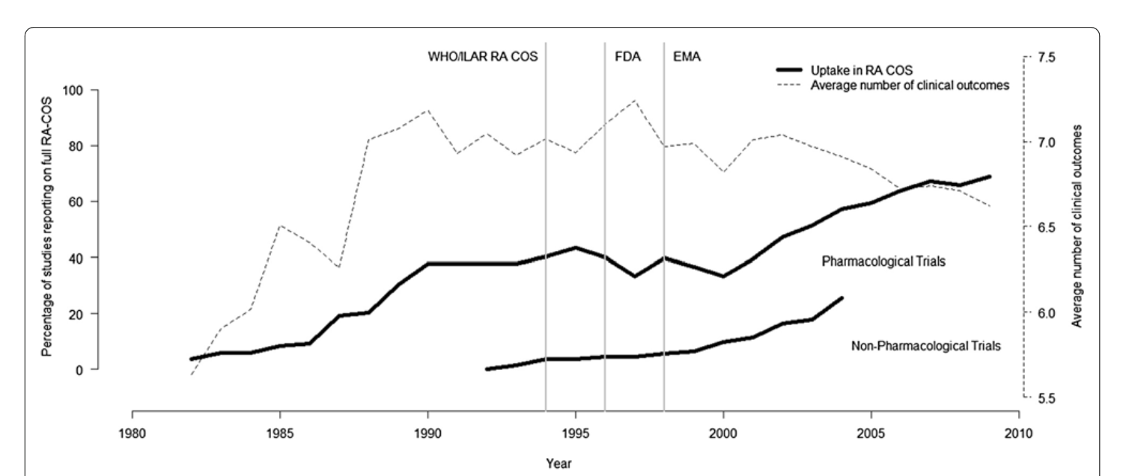
Kirkham JJ, Boers M, Tugwell P, et al. Outcome measures in rheumatoid arthritis randomised trials over the last 50 years. Trials 2013; 14: 324.s

Slide 16
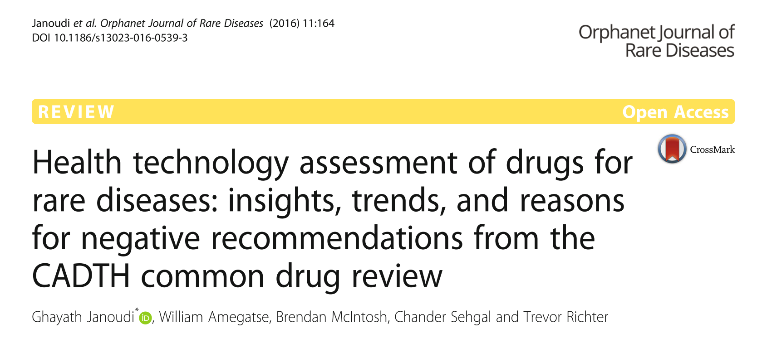

Slide 17
HTAi in Canada for rare disease
From 2004 to 2015
63 of 434 submissions to the CDR were for DRD
Most (74.6%) included at least one double-blind RCT.
The average study size was 190 pts (range: 20 to 742).
The average annual treatment cost was C$215,631
(range to $940,084).
Janoudi G, Orphanet J Rare Dis Orphanet Journal of Rare Diseases; 2016; 11: 164.

Slide 18
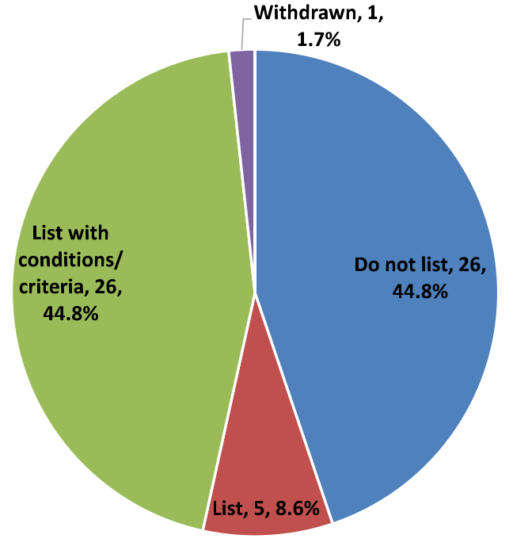
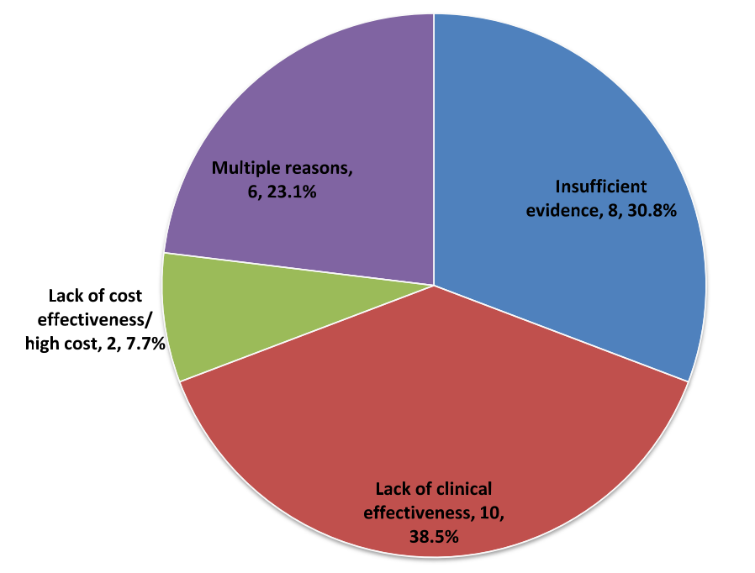
Recommendation
Reason
Mixed
No evidence
No
Cost
Yes, but
No effect
Yes
Janoudi G, Orphanet J Rare Dis Orphanet Journal of Rare Diseases; 2016; 11: 164.

Slide 19
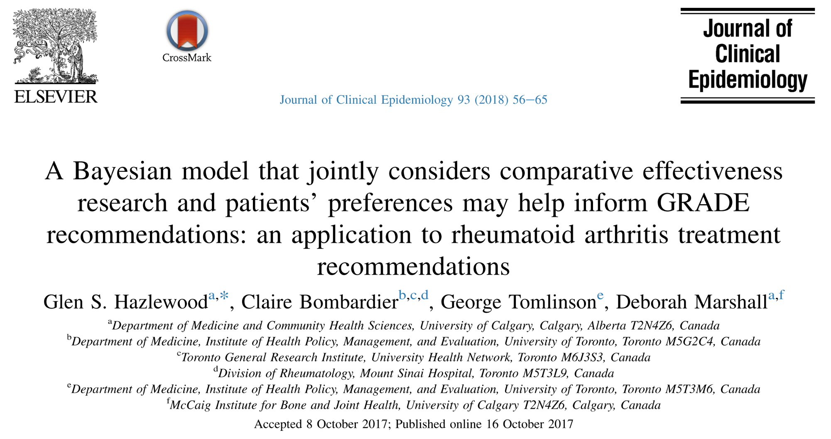

Slide 20
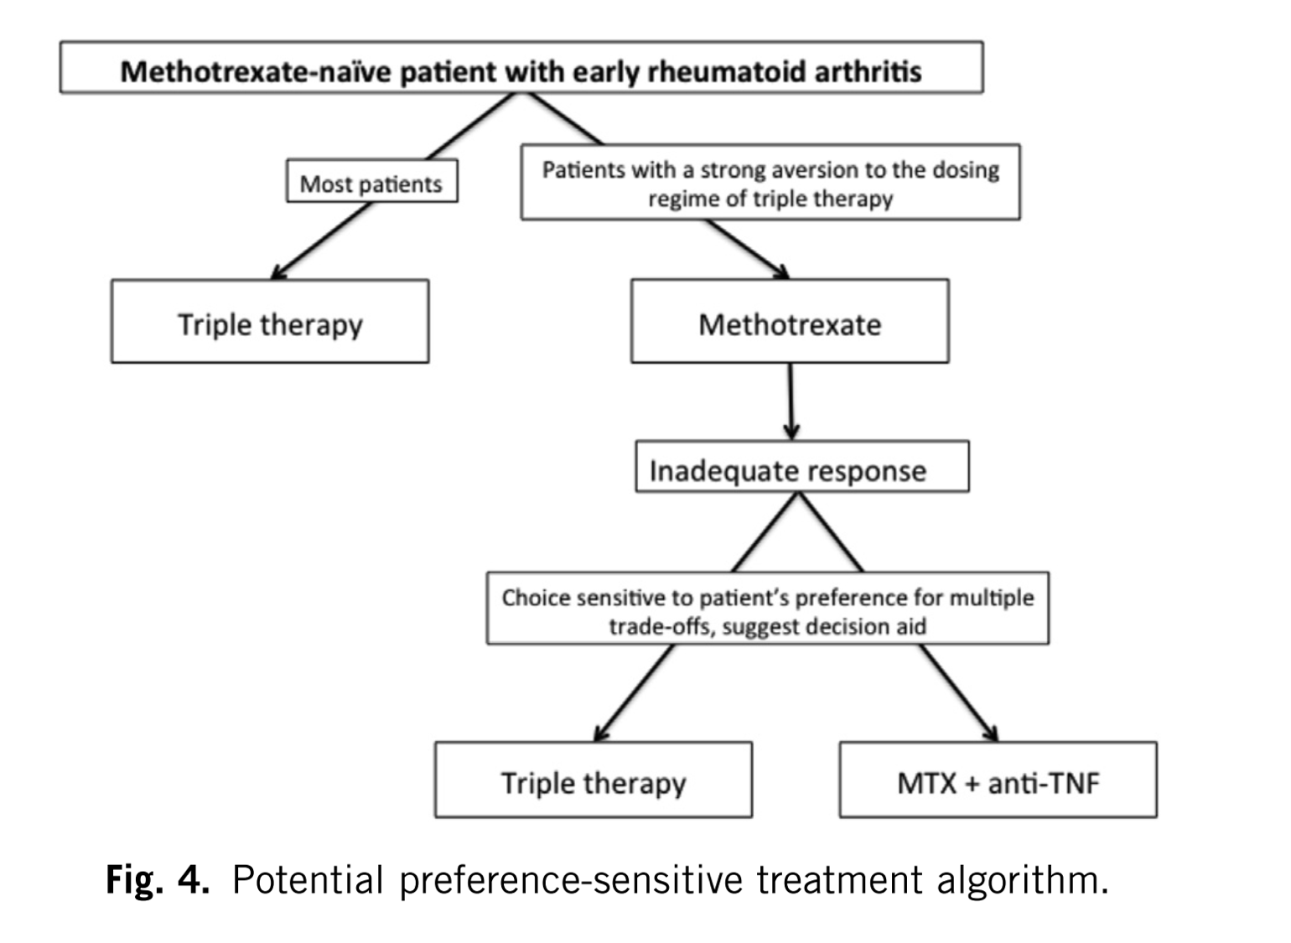
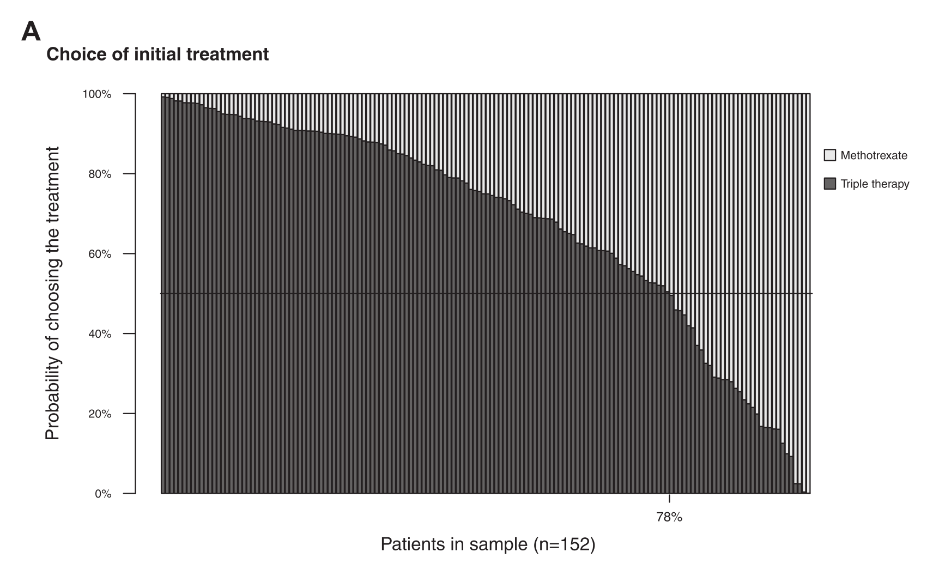
Notes:
DCE with efficacy results out of a NMA

Slide 21
When Patients Write the Guidelines: Patient Panel Recommendations for the Treatment of Rheumatoid Arthritis.
Physician Dominated Panel |  | Patient Dominated Panel
Direction | Strength | Direction | Strength
In patient with severe disease, never exposed to DMARD, using 1 vs 2 DMARDs
Fraenkel L, Miller AS, Clayton K, et al. Arthritis Care Res 2016; 68: 26–35
Notes:
Fraenkel L, Miller AS, Clayton K, et al. Arthritis Care Res 2016; 68: 26–35.

Slide 22
When Patients Write the Guidelines: Patient Panel Recommendations for the Treatment of Rheumatoid Arthritis.
Physician Dominated Panel |  | Patient Dominated Panel
Direction | Strength | Direction | Strength
In patient with severe disease, never exposed to DMARD, using 1 vs 2 DMARDs
1 over 2 (majority) | Conditional (unanimous) | 1 over 2 (majority) | Strong (unanimous)
Fraenkel L, Miller AS, Clayton K, et al. Arthritis Care Res 2016; 68: 26–35
Notes:
Patients: no difference in efficacy, 1 is less cumbersome
Physicians: little difference in efficacy, maybe someone wants to avoid 2

Slide 23
When Patients Write the Guidelines: Patient Panel Recommendations for the Treatment of Rheumatoid Arthritis.
Physician Dominated Panel |  | Patient Dominated Panel
Direction | Strength | Direction | Strength
In patient with severe disease, never exposed to DMARD, using 1 vs 2 DMARDs
1 over 2 (majority) | Conditional (unanimous) | 1 over 2 (majority) | Strong (unanimous)
In patient with severe disease, never exposed to DMARD, using 1 vs 3 DMARDs
1 over 3 (unanimous) | Conditional (unanimous) | 3 over 1 (majority) | Conditional (majority)
Fraenkel L, Miller AS, Clayton K, et al. Arthritis Care Res 2016; 68: 26–35
Notes:
Patients: increase change in fast remission, no increase in toxicity – someone felt burdem, someone else felt will never know which one works
Physicians: increase toxicity (not in the evidence)

Slide 24
8

Slide 25
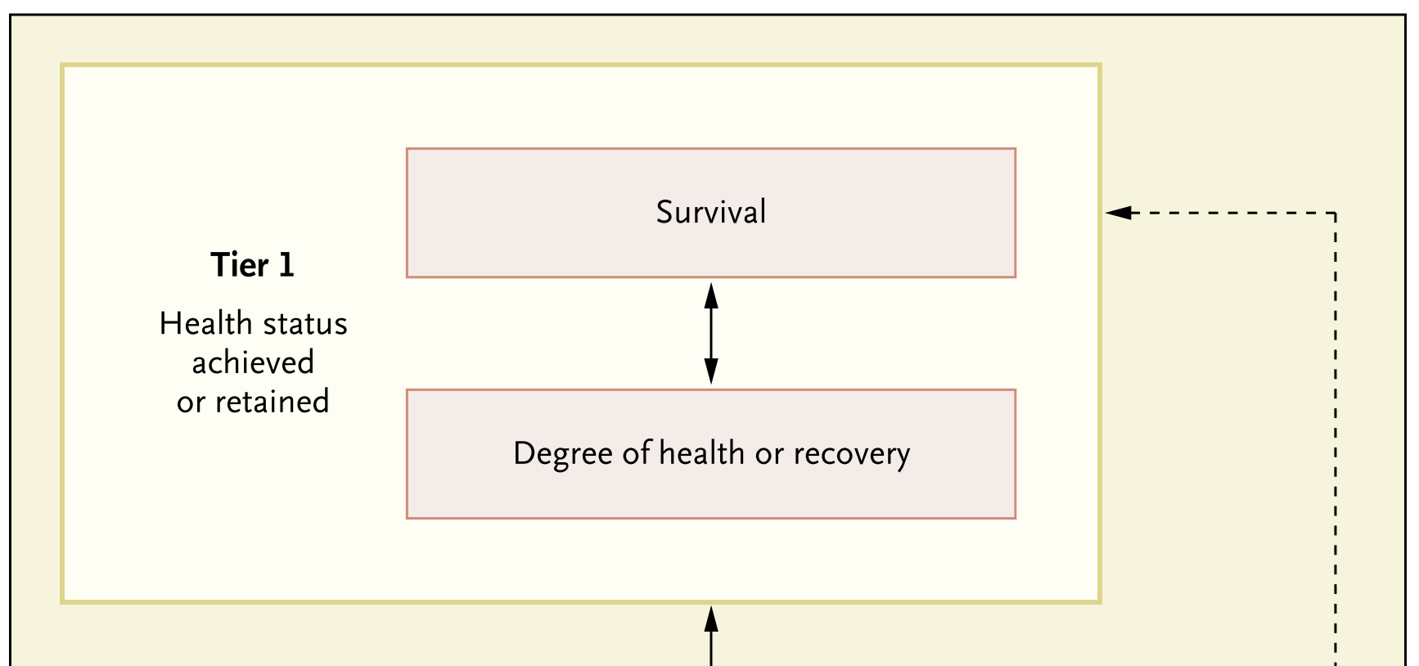
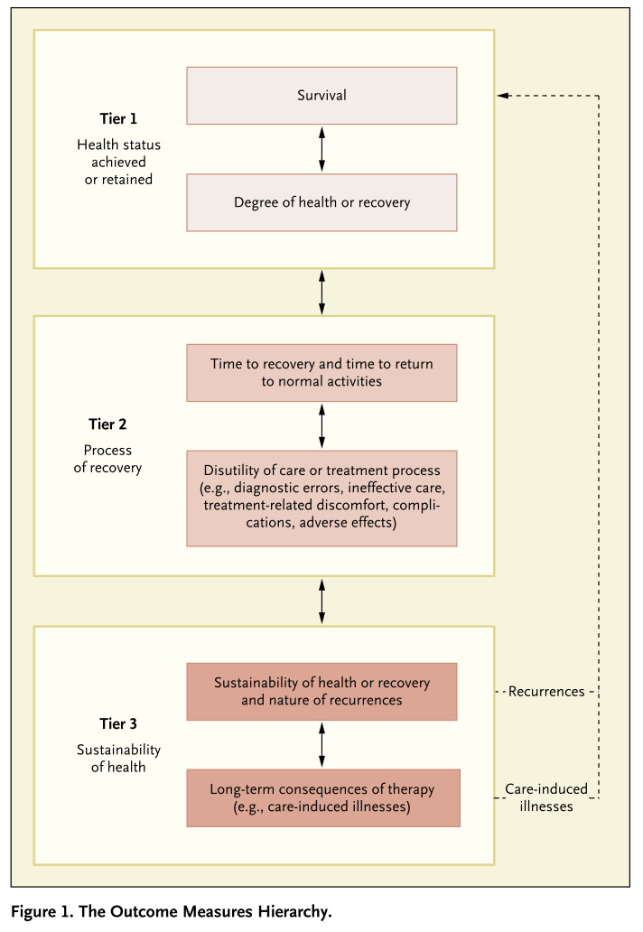
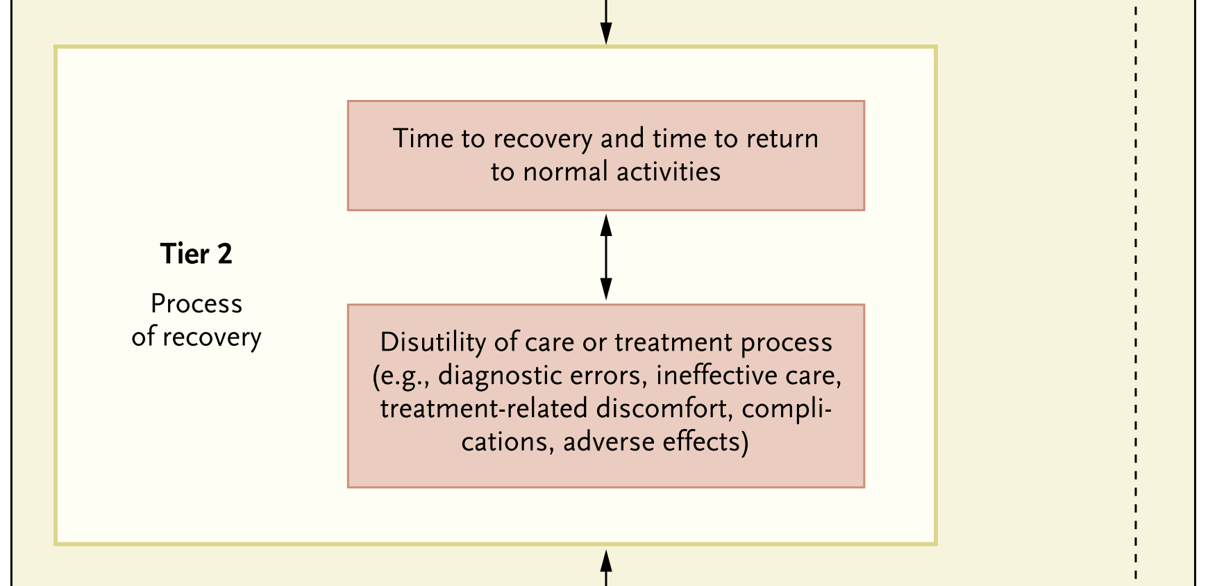
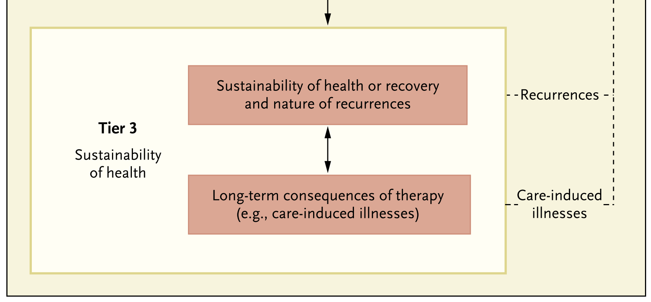
The Outcomes Measures Hierarchy
Porter NEJM 2010

Slide 26
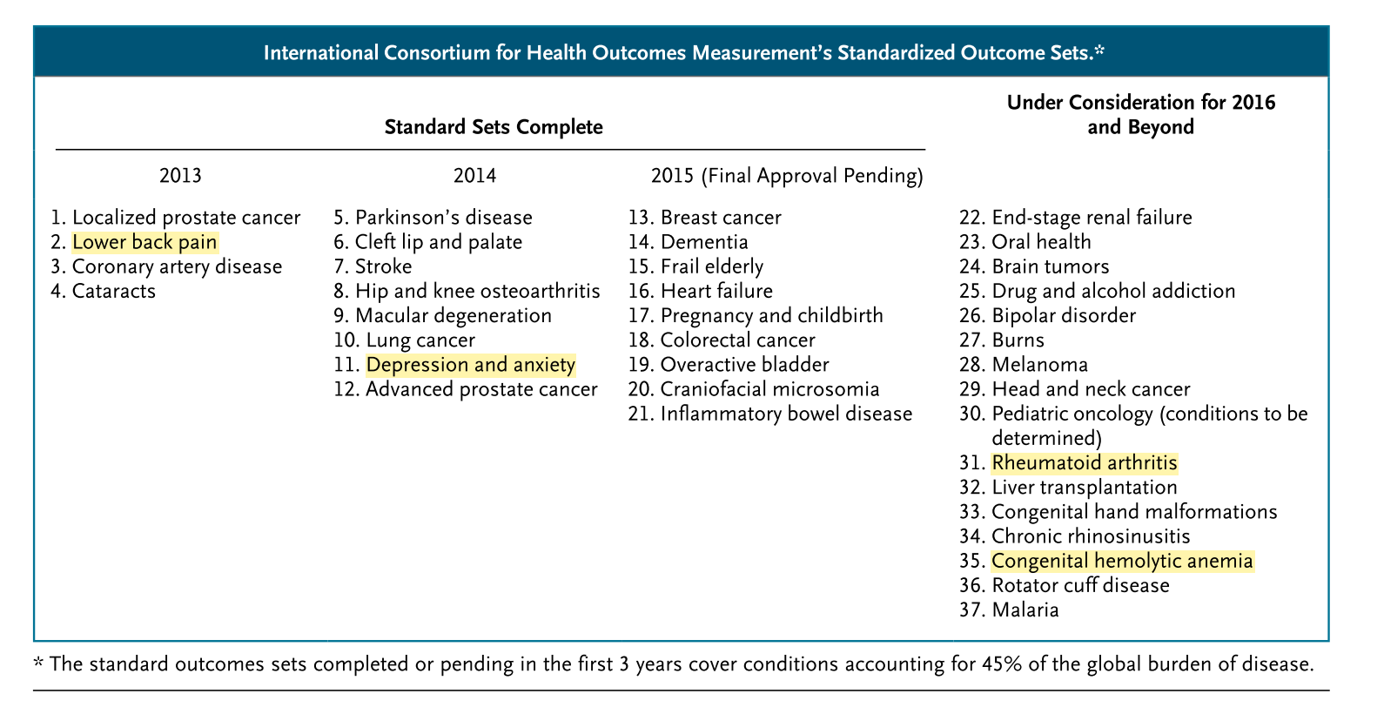
1. Porter ME, Larsson S, Lee TH. Standardizing Patient Outcomes Measurement. N Engl J Med 2016; 374: 504–6.

Slide 27
 | Key Findings | Evidence Favoring Prophylaxis over OD
Tier 1: Health Stat | Bleeding (frequency and severity), MSK complications, Pain, and interference | *No direct comparisons for survival, but ↓ Life-threatening/trauma-related bleeds³⁻⁷ ↓ Intracranial hemorrhage⁸ ↓ Annual bleed rate and joint bleeds²⁻⁷ ↓ Joint damage/target joint development^{2-4,11} _{↓ Pain}7,9,10
Tier 2: Recovery | recovery time, return to normal activities, orthopaedic interventions, inhibitor development, time missed | ↓ Missed activities and work/school days^{1,2} ↓ Recurrent or spontaneous bleeds^{5-7,9} ↓ Joint-related surgeries^{9,10} *No differences in inhibitor development^{2-5,7}; greater risk of infections from indwelling catheters with prophylaxis^{4,12}
Tier 3: Sustainability | Avoidance of breakthrough bleeds, joint preservation, Achievement of long term QOL | ↓ Annual bleed rate and joint bleeds²⁻⁷ ↓ Development of arthropathy^{3,4 /} Normal joint structure³ ?? Academic achievement scores¹³ ?? Physical/recreational activity levels ¹⁴ ?? HRQL ^{4,14} *Improvement in arthropathy not shown with secondary prophylaxis¹²; data on long-term consequences of therapy NA
Dolan G et al. Int J Technol Assess Health Care; 2017; 33: 8–9.
¹Noone et al. Haemophilia 2013;19:44; ²Tagliaferri et al. J Thromb Haemost 2015; 114:35; ³Manco-Johnson et al. NEJM 2007; 357:535; ⁴Gringeri et al. J Thromb.Haemost 2011; 9:700; ⁵Manco-Johnson et al. J Thromb Haemost 2013; 11:1119; ⁶Kavakli et al. J Thromb Haemost 2015; 13:360; ⁷Valentino et al. J Thromb Haemost 2012; 10:359; ⁸Witmer et al. BJH 2011; 152:211; ⁹Noone et al. . Haemophilia 2011; 17:e831; ¹⁰Pocoski et al. Haemophilia 2015; 21:14–94; ¹¹Aledort et al. J. Intern Med 1994; 236:391; ¹²Manco-Johnson. Haemophilia 2007; 13:4; ¹³Shapiro et al. Pediatrics 2001; 108:E105; ¹⁴Hong et al. Haemophilia 2014; 20:1–186.

Slide 28
coreHEM: the journey
From the HAAB, Amsterdam, Jan 1, 2017
To the World Trade Center, Nov 15, 2017

Slide 29
coreHEM
The overarching goal: facilitate and accelerate market access for gene therapy
Anticipated gaps:
Need to pay a large sum of money for a single “shot” treatment affecting one entire life
Capacity (particularly in settings without universal health care)
Willingness
Costing: what is the value we are willing to pay?

Slide 30
coreHEM
The approach: facilitate and accelerate a dialogue among all involved stakeholders
Dialogue around what?
The importance of the gene therapy
How you assess the importance of a treatment?
Measuring the critical effect it produces
The specific goal: agree upon which outcome we need to properly assess and establish the value of gene therapy
The methodological approach: COMET, COS-STAD, DELPHI

Slide 31
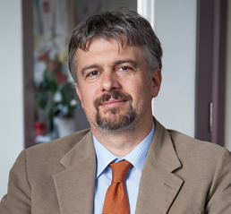
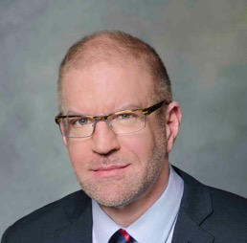
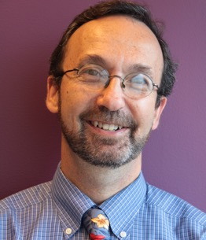
coreHEM: core organizations involved
Alfonso Iorio | McMaster University HiRU | Primary mission is to disseminate high-quality, high impact research Member and contributor of GRADE working group and the Cochrane Collaboration
Mark Skinner | Institute for Policy Advancement, Ltd. | National Hemophilia Foundation (NHF)
Sean Tunis | Center for Medical Technology Policy (CMTP) Green Park Collaborative (GPC) | Independent, non-profit 501(c)(3) organization that aims to make health care more effective and affordable by improving the quality, relevance, and efficiency of health care research
Notes:
Elizabeth to introduce PIs and give a moment for them to say hello and a few words about themselves
The Center for Medical Technology Policy (CMTP)
an independent, non-profit 501(c)(3) organization that aims to make health care more effective and affordable by improving the quality, relevance, and efficiency of health care research
committed to engaging all relevant stakeholders to improve research design, conduct, and communication; research infrastructure; and policy
Green Park Collaborative (GPC)
a major initiative of CMTP
multi-stakeholder forum to clarify evidence needs for “post-regulatory” decisions – patients, providers, payers
Create greater transparency for innovators of studies needed for demonstration of effectiveness and value to payers, HTA, guideline developers, health systems, etc.

Slide 32
Sponsors

Slide 33
Participant Structure
Project stakeholders: 40-50 participants balanced for expertise and knowledge; Delphi participants
Steering Committee: 6-8 project stakeholders broadly representative of the various stakeholder segments who will provide guidance on project approach
Project team: small group composed of CMTP staff, a representative from NHF, a representative from McMaster University, and 1-3 additional experts
Project Stakeholders
Steering Committee
Project Team
Voting member
Non-voting member

Slide 34
Steering Committee
Ron Akehurst, BSc (Econ), Hon MFPHM Professor of Health Economics, School of Health and Related Research (ScHARR) University of Sheffield | Mohit Jain, PhD, MBA Executive Director, Market Access EUMEA BioMarin
Ed Pezalla, MD, MPH, PhD Subject Matter Expert Formerly with Aetna | Glenn Pierce, MD, PhD Entrepreneur in Residence Third Rock Ventures
Leonard Valentino, MD, FAAP Strategy Lead, Hematology Spark Therapeutics | Michelle Witkop, DNP, FNP-BC Head of Research National Hemophilia Foundation (NFH)
Notes:
Since this is the first time we are meeting, I’d also like to take a few minutes for the members of the steering committee to get to know each other. We’ve tried to include one representative from the various stakeholder groups. We can follow along with the list and if you could just introduce yourself and say a little about your interest in this project

Slide 35
Stakeholders
US
payers
clinicians
patients/patient advocates
government
reps
methods and epidemiology experts
industry sponsor reps
international payers/HTA
academic gene therapy research reps

Slide 36
Stakeholders
US
payers
clinicians
patients/patient advocates
government
reps
methods and epidemiology experts
industry sponsor reps
international payers/HTA
academic gene therapy research reps
Notes:
I would transition from the previous to this one, explaining one objective of the process is to ensure everyone understands others needs and goals, outlining common goods more than differences

Slide 37
Panel participants: patients
Jamie O’Hara, MSc (HC Economics, Ltd and Haemophilia Society);
Brian O’Mahony, FACSLM, FIBMS (Irish Haemophilia Society, Ltd and European Haemophilia Consortium);
Gyasi Moscou-Jackson, PhD, MHS, RN (Patient-Centered Outcomes Research Institute, PCORI);
Alain Weill (World Federation of Hemophilia, WFH);
Michelle Rice (National Hemophilia Foundation, NHF)

Slide 38
Panel participants: experts
Samantha Gouw, MD, PhD (Academic Medical Center Amsterdam and Leiden University Medical Center);
Daniel Hart, MD, PhD (Barts and the London School of Medicine and Dentistry);
David Lillicrap, MD, FRCPC (Queen’s University);
Steven Pipe, MD (University of Michigan);
Philipp Dahm, MD, MHSc, FACS (University of Minnesota and Minneapolis VA Health Care System);
Peter Tugwell, MD (Center for Global Health, Ottawa)
Keith Hoots, MD (National Heart, Lung, and Blood Institute (NHLBI), National Institutes of Health (NIH));

Slide 39
Panel participants: regulators
Peter Marks, MD, PhD (US Food and Drug Administration, FDA);
Daniel Keene, MD, MA, FRCPC (Health Canada);
Anneliese Hilger, PhD (Paul-Ehrlich-Institute);
Sol Ruiz, PhD (Spanish Medicines Agency, AEMPS);

Slide 40
Panel participants: HTA
Karen Facey, PhD (University of Edinburgh); HTAi
Craig Hooper, PhD (National Center on Birth Defects and Developmental Disabilities (NCBDDD), Centers for Disease Control (CDC));
Joanne Kim, MSc, PhD (Canadian Agency for Drugs and Technology in Health (CADTH));
Amy Sood, PharmD (Canadian Agency for Drugs and Technology in Health (CADTH);
Marie Österberg, PhD (Swedish Council on Health Technology Assessment (SBU));
Sophie Werkö, MSc, PhD (Swedish Council on Health Technology Assessment (SBU);
Michelle Mujoomdar, PhD (EUnetHTA);

Slide 41
Panel participants: payers
Suzanne Belinson, MPH, PhD (Blue Cross and Blue Shield Association);
James Jorgenson, RPh, MS, FASHP (Visante, Inc. & Visante Limited);
Maria Lopes, MD, MS (Magellan Health);
Vanita Pindolia, PharmD, BCPS (Henry Ford Health System);
Lew Sandy, MD (United Health Group);
Gerard Dolan, MB, ChB, FRCP (Edin), FRCP, FRCPath (NHS England, St Thomas’ Hospital, London, UK);

Slide 42
Panel participants: drug developers
Clive Spiegler, PhD (Spark Therapeutics);
Ellis Neufeld, MD, PhD (St. Jude Children’s Research Hospital);
Ulrike Reiss, MD (St. Jude Children’s Research Hospital);
Eileen Sawyer, PhD (uniQure);
Steven Zelenkofske, DO (uniQure)
Philip Reilly, MD, JD (Third Rock Ventures);
Andreas Altemark, GMACS (Bayer);
Gregory LeCleir (Bayer);
Snejana Krassova, MD, MMBS (Bayer);
Wing Yen Wong, MD (BioMarin);
Charles Petrie, PhD (Pfizer);
Andreas Pleil, PhD (Pfizer);
Jason Booth, MPH (Shire);
Paul Monahan, MD (Shire);

Slide 43
Project overview
Invite stakeholders
Form Steering Committee
Literature Review and KIIs
Design and conduct Delphi to assess outcomes
In-person multi-stakeholder meeting to agree/finalize core list
Publish recs
Develop list of potential outcome domains and metrics
August - October
December/
January
July/
August
November 15th

Slide 44
Outcome Domains for the Delphi
Bleeding
(Frequency, Severity)
Function / Activity / Participation
Musculoskeletal complications
Health Related Quality of Life
Mortality
Economics
Pain
???
(others domains, novel metrics, or groupings)
Safety
Cure
(Factor activity level, Durability)

Slide 45
Results
Currently embargoed until publication of the manuscript
Come back in a while please!!

Slide 46
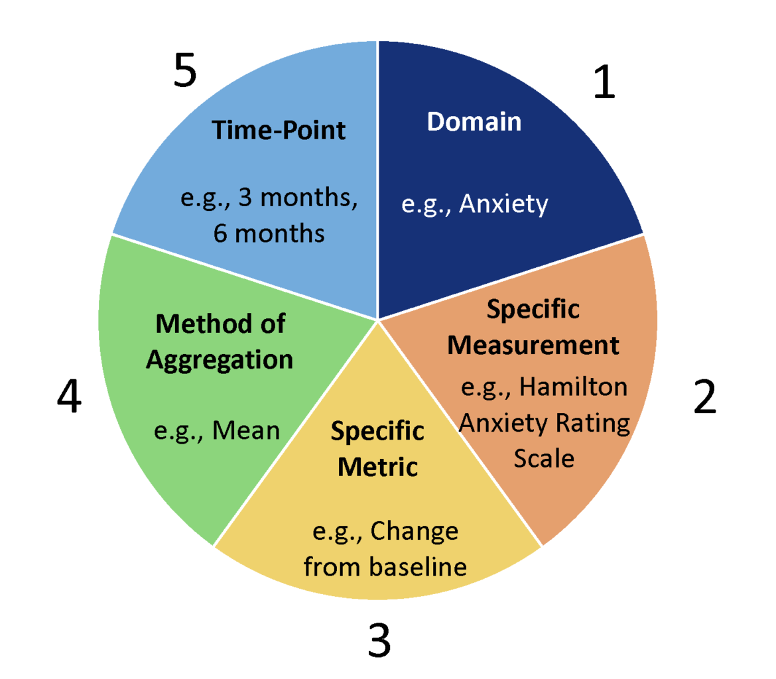
Saldanha IJ, Dickersin K, Wang X, et al. Outcomes in cochrane systematic reviews addressing four common eye conditions: An evaluation of completeness and comparability.
PLoS One 2014; 9: .

Slide 47
Assessing Innovation as Part of Stakeholder Communications
2018 Global Haemophilia Advocacy Leadership
Budapest, Hungary
22 January 2018
Learning from the coreHEM project
Alfonso Iorio, MD, PhD
Hamilton, ON, Canada
Thank you!!!!

