Slide 1


USING EVIDENCE FOR HEMATOLOGY LABORATORY PRACTICE
Alfonso Iorio
McMaster University, Canada
Notes:
5:00pm-5:45pm

Slide 2
Disclosures
Financial
No relevant relationships to disclose
Research funding in the field of hemophilia care
Intellectual
Faculty at McMaster University
Chief of the Health Information Research Unit
Member of the GRADE working group

Slide 3
Our itinerary
Random reflections on laboratory evidence:
Evidence Generation
Players
Study designs
Evidence Search and synthesis
Issuing clinical practice recommendations

Slide 4


Slide 5
EVIDENCE & HEMATOLOGY LABORATORY PRACTICE
Evidence
(Confidence in the) answer to a relevant question
Laboratory medicine
Measurement(s) providing answer to questions of
Diagnosis (screening or confirmation)
Treatment (monitoring or treatment response)
Prognosis (diagnosis of a risk condition)

Slide 6
Questions in EBM
[P]opulation | In patients without bleeding history
[I]ntervention | Does a normal PTT result
[C]omparator | ….(within the normal range)
[O]utcome | Rule out a bleeding disorder
[T]ime | Before ENT surgery

Slide 7
Questions in EBM
[P]opulation | In patients without bleeding history
[I]ntervention | Can a POC PTT be used
[C]omparator | instead that a standard PTT
[O]utcome | To rule out a bleeding disorder
[T]ime | Before ENT surgery

Slide 8
Perspectives..
Is there a “purely” laboratory domain?
Normal ranges
Test validation
Test characteristics
Diagnostic algorithms
Pre-analytical variables

Slide 9
Perspectives..
Is there a “purely” clinical domain?
Treatment?
Well…
Evidence based treatment is defined in PICO terms – P and O have in a vast majority of cases a laboratory component (in hematology more than average).

Slide 10
Perspectives..
Evidence is generated by a close interaction of laboratory and clinical medicine
therefore
Evidence based clinical practice in both fields would require both components in most cases

Slide 11
One simple example: D-Dimer to predict recurrent VTE
Douketis J, … Iorio A. Patient-Level Meta-analysis: Effect of Measurement Timing, Threshold, and Patient Age on Ability of D-Dimer Testing to Assess Recurrence Risk After Unprovoked Venous Thromboembolism. Ann Intern Med 2010;153:523–31.
Douketis J, … Iorio A. Patient-Level Meta-analysis: Effect of Measurement Timing, Threshold, and Patient Age on Ability of D-Dimer Testing to Assess Recurrence Risk After Unprovoked Venous Thromboembolism. Ann Intern Med 2010;153:523–31.
Baglin T, … Iorio A. Does the clinical presentation and extent of venous thrombosis predict likelihood and type of recurrence? A patient level meta-analysis. J Thromb Haemost 2010;8:2436–42.
Douketis J,….Iorio A. Risk of recurrence after venous thromboembolism in men and women: patient level meta-analysis. BMJ 2011;342:d813.
Tosetto A, Iorio A, et al. Predicting disease recurrence in patients with previous unprovoked venous thromboembolism: a proposed prediction score (DASH). J Thromb Haemost 2012;10:1019–25.
Marcucci M, … Iorio A. Patient-level compared with study-level meta-analyses demonstrate consistency of D-dimer as predictor of venous thromboembolic recurrences. J Clin Epidemiol 2013;66:415–25.
Marcucci M, Iorio A, et al. Management of patients with unprovoked venous thromboembolism: an evidence-based and practical approach. Curr Treat Options Cardiovasc Med 2013;15:224–39.
Iorio A, Douketis JD. Ruling out DVT using the Wells rule and a D-dimer test. BMJ 2014;348:g1637–g1637.
Marcucci M, Iorio A, et al. Risk of recurrence after a first unprovoked venous thromboembolism: external validation of the Vienna Prediction Model with pooled individual patient data. J Thromb Haemost 2015;13:775–81.

Slide 12
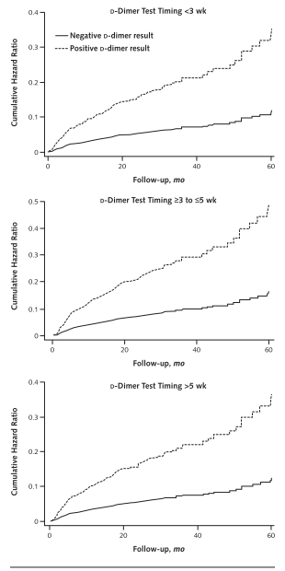
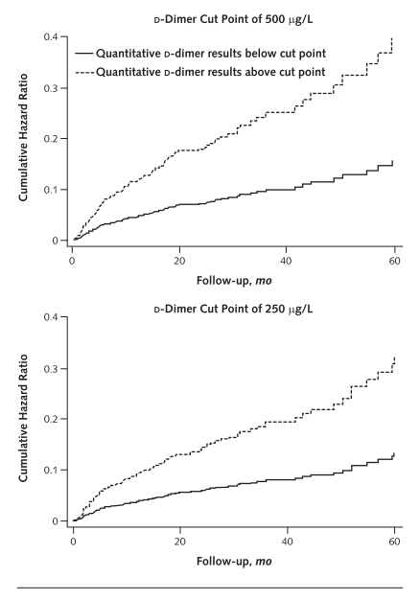
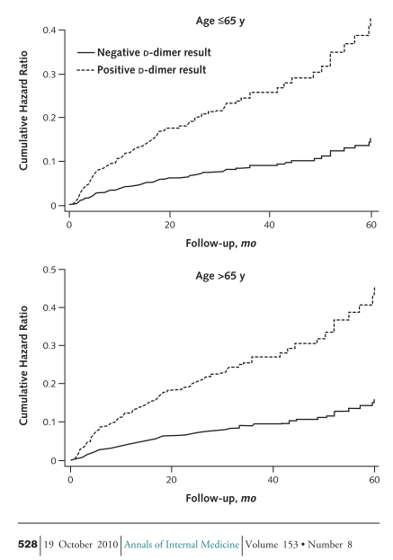
Testing <3, vs 3-5 vs >5 weeks
Cut point
500 vs 250
Age =< 65 vs > 65

Slide 13
One simple example: D-Dimer to predict recurrent VTE
Douketis J, … Iorio A. Patient-Level Meta-analysis: Effect of Measurement Timing, Threshold, and Patient Age on Ability of D-Dimer Testing to Assess Recurrence Risk After Unprovoked Venous Thromboembolism. Ann Intern Med 2010;153:523–31.
Baglin T, … Iorio A. Does the clinical presentation and extent of venous thrombosis predict likelihood and type of recurrence? A patient level meta-analysis. J Thromb Haemost 2010;8:2436–42.
Douketis J,….Iorio A. Risk of recurrence after venous thromboembolism in men and women: patient level meta-analysis. BMJ 2011;342:d813.
Tosetto A, Iorio A, et al. Predicting disease recurrence in patients with previous unprovoked venous thromboembolism: a proposed prediction score (DASH). J Thromb Haemost 2012;10:1019–25.
Marcucci M, … Iorio A. Patient-level compared with study-level meta-analyses demonstrate consistency of D-dimer as predictor of venous thromboembolic recurrences. J Clin Epidemiol 2013;66:415–25.
Marcucci M, Iorio A, et al. Management of patients with unprovoked venous thromboembolism: an evidence-based and practical approach. Curr Treat Options Cardiovasc Med 2013;15:224–39.
Iorio A, Douketis JD. Ruling out DVT using the Wells rule and a D-dimer test. BMJ 2014;348:g1637–g1637.
Marcucci M, Iorio A, et al. Risk of recurrence after a first unprovoked venous thromboembolism: external validation of the Vienna Prediction Model with pooled individual patient data. J Thromb Haemost 2015;13:775–81.
Tosetto A, Iorio A, et al. Predicting disease recurrence in patients with previous unprovoked venous thromboembolism: a proposed prediction score (DASH).
J Thromb Haemost 2012;10:1019–25.
Marcucci M, Iorio A, et al. Risk of recurrence after a first unprovoked venous thromboembolism: external validation of the Vienna Prediction Model with pooled individual patient data. J Thromb Haemost 2015;13:775–81.
Marcucci M, … Iorio A. Patient-level compared with study-level meta-analyses demonstrate consistency of D-dimer as predictor of venous thromboembolic recurrences. J Clin Epidemiol 2013;66:415–25.

Slide 14
Diagnosis versus Prognosis
Test
Observation
(+A)
(+)
(-)
Health status
(+)
(-)
(-)
0
Time
n

Slide 15
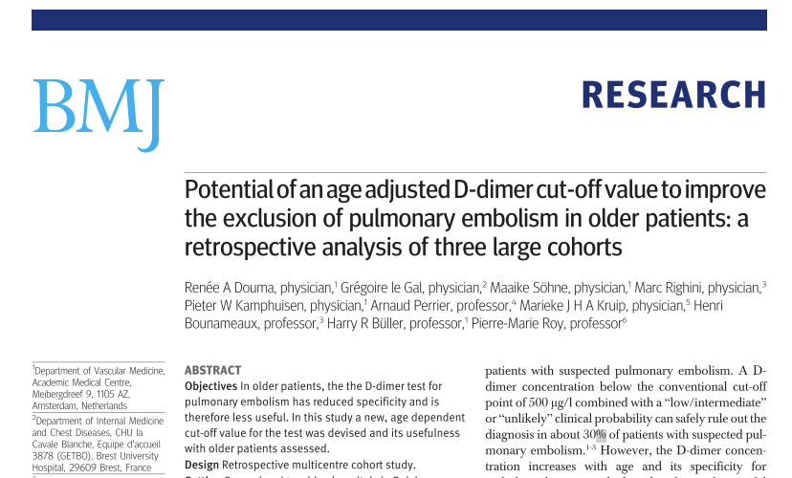
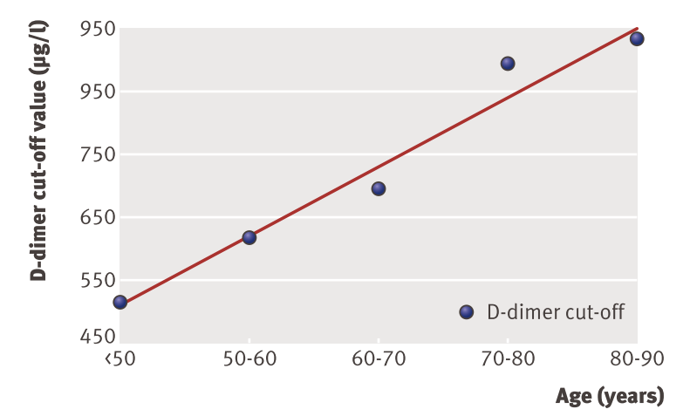

Slide 16
Phases of diagnostic studies
Phase I
Do test results in patient with the target disorders differ from those in normal people?
Phase II
Are patients with certain test results more likely to have the target results?
Phase III
Does the test result distinguish patients with and without the target disorders among patients in whom it is clinically reasonable ro suspect that the disease is present?
Phase IV
Do patients who undergo this diagnostic test fare better (in their ultimate health outcomes) than similar patients who are not tested?

Slide 17
Diagnostic test performance indexes
Accuracy
Sens, Spec, PPV, NPV, Likelihood ratio
Agreement
ROC/AUC
Misclassification
(Re)classification index
TP, TN, FP, FN & undetermined

Slide 18
Study designs
Diagnostic test (derivation – validation)
Diagnostic algorithm (derivation – validation)
Screening procedure (derivation – validation)
Inception cohort
Gold standard
Blinding
Implementation study
New test
Faster
Cheaper
Less invasive, safer
New test role
Triage test
Replacement test
Add-on test

Slide 19
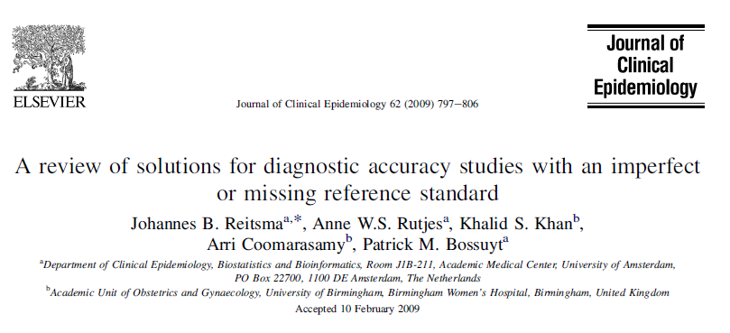
Discrepant analysis
Two-test reference standard
Latent class analysis
Construct validation

Slide 20
Bias in Diagnostics Research
Inappropriate reference standard
Spectrum bias
Verification (work-up) bias
Partial verification bias
Differential verification bias
Review bias (lack of blinding)
Incorporation bias
Bias due to exclusions, indetermined results, etc

Slide 21


Slide 22
Comparison of two tests
Bland JM, Altman DG. Statistical methods for assessing agreement between two methods of clinical measurement. Lancet 1986;1:307–10.
Bland JM, Altman DG. Comparing methods of measurement: why plotting difference against standard method is misleading. Lancet 1995;346:1085–7.
Bland JM, Altman DG. Applying the right statistics: analyses of measurement studies. Ultrasound Obstet Gynecol 2003;22:85–93.
1

Slide 23
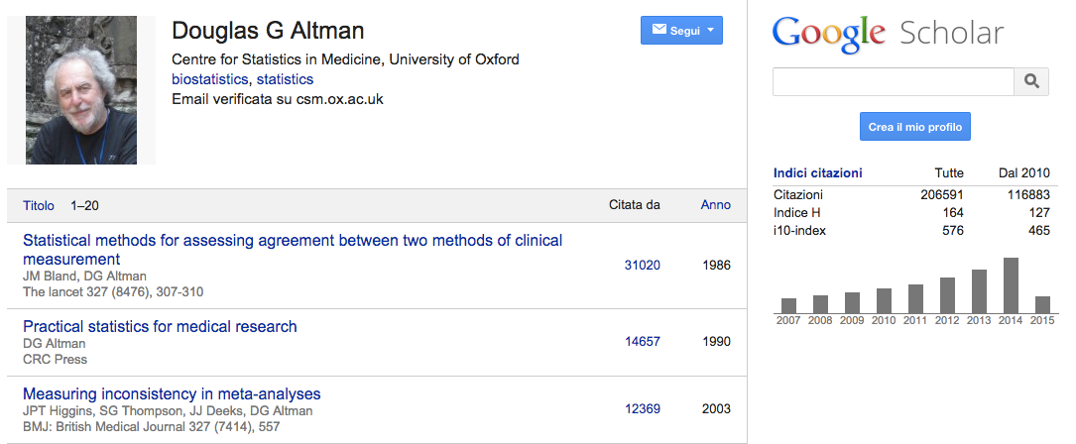


Slide 24
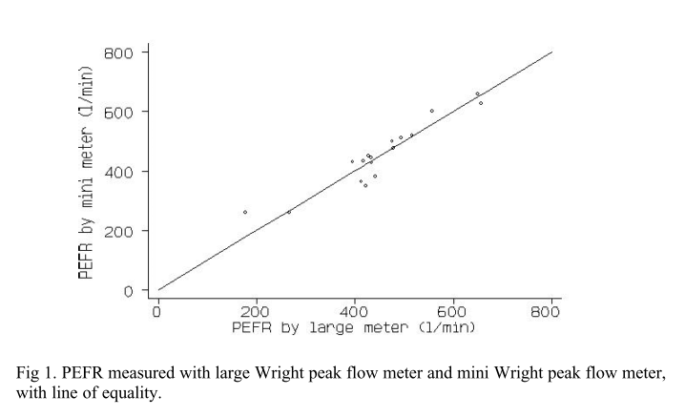
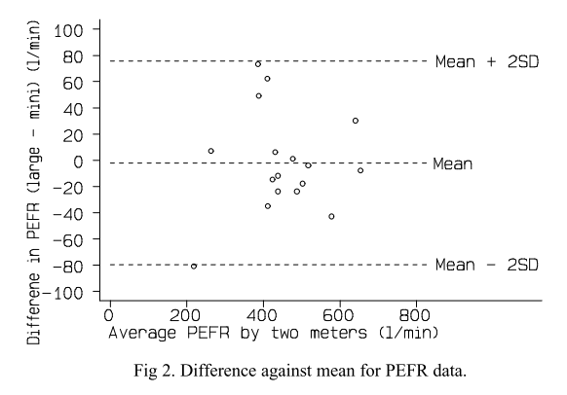
The original example
Bland JM, Altman DG. Lancet 1986;1:307–10.

Slide 25
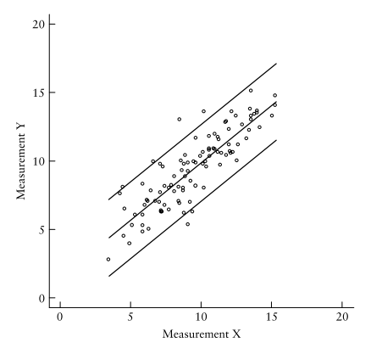
Fancier statistics
Bland JM, Altman DG. Ultrasound Obstet Gynecol 2003;22:85–93.

Slide 26

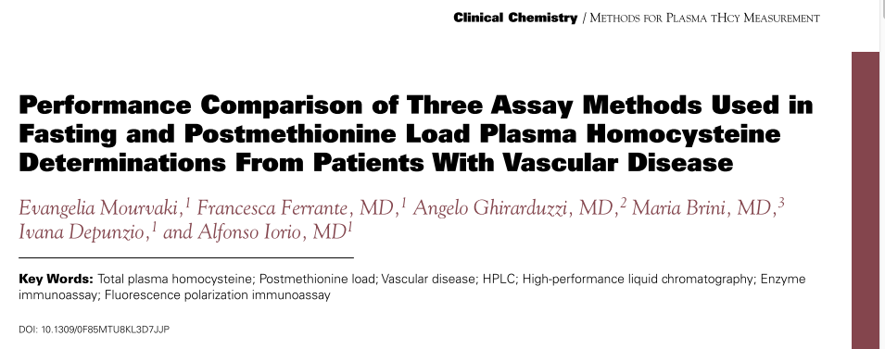
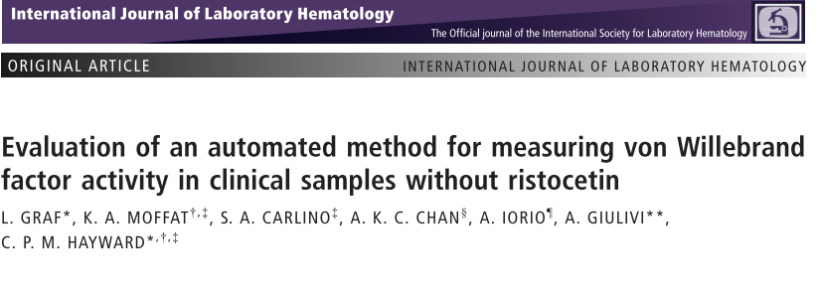


Slide 27
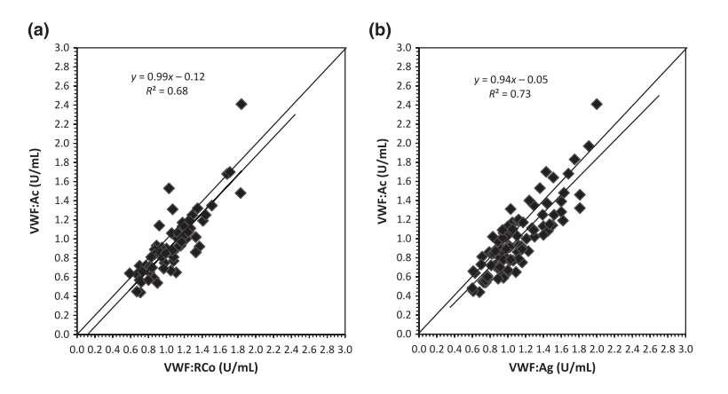
Bland & Altman plots
Graf L, et al. Int J Lab Hematol 2014;36:341–51.
Notes:
Top fasting // bottom methionine load

Slide 28
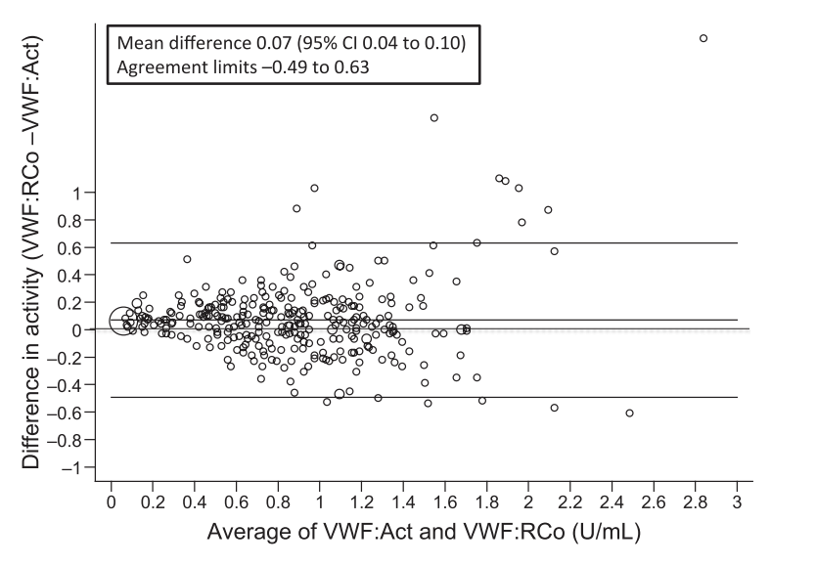
Bland & Altman plots
Graf L, et al. Int J Lab Hematol 2014;36:341–51.
Notes:
Top fasting // bottom methionine load

Slide 29
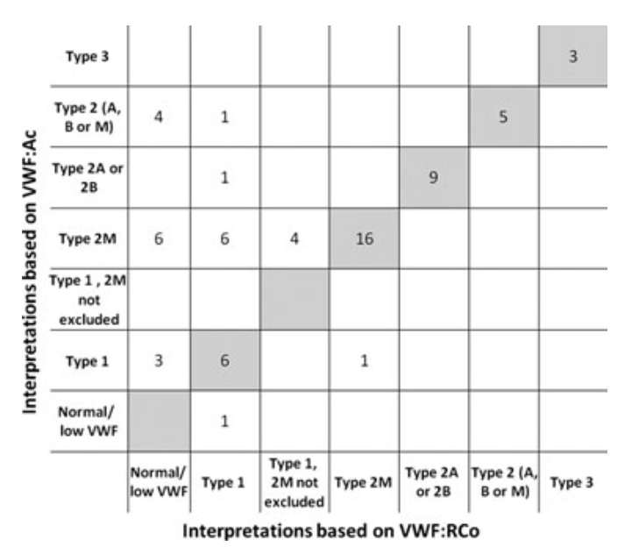
Classification properties
Graf L, et al. Int J Lab Hematol 2014;36:341–51.
Notes:
Top fasting // bottom methionine load

Slide 30
SEARCHING AND SUMMARIZING the evidence

Slide 31
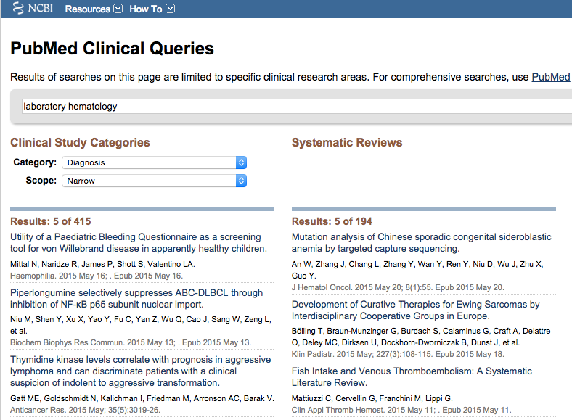

Slide 32
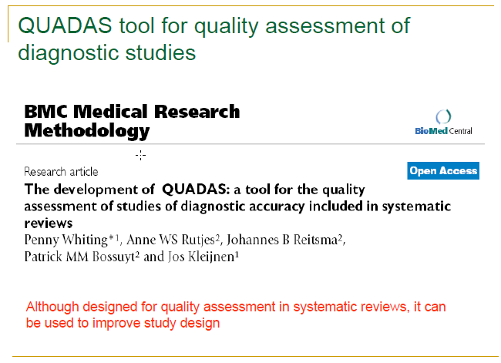

Slide 33
Systematic Review in diagnosis
SROC
Walter SD. Properties of the summary receiver operating characteristic (SROC) curve for diagnostic test data. Stat Med 2002;21:1237–56.
Harbord RM, Deeks JJ, Egger M, et al. A unification of models for meta-analysis of diagnostic accuracy studies. Biostatistics 2007;8:239–51.
Cochrane
64 titles
Rapid diagnostic tests versus clinical diagnosis for managing fever in settings where malaria is common
Odaga J et al. Cochrane Database of Systematic Reviews 2014, Issue 4. Art. No.: CD008998.
Notes:
Seven studies, 17,000 patients - 3 times reduction in prescription.

Slide 34
Systematic review in laboratory hematology
Gore CJ, Hopkins WG, Burge CM. Errors of measurement for blood volume parameters: a meta-analysis. J Appl Physiol 2005;99:1745–58.
Wang Y-H, Fan L, Xu W, et al. Detection methods of ZAP-70 in chronic lymphocytic leukemia. Clin Exp Med 2012;12:69–77.
Zhi M, Ding EL, Theisen-Toupal J, et al. The landscape of inappropriate laboratory testing: A 15-year meta-analysis. PLoS One 2013;8:1–8.
Cao C, Liu S, Lou SF, et al. The +252A/G polymorphism in the lymphotoxin-α gene and the risk of non-Hodgkin lymphoma: A meta-analysis. Eur Rev Med Pharmacol Sci 2014;18:544–52.
Jiang D, Hong Q, Shen Y, et al. The diagnostic value of DNA methylation in leukemia: A systematic review and meta-analysis. PLoS One 2014;9:1–7.
Benner A, Mansouri L, Rossi D, et al. MDM2 promotor polymorphism and disease characteristics in chronic lymphocytic leukemia: Results of an individual patient data-based meta-analysis. Haematologica 2014;99:1285–91.
Wang Z, Jia M, Zhao H, et al. Prognostic impact of pretransplantation hyperferritinemia in adults undergoing allogeneic hematopoietic SCT: a meta-analysis. Bone Marrow Transplant 2014;49:1339–40.
Nijsten J, Boonacker CWB, Haas M De, et al. Clinical and laboratory predictors of chronic immune thrombocytopenia in children : a systematic review and meta-analysis. Blood 2015;124:3295–308.
Notes:
Cao: predictive only in North American and for diffuse B cell lymphoma

Slide 35
Clinical practice guidelines

Slide 36
Guideline in laboratory hematology
Area | Number | Year
Pre-analytic process | 6 | 2007-2010
Cellular analysis, including smears | 9 | 2001-1014
General hematology lab | 6 | 2000-2013
Coagulation | 27 | 1994-2014
Flow cytometry | 10 | 2007-2015
Hemopathology | 4 | 2010-2013
Hemoglobinophaties | 3 | 2012-2014
Point-of-care | 3 | 2007-2008
Hayward CPM, Moffat KA, George TI, et al. Assembly and evaluation of an inventory of guidelines that are available to support clinical hematology laboratory practice. Int J Lab Hematol 2015;x:1–10. doi:10.1111/ijlh.12348

Slide 37
Guideline in laboratory hematology
Area | Number | Year
Pre-analytic process | 0/6 | 2007-2010
Cellular analysis, including smears | 3/9 | 2001-1014
General hematology lab | 2/6 | 2000-2013
Coagulation | 9/27 | 1994-2014
Flow cytometry | 1/10 | 2007-2015
Hemopathology | 3/4 | 2010-2013
Hemoglobinophaties | 1/3 | 2012-2014
Point-of-care | 0/3 | 2007-2008
Hayward CPM, Moffat KA, George TI, et al. Assembly and evaluation of an inventory of guidelines that are available to support clinical hematology laboratory practice. Int J Lab Hematol 2015;x:1–10. doi:10.1111/ijlh.12348

Slide 38
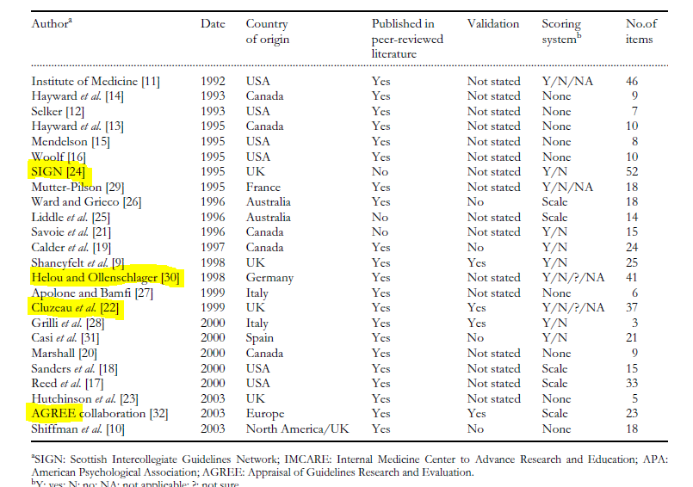
Vlayen J et al. Int J Qual Heal Care 2005;17:235–42.
Notes:
The instrument developed by Sanders and the AGREE instrument use a numerical scale.
•AGREE instrument instruments are based on the Cluzeauinstrument(23/37)
•Four appraisal tools were found to address all the guideline dimensions [22,24,30]
•Cluzeauinstrument(+AGREE)is the only instrument that has been subject to a thorough validation study.

Slide 39


Slide 40
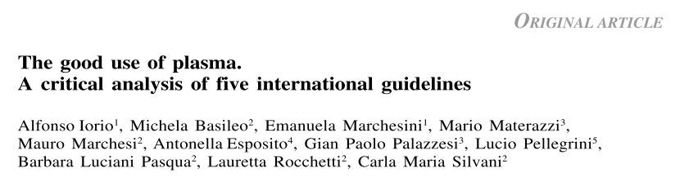

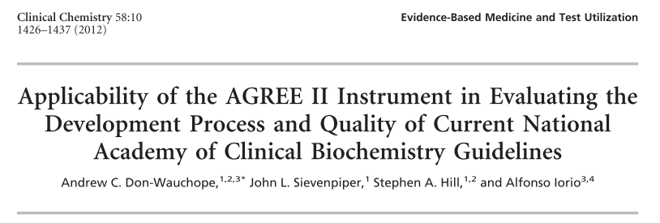
AGREE appraisals

Slide 41
6 domains & 23 items
Scope & purpose
Stakeholder involvement
Rigour of development
Clarity & presentation
Applicability
Editorial independence

Slide 42
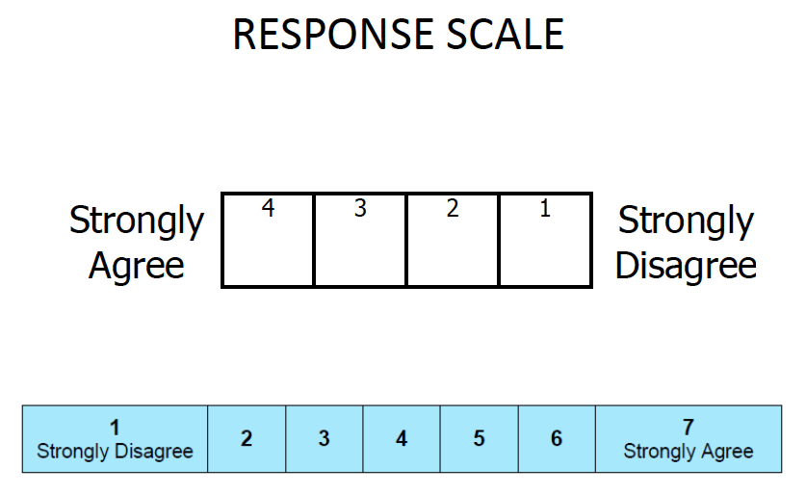

Slide 43
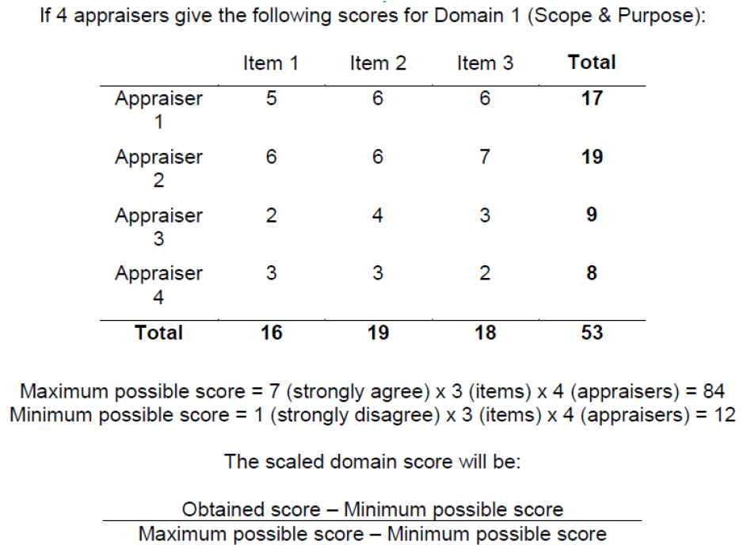

Slide 44
GRADE for DIAGNOSIS (AND PROGNOSIS)

Slide 45
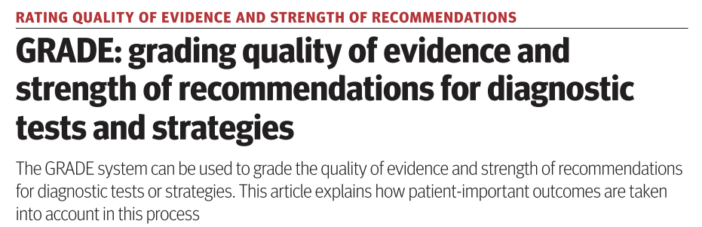
BMJ 2008;336:1106–10.
Brozek JL, et al. Allergy Eur J Allergy Clin Immunol 2009;64:1109–16.
Mustafa R et al. J Clin Epidemiol 2013;66:736–42
Hu J et al. Implementation Science 2011:6:62

Slide 46
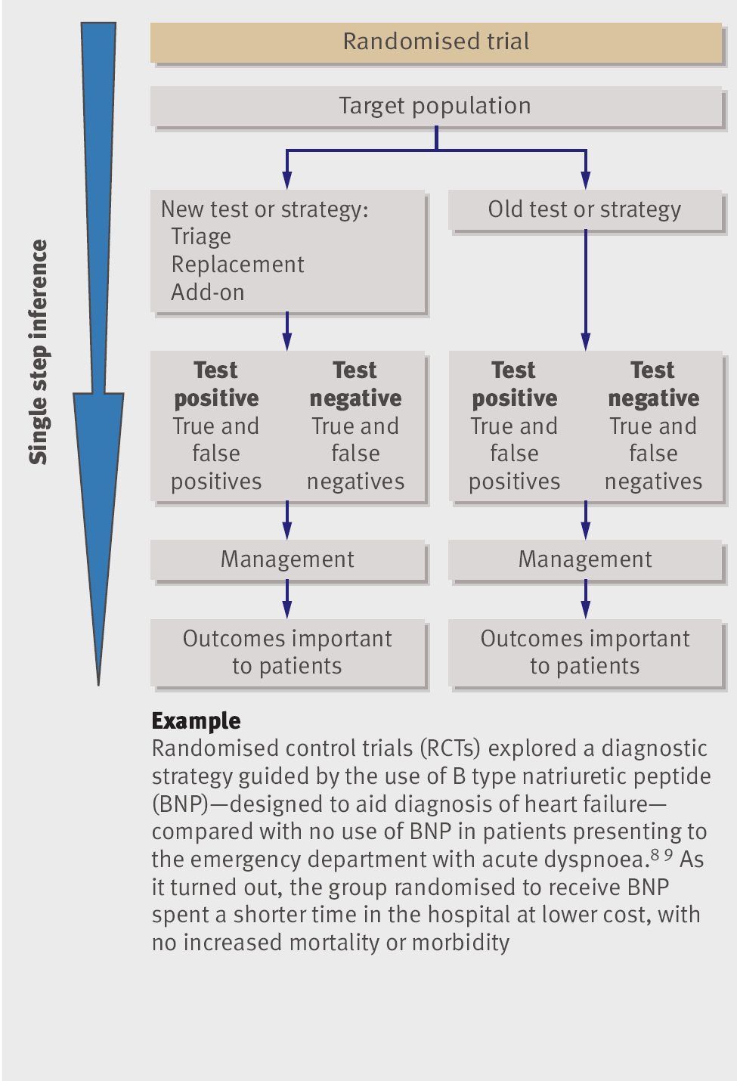
Study designs IV
Are there studies that directly focus on: mortality, morbidity, symptoms, and/or quality of life?
No
Yes
Apply GRADE approach as for treatment or other intervention
Schunemann et al. BMJ, 2008

Slide 47
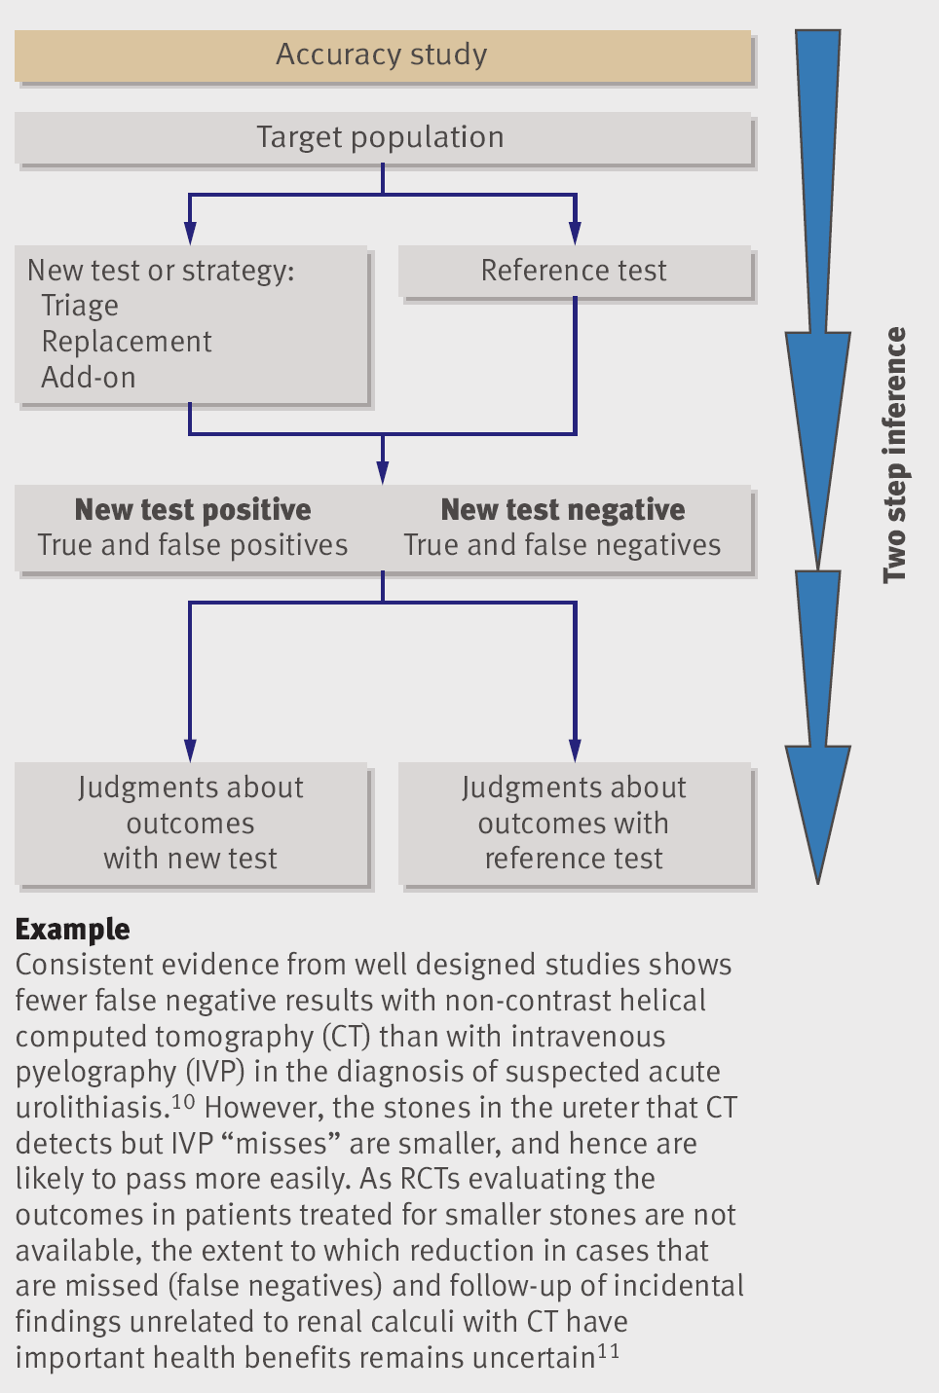
Study designs III
Look for diagnostic test accuracy studies
And then draw inferences from other evidence
Schunemann et al. BMJ, 2008

Slide 48
GRADE’s specifics for diagnosis
Review TP,TN, FP,FN
Consider indeterminate results
Review a spectrum of candidate populations with different disease prevalence
Define thresholds to treat and stop testing
Consider clinical consequences of the possible results

Slide 49
Diagnostic studies (Preferably from SR)
Studies that link (TP, FP, TN, FN) to patient-important outcomes:
(Preferably from a SR)
QoE
Diagnostic test accuracy
⊕⊕⊕⊕
⊕⊕⊕⊝
QoE
Linked evidence
⊕⊕⊕⊕
⊕⊕⊕⊝
Balance
all outcomes
together
Recommendation
GRADE
GRADE

Slide 50
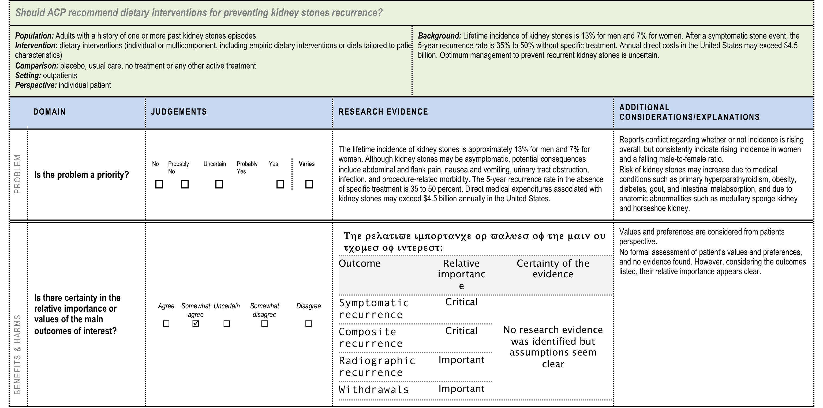
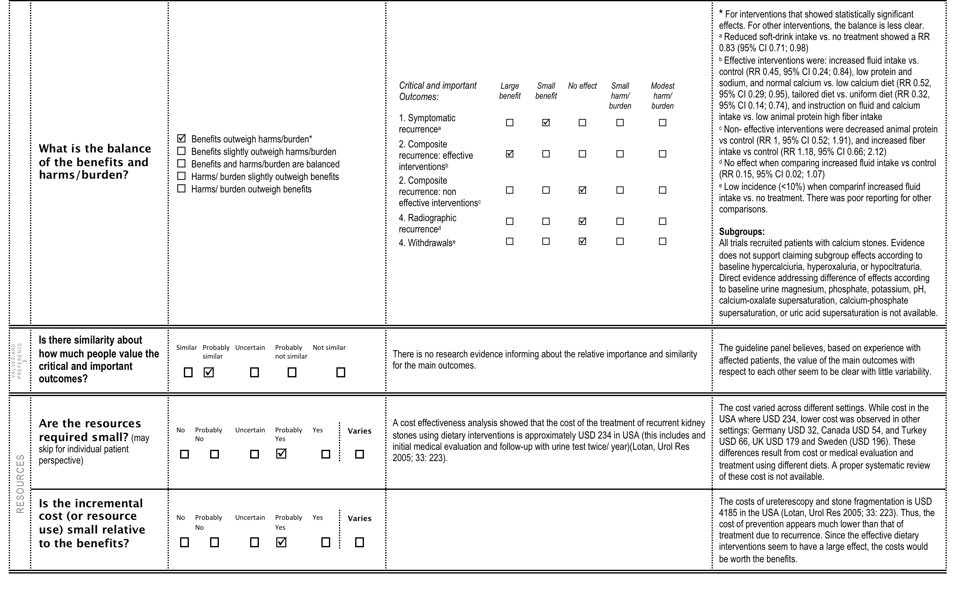
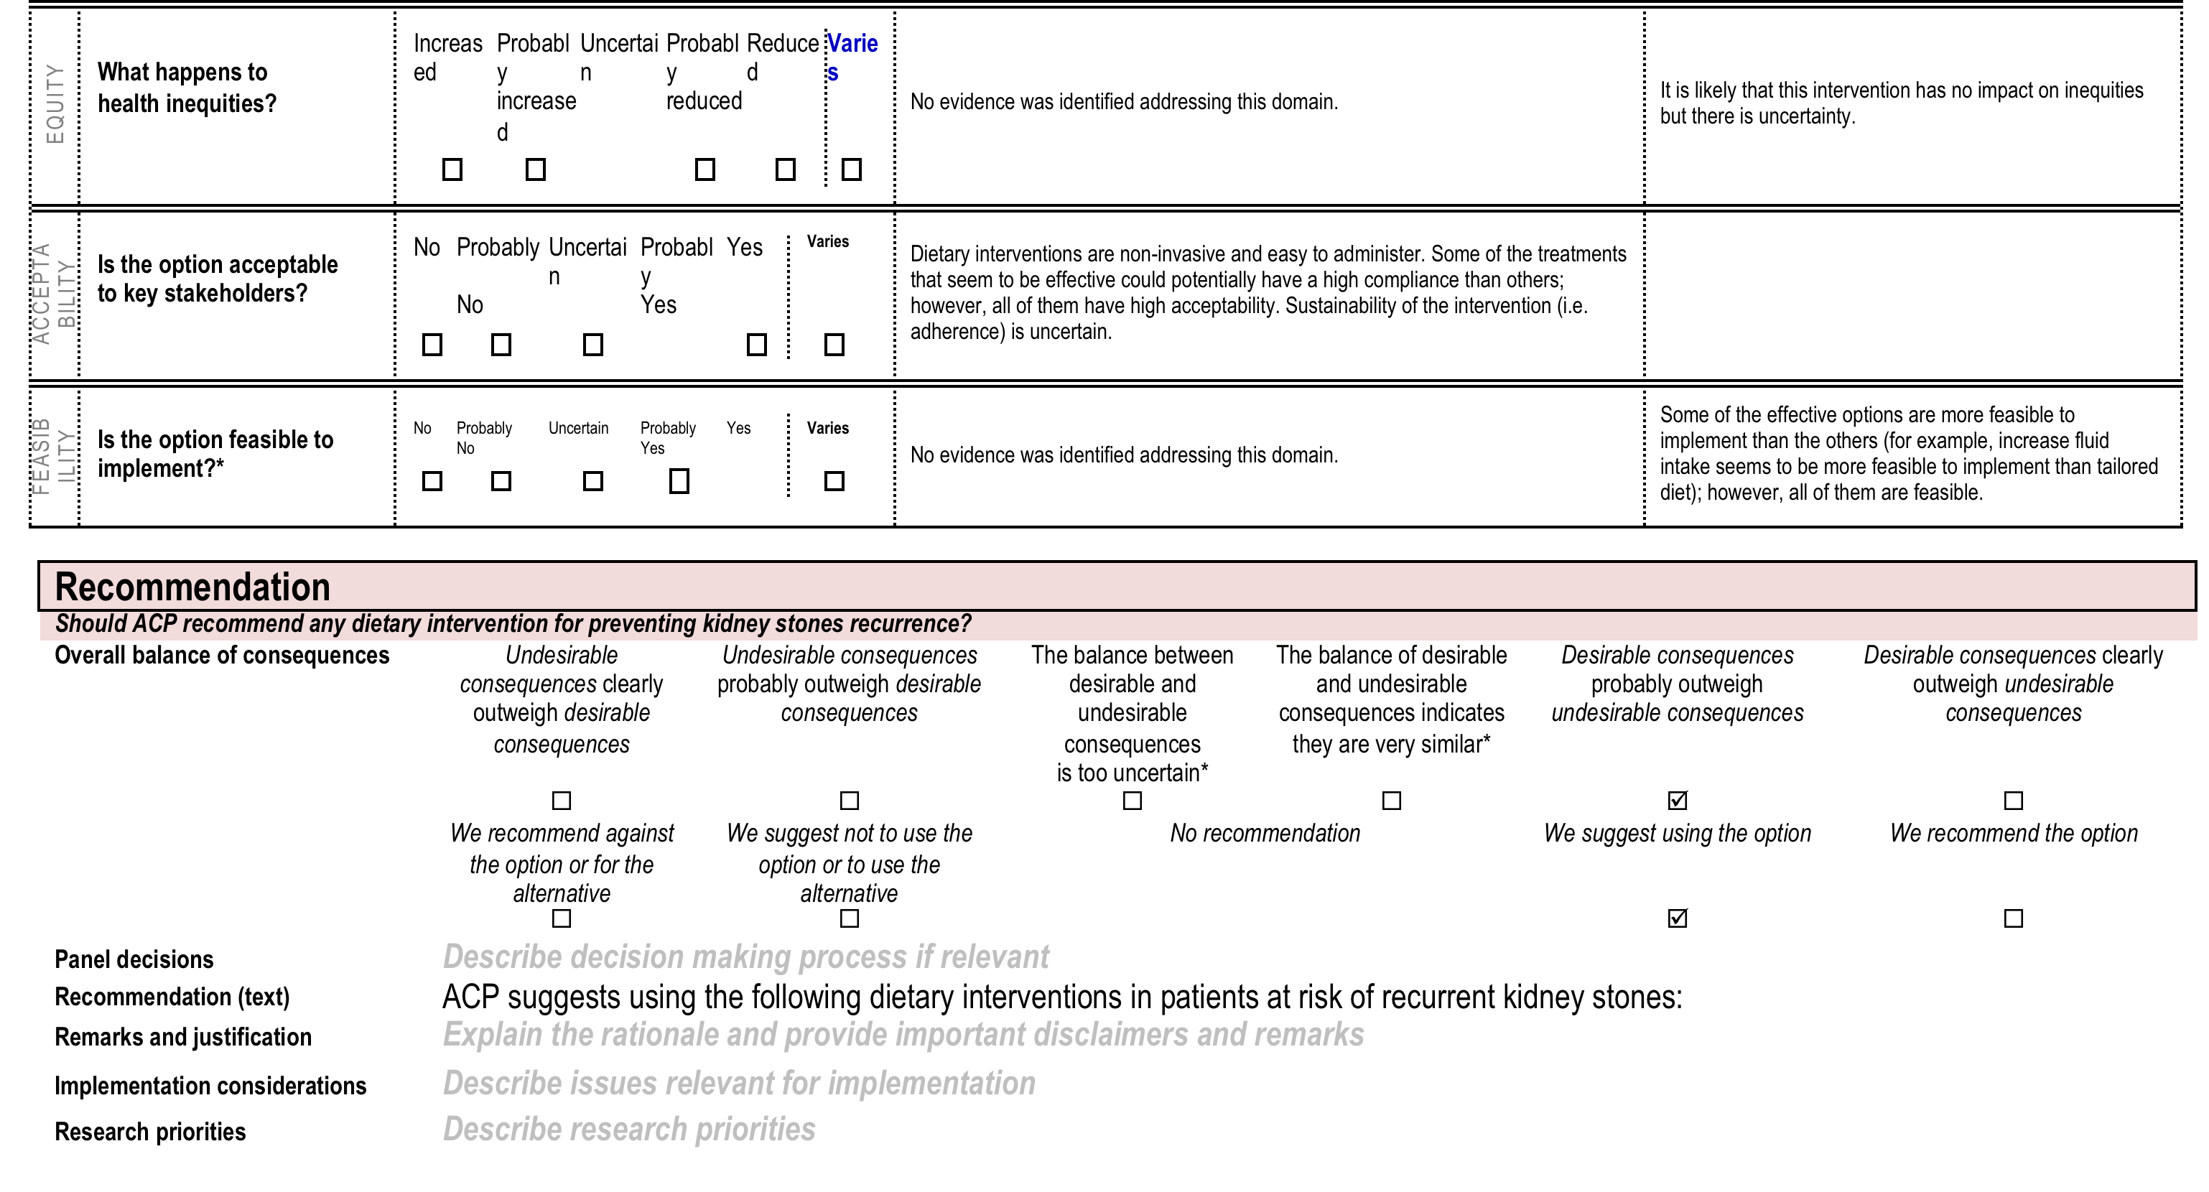
E
vidence to decision
Question/Problem
Test accuracy
Benefits and harms
Quality of evidence
Values
Resources
Equity
Acceptability
Feasibility
Recommendation
Implementation

Slide 51
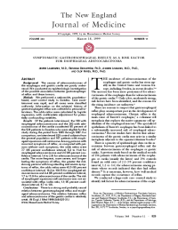
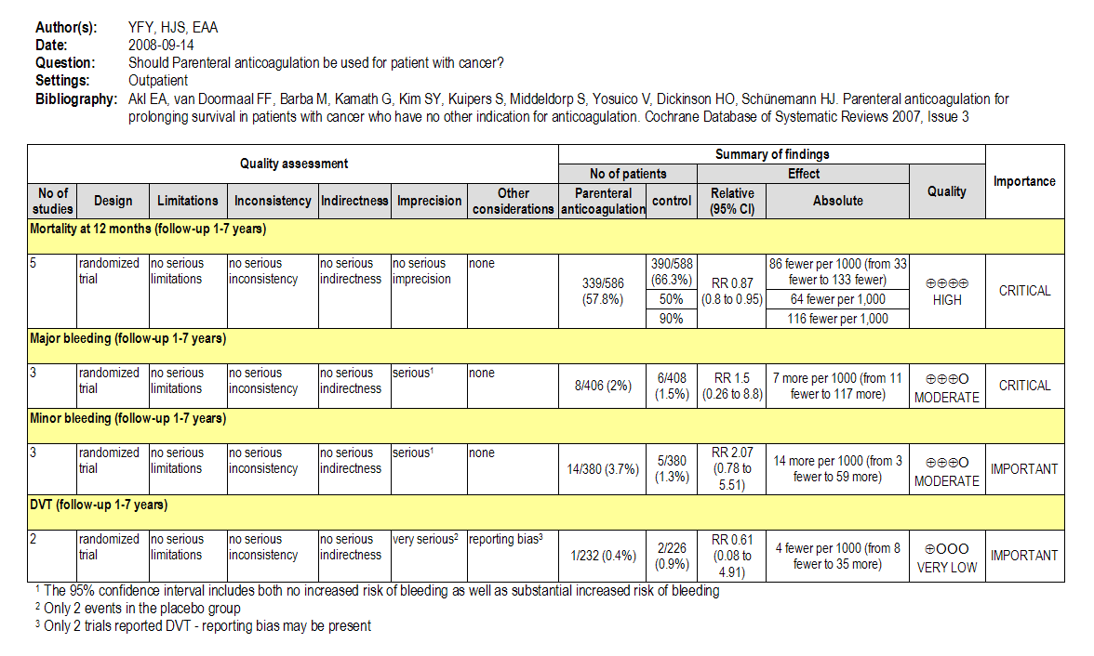
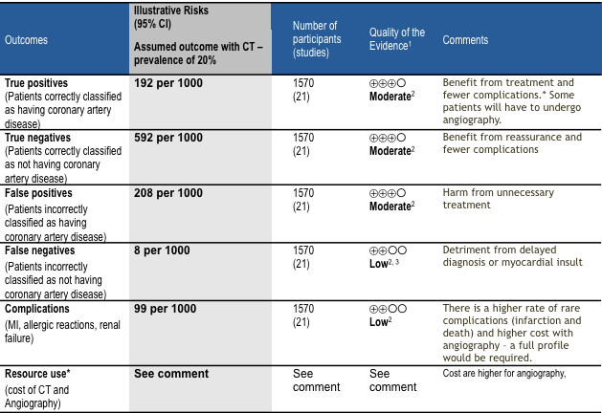
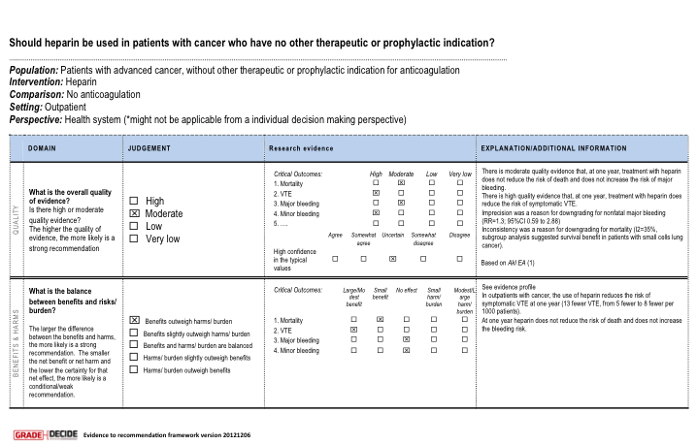
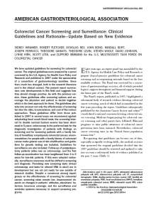
Risk of bias
Inconsistency
Indirectness
Imprecision
Publication bias
Rate quality of evidence for each patient important outcome
Rate importance: based on potential consequences
TA Outcomes across studies
Create TA
evidence profile (pooled TA)
Grade down
Treatment (side) effects
Natural history
Patient important outcomes
Test accuracy outcomes
Large effect
Dose response
Opposing bias & Confounders
Grade up?
P
I
C
O
True positives
Critical?
Confidence in link?
False negatives
Critical?
High
⊕⊕⊕⊕
Moderate
⊕⊕⊕O
True negatives
Important?
Resources
Side effects of test
Inconclusive results
Low
⊕⊕OO
False positives
Not
Quality of evidence & estimates for TP, FN, TN & FP
Very low
⊕OOO
important?
Summary of Findings based on impact on patient important outcomes
Evidence synthesis (SR or HTA)
Panel
Recommendation/Decision
Grade recommendations
For or against (direction) ↓↑
Strong or conditional/weak (strength)
Evidence to decision frameworks
Quality of evidence
Balance benefits/harms
Values and preferences
Feasibility, equity & acceptability
Resource use (if applicable)
Grade overall quality of evidence across outcomes based on lowest quality
of critical outcomes
EtD framework
with GDT
Guideline | Decision
Formulate Recommendations (↓↑ | ⊕…)
“The panel recommends that ….should...”
“The panel suggests that ….should...”
“The panel suggests to not ...”
“The panel recommends to not...”
Transparency, clear, actionable
Research?

Slide 52
To conclude..
Building robust DTA data is the start-point
Review all the available DTA evidence
Explore the link between DTA and Patient important outcomes
For a reasonable spectrum of population
Balancing benefits and harms of TP, TN, FP, FN and indeterminate results
Employing suggesting decision thresholds
In a multi-stakeholder team approach

Slide 53

Thank you
Download this slides at:
Hemophilia.mcmaster.ca/resources

