Slide 1
Risk factors for inhibitor development: any clinical role?
Alfonso Iorio
McMaster University
Canada

Slide 2
Disclosures for Alfonso Iorio, MD
Research Support/P.I. | Baxter, Bayer, Biogen, Novo Nordisk, Octapharma, Pfizer
Employee | No relevant conflicts of interest to declare
Consultant | No relevant conflicts of interest to declare
Major Stockholder | No relevant conflicts of interest to declare
Speakers Bureau | No relevant conflicts of interest to declare
Honoraria | No relevant conflicts of interest to declare
Scientific Advisory Board | Baxter, Bayer, Novo Nordisk

Slide 3
Program
What we do know
What we don’t know
Where do we go from here

Slide 4
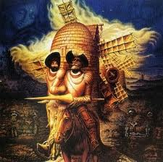
Notes:
The play was a brilliant one. Directed by Roy Surette, and written for the stage by Colin Heath and Peter Anderson it took a new take on an old story. It was composed and produced by the Vancouver’s Arts Club Theatre Company a co-production with the Axis Theatre Company, both from Vancouver
By a small sample, we may judge of the whole piece."

Slide 5
What we do know
About 1/3 of PUPs develop some form of inhibitory response
Extreme variability and inconsistency of results
Subclinical antibodies responsible for variation in half-life?
About ¾ of inhibitors disappears at some point
ITI?
QoL of patients with persistent inhibitors is reduced

Slide 6
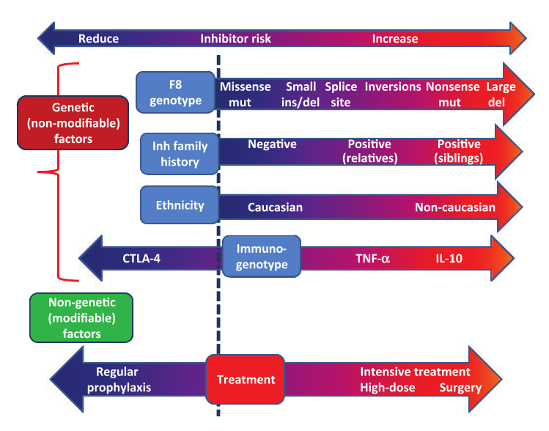
Coppola A et al. Haemophilia,16 Suppl 1:13–9.

Slide 7
Multicausality principle¹
Previous F8 exposure
CTL-4 polymorphism
FVIII genotype
(missense/point)
IL10, TNF-a
polymorphism
FVIII genotype
(deletions/inversions)
F8
F8
Danger signal
F8
Danger signal
treatment
1. Rothman KJ, Greenland S. Am J Public Health. 2005;95:S144–50.
Modified from Gouw S. Semin Thromb Hemost 2007;35:723–34.
Notes:
(4) To comment about the interplay of several aspects

Slide 8
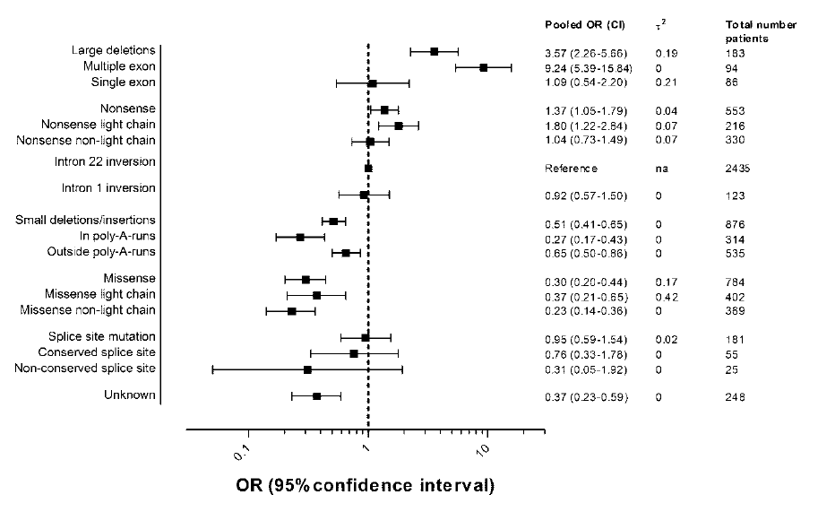
SR: gene-related inhibitor risk
Gouw S et al. Blood 2012;119(12):2922–2934.

Slide 9
Risk PREDICTION MODELS

Slide 10
Alternate view on the problem
Why 2/3 patients
DO NOT
develop inhibitory antibodies
toward a complex and highly immunogenic protein they were not exposed to before?

Slide 11
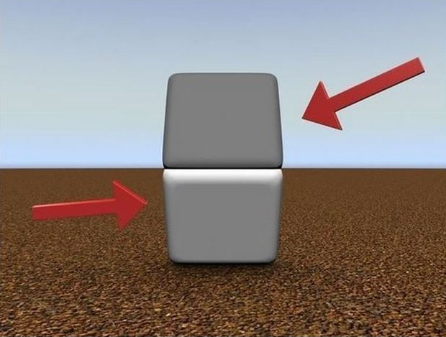

Slide 12
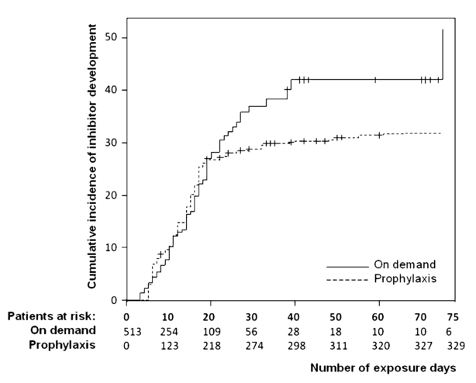
Gouw, S.C.. Blood, 2013, 121, 4046–55.

Slide 13




Inhibitor incidence per protocol
19 subjects dosed
9 subjects with suspected FVIII inhibitor
1 not confirmed FVIII inhibitor
8 subjects (42.1%) with confirmed FVIII inhibitor
5 high titer (26.3%) FVIII inhibitors (> 5 BU/ml)
3 low titer (15.8%) FVIII inhibitors
(≥ 0.6 and ≤ 5 BU/ml)
Courtesy of Guenter Auesrwald: ASH, New Orleans, 2013.
Notes:
subj inhib inhib + Ab
PUPs 11 (57.9) 4 (36.4) 3 (27.3)
MTPs 8 (42.1) 4 (50.0) 3 (37.5)
Total 19 (100) 8 (42.1) 6 (31.6)
CSR, 11.3.1.1 Primary Endpoint
Two of the subjects initially classified as low-titer Bethesda confirmed inhibitors based on their first positive inhibitor result, subsequently converted to high titer inhibitors after having been withdrawn from the treatment regimen (subjects 610001 and 710001).
Subject 610001 had a FVIII inhibitor detected at his ED 6 visit (1.5 BU/ml), confirmed at ED 8, 4.7 BU/ml). At his termination visit (approximately 4 weeks later) his inhibitor titer was 6.3 BU/ml. At a follow-up visit approximately 4 months after initial inhibitor
detection (Month 3 Observational Visit) his titer was 11.4 BU/ml
Follow-up information on subject 610001 including successful ITI treatment outcome is published in
Moorehead et al, poster presentation at ISTH 2013
Subject 710001 had a PICC line inserted in the right arm at ED 17 to the IP. This
intervention took place after the subject was withdrawn from further treatment with IP,
due to a confirmed positive FVIII inhibitor result (1.1 BU on ED 15 Visit, 02-Oct-2012),
and became necessary while the subject was hospitalized for a hemorrhage in the left
Forearm.
The subject’s study termination visit (16 Nov 2012) was delayed due to events occurring around
Hurricane Sandy (29 Oct 2012) and was thus performed after the surgery.
Subject 710001 had a FVIII inhibitor detected at his ED 15 visit (1.1 BU/ml). At the termination visit (6.5 weeks after first inhibitor
detection) his inhibitor titer was 24.4 BU/ml.

Slide 14
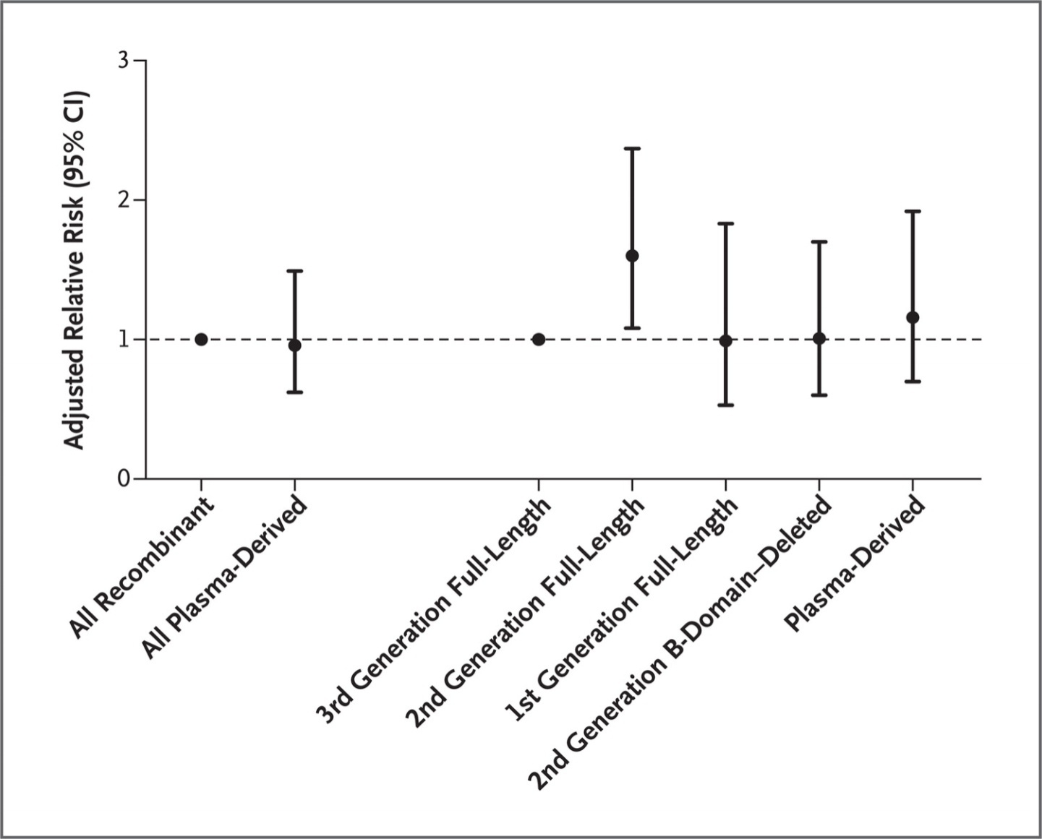
Adjusted Relative Risk of Inhibitor Development,
According to the Type of Factor VIII Product
Gouw SC et al. N Engl J Med 2013;368:231-239.
Notes:
Figure 2. Adjusted Relative Risk of Inhibitor Development, According to the Type of Factor VIII Product. Data are for 574 previously untreated children with severe hemophilia A. In the comparison between all recombinant products and all plasma-derived products (at left), the reference group was the recombinant products. In the comparison of specific products (at right), the reference group was third-generation full-length recombinant products. The only first-generation full-length recombinant product that was evaluated was Recombinate (Baxter BioScience). The I bars indicate 95% confidence intervals.

Slide 15
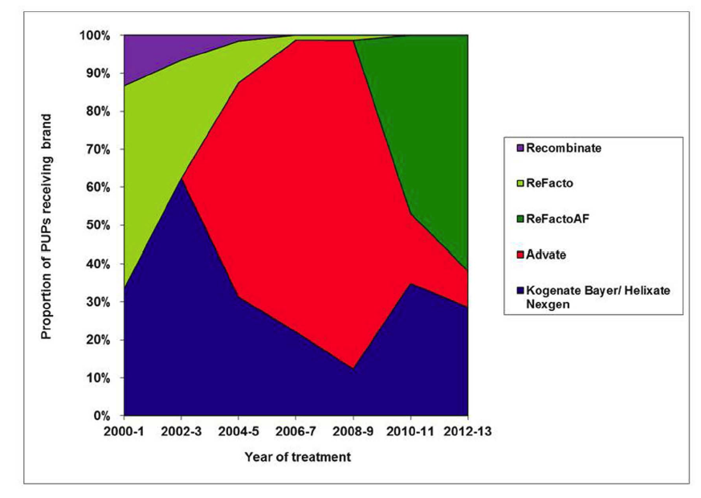
Proportion of recombinant FVIII used in UK PUPs by year
Collins et al, Blood 2014

Slide 16
UKHCDO cohort: effect of time and … RODIN?
Kogenate
Advate
RODIN = Dashed
Not RODIN = Solid
RODIN vs not RODIN
P = 0.08
Advate 3/12 | 26/117 | 13/43
Kogenate 24/65 | 16/31 | 5/32
Notes:
Also comment that many patients when to Refacto, and got inhbitors

Slide 17
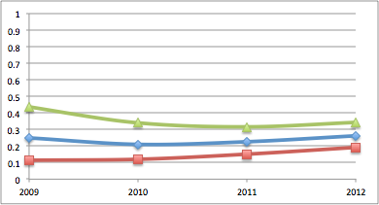
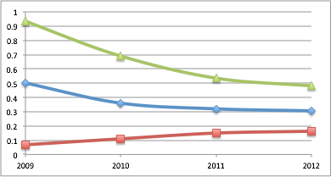
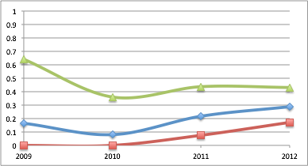
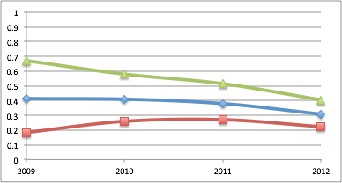
8 | 12 | 24 | 37
32 | 56 | 106 | 141
1 | 1 | 5 | 15
6 | 13 | 23 | 52
2 | 4 | 8 | 11
4 | 11 | 25 | 36
7 | 17 | 26 | 33
17 | 41 | 67 | 107
Data from the EUHASS annual reports to the Investigators

Slide 18
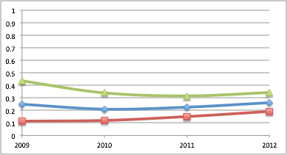
Year | 2009 | 2010 | 2011 | 2012
Inhib | 8 | 34 | 63 | 96
Exposed | 59 | 121 | 221 | 336
Proportion | 0.31 | 0.28 | 0.29 | 0.29
Data from the EUHASS annual reports to the Investigators
Notes:
The overall rate did not change - the figure is slightly different from the one of the final analysis, because this are non validated data. Data for individual studies converged. This suggests cancelling of random errors in the initial estimates. Also, it looks like PUPs are not so bad to this scope..

Slide 19
FVIII concentrates
rFVIII: E (121 patients)
Advate (Baxter Bioscence)
3rd generation concentrate (full length)
CHO
Marketing authorization: March 2, 2004
pdFVIII: G (99 patients)
- Factane (LFB)
- Ion exchange chromatography (SA: FVIII: 100 IU/mg)
VWF content: 20-40 IU/100 IU FVIII
Marketing authorization: January 16, 2001
Goudemand, Oral communication, ISTH Toronto 2015

Slide 20
Results: Outcomes according to the first FVIII product received
 | First FVIII product received
 | Product E | Product G | All FVIII products
 | (N=121) | (N=99) | (N=474)
All inhibitors– no (%) | 37 (30.0) | 20 (20.2) | 154 (32.5)
High titer inhibitors – no (%) | 23 (19) | 12 (12.1) | 87 (18.4)
Inhibitors occurring during the first 75 EDs and treated at any time during FranceCoag follow-up – no. (%)
Cases treated with bypassing agents | 27 (22.3) | 15 (15.2) | 108 (22.8)
Cases treated with immune tolerance induction (ITI) | 25 (20.7) | 14 (14.1) | 106 (22.4)
Cases treaetd with bypassing agents and/or ITI | 32 (26.4) | 16 (16.2) | 128 (27.0)
Goudemand, Oral communication, ISTH Toronto 2015

Slide 21
Results: inhibitor risk according to the FVIII product (primary analysis)
 | No ED | Unadjusted analysis |  |  | Multivariate analysis
 |  | Crude HR | (95%CI) | P value | Adjust HR | (95%CI) | P value
All inhibitors
Product E | 5805 | 1.00 |  |  | 1.00
Product G | 5543 | 0.60 | (0.34-1.03) | .065 | 0.53 | (0.29-0.98) | 0.042
High-titer
Product E | 5805 | 1.00 |  |  | 1.00
Product G | 5543 | 0.58 | (0.29-1.17) | .126 | 0.60 | (0.28-1.27) | 0.181
Treated inhib
Product E | 5805 | 1.00 |  |  | 1.00
Product G | 5543 | 0.56 | (0.30-1.02) | .057 | 0.55 | (0.29 – 1.06) | 0.075
Goudemand, Oral communication, ISTH Toronto 2015

Slide 22
FranceCoag RODIN UKHCDO
303
50
436
88
321
51
721
IPDMA - EUHANET

Slide 24
Lesson learnt
1/3 patients exposed develop an inhibitor
this is not a “rare” adverse event
The RR/HR for the few predictors identified do not explain a significant proportion of the variability, and mostly point to “circumstances” of factor VIII presentation
PUPs can be accrued fast enough and are very countable, yet needed sample size is huge

Slide 25
Lesson learnt
1/3 patients exposed develop an inhibitor
this is not a “rare” adverse event
The RR/HR for the few predictors identified do not explain a significant proportion of the variability, and mostly point to “circumstances” of factor VIII presentation
PUPs can be accrued fast enough and are very countable, yet needed sample size is huge

Slide 26
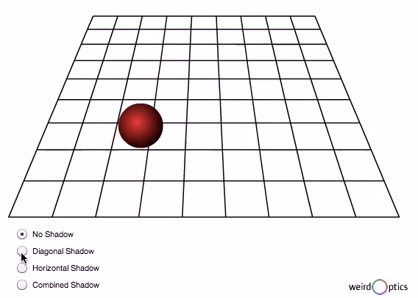

Slide 27
Evidence suggesting RCTs are superior to observational studies
Observational study results | RCT results
Extracranial to intracranial bypass: > 200 case series showed benefit | RCT (n=1377) RR increase of 14% for stroke
HRT for post-menopausal women: M-A of 16 cohort and 3 X-sectional studies: RRR of 0.5 for CAD | RCT (n=16,608): HRT increased risk of CAD HR=1.29
Cohort study (n=5133): significant decrease in CAD death with vit E | RCT (n=9541): no effect of vit E (harm from high doses)
Notes:
That’s the theory behind why RCTs are powerful and here are some examples of studies in which randomization made a big difference.
Surgeons developed an elegant and technically feasible method to bypass blocked arteries in the brain that were associated with stroke. The extracranial-intracranial arterial bypass was widely praised as a beneficial procedure for stroke victims in over 200 case series before a multicentre RCT was conducted. The RCT compared patients, all of whom received best medical therapy, and a random half of whom received EC-IC bypass. Those who received EC-IC bypass were shown to have a 14% increased risk of stroke compared with those who did not receive surgery.
Hormonal replacement therapy, in a meta-analysis of observational studies, was reported to be associated with a 50% decrease in coronary artery disease events, leading to widespread prescription into the postmenopausal period. Eventually, however, a large RCT was performed among over 16000 women, followed for several years, which showed a Hazard Ratio of 1.29, that is, a 29% increase in coronary artery disease among post-menopausal women receiving HRT.
In the third example, a large observational study found vitamin E to be associated with a significant decrease in coronary artery disease deaths – but an even larger RCT showed no such effect, and in fact found harm from higher doses.

Slide 28
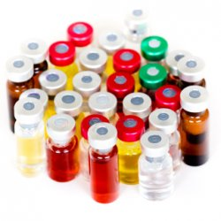


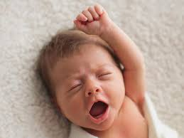
The randomized trial design - hemophilia
1
4
3
2
Notes:
Each participant center continuously updates the list of concentrates they are can/want to use
This info is tracked all along
Each participant center register all the newborn PUPs into the registry
Whenever a new PUPs is to be started on treatment, consent to randomization AND/OR data collection is chosen
Inhibitor events are collected on both the randomized and not randomized subjects

Slide 29
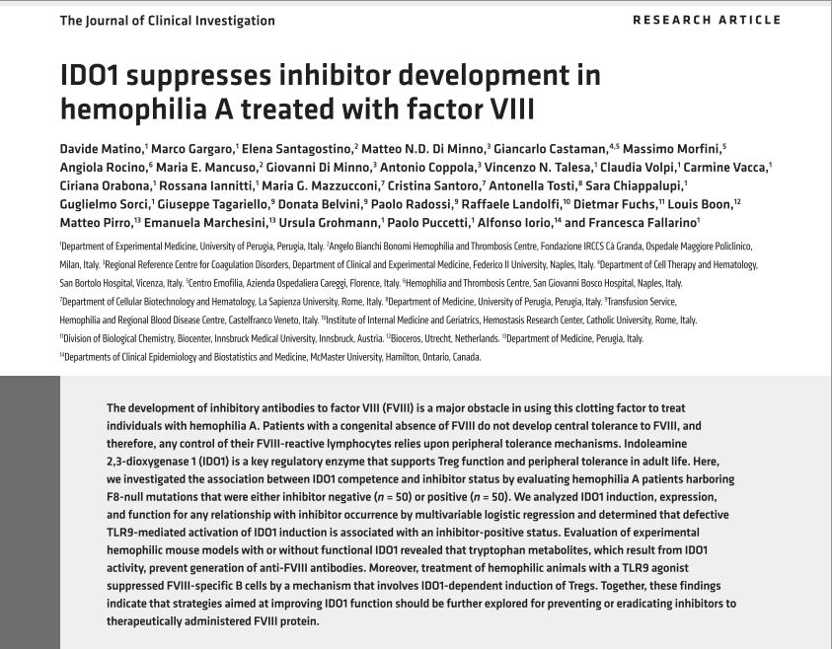
Tolerogenic interventions

Slide 30
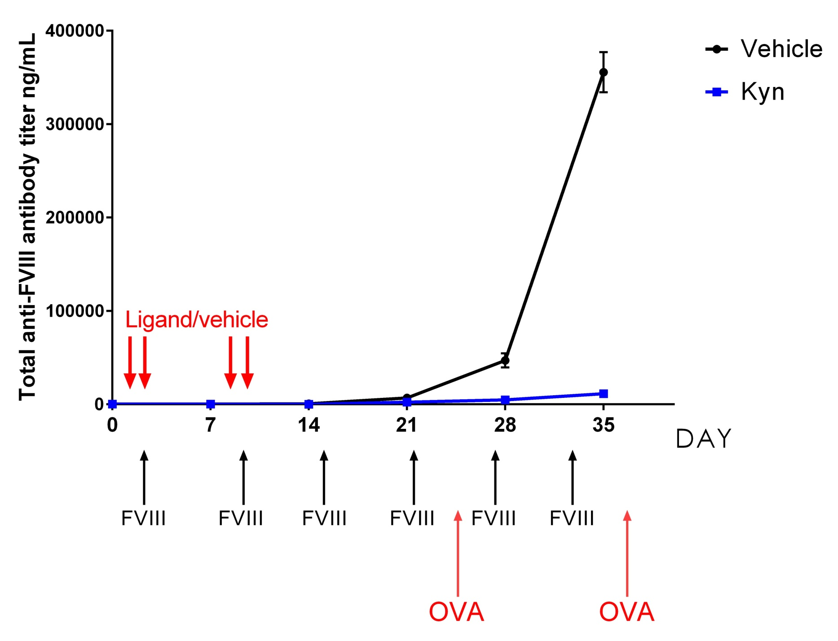
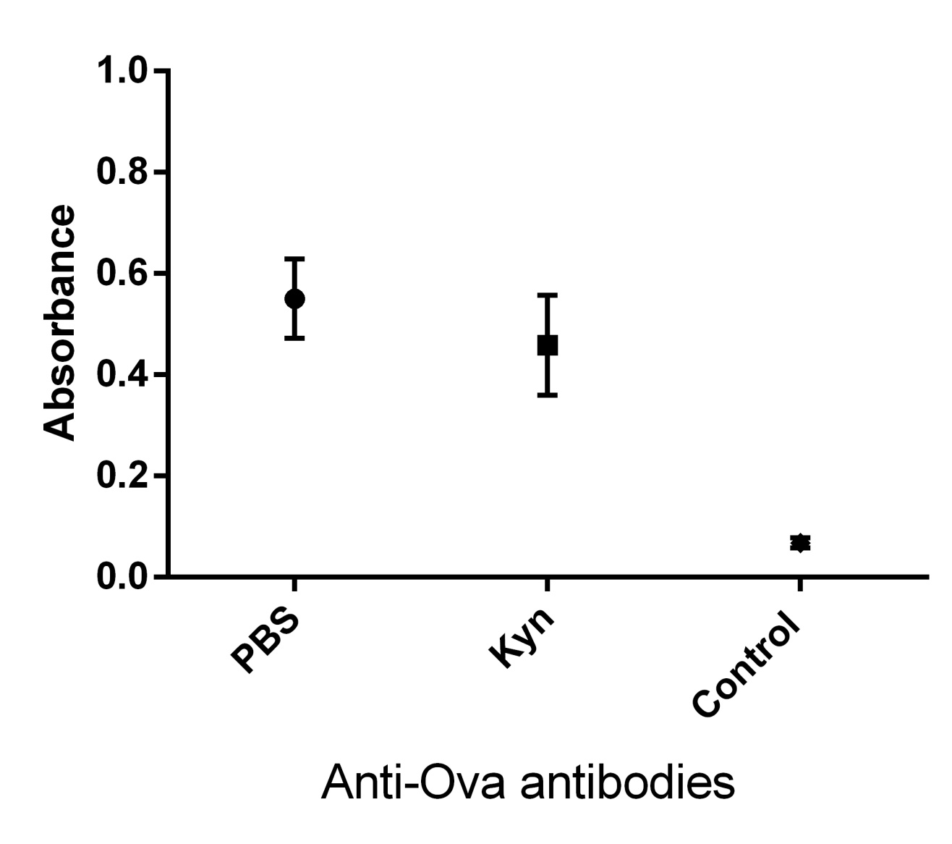
Treatment with kynurenine prevents anti-FVIII antibody development
Kynurenine/vehicle

Slide 31
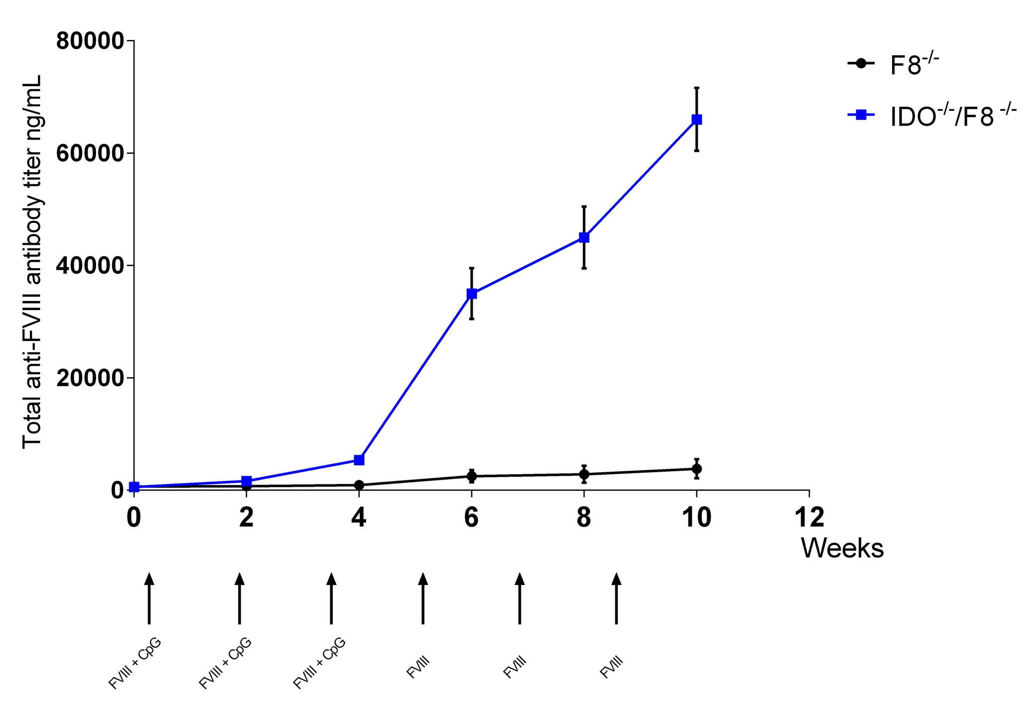
IDO1 induction through CpG ODN prevents inhibitor development in hemophilic mice
Notes:
Challenge with a prototypical danger (mimicking infection/tissue damage) signal that induces IDO protects mice from developing inhibitor ONLY if capable of induce IDO. IDO KO hemophilic mice develop higher titer inhibitor after challenge with rhFVIII and danger signal triggering innate immunity.

Slide 32
Inhibitor rates in PTPs
1.7 (95% CI 1.3 – 1.7) * 1000 pts y (43/4323)
3.0 (95% CI 1–4) per 1000 patients-years
(25 studies providing data on follow-up)
Xi M et al. J Thromb Haemost 2013;11:1655–62.
HA: 1.5 (CI 1 – 2.2) * 1000 pts y (26/17,667)
HB: 0.4 (CI 0 – 2.0) * 1000 pts y (1/2836)
Fischer K et al. Thromb Haemost 2015;113:968–75.

Slide 33
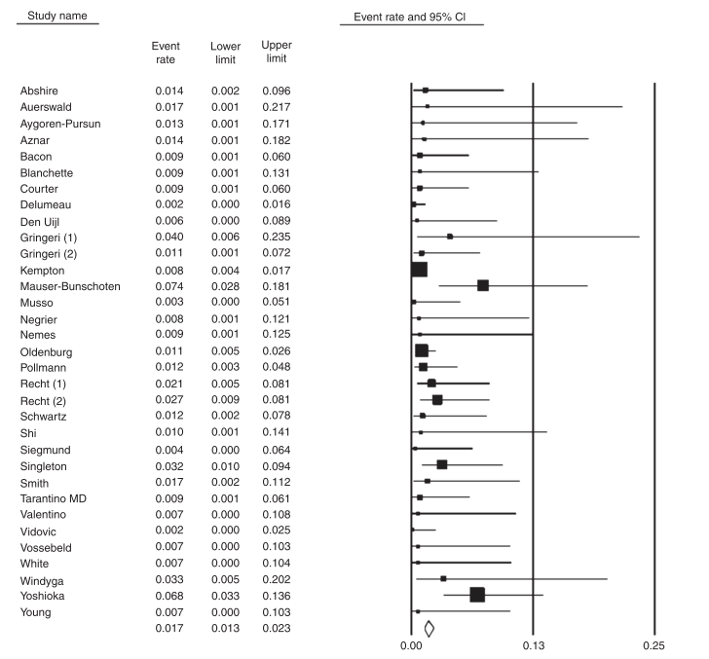
0/29
1/25
1/30
Xi, M et al. Journal of Thrombosis and Haemostasis : JTH, 2013; 11(9), 1655–62.
Notes:
Inclusion criteria: prospective or retrospective studies with follow up of at least 25 patients treated with factor VIII - separate data for PTPs to be available if PUPs included.
43 inhibitors in 4323 subjects
3 x 1000 patient years (1-4)

Slide 34
Inhibitor rates, selected recombinant FVIII
Product | Studies | Rate (x 100 py) | 95% CI
Advate | 9 | 0.10 | 0.05-0.18
Kogenate | 9 | 0.12 | (0.04-0.33)*
Refacto | 8 | 0.19 | 0.11-0.34
PD factor VIII | 4 | 0.09 | 0.02-0.45
* 0.26 (0.16 - 0.44) at fixed effect model
Xi, M et al. Journal of Thrombosis and Haemostasis : JTH, 2013; 11(9), 1655–62.
Notes:
This slide to show the variability and consequent imprecision of estimates for individual molecules; the analysis has to be considered hypothesis generating, and no formal statistical test is possible, being the cohorts completely unrelated.
The effect of adding Peerlink, invoke the importance of full data collection

Slide 35
Results: case retrieved
Literature:
29/43 cases
19 publications
Source population:
4443
EUHASS / CHESS
27/45 cases
19 centers
Source population:
31551 patient years
=> 7887 patients

Slide 36
Conclusions – PTP study
More than half of the inhibitors was cleared, either spontaneously or with ITI
More than half was low responder
Two only were refractory to ITI
1 in 4 had surgery and/or intense treatment in the previous 2 months.
Notes:
Check dataset for overlap
35 y median age
titre
intial 1.6 (1.6)
peak 4.8 (6.3) 135
last 0.4 (0.5) 41
follow up (months)
29 (39)
60% on demand
5% surgery
65% lifetime surgery
25% surgery within 2 month (20% in severe)
6% switch over last 2 months (******)
6% malignancy within 2 months, vaccination immune dis diagnosis
intense treatment
lifetime 47%
recent 24%
21 used bypassing
12 had ITI 10 successful
16 transient

Slide 37
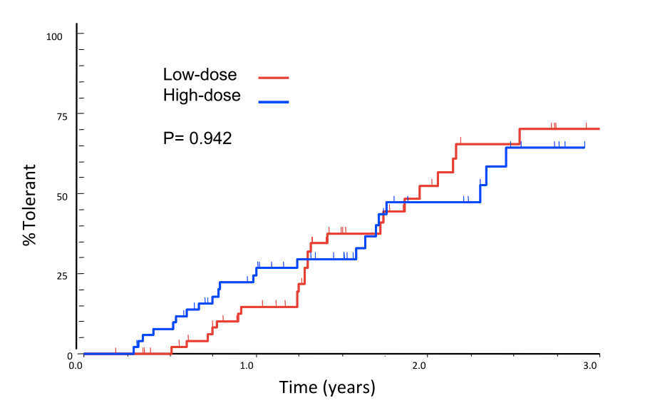
Immune Tolerance Treatment

Slide 38
Inhibitor clearance
Caram C, et al. Thromb Haemost 2011;105:59–65.
Tagariello G, et al J Hematol Oncol 2013;6:63.

Slide 39
Conclusion
Over the last 30 year the data collection capacity has enormously increased
However, a purely observational approach has not produced any actionable evidence
We need to climb up one step in our capacity to produce trustable comparative data

Slide 42
Thank you
Slides available for download at:
http://hemophilia.mcmaster.ca

