Slide 1
An Interview with A/Professor Alfonso Iorio – The International Perspective
With Co-Chairs:
Dr Chris Barnes and Dr Simon McRae
HFA Conference, October 2015
HG-AU-0142

Slide 2
Disclaimer
The content for this session was determined by an independent steering committee – Dr Chris Barnes and Dr Simon McRae
The views and opinions expressed during this discussion are those of the physicians and do not necessarily reflect the position of Biogen
The responses have not been pre-written or rehearsed, and Biogen has not had any input into, or reviewed, the content of this discussion
The discussion may contain information relating to products or use of products that are not yet approved for use in Australia; Biogen does not endorse or promote any such information
Prescribers are cautioned to use their own professional judgement and consult any other necessary or appropriate sources prior to making clinical judgements for individual patients based on the content of this discussion
Primary references and full prescribing information for any product mentioned herein should always be consulted
HG-AU-0142

Slide 3
Biography: Alfonso Iorio MD (Perugia), PhD (Perugia), FRCPC
Dr Iorio is an Associate Professor of Clinical Epidemiology & Biostatistics and Medicine at McMaster University. He is Chief of the Health Information Research Unit with clinical service at the Congenital Bleeding Disorders Clinic at MUMC and Thrombosis Service at the Juravinski and MUMC.
His main research interest is in targeting research results to individual specificities, joining knowledge translation, risk stratification and usage of individual patient data databases. He is the principal investigator of three multicentric initiatives: CHESS (Canadian Hemophilia Surveillance Scheme), the Canadian “branch” of the EUHASS surveillance scheme for adverse effects of haemophilia treatment; CBDR (Canadian Bleeding Disorders Registry), the new clinical management software of the network of haemophilia clinics in Canada; WAPPS-Hemo (Web Available Population Pharmacokinetics Service for Hemophilia) a web-based solution for simplified estimation of individual factor concentrate pharmacokinetic.
Dr Iorio is an Associate Editor for Blood Coagulation Disorders of the Cystic Fibrosis and Genetic Disorders Review Group of the Cochrane Collaboration, and Chair of the Data and Demographics Committee of the World Federation of Hemophilia (WFH).
HG-AU-0142

Slide 4
Personalized prophylaxis

Slide 5
WAPPS: vision
Barrier:
Number of samples
PK
Solution:
Population PK

Slide 6
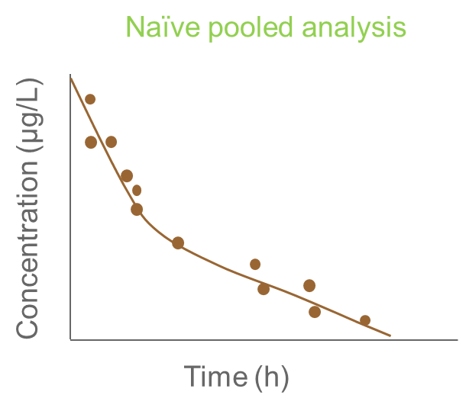
Population Pharmacokinetics isn`t = “Non linear mixed effect” analysis
Two-stage analysis | Naive pooled analysis
1.) Each individual is modeled 2.) Parameters are summarized | All individuals are modeled as if they were one individual
1 sample per subject
Population PK parameter
Individual PK parameter
Sparse Sampling
Estimated Variability
Population PK parameter
Individual PK parameter
Sparse Sampling
Estimated Variability
Notes:
Using population Pharmacokinetics (popPK) the variability in the observed drug concentration within and between subjects can be quantified to help us understanding the PK of a drug, i.e. how fast and to what extent a drug is absorbed, distributed and eliminated.
We can distinguish the variability within a subject or population, which can be described using a structural PK model. In this example, the trend of decreasing concentration after iv dosing can be described by a one-compartmental model, assuming that body can be reflected/modelled by one compartment with an apparent volume of disttribution Vd and is eliminated by a first order elimination / clearance process, defined by the Clearance (CL). As can be seen in the example, the structural variability within this subject can be described adequately.
However, if we look at the structural variability from other subjects, we can observe that there is also variability between subjects, as the concentration versus time profiles differ among subjects. This between subject variability can be described by assuming that the structural PK parameters, CL and Vd in this example, differ between subjects. It is assumed that these difference occur at random, i.e. we do not know why these parameters differ among subjects. The distribution of this random process is described with a statistical/stochastic model.

Slide 7
Population PK
Classical approach
Mixed approach
Population approach
Derivation
Rich data in a
limited sample of
individuals
Average of iPK
Derivation
Rich data in a
large sample of
Individuals
Population model
Derivation
Sparse data in a
large sample of
individuals
Population model
Estimation
Bayesian estimation
individual sparse data population priors
Individual PK

Slide 8
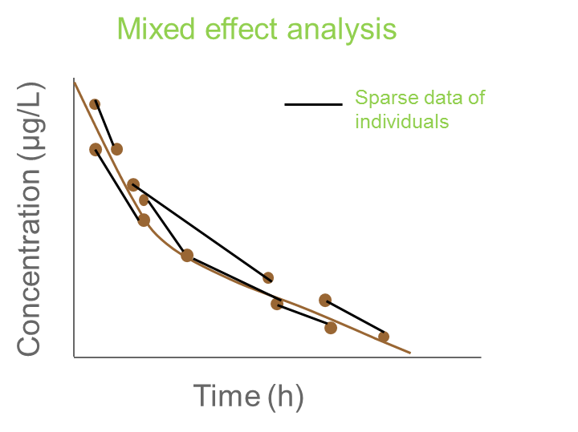
..“Non linear mixed effect” analysis is one of the best methods to estimate popPK
Mixed effect analysis (popPK)
One population model is fit to data Data sampled within individuals are considered to be correlated Variation between and within subjects are explained using statistical parameters
Population PK parameter
Individual PK parameter
Sparse Sampling
Estimated Variability
Technical complex
Notes:
Using population Pharmacokinetics (popPK) the variability in the observed drug concentration within and between subjects can be quantified to help us understanding the PK of a drug, i.e. how fast and to what extent a drug is absorbed, distributed and eliminated.
We can distinguish the variability within a subject or population, which can be described using a structural PK model. In this example, the trend of decreasing concentration after iv dosing can be described by a one-compartmental model, assuming that body can be reflected/modelled by one compartment with an apparent volume of disttribution Vd and is eliminated by a first order elimination / clearance process, defined by the Clearance (CL). As can be seen in the example, the structural variability within this subject can be described adequately.
However, if we look at the structural variability from other subjects, we can observe that there is also variability between subjects, as the concentration versus time profiles differ among subjects. This between subject variability can be described by assuming that the structural PK parameters, CL and Vd in this example, differ between subjects. It is assumed that these difference occur at random, i.e. we do not know why these parameters differ among subjects. The distribution of this random process is described with a statistical/stochastic model.

Slide 9
WAPPS - HEMO
Brand specific Source individual PK data
Single patient data
patients
patients
patients
Control files for bayesian individual estimation
Web-application
Online PPK engine
(NONMEM)
Offline PPK modeling
ADVATE
KOGENATE
BENEFIX
ALPROLIX
ELOCTATE
Others..
Brand specific PPK models
Single patient report

Slide 10
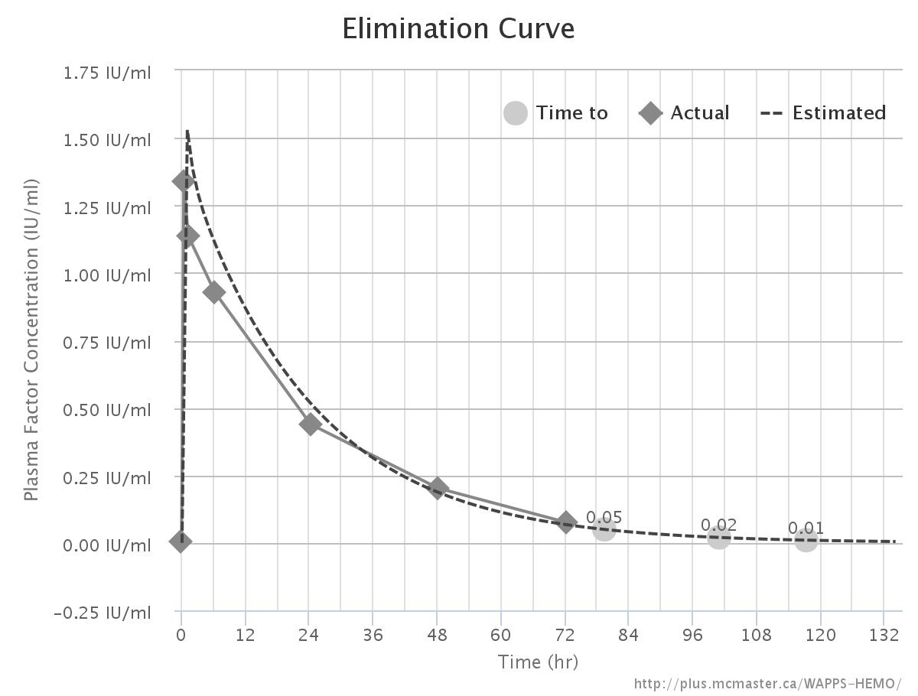
Advate
Points term HL time to 0.02
All 16.5 101
4 days

Slide 11
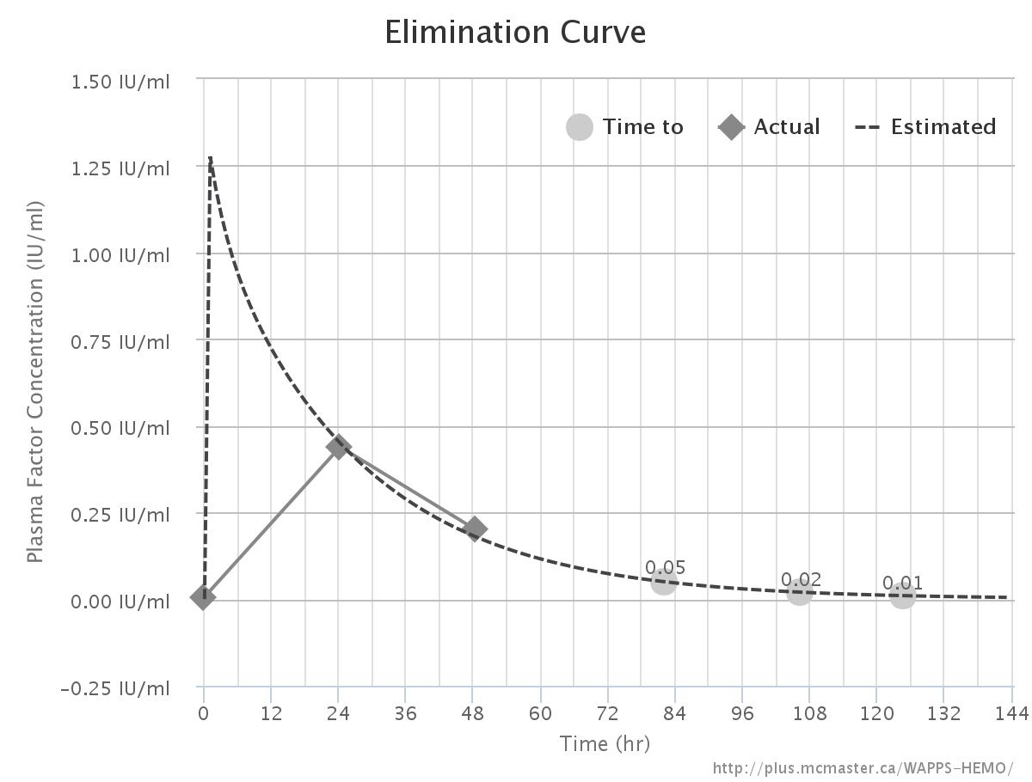
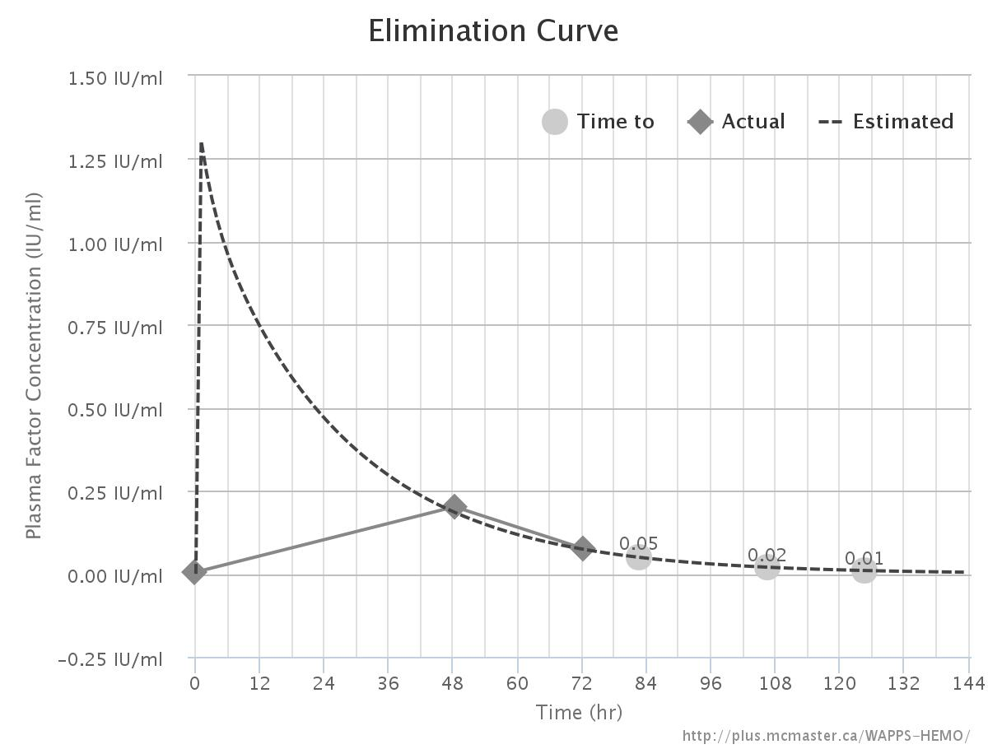
Advate
Points term HL time to 0.02
All 16.5 101
48-72 18 106 4 g
24-48 18.5 106

Slide 12
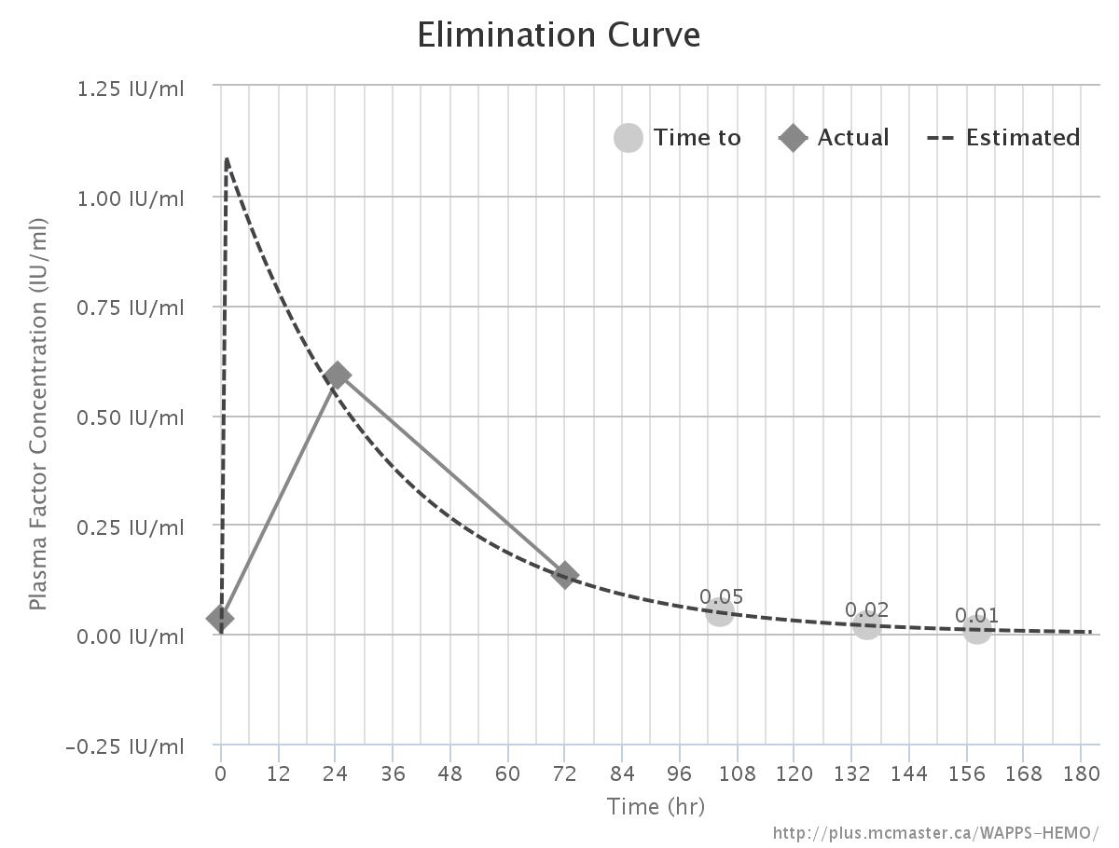
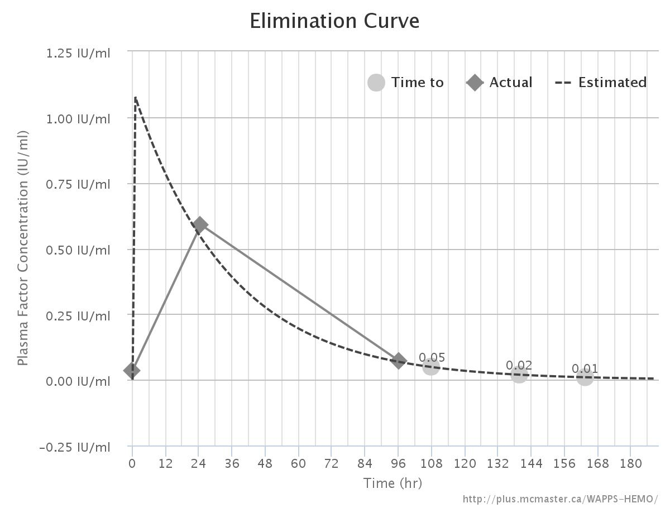
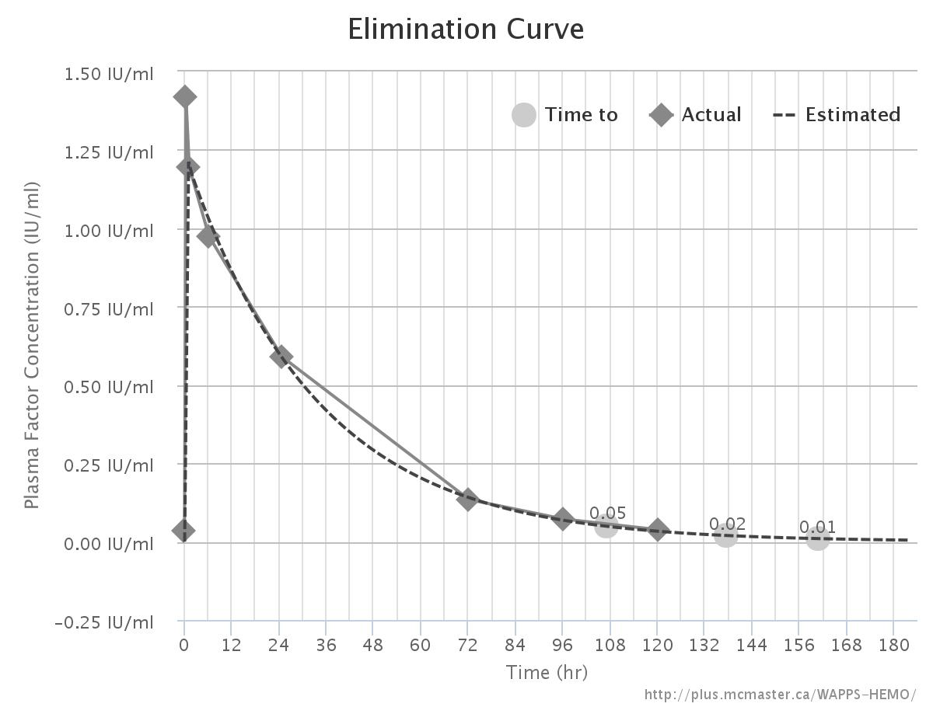
Advate
Points term HL time to 0.02
All 16.5 101
48-72 18 106 4 g
24-48 18.5 106
Eloctate
Points term HL time to 0.02
24-72 23 135
24-96 24 139 5 ½ g
All 23 137

Slide 13
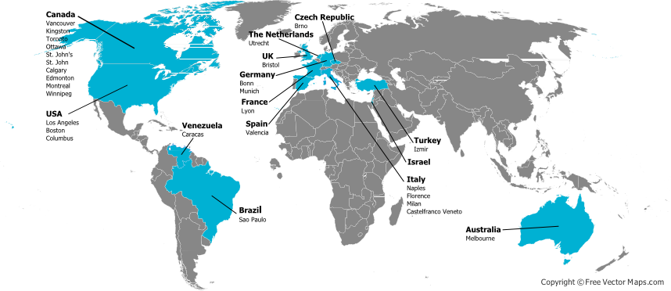
The WAPPS network

Slide 14
Thank You
HG-AU-0142

