Slide 1
Connecting Pharmacokinetics and Phenotypes to Tailored Hemophilia Treatment 1. Pharmacokinetic approaches
Professor Alfonso Iorio, MD, PhD, FRCPC
Director, Health Information Research Unit
Director, Hamilton-Niagara Hemophilia Program
McMaster University, Hamilton, ON, Canada
iorioa@mcmaster.ca
Notes:
1

Slide 2
Learning objectives…
PK basics
PK in practice
Setting goals
Barriers
Perspectives

Slide 3
1 – Pharmacokinetic estimation

Slide 4
Plasma Drug Disposition after a Single IV bolus
Peak, C_{max}, Recovery
Concentration (%)
AUC
Half-life
Trough
Time (hours)

Slide 5
Basic Pharmacokinetics
MEASURED
AUC_{last} = measured until the last data point
k = estimated on the last (sole) monotonic curve (C_{t} = C₀ * e^{-kt})
CALCULATED
AUC_{inf} = Calculated starting from AUC_{last} and k
Clearance = Dose / AUC_{inf}
V_{d(ss)} = Clearance/k
MRT=V_{d(ss)}/Cl
T_{1/2}= 0.693/k

Slide 6
Classical PK study design
Infuse, dose and estimate Pk for a small population (15-25 patients)
Calculate average values for the population
Apply to the average to all subsequent patients
THIS IS A METHOD TO STUDY THE CHARACTERISTICS OF A DRUG, NOT TO TAILOR TREATMEN TO A SPECIFIC PATIENT
Morfini M, Lee M, Messori A. Thromb. Haemost. 1991; 66(3), 384–6
Lee M, Morfini M, Schulman S, Ingerslev J. ISTH Website, Sci. Stand. Comm. Commun. , 1–9 (2001).

Slide 7
SR of the Published Evidence on the PK Characteristics of Factor VIII and IX Concentrates
Factor | Class | Studies | Patients | Half-life (h)
FVIII | Wild type | 30 | 790 | 7.82- 19.2
 | BDD | 12 | 339 | 7.5 – 17.7
 | EHL | 3 | 106 | 11.5 – 23.8
FIX | Wild type | 22 | 492 | 12.9 - 36
 | EHL | 6 | 106 | 53.5 – 110.4
Xi M et al. Blood 2014; 124 (21) Abs.

Slide 8
2 – Measuring factor levels

Slide 9
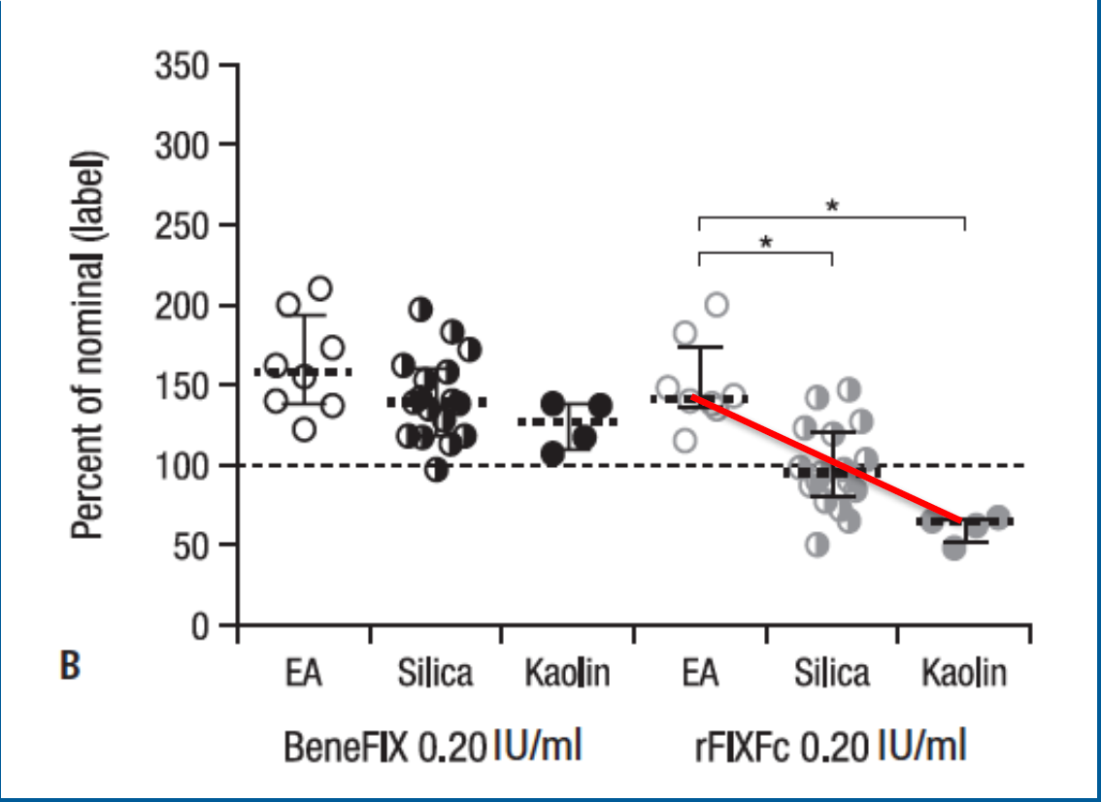
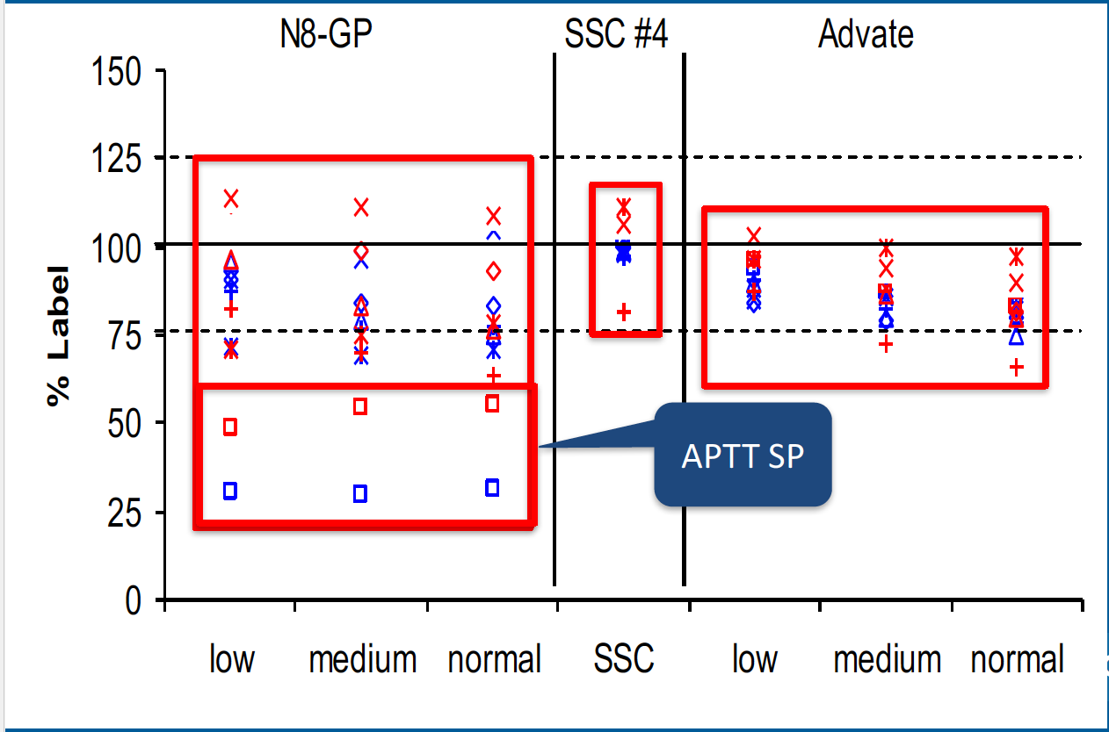
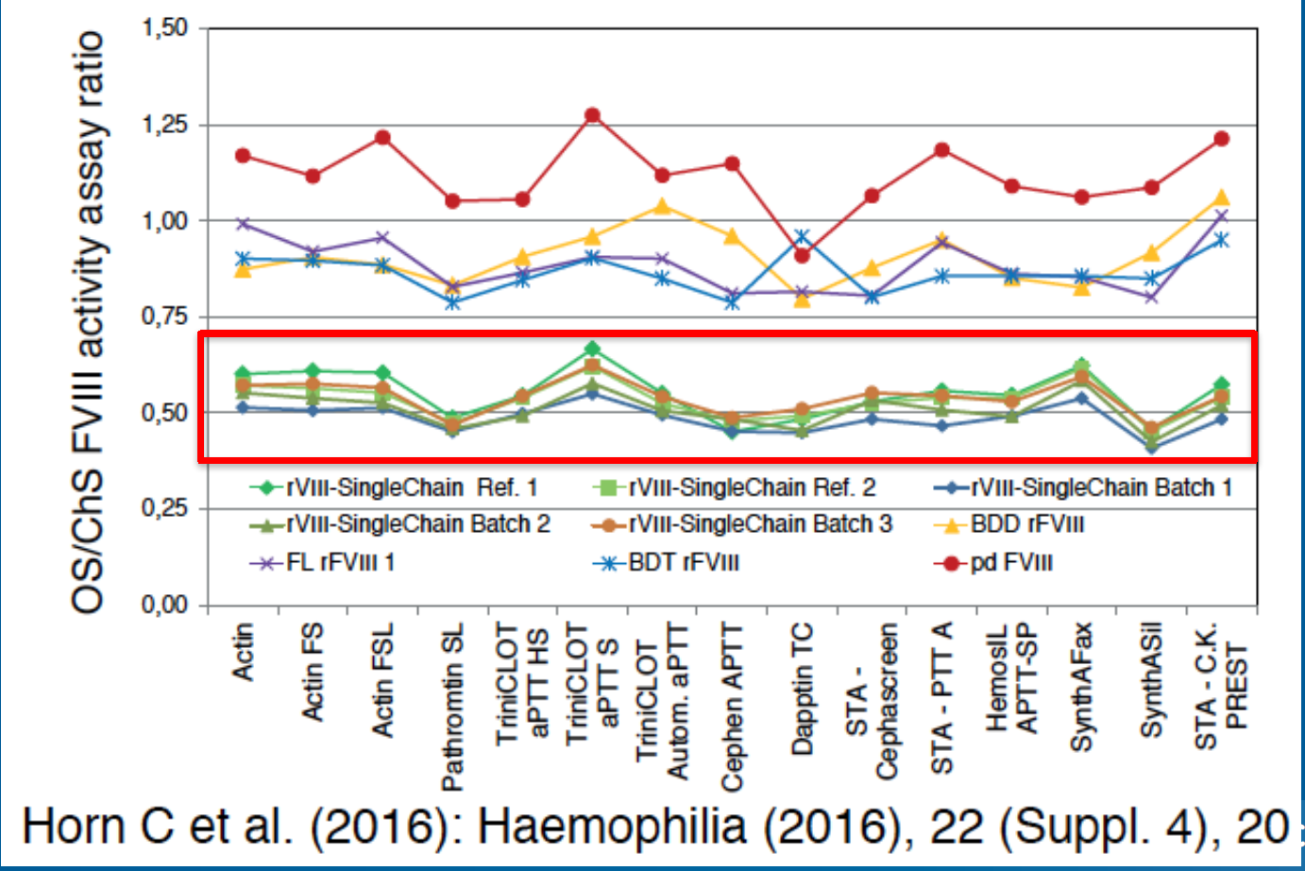
Measuring factor VIII/IX plasma levels
Bowyer, A et al JTH 2016,14 (7):1428-35
Sommer J Blood Coag Fibrinol 2016
Courtesy of Prof Gay Young,
Freely adapted
Notes:
Measuring factor IX activity of nonacog beta pegol with commercially available one-stage clotting and chromogenic assay kits: a two-center study.

Slide 10
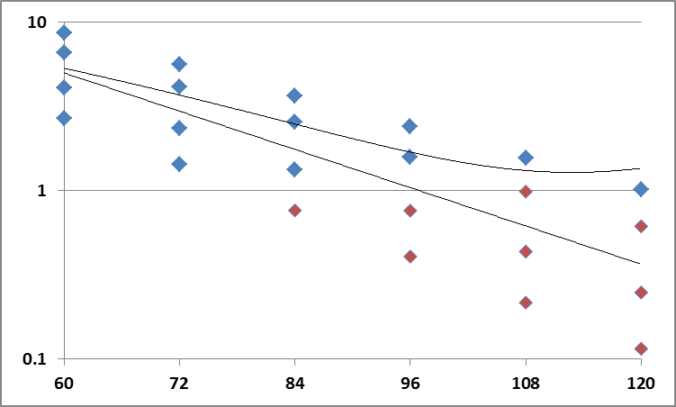
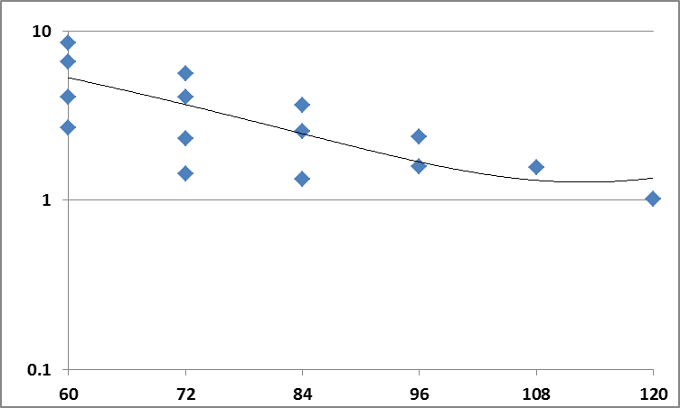
Impact of samples Below Limit of Quantitation
LOG c:fVIII [IU/dL]
BLQ
Courtesy of Dirk Gartmann
TIME (hr)
Notes:
Typically those measurements are limited and ignored in population PK

Slide 11
Single patient – BLQ and measurement errors
?

Slide 12
Single patient – BLQ and measurement errors

Slide 13
Single patient – BLQ and measurement errors

Slide 14
Single patient – BLQ and measurement errors

Slide 15
3 – Measuring (and modelling) (individual) variability

Slide 16
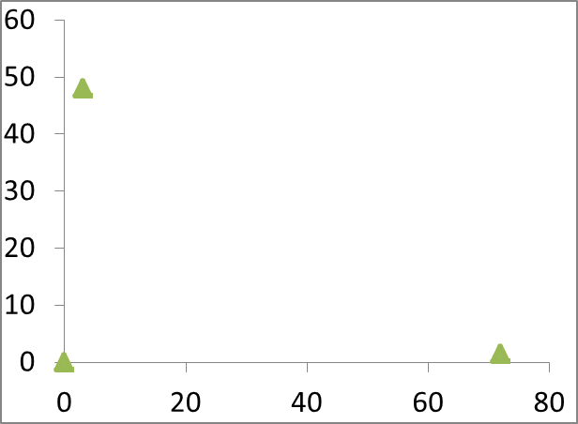
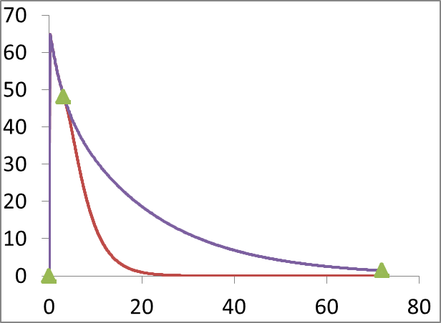
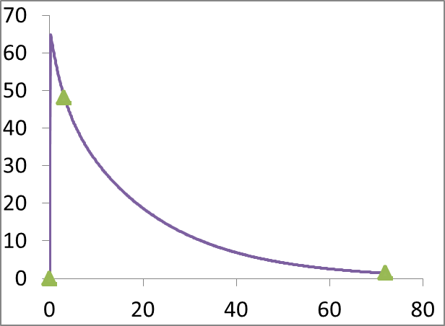
Individual PK can be estimated by using popPK based structural model and variability information
sparse samples
Many possibilities for PK/profiles
most likely PK/profile
+ popPK information
STRUCTURAL MODEL
DOSE
CL
V
VARIABILITY

Slide 17
The Bayesian approach to individual PK estimates – step 1
According to the Bayesian principle,
The best assumption about an individual PK, before any FVIII:C data have been measured is:
taking the values calculated from the population model, using any covariates if applicable
E.g., the most likely CL for FVIII is calculated from BW and age.

Slide 18

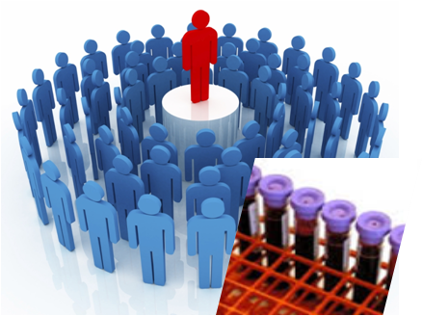
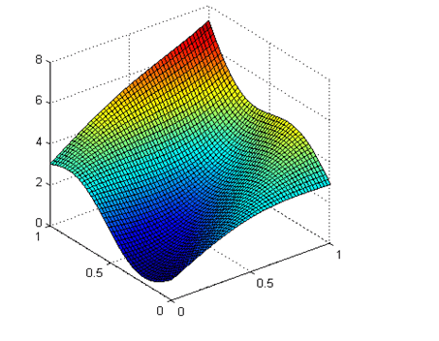
The Bayesian approach to individual PK estimates – step 2
Patient specific values shifts the estimate
- from the most likely (population based)
- towards the individuals actual values.
As biological measurements are imprecise, a probabilistic approach is adopted:
- few measurements → compromise between model and best fit to the data
- more measurements → More weight given to the individual
Statistically, this balance is handled by comparing
- the variability of PK parameters between individuals
- with the residual variance in the estimation process

Slide 19
Modeling: base structural model
1-cmt
FO
FOCE
FOCEI
Type
Estimation Method
IIV
Residual Variability
Model Parameters
Assessment
Laplacian
Additive
CCV
Exponential
Additive
CCV
Additive+CCV
Cl
Vol
OBJF
Diagnostic
plots
Notes:
Base compartment model – using CONCENTRATION and DOSE – we are estimate our two parameters of interest – clearance and volume
Objective function is based on extended least squares
Note: FOCEI is the current standard method for NONMEM analyses
FO – first order estimation; FOCE – first order conditional estimation;
FOCEI – first order conditional estimation interaction
Laplaian

Slide 20
Population PK
Classical approach
Mixed approach
Population approach
Derivation
Rich data in a
limited sample of
individuals
Average of iPK
Derivation
Rich data in a
large sample of
Individuals
Population model
Derivation
Sparse data in a
large sample of
individuals
Population model
Estimation
Full study (rich data)
of the individual of interest
Individual PK
Estimation
Bayesian estimation
individual sparse data population priors
Individual PK

Slide 21
4 –Practical solutions to barriers

Slide 22
The WAPPS core team
Principal investigators: Iorio, Alfonso and Hermans, Cedric
Advisory Committee: Blanchette, V; Collins, P; Morfini, M; Berntorp, E;
Project coordinator: Navarro, Tamara
Information Technology: Cotoi, Chris; Hobson, Nicholas;
Pharmacokinetics: Edginton, Andrea; McEneny-King, Alanna
Statistics: Foster, Gary; Thabane, Lehana;
Consultant: Bauer, Rob (Consultant at ICON)
Literature search, data entry: Xi, Mengchen; Mammen, Sunil; Yang, Basil;
User testing: Bargash, Islam

Slide 23
WAPPS project: derivation/validation cohorts
Cohort | # of subjects | # of PKs
Derivation | > 750 | > 1200
Validation | 240 | 275

Slide 24
Modeling: base structural model
1-cmt
FO
FOCE
FOCEI
Type
Estimation Method
IIV
Residual Variability
Model Parameters
Assessment
Laplacian
Additive
CCV
Exponential
Additive
CCV
Additive+CCV
Cl
Vol
OBJF
Diagnostic
plots
Notes:
Base compartment model – using CONCENTRATION and DOSE – we are estimate our two parameters of interest – clearance and volume
Objective function is based on extended least squares
Note: FOCEI is the current standard method for NONMEM analyses
FO – first order estimation; FOCE – first order conditional estimation;
FOCEI – first order conditional estimation interaction
Laplaian

Slide 25
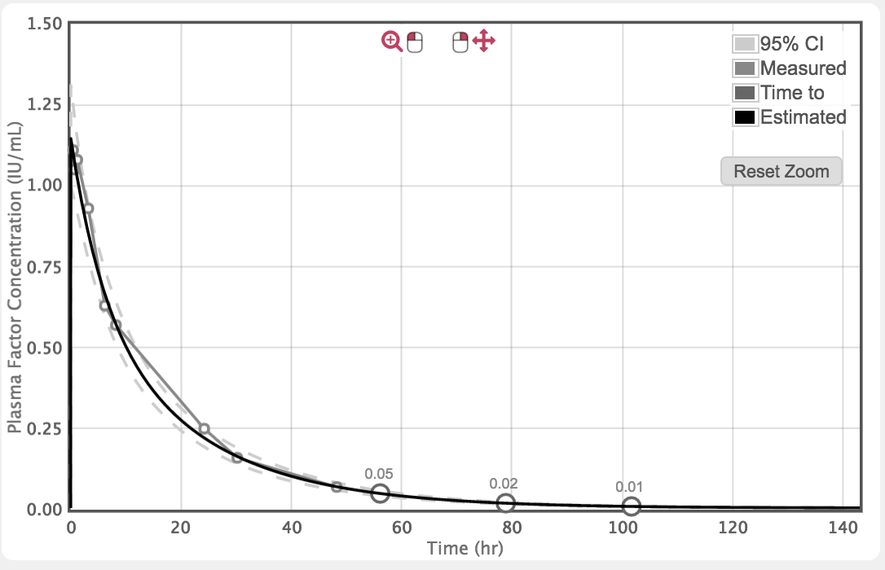
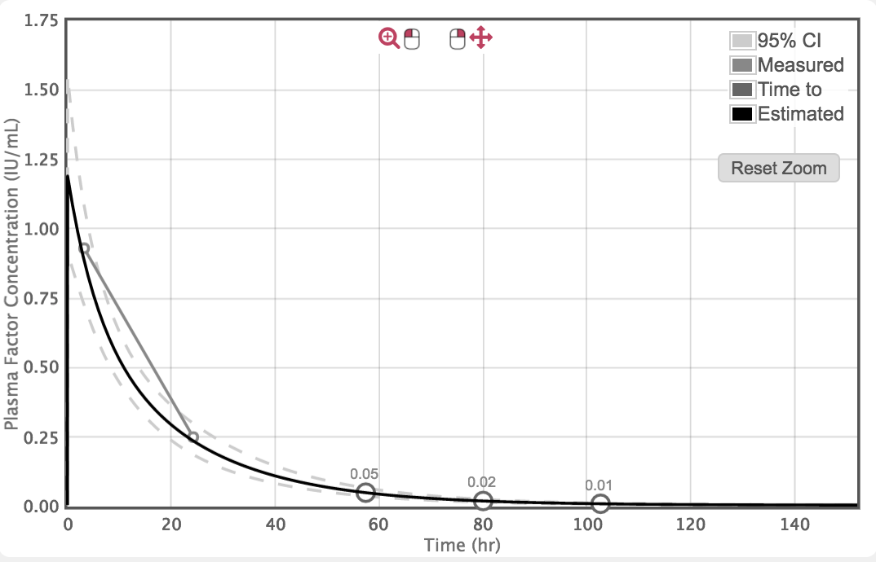
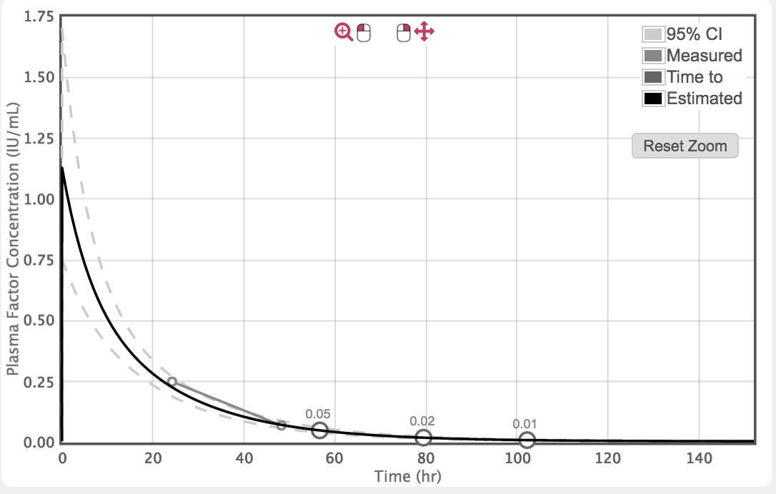
Kowaltry 50 IU/Kg
Samples term HL time to 0.01 (hr)
All 14.25 101.75
3-24 14.2 102.5
24-48 14.25 102.25

Slide 26
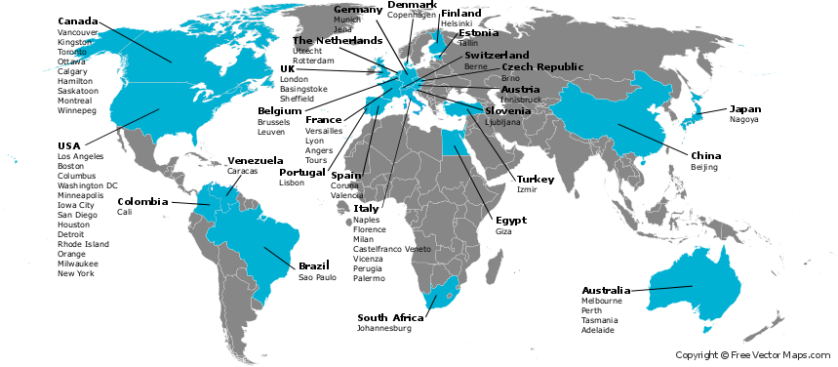
The WAPPS network
The Development of the Web-based Application for the Population Pharmacokinetic Service – Hemophilia (WAPPS-Hemo) – Phase1.
ClinicalTrials.gov Identifier: NCT02061072. Available at: https://clinicaltrials.gov/ct2/show/NCT02061072.

Slide 27
PK studies performed on the WAPPS platform
Cohort | # of subjects | # of PKs
Derivation | > 750 | > 1200
Validation | 240 | 275
WAPPS | 407 | 453
Total | >1500 | >2000

Slide 28
Optimal sampling time
Factor VIII
4, 24 and 48 h
Alternatives
8, 30 h
24 h alone
Factor IX
48-54, 72-78 h
(anytime during day 2 and 3)
Based on re-analysis of data from 41 FVIII PK studies
Single study, multiple sourced patients
Bjorkman S. Haemophilia 2010; 16: 597–605.
Brekkan A et al. J Thromb Haemost 2016;13:1-9
Notes:
sampling at 4, 24 & 48 h, equals to 7–10 samples
gave useful but less accurate results, gave useful but less accurate results

Slide 29
Bjorkman, S JTH 2013;11:180-2
Notes:
Comment on one vs two compartment modelling

Slide 30
Practicalities
Washout is not needed
Five FVIII half-lives would correspond to up to 5 days in prophylaxis patients.
Data from practically any dosing schedule.
Residual above baseline can be modeled
For optimal assessment, doses and times of preceding infusions must be known for at least five half-lives (after which <3% of a dose remains in the body) before the study infusion.

Slide 31
Study population
Comparison of WAPPS and MyPkFit estimates
20 subjects external to the derivation and validation cohort
 | Age | BW(Kg) | Dose (IU/Kg)
Median (min-max) | 14 (10-80) | 46 (18-96) | 32.9 (20.5 -61.1)
Notes:
20 subjects external to the derivation and validation cohort

Slide 32
Comparison of WAPPS and MyPK Fit estimates

Slide 33
Comparison of WAPPS and MyPK Fit estimates
MyPKFit average overestimate of 2.15 hrs
MyPKFit average overestimate of 8 hrs

Slide 34
4 – Setting thresholds

Slide 35
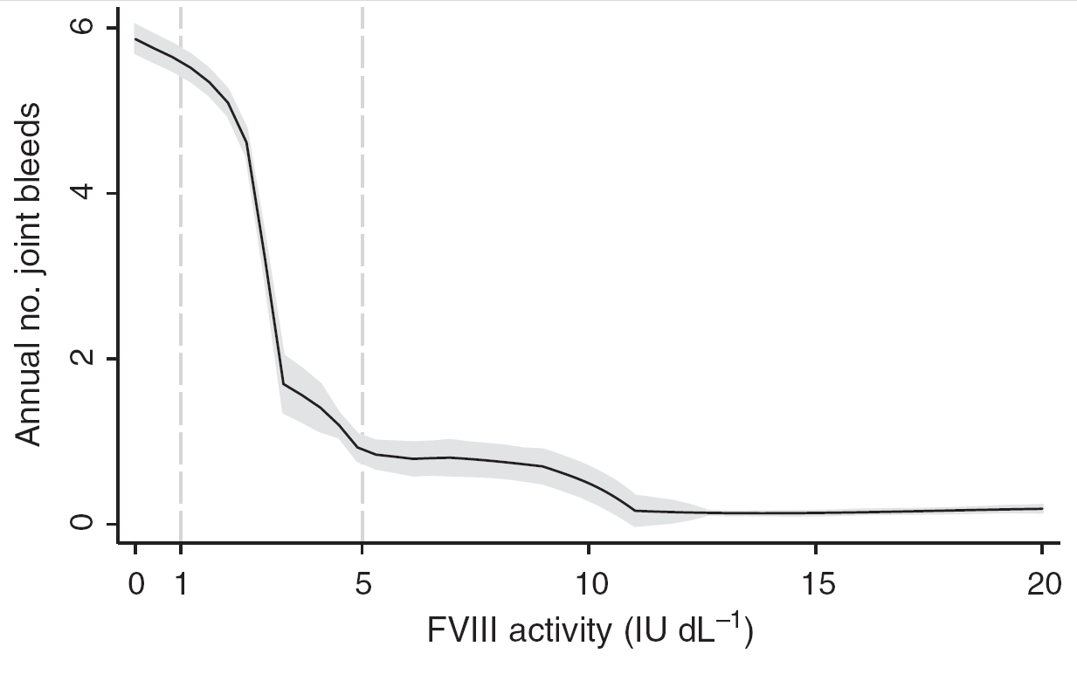
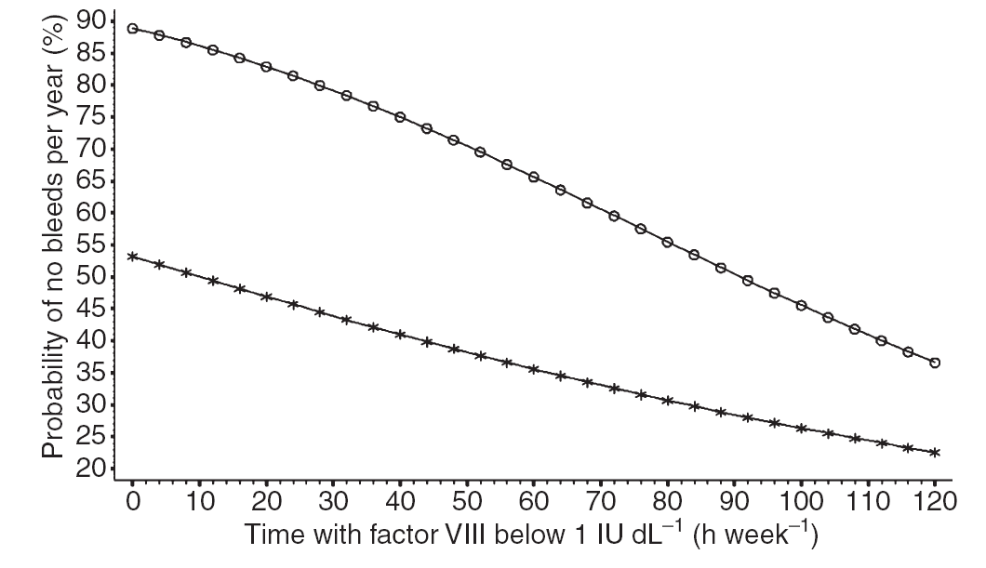
Endogenous (left) and therapeutic (right) factor levels and bleeding
Annual number of joint bleeds by FVIII activity
Annual probability of zero bleeds by time below 1%
den Uijl IEM, Mauser Bunschoten EP, Roosendaal G, et al. Haemophilia 2011;17:849–53.
Collins PW, et al. J Thromb Haemost. 2009;7(3):413-20.
Notes:
Maybe only one of the 3 slides (slide 18, 19, 20) is needed as it refers to the same topic.

Slide 36
Patient 1 – BeneFix 50 U/kg
(hrs, 95 % CrI) | Pt 1 | Pt 2
Terminal half-life | 20.5 | 26.0
Time to 0.05 IU/ml | 46.5 (41.5–51.5) | 35 (30–39.75)
Time to 0.02 IU/ml | 73.75 (65.25–83.25) | 68.75 (58.25–79.5)
Time to 0.01 IU/ml | 94.5 (81.25–107.5) | 95 (75.75–114.25)
0.50 IU/ml
0.40 IU/ml
0.30 IU/ml
Plasma Factor Concentration (IU/ml)
0.20 IU/ml
0.10 IU/ml
0.00 IU/ml
0.01
-0.10 IU/ml
0
12
24
36
48
Time (hr)
60
84
96
Time (hr)
108

Slide 37

Personalized prophylaxis
PK
Carcao, M. & Iorio, A. (2015) Individualizing Factor Replacement Therapy in Severe Hemophilia. Seminars in Thrombosis and Hemostasis, 41, 864–871.

Slide 38

Thank you !!!
Join the WAPPS network at:
www.wapps-hemo.org
Download these slides at:
Hemophilia.mcmaster.ca

