Slide 1
How HIRU Might Support Chronic Pain Research
Alfonso Iorio, MD, PhD, FRCPC
Professor, McMaster University

Slide 2
Disclosures
Direct financial
None
Indirect financial
Member of the CPN SPOR and CanVECTOR network (CIHR funded)
Supported by research service agreements with EBSCO, ACP, Walter-Kluvers, McGraw-Hill
Intellectual
Director, Health Information Research Unit

Slide 3
Objectives
Health Information Research Unit
Hedges
The PLUS suite of products
CPN Pain +
Patient oriented communication strategies

Slide 5
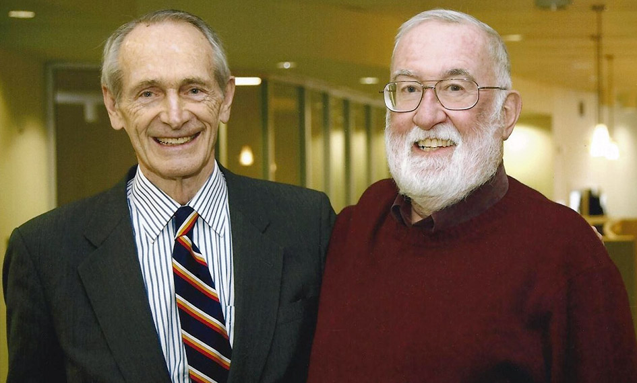
Our roots
“Evidence-based medicine is the integration of best research evidence with clinical expertise and patient values”
Notes:
Sackett DL, Rosenberg WMC, Gray JAM, Haynes RB, Richardson WS: Evidence based medicine: what it is and what it isn’t. BMJ 1996;312:71-2.
This definition of what EBM is and isn’t has gained wide acceptance and made it easier for us to get our points across.

Slide 6
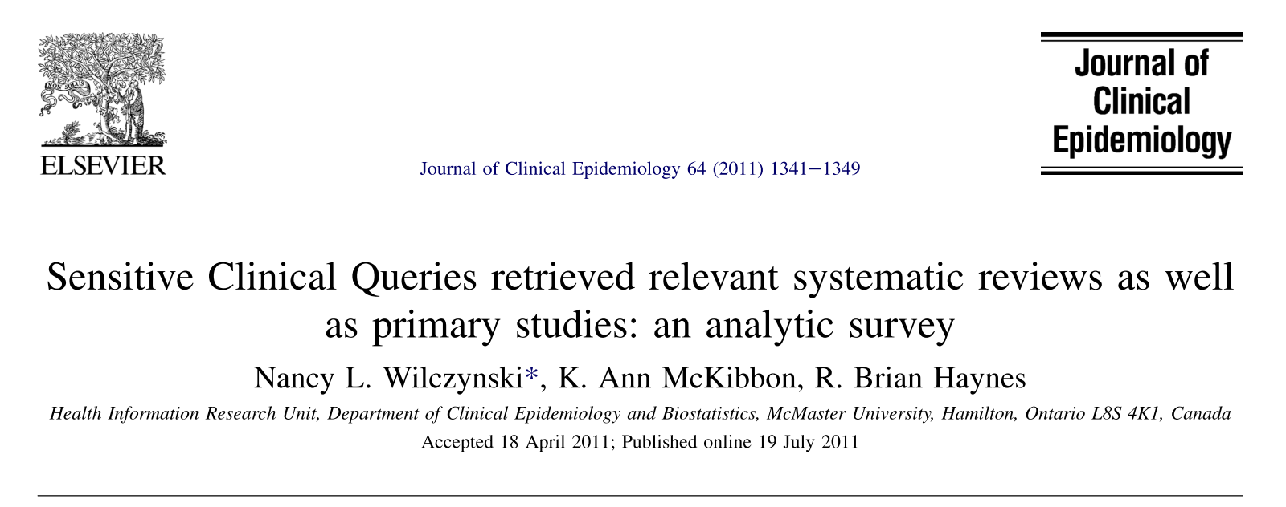
The Hedges project

Slide 7
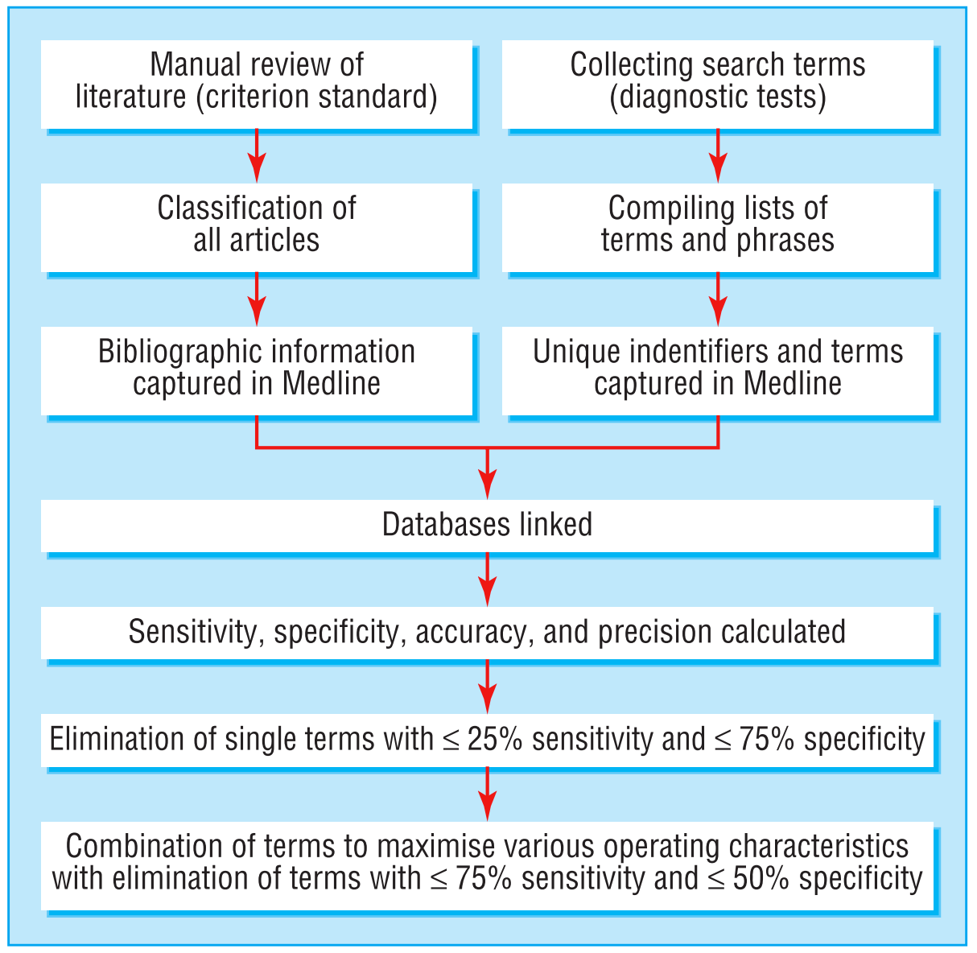
Haynes RB.
BMJ. 2005;330:1179–0.

Slide 8
The Hedges project
 | Manual classification
Search term | Meets criteria | Does not meets criteria
Detected | a | b
Non detected | c | d
 | a+c | b+d
Sensitivity = a/(a+c) = proportion positive retrieved
Specificity = d/(b+d) = proportion negative excluded
Precision = a/(a+b) = proportion positive in retrieval set
Accuracy = (a+d)/(a+b+c+d) = proportion correctly classified
Haynes RB. BMJ. 2005;330(7501):1179–0.

Slide 9
The Hedges project
Search strategy (using Ovid format) | Sensitivity (%) (95% CI) | Specificity (%) (95% CI) | Precision (%) (95% CI) | Accuracy (%) (95% CI)
Randomized controlled trial.pt. OR randomized.mp. OR placebo.mp. | 95.8 (94.5 to 97.1) | 95.0 (94.8 to 95.3) | 38.5 (36.5 to 40.5) | 95.0 (94.8 to 95.3)
Randomized controlled trial.mp. OR randomized controlled trial.pt. OR randomized.tw. OR placebo:.tw.Randomized | 95.8 (94.5 to 97.1) | 95.0 (94.7 to 95.2) | 38.4 (36.4 to 40.4) | 95.0 (94.8 to 95.3)
Randomized controlled trial.pt. OR randomized.tw. OR placebo:.tw. | 95.8 (94.5 to 97.1) | 95.0 (94.7 to 95.2) | 38.4 (36.4 to 40.4) | 95.0 (94.8 to 95.3)

Slide 10
Hedges: sensitive filters
RCT only | Sensitivity | Specificity | Precision
Treatment | 99.2 (98.7 - 99.6) | 70.1 (69.7 - 70.6) | 10.0 (9.5 - 10.5)
Diagnosis | 97.4 (95.1 - 99.6) | 74.3 (73.9 - 74.7) | 1.5 (1.3 - 1.7)
Prognosis | 84.0 (79.0 - 88.9) | 79.7 (79.4 - 80.1) | 1.8 (1.5 - 2.0)
Etiology | 91.1 (88.8 - 93.4) | 63.5 (63.0 - 63.9) | 2.9 (2.6 - 3.2)
RCT + SR | Sensitivity | Specificity | Precision
Treatment; - | 99.5 (99.2 - 99.8) | 54.8 (54.3 - 55.2) | 9.5 (9.1 - 9.9)
Diagnosis | 99.5 (98.5 - 100.0) | 56.6 (56.1 - 57.0) | 0.9 (0.8 - 1.0)
Prognosis | 93.9 (90.6 - 97.1) | 61.3 (60.8 - 61.7) | 1.0 (0.9 - 1.2)
Etiology | 97.9 (96.8 - 99.1) | 51.0 (50.6 - 51.4) | 2.3 (2.2 - 2.5)
Wilczynski NL. J. Clin. Epidemiol. 2011;64(12):1341–1349.
Notes:
(1) sensitivity: the proportion of relevant, sound articles (e.g., original and review treatment articles) in the hand- searched journals detected by a given search filter
(2) spec- ificity: the proportion of unsound studies and irrelevant articles excluded by the search filter
(3) precision: the proportion of all original and review articles retrieved by a search filter that are sound and relevant.

Slide 11
Hedge: specific filters
RCT only | Sensitivity | Specificity | Precision
Treatment | 67.6 (65.7 - 69.6) | 97.5 (97.3 - 97.6) | 56.1 (54.2 - 57.9)
Diagnosis | 56.8 (49.8 - 63.8) | 98.4 (98.3 - 98.5) | 12.1 (10.0 - 14.3)
Prognosis | 48.1 (41.4 - 54.8) | 94.2 (93.9 - 94.3) | 3.4 (2.8 - 4.1)
Etiology | 42.2 (38.2 - 46.2) | 95.1 (94.9 - 95.2) | 9.3 (8.2 - 10.4)
RCT + SR | Sensitivity | Specificity | Precision
Treatment | 88.1 (86.7 - 89.4) | 96.5 (96.3 - 96.6) | 54.4 (52.8 - 56.0)
Diagnosis | 66.1 (59.5 - 72.8) | 96.6 (96.4 - 96.7) | 7.0 (5.8 - 8.2)
Prognosis | 51.9 (45.2 - 58.6) | 92.4 (92.1 - 92.6) | 2.9 (2.3 - 3.4)
Etiology | 65.9 (62.0 - 69.7) | 93.8 (93.6 - 94.0) | 11.3 (10.2 - 12.4)
Wilczynski NL. J. Clin. Epidemiol. 2011;64(12):1341–1349.

Slide 12
Wilczynski NL J. Am. Med. Informatics Assoc. 2013;20(2):363–368.
Wilczynski NL, AMIA Annual Symposium Proceedings. 2011;2011:1506-1513.

Slide 13
Two main streams of EBM
Teach how to fish:
Clinical Trials
JAMA’s User’s Guides to the medical literature
EBM: how to teach it, how to practice it
Pre-cooked fish:
PLUS / MORE
ACP Journal Club
Cochrane Collaboration

Slide 14
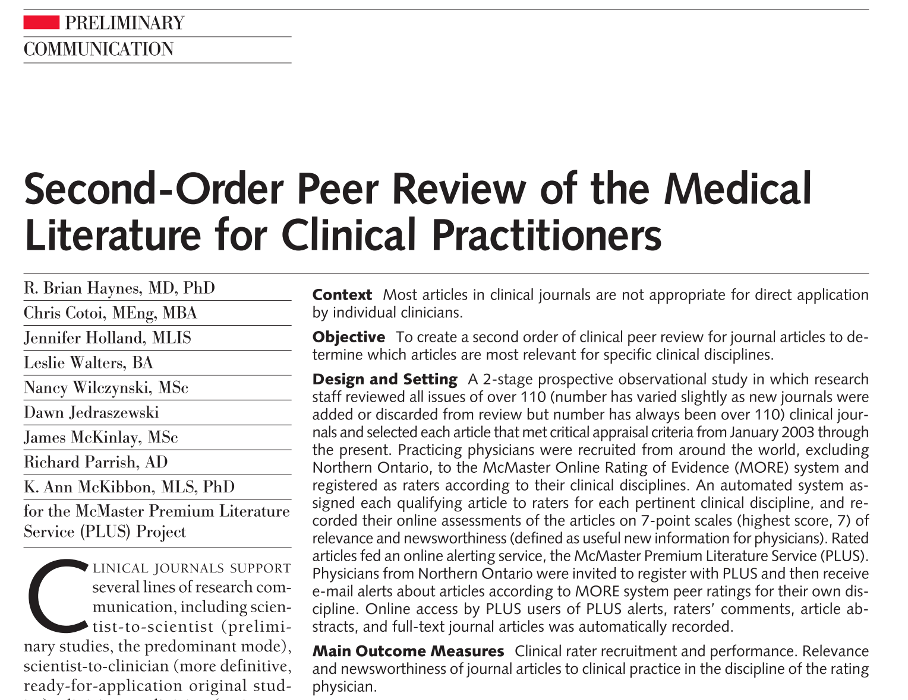
JAMA. 2006;295(15):1801–8.

Slide 15
Alper BS, Haynes RB. (2016). Evid. Based Med. 21, 123–125
5. Systems
Computerized decision support
Evidence-based textbooks
Various
Pre-appraised
4. Summaries (clinical reference)
3. Systematically derived recommendations (guidelines)
2. Systematic Reviews
as such /// “pre-appraised [synopsys]
1. Studies
as such /// or “pre-appraised [synopsys]
Your own appraisal

Slide 16
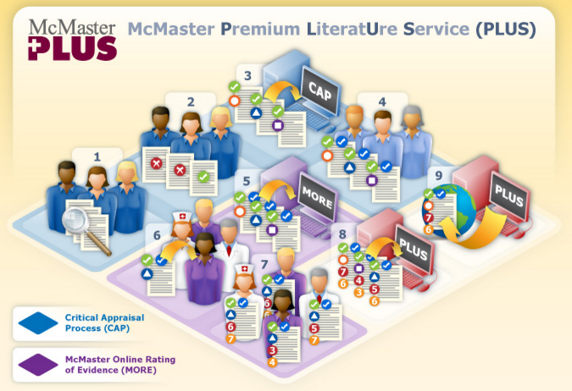
http://hiru.mcmaster.ca/hiru/Default.aspx
Notes:
1 journal selection
2 article selection
3 critical appraisal
4 expert validation
5 McMaster Online Rating of Evidence
6 More raters
7 More ratings
8 PLUS database
9 End products

Slide 17
McMaster Online Rating of Evidence
Relevance
Newsworthiness
0 - Beyond my area of expertise
7 – Directly and highly relevant
6 – Definitely relevant
5 – Probably relevant
4 – Possibly relevant: likely of indirect or peripheral relevance at best
3 – Possibly not relevant
2 – Possibly not relevant: content only remotely relevant
1 – Definitely not relevant: completely unrelated content area
0 - I don’t know if this is newsworthy
Useful information: most practitioners in my discipline ….
7 - definitely don’t know this (unless they have read this article)
6 – probably don’t know this
5 – possibly don’t know this
4 – possibly already know this
3 – probably already know this
2 – It probably does not matter whether they know this or not
1 – Not of direct clinical interest

Slide 18
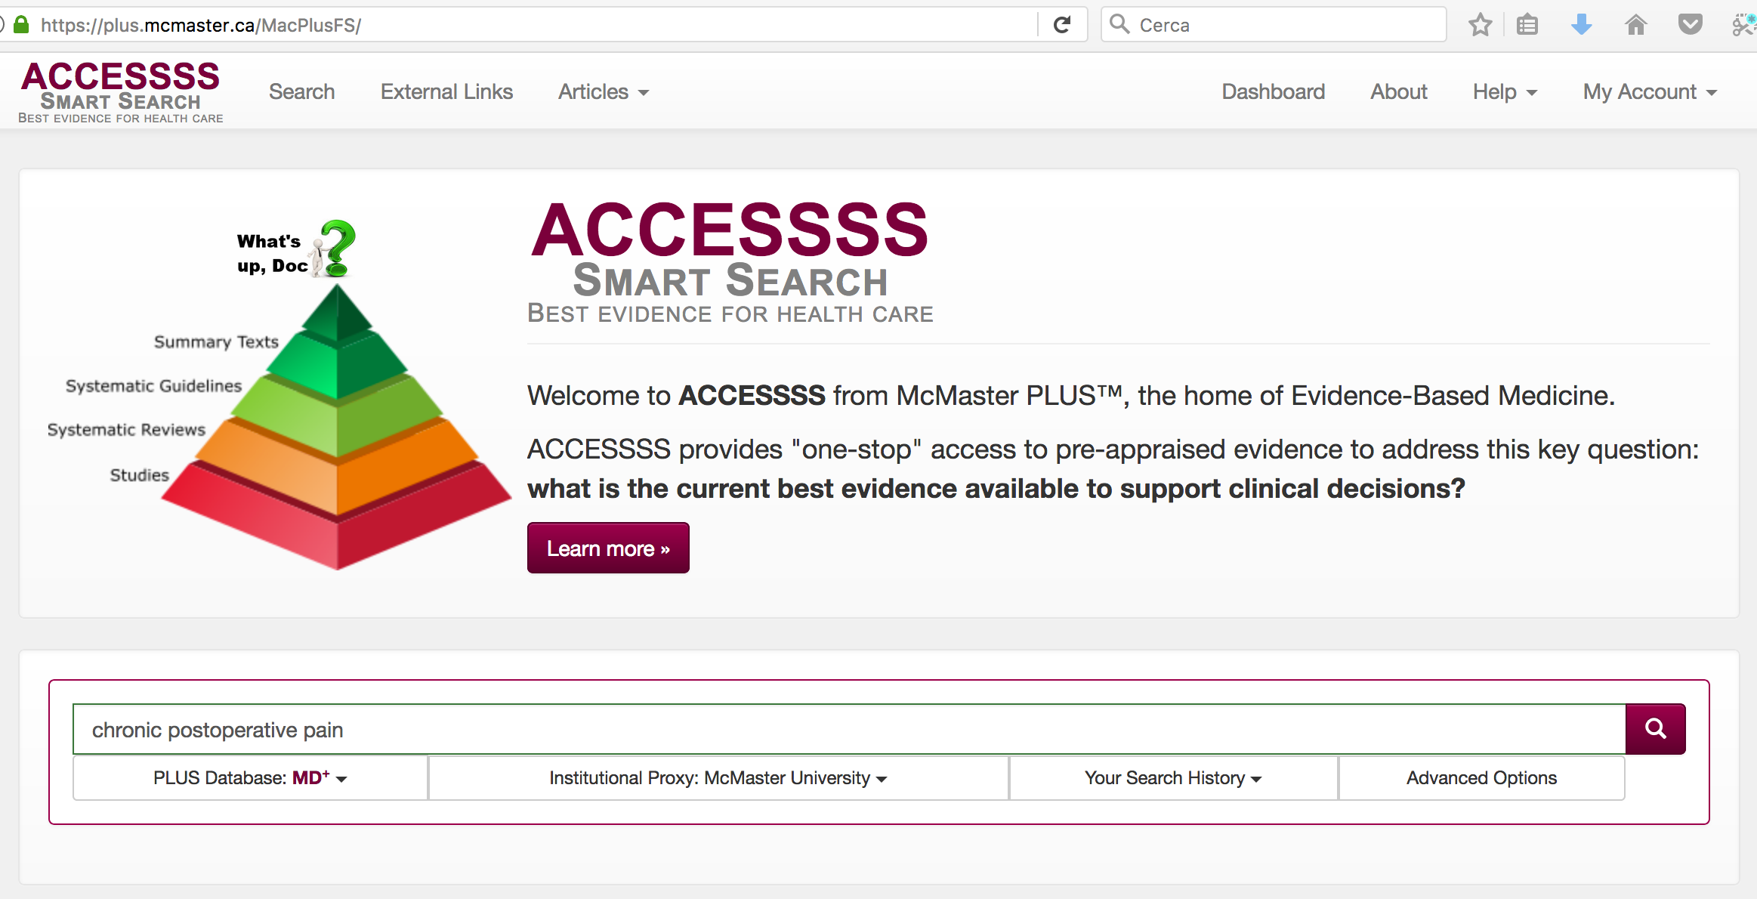
https://plus.mcmaster.ca/MacPlusFS/

Slide 19
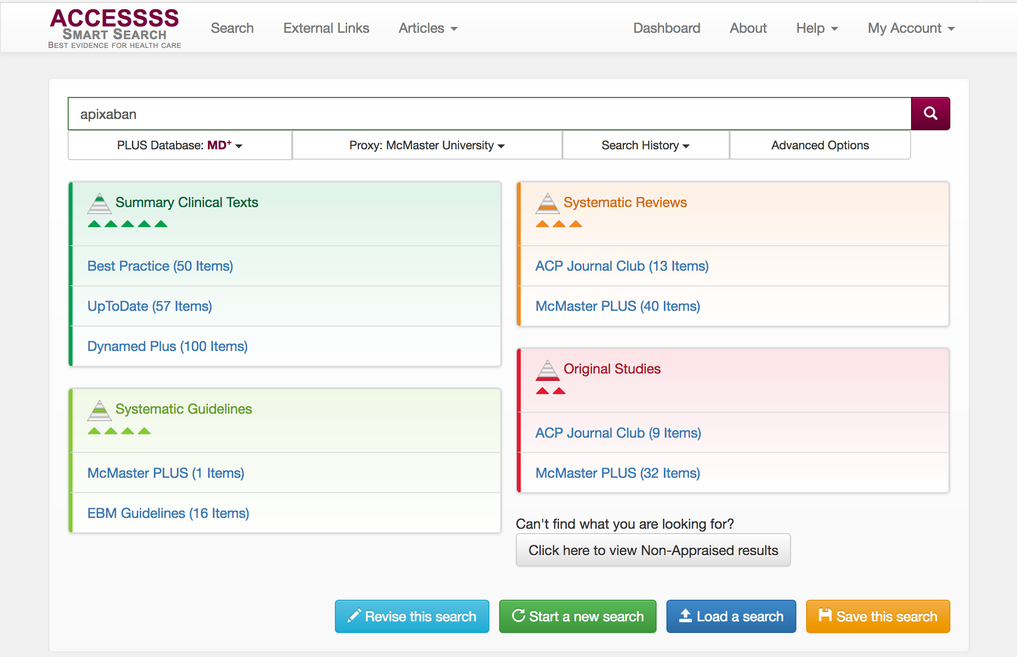
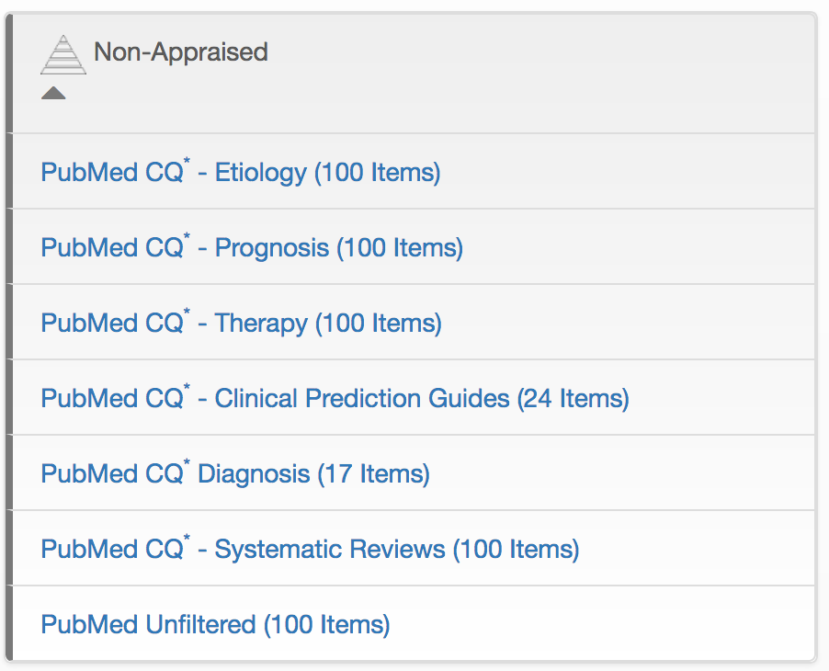
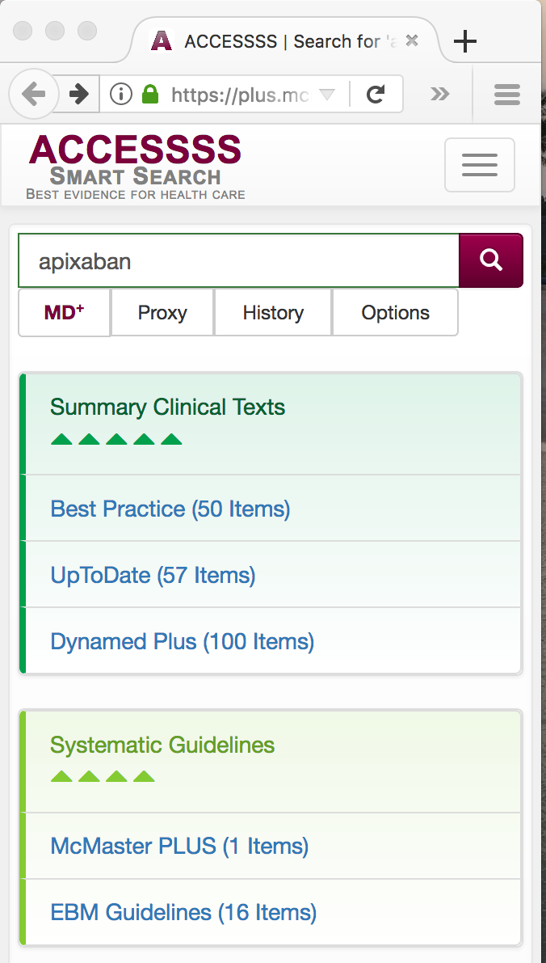
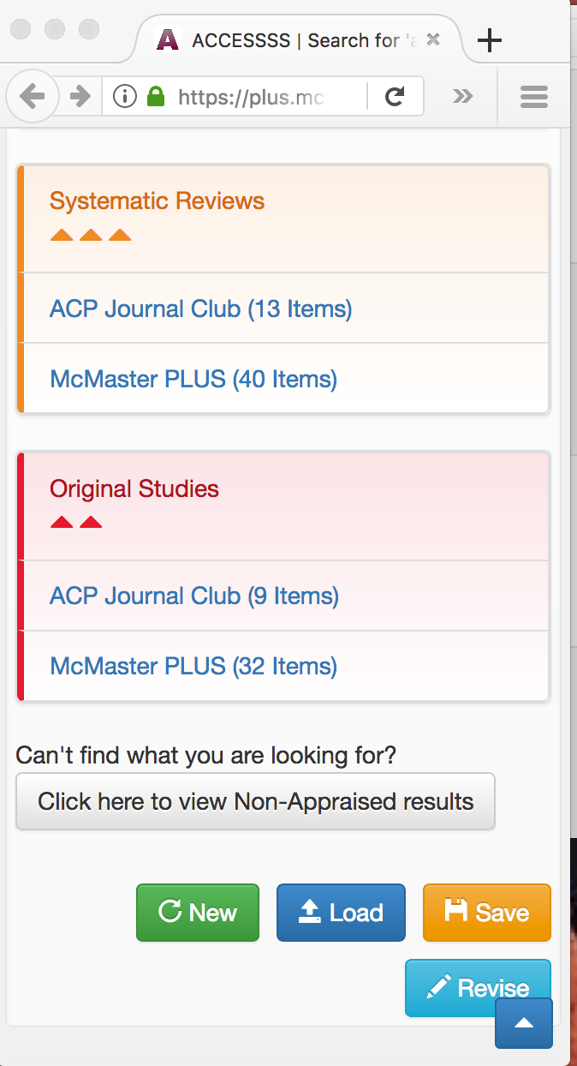
https://plus.mcmaster.ca/MacPlusFS/

Slide 20
HiRU and pain research
Is this content / technology suitable to support research?
Focused [background] content dissemination
Prioritizing SR/guidelines updates
Performing SR/guidelines updates
Feeding downstream implementation research
Patient decision aids (option grid, decision boxes)
Educational interventions

Slide 21
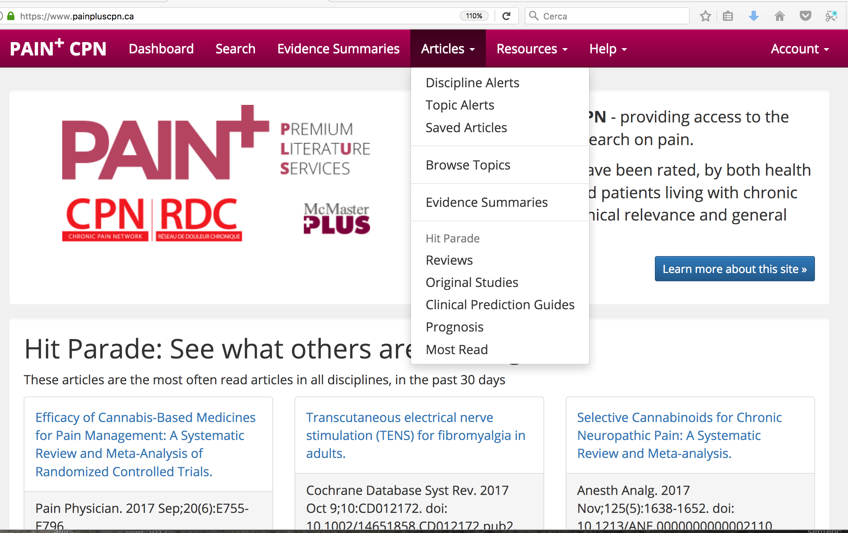

Slide 22
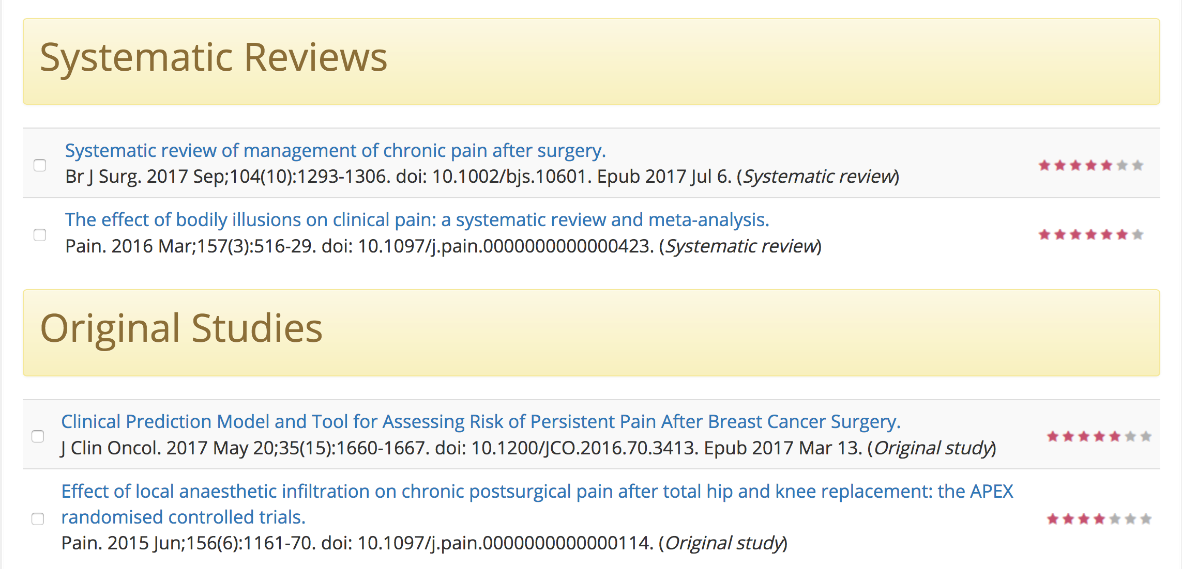

Slide 23
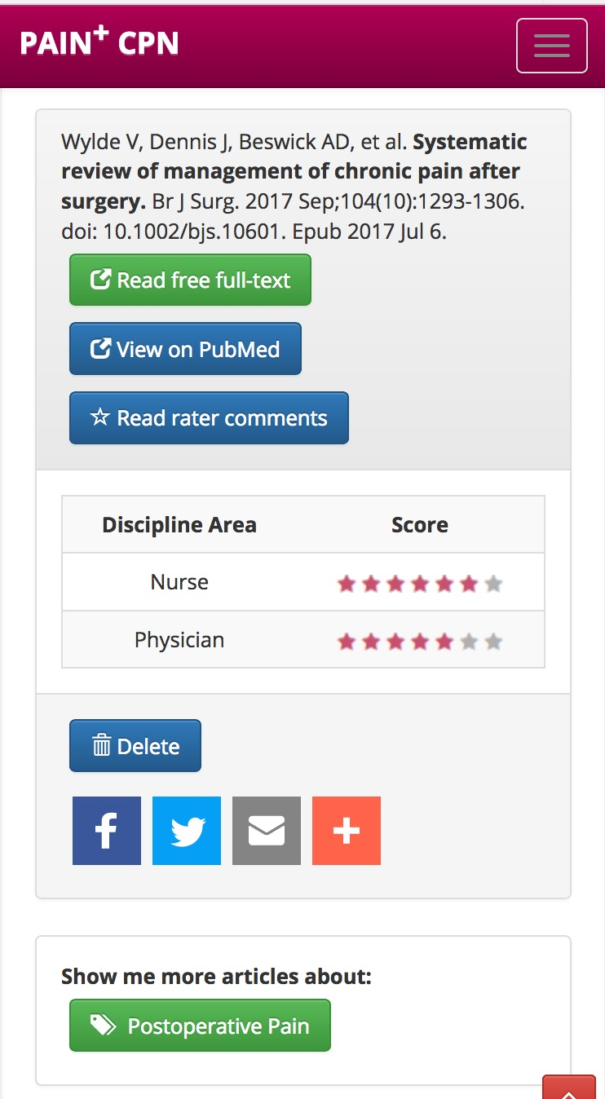

Slide 24
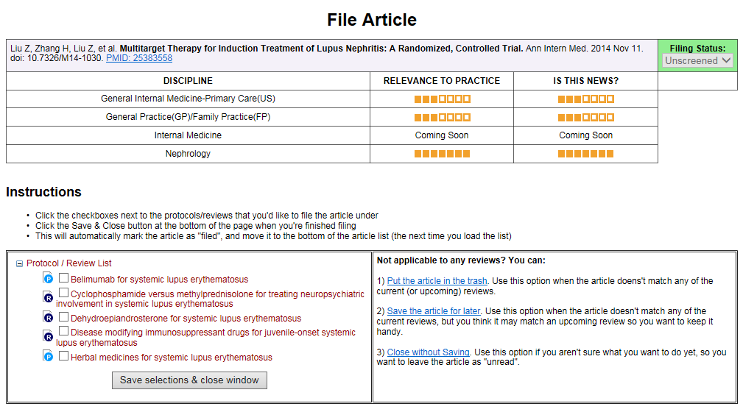
Prioritizing/triggering updates
 | Cochrane review group
 | MSK | UGI
Topics | 22 | 18
Reviews and Protocols | 268 | 145
PLUS Studies | 2677 | 704
Authors | 177 | 99

Slide 25
Prioritizing/triggering updates
Editorial level | Cochrane review group
 | MSK Count (%) | UGI Count (%)
Article Category
PLUS Studies matched to Topic | 2677 | 704
PLUS Studies screened by Editors | 2489 (93%) | 704 (100%)
Filing Status
Filed to Review or Protocol | 1101 (44.2) | 157 (22.3)
Saved for future | 1243 (49.9) | 152 (21.6)
Rejected | 145 (5.8) | 395 (56.1)
Author level [#] | MSK [42] | UGI [15]
Processed Articles | 425 | 74
Relevant Articles | 160 | 16
Not Relevant Articles | 265 | 58
Number Needed to Read | 2.7 | 4.6
Proportion already aware of the paper? | <50% | <66%

Slide 26
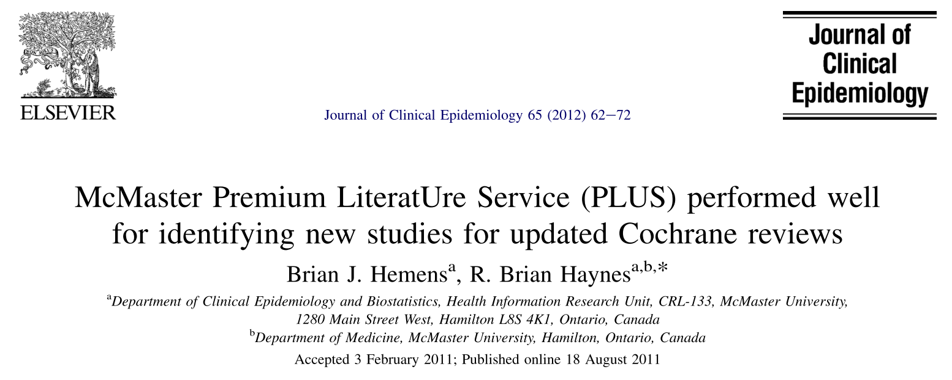
Hemens BJ, Iorio A. Ann. Intern. Med. 2017;167(3):210.

Slide 27
Machine Deep Learning
Average recall and precision for the deep learning approach and Clinical Queries Broad filter against the Clinical Hedges gold standard.
Average recall and precision for the deep learning approach, keyword search, and Clinical Queries Broad filter without MeSH terms and publication type against the Clinical Hedges gold standard.
 | Deep Learning | CQ*
Recall | 96.9% | 98.4%
Precision | 34.6% | 22.4%
 | Deep Learning | Keyword Search | CQ* no MeSH
Recall | 96.9% | 97.1% | 91.1%
Precision | 34.6% | 11.8% | 28.5%
* CQ = Clinical Queries Broad Treatment filter

Slide 28
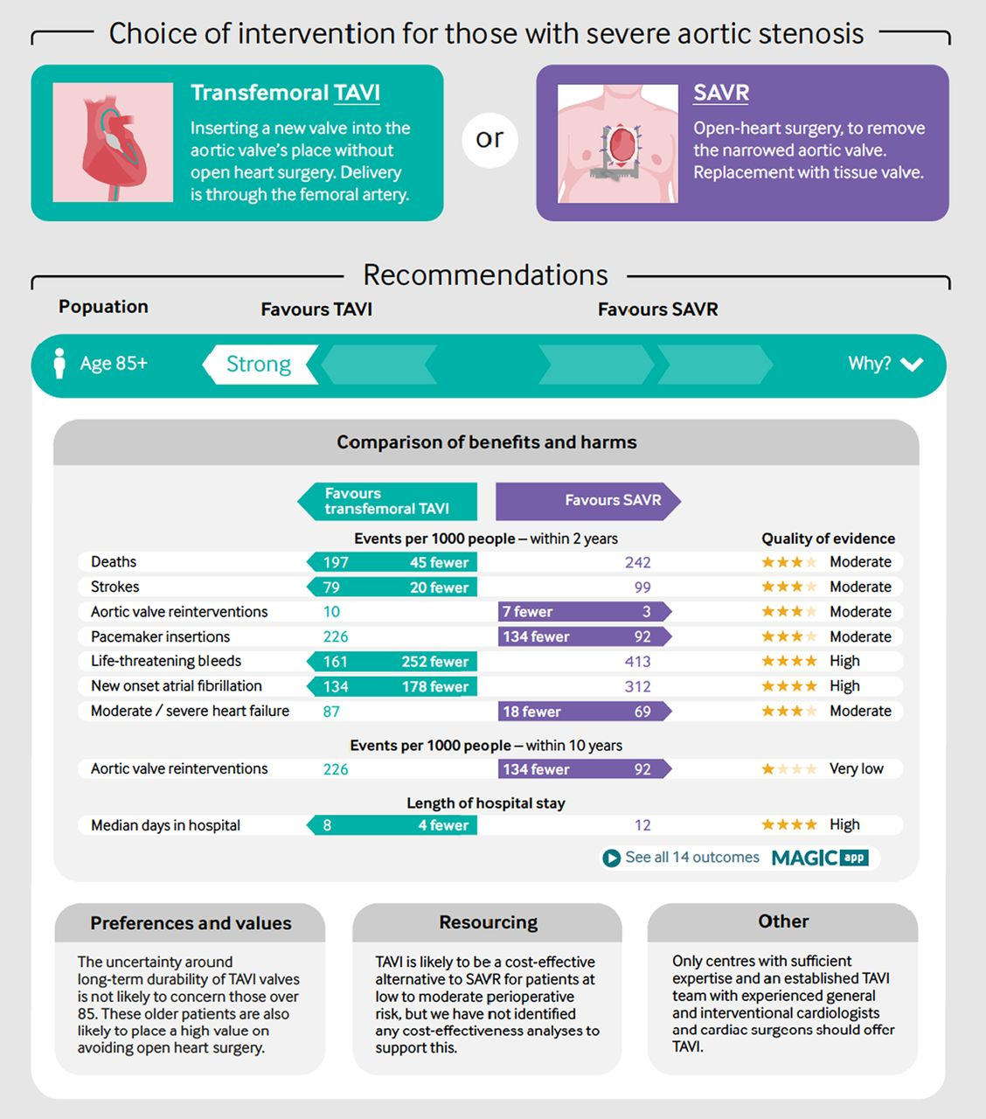

Slide 29
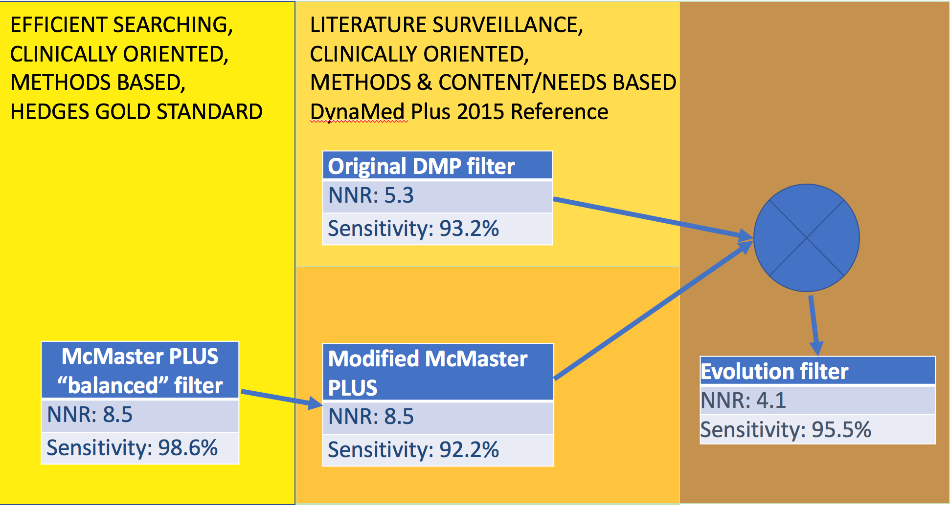
Extended surveillance

Slide 30
From 4 clinical guidelines from
the Spanish National Health System Clinical Guidelines Programme, 43 clinical questions and 113 recommendations were randomly selected.
With an exhaustive search approach
69 key references were identified
32/35 citation from the pool of journals included in the new filter set were retrieved:
Recall = 88.6%

Slide 32
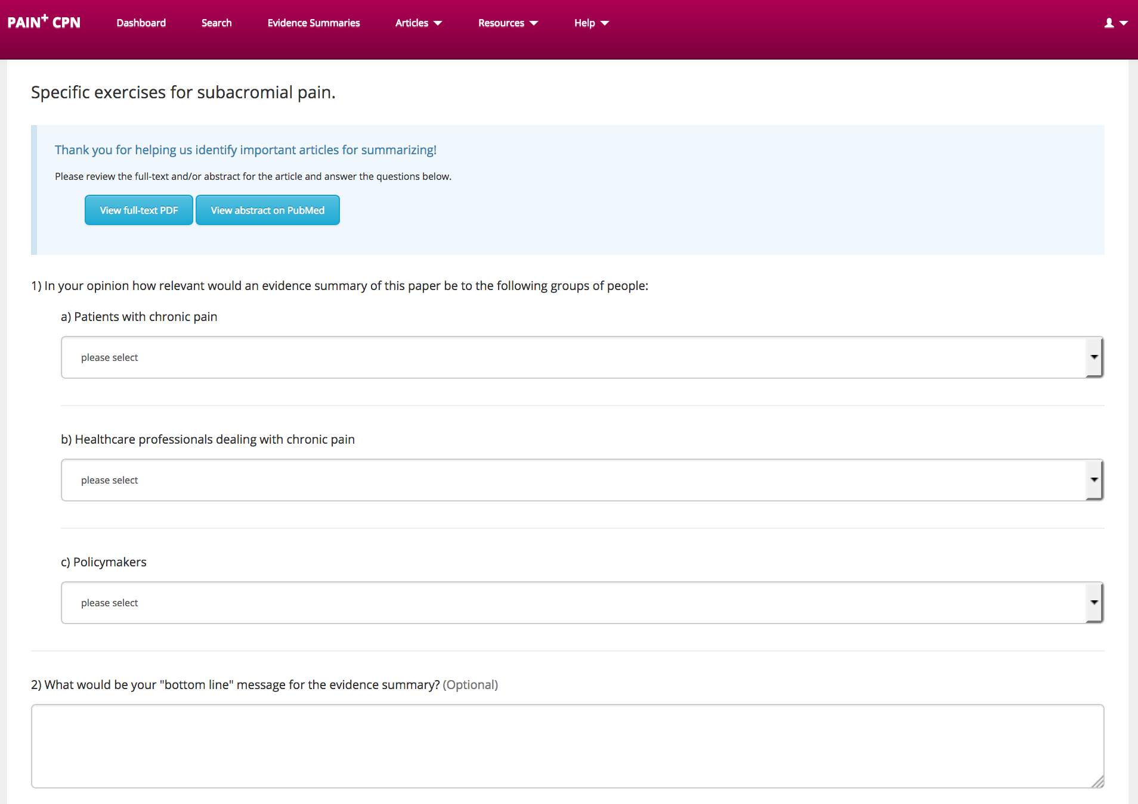

Slide 33
Evaluation
Barbara AM, et al. McMaster Optimal Aging Portal: an evidence-based database for geriatrics-focused health professionals. BMC Res. Notes. 2017;10(1):271.
Barbara AM, et al. The McMaster Optimal Aging Portal: Usability Evaluation of a Unique Evidence-Based Health Information Website. JMIR Hum. Factors. 2016;3(1):e14.
M Barbara A, et al. User Experiences of the McMaster Optimal Aging Portal’s Evidence Summaries and Blog Posts: Usability Study. JMIR Hum. Factors. 2016;3(2):e22.

Slide 34
Thank you

