Slide 1
How to measure progress in the provision of care for hemophilia
Alfonso Iorio
J Stonebraker, M Brooker, M Soucie.
A workgroup of the Data and Demographics committee
Notes:
Add slide number

Slide 2
Disclosures for A. Iorio
Shareholder | None
Grant / Research Support | Funds managed via Institution (Bayer, Baxter, BioGen, NovoNordisk)
Consultant | Funds managed via Institution (Pfizer, Bayer, Biogen, NovoNordisk, Octapharma)
Employee | McMaster University
Paid Instructor | None
Speaker bureau | None
Other | PI of the WAPPS project, co-investigator of PROBE Chair of the Data&Demographics Committee WFH, CFGD RG Cochrane Collaboration Editor

Slide 3
Background
“20% of PWH receive 80% of the hemophilia care provided”
Jones (1995): 80% of PWHA have NO access to fVIII therapy.
Jones and Robillard (2003): the 90s 80% estimates was neither
Backed up by any worldwide demographic information on hemophilia nor
Accompanied by any good information on which countries presented the best opportunities for development

Slide 4
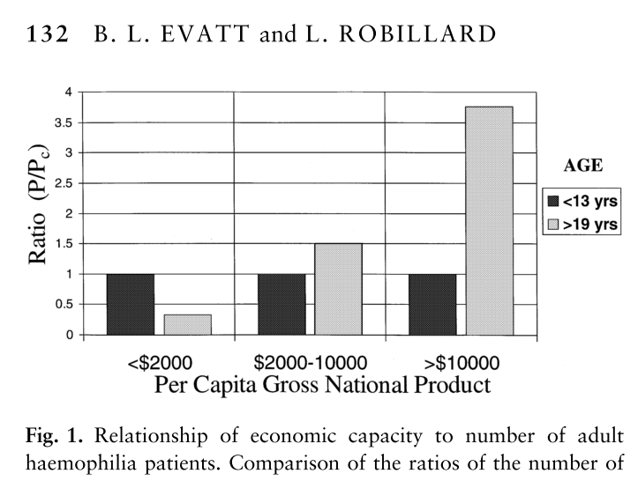


Slide 5
Aim of project
General: identifying indicators of coverage /quality of the health care for PWH
Specific: demographic measures for cross-sectional and longitudinal evaluation

Slide 6
Status of the project
☑ Definition of indicators
☑ Protocol definition
☑ Mock table definition
☑ Data “collection”
☑ Report to the D&D and MAB

Slide 7
Methods
☑ Data extraction from Global Survey and demographic sources
☑ Exploratory calculations
Proposed interpretation

Slide 8
Male population year 2013

Slide 9
PWH year 2013
Notes:
Modelling
Sample group of country used as example
Representative of different economic groups
We know about - trustworthy

Slide 10
Selected indicators
Rate of Missing PWH (0-E)
% of severe PWH
Survival of PWH

Slide 11
Missing (0-E)
M (proportion missing) = (O) observed prevalence (number of patients [age 5-18] / number of males [age 5-18] - (E) expect incidence (as cases x 100,000 males)
(O) will be calculated using the number of patient in the age band 5-18 from the WFH global survey and the number of males will be extracted from a reliable source for the corresponding year, e.g.
CIA world fact – https://www.cia.gov/library/publications/the-world-factbook/
UN population - http://esa.un.org/unpd/wpp/Excel-Data/population.htm)
(E) will be estimated from established registries (UK, Canada, Australia, France, UDC, Italy). For the current estimate we have summed the upper limit of the confidence intervals for HA (18.8) and HB (4.3) from Stonebraker et al papers (refs), and assumed the prevalence to be 23.1 per 100,000 males. Number of patients in developing world registries (Iran, South Africa – Taiwan, Japan) will also be considered as a benchmark.
Notes:
Comment on: using 5-18 as more reliable than 0-4 (convenience and reliability choice)
estimate incidence from prevalence
Same concept later on for 45+

Slide 12
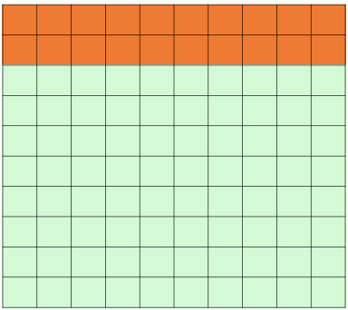
Missing (0-E)
Observed
20
Obs - Exp
= 0
Expected
20

Slide 13
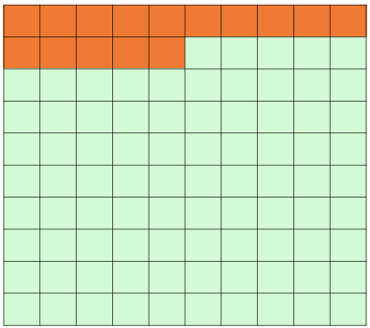
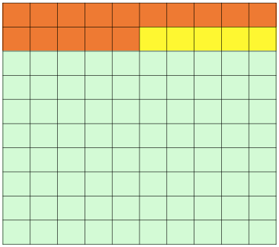
Missing (0-E)
BETTER
0
Observed
15
-5
Obs - Exp
-5
Expected
20
-10
WORSE

Slide 14
Rate of “Missing” PWH (x 100,000 males), year 2013
Notes:
Outlier -

Slide 15
% of severe PWH
% PROPORTION OF SEVERE HEMOPHILIACS
R s/t (ratio severe/total) = number severe patients (s) / (total number of patients)(t) * 100
The true value of this indicator is unknown; it will be higher when less mild and moderate than severe patients are identified and contribute to the total number of patients; values will be lower (e.g. 50 to 20%), when more mild and moderate than severe patients are identified and contribute to the total number of patients. A reference norm will be estimated from high quality registry data

Slide 16
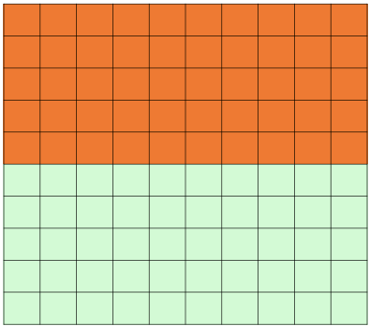
Missing (0-E)
Severe PWH
= 50%
Non-severe PWH
Notes:
Mild definition varies – not really well know

Slide 17
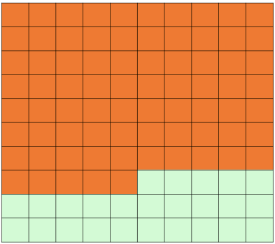
Missing (0-E)
WORSE
75
Severe PWH
= 75%
50
25
Non-severe PWH
BETTER

Slide 18
% severe PWH year 2013

Slide 19
Estimating survival in PWH
Ratio of old to young hemophiliacs
Ratio of the prevalence of Hemophilia in the age band 19-44 (older) and prevalence in the age band 5-18 (younger), where the rates are calculate as hemophilia patients x 100,000 males in the age band.
If the old/young ratio in hemophilia is similar to the old/young ratio in the general population for the country the ratio of these two ratios (hemophilia ratio/general population ratio) will be close to one. If mortality is higher in hemophilia then this ratio will be less than 1.
Notes:
Hemophilia A and B separate

Slide 20
Survivability: Ratio of hemophilia versus general population
Adult/young
PWH
PWH
prevalence
Adult
1.5
20
= 1
PWH
prevalence
Young
Adult/Young
males
1.5
20
Notes:
Top: old PWH/young PWH: denominator old males/young males → ratio of ratios

Slide 21
Survivability: Ratio of hemophilia versus general population
BETTER ?
Adult/young
PWH
1.92
2
= 0.85
1
Adult/Young
males
2.25
0.5
WORSE

Slide 22
Survivability: Ratio of hemophilia versus general population
Adult/young
PWH
1.5
Adult/Young
males
1.5

Slide 23
Selected indicators
Rate of Missing PWH (0-E)
% of severe PWH
Survival of PWH

Slide 24
Conclusion
We have described 3 simple demographic indicators of health care for hemophilia
Longitudinal analysis
☑ Exploratory calculations
Proposed interpretation

Slide 25
Thanks
Question time

