Slide 1
PK / inhibitors: how to interpret in hemophilia
Alfonso Iorio, MD PhD
McMaster University, Canada

Slide 2
Alfonso Iorio MD, PhD, FRCPC Professor of Medicine McMaster University
Disclosures
McMaster University has received research, consultancy and educational funding for Population PK projects from Bayer, Grifols, NovoNordisk, Octapharma, Pfizer
I am the co-PI of the WAPPS-Hemo project

Slide 3
The Practical Use of Pharmacokinetics in Hemophilia Care
How important
is PK?
Myth
Or
Reality
Alfonso Iorio
McMaster University
Hamilton ON Canada
Notes:
any algorithms, influencing factors or art of dosing tools which predict bleeding outcomes in severe hemophilia A and help to cluster patients according to their characteristics and treatment requirements.

Slide 4
Interactive Question 1
Do you use individual PK profiling for tailoring of prophylaxis in hemophiilia?
YES, in most patients
YES, in some patients
NO

Slide 5
Interactive Question 2
Do you use WAPPS for individual PK profiling of your patients?
YES
Not yet, but maybe I will someday
NO

Slide 6
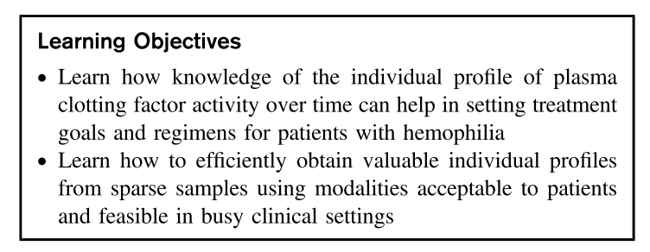
Hematology 2017; 2017: 595–604.

Slide 7
Hemophilia treatment
Clinical Management
Scenario (bleeding, surgery, prophylaxis)
Patient History/ Lifestyle
Presence of Inhibitors
Patient needs
Pharmaco-kinetics (PK)
Comprehensive care is the cornerstone of effective hemophilia treatment
Prophylactic factor replacement therapy
1960s, Sweden
non-severe hemophilia patients do not bleed spontaneously
Many guidelines, no consensus on optimal treatment regimen

Slide 8
Pharmacokinetics and Hemophilia
Regulatory level
Concentrates approved by proving their bio-equivalence
Formal PK studies
Clinical level
Prophylaxis “empirically” managed by targeting a (0.01 IU/mL) target level
Peri-surgical management based on longitudinal factor level measurements
ITI success/failure judged upon by ”normalization” of half-life

Slide 9
Plasma Drug Disposition after an IV bolus
Peak, C_{max}, Recovery
CL 1.725
V1 9.560
k 0.055
Half-life (h) 12.5
Concentration (%)
AUC
Half-life
Trough
Time (hours)

Slide 10
Interactive question 3
Which of the following is the most important PK parameter when comparing two or more factor concentrates?
Terminal half-life
AUC
Recovery
Clearance
Volume of distribution
All of the above
None of the above

Slide 11
Interactive question 4
Which of the following is the most important PK parameter when tailoring treatment of an individual patient?
Terminal half-life
AUC
Recovery
Clearance
Volume of distribution
All of the above
None of the above

Slide 12
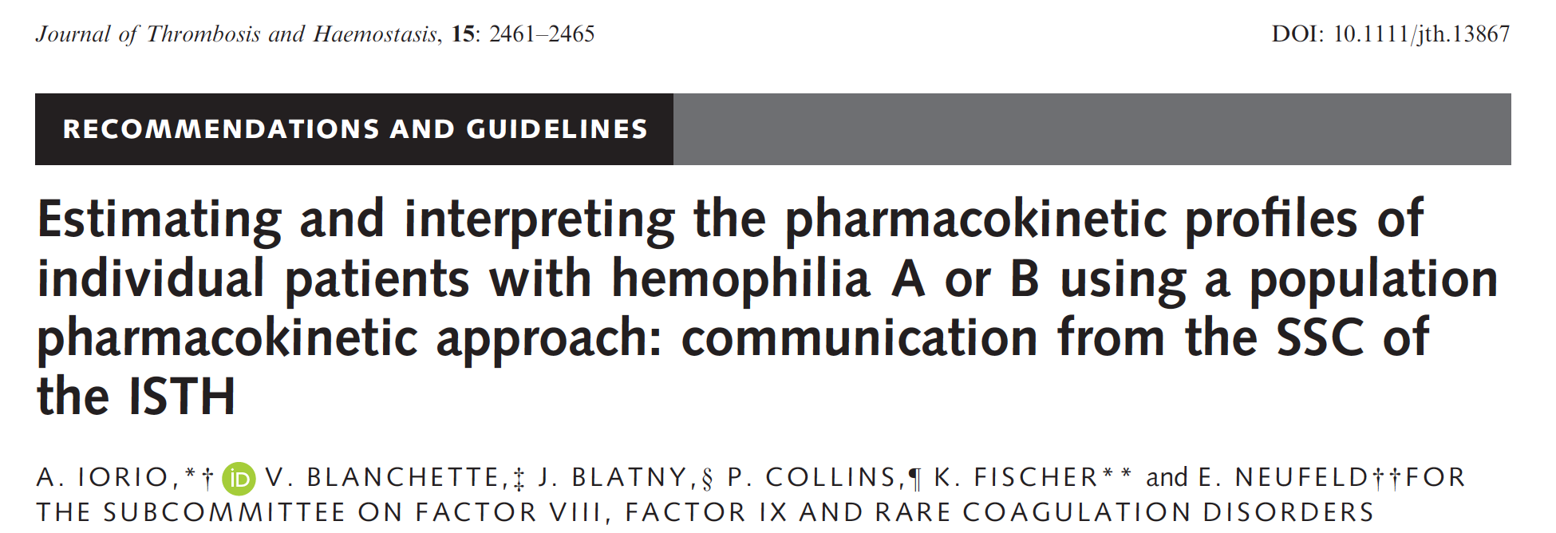
Determining individual PK
Focus on individual PK estimation
2-3 samples for one patient
Use a population pharmacokinetic model & individual samples to derive individual PK estimates
Designed to understand the average PK of a concentrate
10 or 11 blood samples over a period of 32-72 h after infusing 25-50 IU/kg at baseline
12-15 patients with a crossover design
Lee M et al. 2001. The design and analysis of pharmacokinetic studies of coagulation factors. ISTH Website, Scientific and Standardization Committee Communication p. 1–9.
Iorio A, Blanchette V, Blatny J, Collins P, Fischer K, Neufeld E
J Thromb Haemost. 2017 Oct 12. doi: 10.1111/jth.13867.

Slide 13
Interactive question 5
Which of the following is the most important contribution of population PK modeling to care for hemophilia?
Introducing (random) error in clinical practice
Increasing the feasibility of individual PK profiles
All of the above
None of the above

Slide 14
Determining individual PK
Historical ISTH guidelines
(dense sampling)
Designed to understand the average PK of a concentrate
10 or 11 blood samples over a period of 32-72 h after infusing 25-50 IU/kg at baseline
12-15 patients with a crossover design
Washout
Time
Lee M et al. 2001. The design and analysis of pharmacokinetic studies of coagulation factors. ISTH Website, Scientific and Standardization Committee Communication p. 1–9.

Slide 15
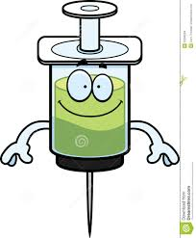
Determining individual PK
New ISTH guidelines
(popPK + sparse sampling)
Washout
Fixed dose
Focus on individual PK estimation
2-3 samples for one patient
Use a population pharmacokinetic model & individual samples to derive individual PK estimates
4
4
24
24
48
48
Time
Iorio A, Blanchette V, Blatny J, Collins P, Fischer K, Neufeld E
J Thromb Haemost. 2017 Oct 12. doi: 10.1111/jth.13867.

Slide 16
Determining individual PK
New ISTH guidelines
(popPK + sparse sampling)
Historical ISTH guidelines
(dense sampling)
Washout
Washout
Lee M et al. 2001. The design and analysis of pharmacokinetic studies of coagulation factors. ISTH Website, Scientific and Standardization Committee Communication p. 1–9.
Iorio A, Blanchette V, Blatny J, Collins P, Fischer K, Neufeld E
J Thromb Haemost. 2017 Oct 12. doi: 10.1111/jth.13867.

Slide 17
The 3 key concepts about PopPK
Individual PopPK tailoring of hemophilia treatment is about:
Modeling inter-individual variability
Cannot be sustituted by using average population data
Cancel out the need for understanding PK parameters

Slide 18
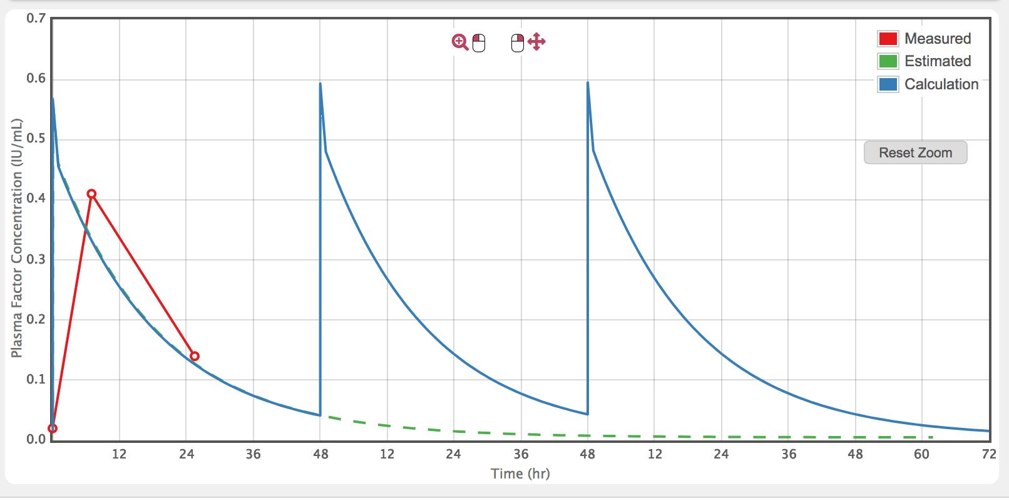
The 3 key concepts about PopPK
Understanding variability
Applying population averages vs individualized PK profiles
Drug A: 12+/-3 hrs
Drug B: 16+/-3 hrs

Slide 19
Understanding variability to define a dosing strategy
Infusion 1
Infusion 2
Maximum concentration
Concentration
Minimum effective concentration
Patients have similar PK
Individual PK similar over time
Generic population dose
(e.g. 10 mg/kg)
Subject

Slide 20
Understanding variability to define a dosing strategy
Infusion 1
Infusion 2
Maximum concentration
Concentration
Minimum effective concentration
Patients have different PK
Individual PK varies over time
Can’t define a regimen
Subject

Slide 21
Understanding variability to define a dosing strategy
Infusion 1
Infusion 2
Maximum concentration
Concentration
Minimum effective concentration
Patients have different PK
Individual PK similar over time
Individualized dose
Subject

Slide 22
Why we cannot use population estimates

Slide 23
Interactive question 6
How would you rate the average evidence for PK comparisons across concentrates?
Very high
High
Moderate
Low
Very low

Slide 24
Interactive question 7
Which of the following does reduce the comparability of PK studies of factor concentrates?
Population size
Population characteristics
Study design
Analysis method
All of the above

Slide 25
Interactive question 8
Which of the following is the most important barrier to the use of average PK estimates for individual tailoring?
Study design
Population characteristics
Analysis method
Interindividual variability
None of the above

Slide 26
Why we cannot use population estimates

Slide 27
Why we cannot use population estimates

Slide 28
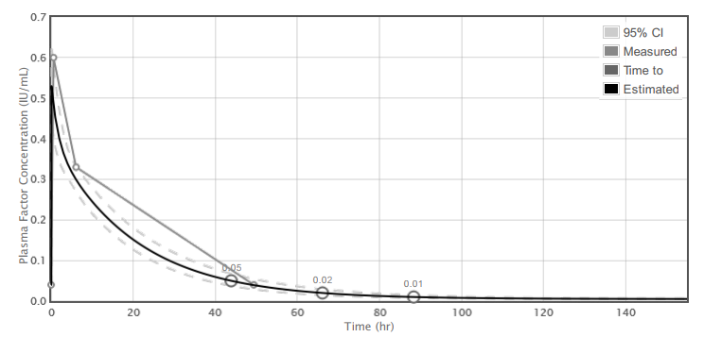
Individual PK profile
Specific patient
Specific concentrate
(Limited) set of measured data

Slide 29
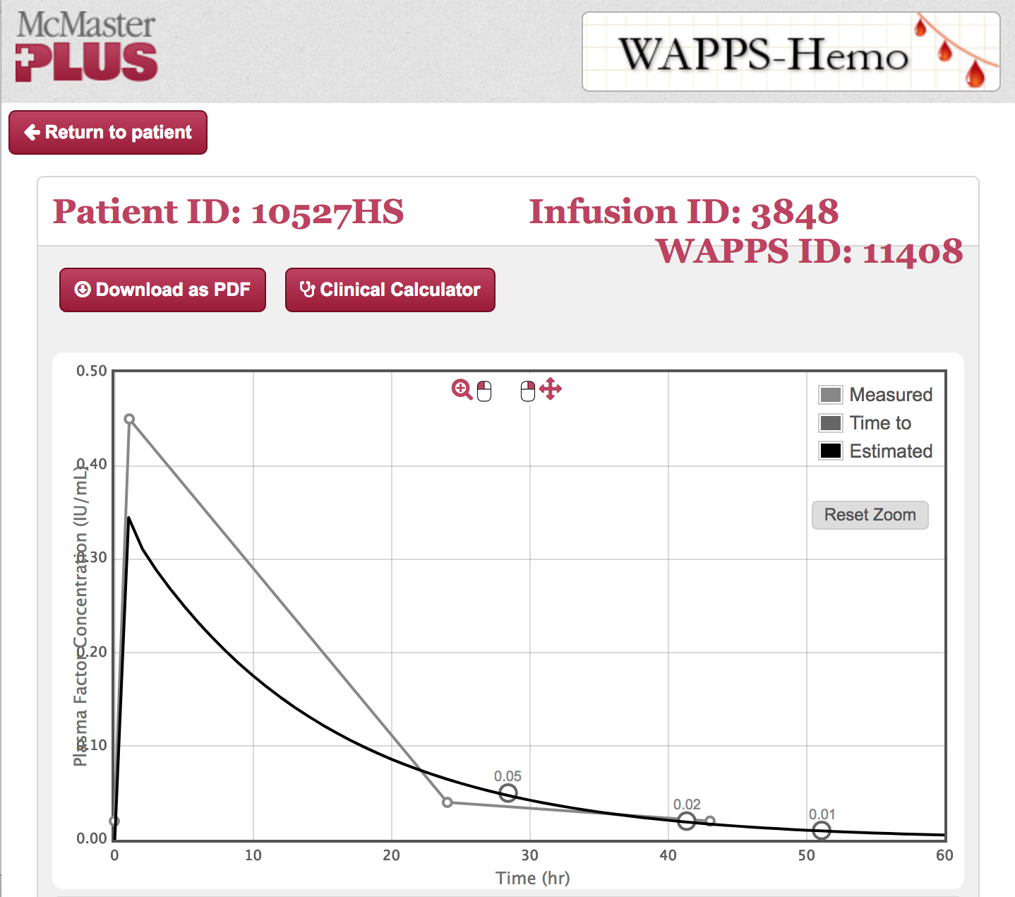
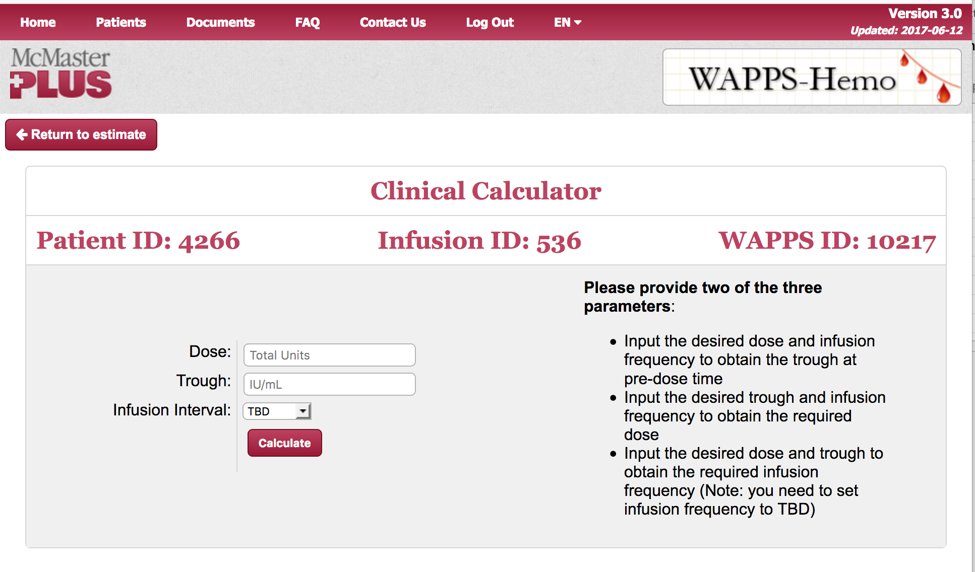
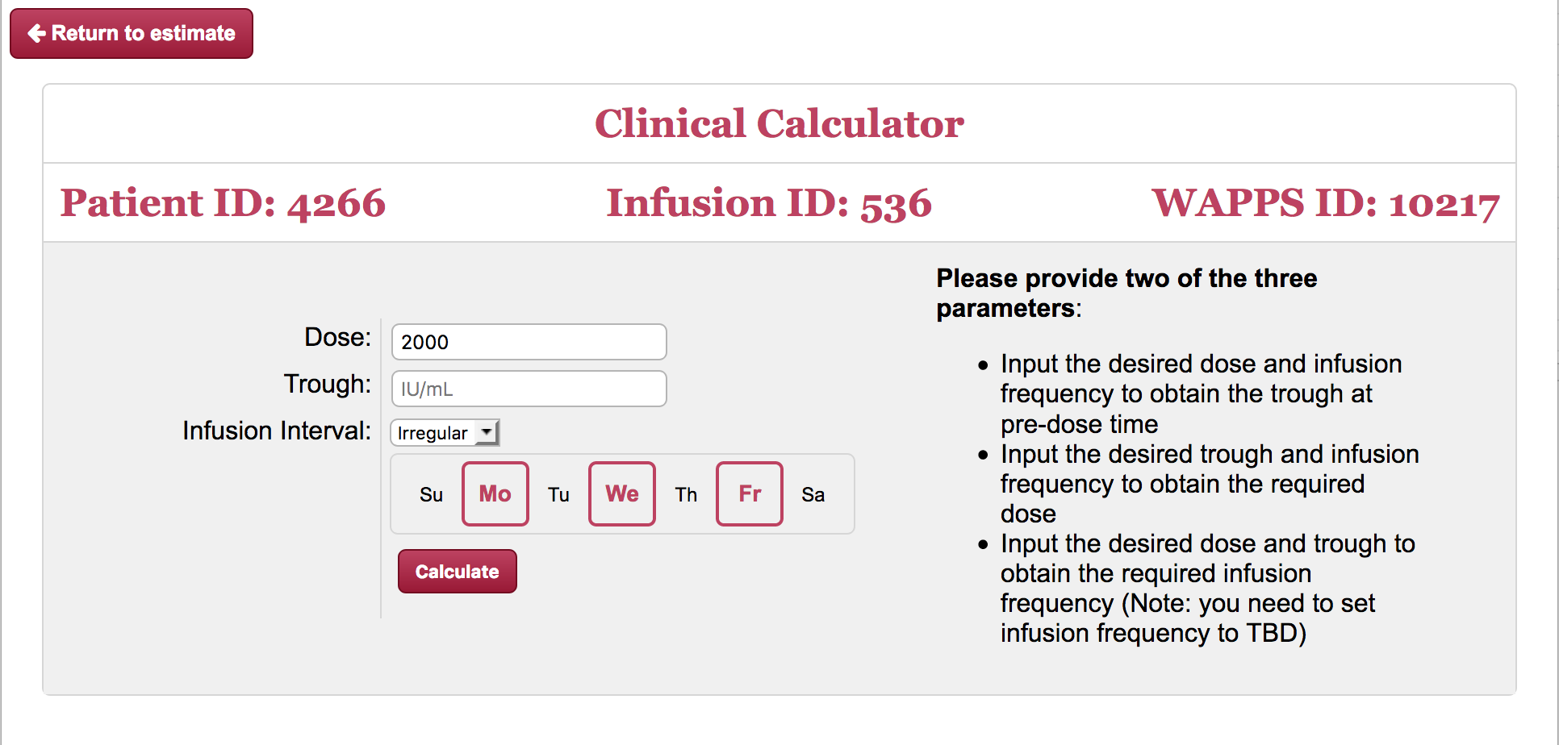
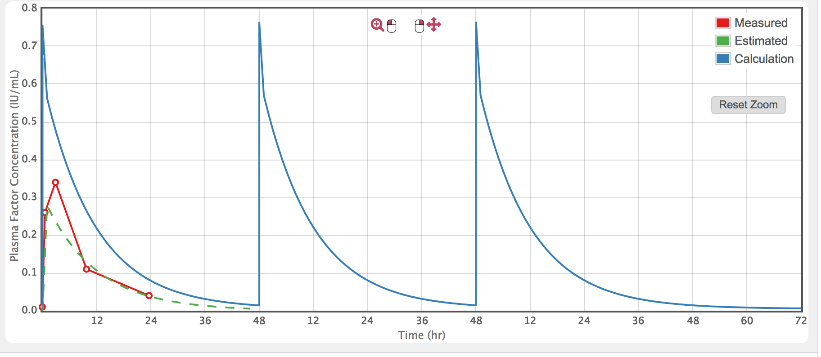

Slide 30
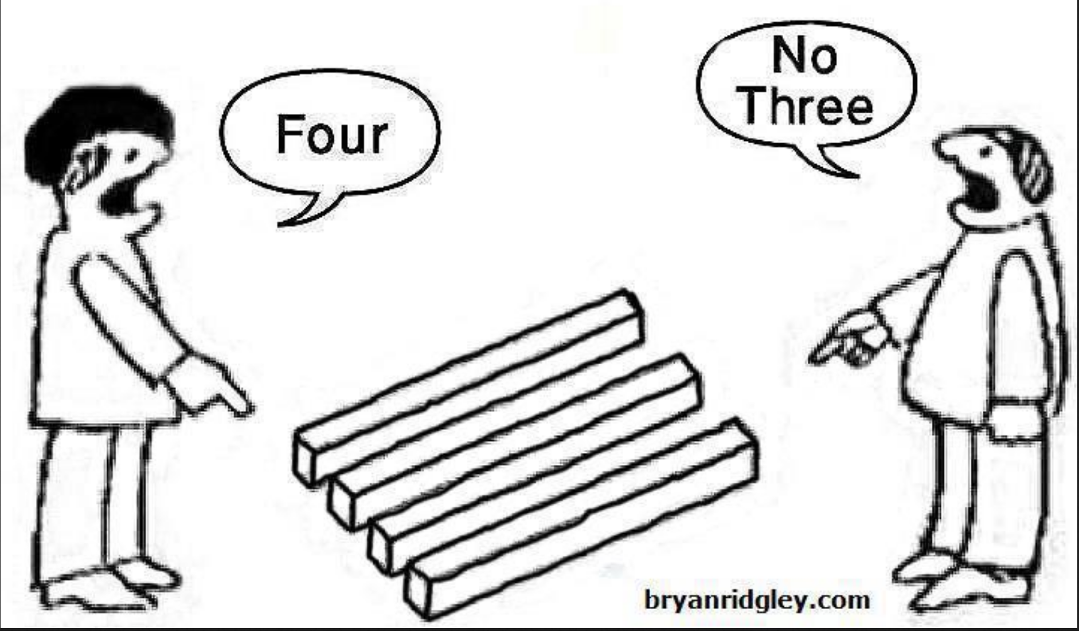
Back-of-napkin individual PK profiling?

Slide 31
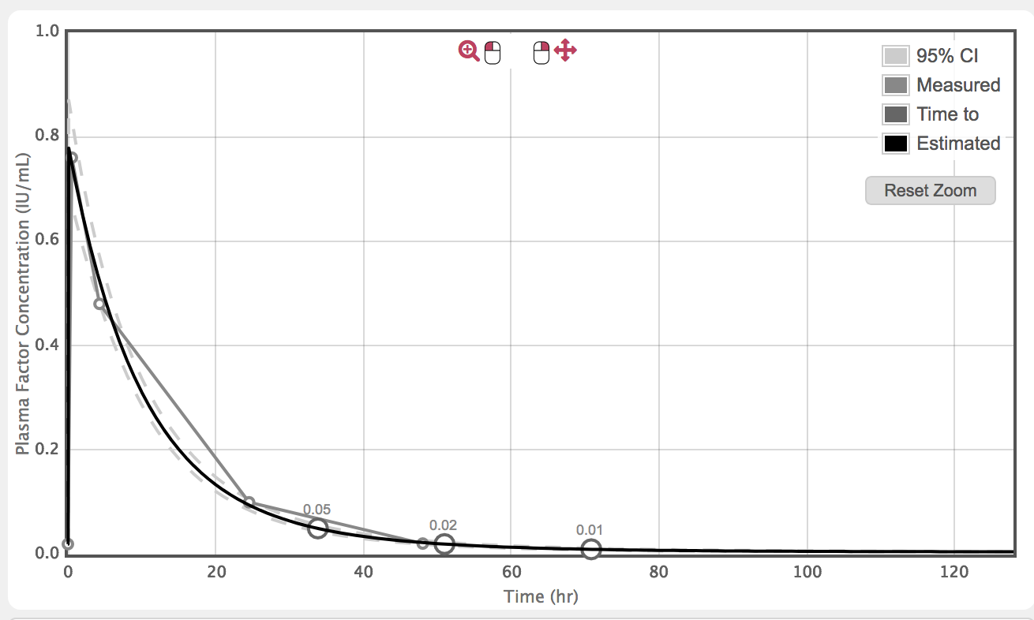
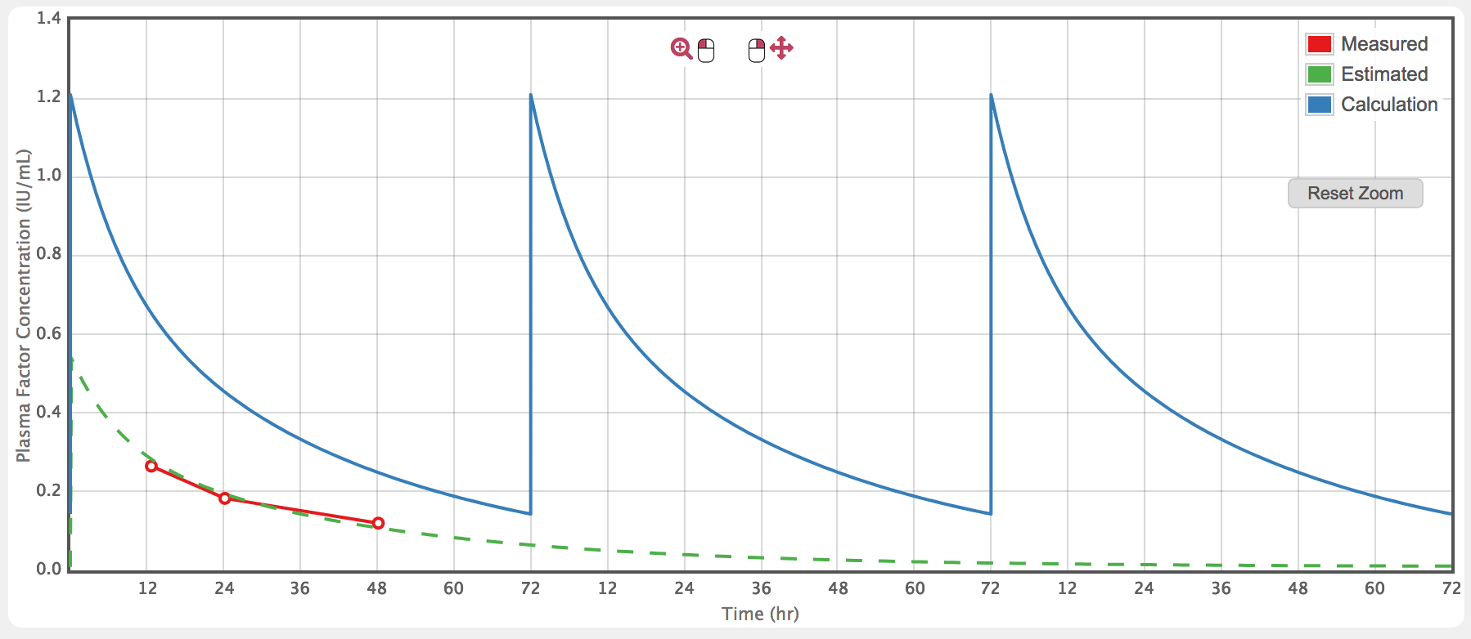
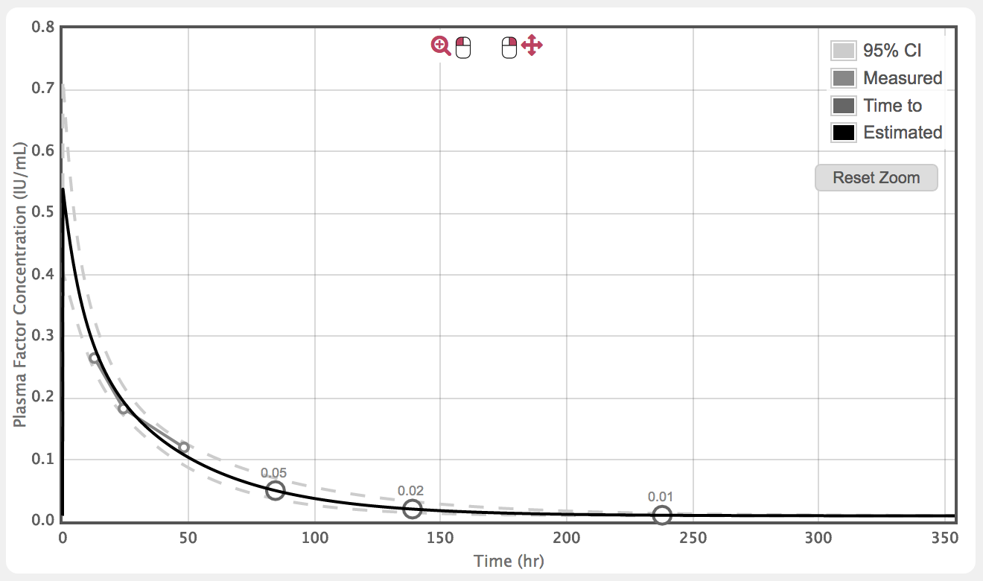
Back-of-napkin individual PK profiling?

Slide 32
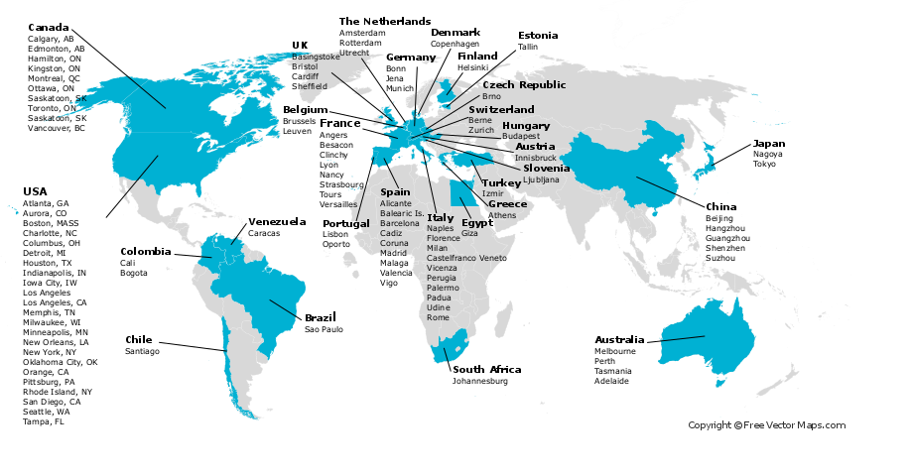
The WAPPS-Hemo co-investigator network
The WAPPS-Hemo network:
114 registered HTC
32 different countries
1550 patients
2459 infusions
www.wapps-hemo.org

Slide 33
Inhibitors

Slide 34
Interpreting risk
Observational studies, comparing
Exposed
Non-exposed
Smoke and cancer
Packs/year, age, sex
Rheumatoid arthritis and myocardial infarction
Treatment, treatment duration

Slide 35
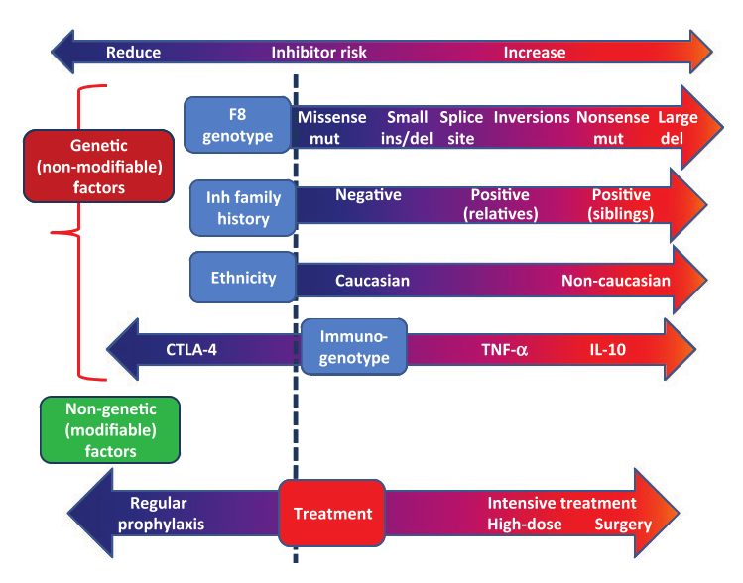
Coppola A et al. Haemophilia,16 Suppl 1:13–9.

Slide 36
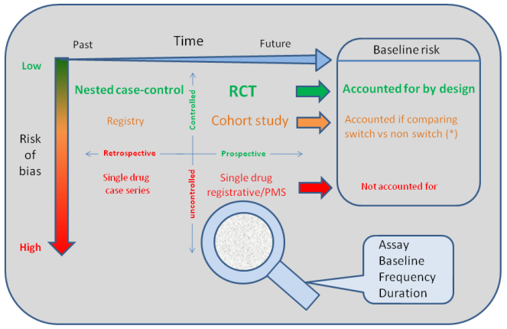
Iorio A, Puccetti P, Makris M. Clotting factor concentrate switching and inhibitor development in hemophilia A. Blood 2012; 120: 720–7.
Notes:
1 Iorio A, Puccetti P, Makris M. Clotting factor concentrate switching and inhibitor development in hemophilia A. Blood 2012; 120: 720–7.
For some reasons that makes it unlikely and not cost-effective

Slide 37
Predicting risk
Exposure is not sufficiently standardized:
Dose, frequency, reason for treatment, concomitant events/treatments
Even with the concentrate associated with the lowest risk, the risk is still too high

Slide 38
Interpreting risk of inhibitors
All studies preformed to date have failed to produce evidence impacting on clinical practice
We need a paradigm shift – an innovative, alternative approach
Mimetics and gene therapy are both changing the landscape, in different ways
NIH research initiative

Slide 39
The future is prevention and cure, not prediction !!
Sherman A, Biswas M, Herzog RW. Innovative Approaches for Immune Tolerance to Factor VIII in the Treatment of Hemophilia A. Front Immunol 2017; 8: 1604.
Kwon K et al. Expression and assembly of largest foreign protein in chloroplasts: Oral delivery of human FVIII made in lettuce chloroplasts robustly suppresses inhibitor formation in hemophilia A mice. Plant Biotechnol J 2017; : 1–13.
3 Parvathaneni K et al. Hemophilia A inhibitor treatment: the promise of engineered T-cell therapy. Transl Res Elsevier Inc.; 2017; 187: 44–52. Lai JD, Lillicrap D. Factor VIII inhibitors: Advances in basic and translational science. Int J Lab Hematol 2017; 39: 6–13.
4 Meunier S et al. CD4 T cells specific for factor VIII are present at high frequency in healthy donors and comprise naïve and memory cells. Blood Adv 2017; 1: 1842–7.
Notes:
1 Kwon K, Sherman A, Chang W-J, Kamesh A, Biswas M, Herzog RW, Daniell H. Expression and assembly of largest foreign protein in chloroplasts: Oral delivery of human FVIII made in lettuce chloroplasts robustly suppresses inhibitor formation in hemophilia A mice. Plant Biotechnol J 2017; : 1–13.
2 Lai JD, Lillicrap D. Factor VIII inhibitors: Advances in basic and translational science. Int J Lab Hematol 2017; 39: 6–13.
3 Meunier S, Menier C, Marcon E, Lacroix-Desmazes S, Maillère B. CD4 T cells specific for factor VIII are present at high frequency in healthy donors and comprise naïve and memory cells. Blood Adv 2017; 1: 1842–7.
4 Sherman A, Biswas M, Herzog RW. Innovative Approaches for Immune Tolerance to Factor VIII in the Treatment of Hemophilia A. Front Immunol 2017; 8: 1604.
5 Parvathaneni K, Abdeladhim M, Pratt KP, Scott DW. Hemophilia A inhibitor treatment: the promise of engineered T-cell therapy. Transl Res Elsevier Inc.; 2017; 187: 44–52.
6 Chen J, Schroeder JA, Luo X, Shi Q. The impact of von Willebrand factor on factor VIII memory immune responses. 2017; 1: 1–3.

Slide 40
Thanks – and questions welcome
www.wapps-hemo.org

