Slide 1
Managing Inhibitor Risk in both PUPs and PTPs
Alfonso Iorio, McMaster University, Canada
July 26, 2016 --- 7:00 – 8:30
Room 308, Orange County Convention Center
Notes:
Sunday, July 24, 2016
08:30-11:30 PD-S-01
SHOW ME THE DATA! CHALLENGES AND OPPORTUNITIES IN DATA COLLECTION Room: 307
Chair: Alfonso Iorio, Canada

Slide 2
Disclosures for: Alfonso Iorio
In compliance with the PIM* policy, WFH requires the following disclosures be made at each presentation
CONFLICT | Disclosure — if conflict of interest exists
Research Support | McMaster receives support for research in hemophilia by Bayer, Biogen, Octapharma, Novo-Nordisk, Pfizer, Shire
Director, Officer, Employee | Data and Demographics committee, WFH
Shareholder
Honoraria
Advisory Committee | McMaster receives support for services in hemophilia by Bayer, Biogen, Octapharma, Novo-Nordisk, Pfizer, Shire
Consultant
* Postgraduate Institute for Medicine
2

Slide 3
Learning objectives
Review evidence for inhibitor risk and ways to manage the risk.
In PUPs: evidence from SIPPET and other strategies.
In PTPs: strategies for reducing the risk

Slide 4
Antibodies against factor VIII
One size fits all?
High titer versus low titer inhibitors
Clinically relevant versus screening up taken
Inhibitory versus non blocking antibodies
Natural antibodies versus factor VIII

Slide 5
Assessing immunogenicity of FVIII concentrates
Dimichele DM et al. Design of clinical trials for new products in hemophilia: Communication from the SSC of the ISTH. J. Thromb. Haemost. 13(5), 876–879 (2015).
Notes:
The immunology of product neoantigenicity Optimal design of preauthorization clinical trials is hampered by an incomplete understanding of the precise nature of interactions between an FVIII product and the recipient’s immune system. Our limited knowledge derives in part from incomplete characterization of the PTP’s immune status relative to pretrial therapeutic product exposure. Immunological ignorance is not routinely distinguished from active tolerance. Consequently, when a PTP devel- ops an inhibitor during a new product trial, an immuno- logical break in preexisting tolerance cannot be distinguished from product-associated neoimmunogenici- ty. Systematic harmonized collection of clinical and bio- logical data from subjects entering pre- and post- authorization studies will be required to scientifically address these questions (Table S6 in Appendix S1).

Slide 6
Coppola A et al. Understanding inhibitor development in haemophilia A: towards clinical prediction and prevention strategies. Haemophilia. 16 Suppl 1, 13–9 (2010).

Slide 7
Coppola A et al. Understanding inhibitor development in haemophilia A: towards clinical prediction and prevention strategies. Haemophilia. 16 Suppl 1, 13–9 (2010).

Slide 8
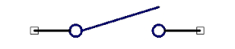
Matino D et al. IDO1 suppresses inhibitor development in hemophilia A treated with factor VIII. J. Clin. Invest. 125(10), 3766–3781 (2015).
Notes:
Anti-CD3 prevents factor VIII inhibitor development in hemophilia A mice by a regulatory CD4+CD25+-dependent mechanism and by shifting cytokine production to favor a Th1 response
Braden Waters, Mohammad Qadura, Erin Burnett, Rouzbeh Chegeni, Andrea Labelle, Patrick Thompson, Christine Hough, David Lillicrap
Blood 2009 113:193-203; doi:10.1182/blood-2008-04-151597

Slide 9
Previously UNTREATED PATIENTS
Previously UNTREATED PATIENTS

Slide 10
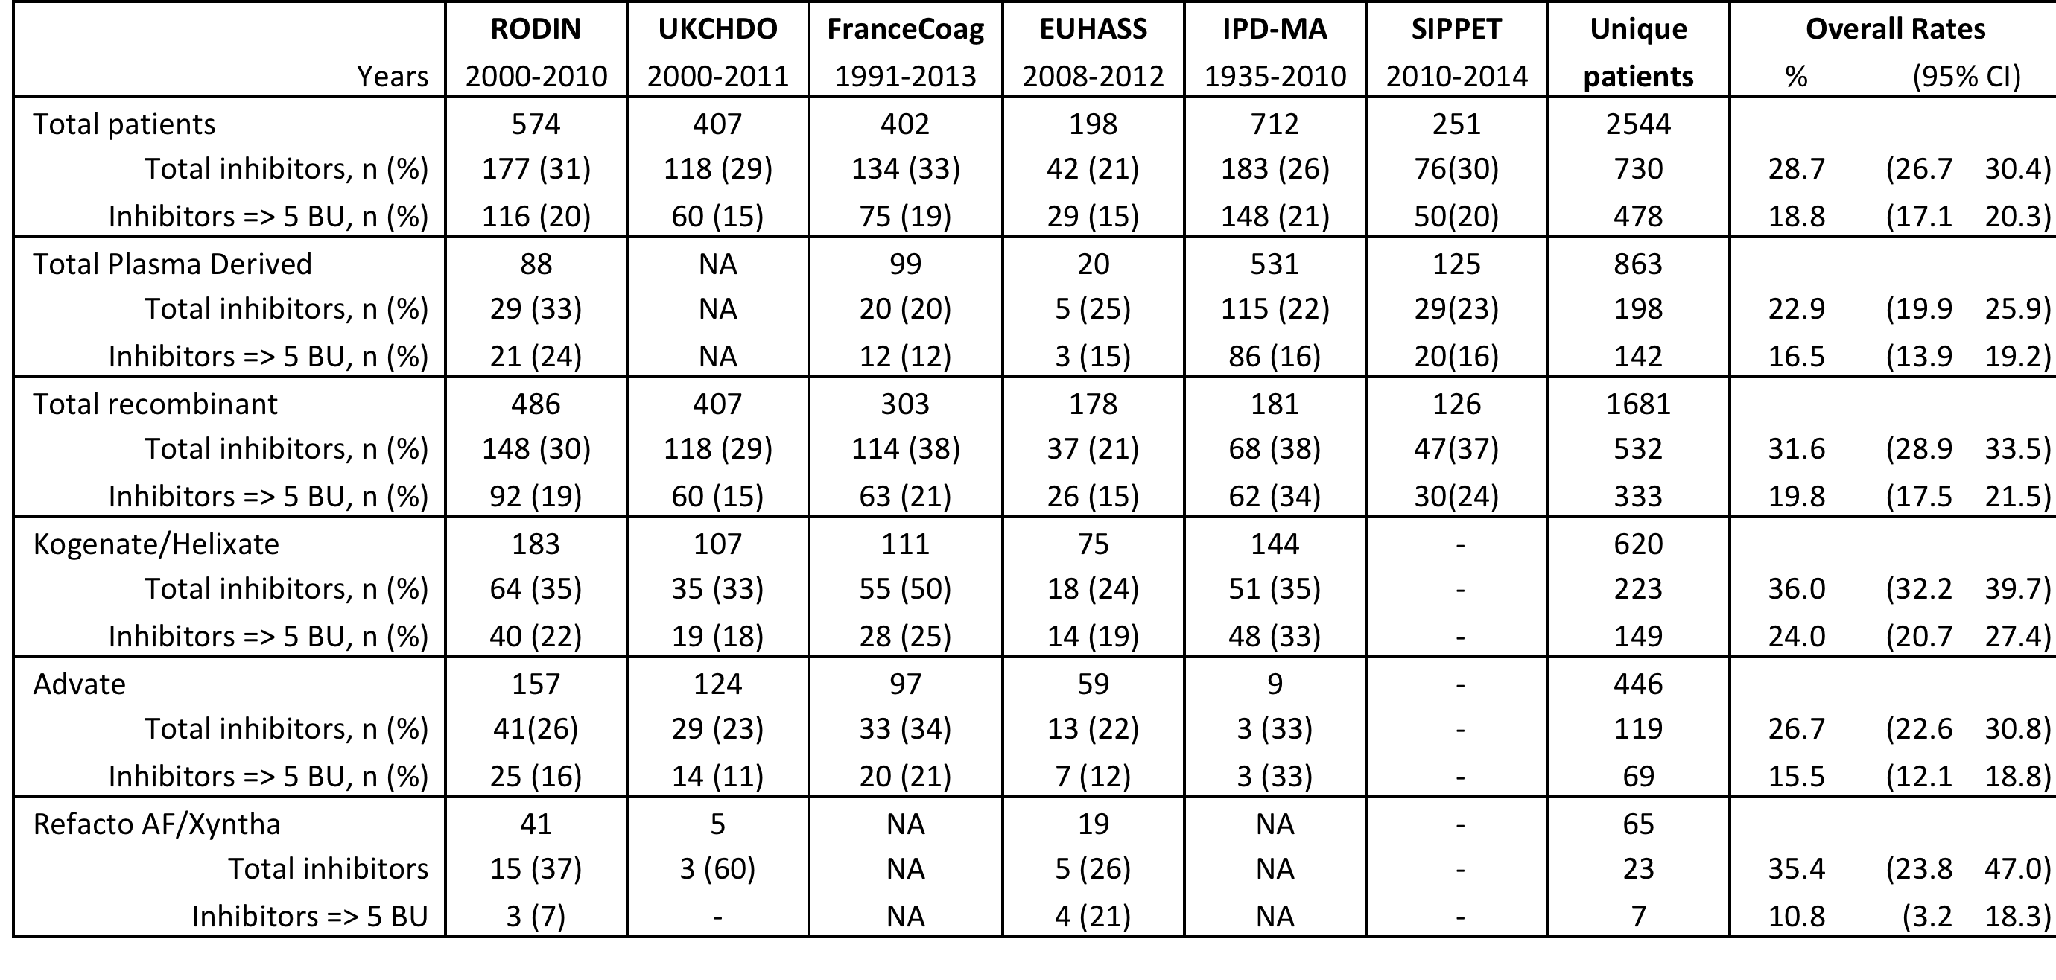

Slide 11
Iorio A, Puccetti P, Makris M. Clotting factor concentrate switching and inhibitor development in hemophilia A. Blood. 120(4), 720–727 (2012).

Slide 13
Study | Design* | Years | PD | Diff | Notes
 |  | Patients$
RODIN | P, R, IC, MC | 2000-2010 | 24 | -5 | No difference with plasma derived - Increased risk with Kogenate found at post hoc analysis: hypothesis generation
 |  | 88/574
UKHCDO | R, IC, SC | 2000-2010 | NA |  | No difference with plasma derived Increased risk with Kogenate confirmed and shown for Refacto
 |  | ---/407 |  |  | Alternative explanations supported: evidence of temporal effect, and “RODIN” effect (higher rate in RODIN centers).
France C | R, IC, SC | 2000-2010 | 21 | 9 | Decreased risk with plasma derived Increased risk with Kogenate confirmed
 |  | 99/402 |  |  | Alternative explanations supported: “center” effect, and “RODIN” effect (higher rate in RODIN centers).
EUHASS | P, DC, MC | 2009-2013 | 15 | 0 | No difference with plasma derived – Increased risk with Kogenate NOT confirmed
 |  | 20/198 |  |  | RODIN effect (higher rate in RODIN centers).
EAHAD IPD | MA, MC | 1994-2003 | 16 | 18 | No difference with plasma derived – Increased risk with Kogenate NOT confirmed
 |  | 531/712 |  |  | Direction of effect, Inconsistency
SIPPET | RCT | 2010-2014 | 16 | 8 | Decreased risk with plasma derived Increased risk with Kogenate NOT confirmed
 |  | 125/261 |  |  | Center effect, Recombinate possibly higher than Kogenate
Notes:
* Design = R = retrospective, P = prospective, IC = Inception cohort, MC = Multi country
$ Patients = available for the analysis kogenate vs advate / total enrolled
# CR = control rate, i.e event rate in the Advate group (%)
& RD = risk difference, i.e absolute increase in risk in the Kogenate group (%)

Slide 14
Previously TREATED PATIENTS
Previously TREATED PATIENTS

Slide 15
Natural history and clinical characteristics of inhibitors in previously treated hemophilia A patients
Angela M. Barbara, Michael Makris, Kathelijn Fischer, Prasad Mathew, Giancarlo Castaman, Cristina Catarino, Estelle Gilman, Kaan Kavakli, Thierry Lambert, Riitta Lassila, Toshko Lissitchkov, Evelien Mauser-Bunschoten, María E. Mingot-Castellano, Nihal Ozdemir, Ingrid Pabinger, Rafael Parra, John Pasi, Kathelijne Peerlinck, Sylvia Reitter-Pfoertner, Antoine Rauch, Gianna F. Rivolta, Vadim Romanov, Valerie Roussel-Robert, Margit Serban, Annarita Tagliaferri, Jerzy Windyga, Ezio Zanon, Bülent Zülfikar, Iorio, Alfonso
Submitted, Thrombosis and Haemostasis

Slide 16
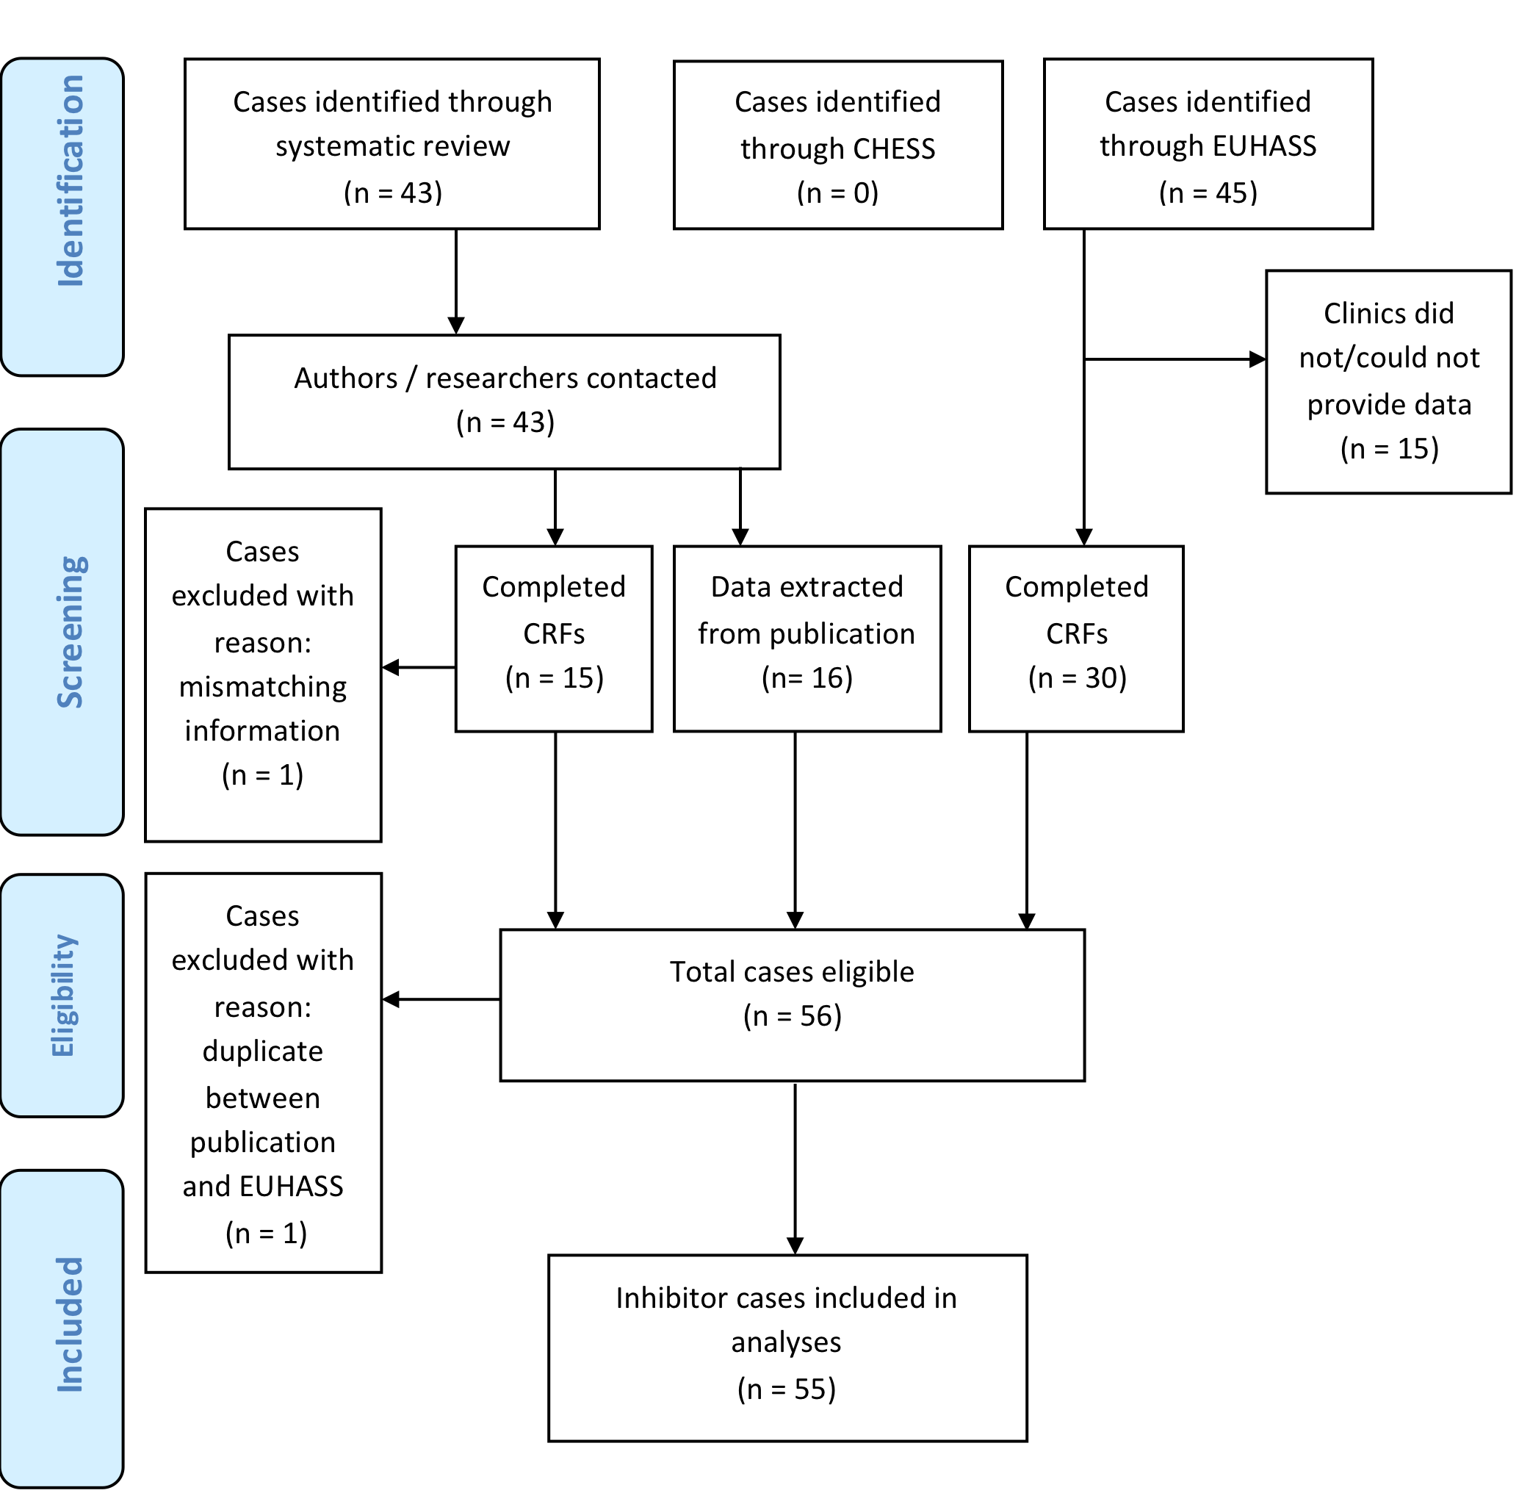

Slide 17
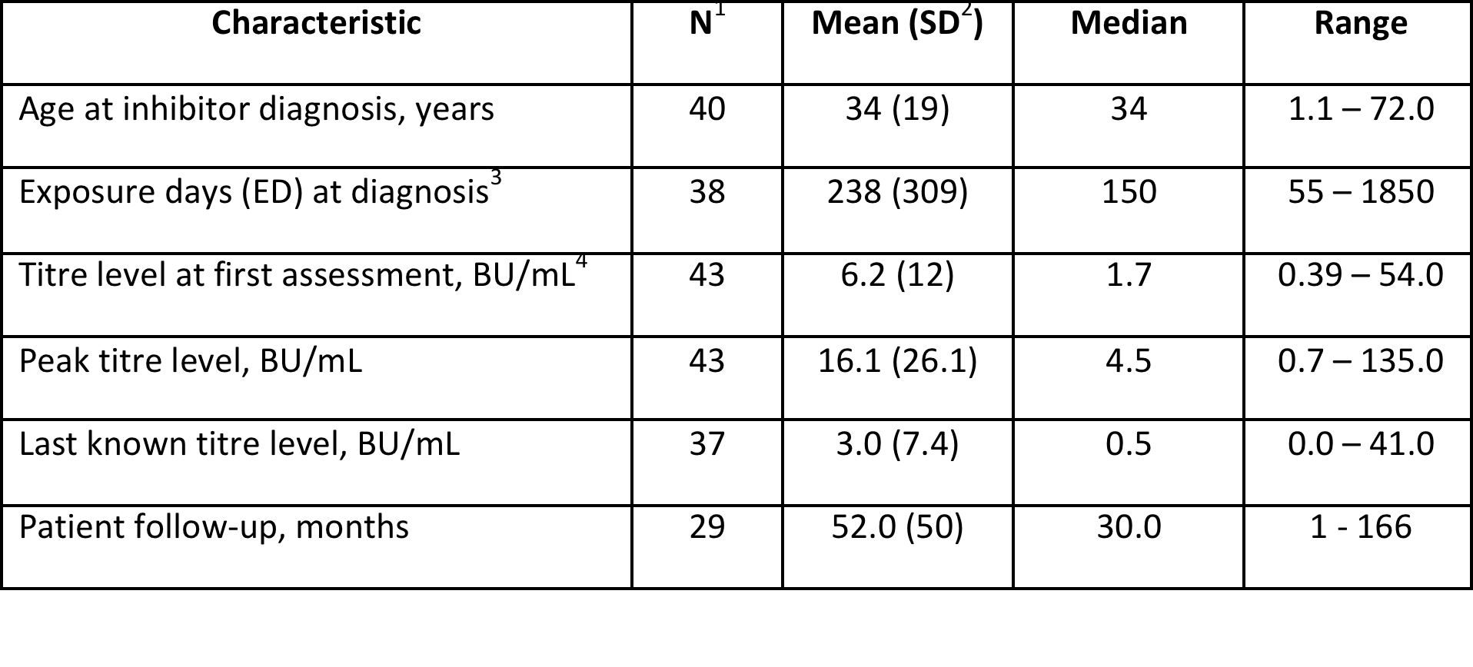
¹N=number of patients with available data
²SD=standard deviation
³3 patients with EDs of 55, 59 and 65 EDs at time of inhibitor detection; all others had more than 75 EDs
⁴BU/mL=Bethesda units per millilitre.

Slide 18
Iorio A, Puccetti P, Makris M. Clotting factor concentrate switching and inhibitor development in hemophilia A. Blood. 120(4), 720–727 (2012).

Slide 19
Conclusions - 1
Rather than performing PUP studies for separate molecules, a randomized controlled registry design would be more efficient
The multivariable analysis would account for the inter-patient variability and
the randomization would account for residual confounding by unknown confounders.
Implementing a randomized registry trial design would be a large undertaking, but it would be feasible and highly efficient
Lauer MiS, D’Agostino RB. The Randomized Registry Trial — The Next Disruptive Technology in Clinical Research? N. Engl. J. Med. 369(17), 1579–1581 (2013).

Slide 20
Conclusions - 2
How to minimize the risk of inhibitors in PUPs?
Prophylaxis?
Plasma derivatives?
Long-acting / Engineered protein?
All of the above
None of the above

Slide 21
Acknowledgements
Mike Makris and Kathlejin Fischer for endless very stimulating discussion
Slides at http://hemophilia.mcmaster.ca

