Slide 1
Outline
How important
is PK?
How important
is PK?
Prediction of bleeding in hemophilia patients
The art of predicting the risk of bleeding
The art of preventing bleeding
Individuals or clusters
Population pharmacokinetics
Repeated Time To Event (RTTE) analysis
Alfonso Iorio
McMaster University
Hamilton ON Canada
Alfonso Iorio
McMaster University
Hamilton ON Canada
Notes:
any algorithms, influencing factors or art of dosing tools which predict bleeding outcomes in severe hemophilia A and help to cluster patients according to their characteristics and treatment requirements.

Slide 2
Personalized prophylaxis
PK
Carcao MD & Iorio A. Individualizing Factor Replacement Therapy in Severe Hemophilia. Semin Thromb Hemost 2015; 41: 864–71.

Slide 3
Why is PK important?
Because we are
all different!!

Slide 4
Searching for patterns…

Slide 5
Rationale for the role of PK in hemophilia treatment

Slide 6
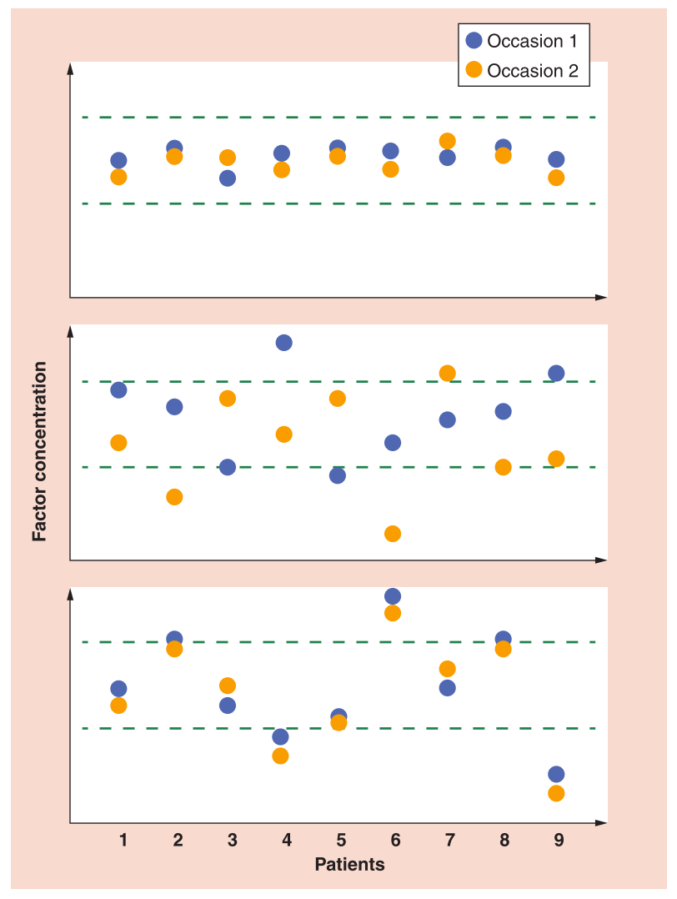
Variability
Inter Intra
Low Low
In hemophilia, PK variability is high among subjects and low within subjects
High High
High Low
Different individuals
Int J Pharmacokinet 2017; 2(2). ISSN 2053-0846 (in press)
Notes:
Message here is that the role for PK in hemophilia is in the vairaiblity being large among subjects and small within
The title could be:
‘Rationale for the role of PK in hemophilia treatment”

Slide 7
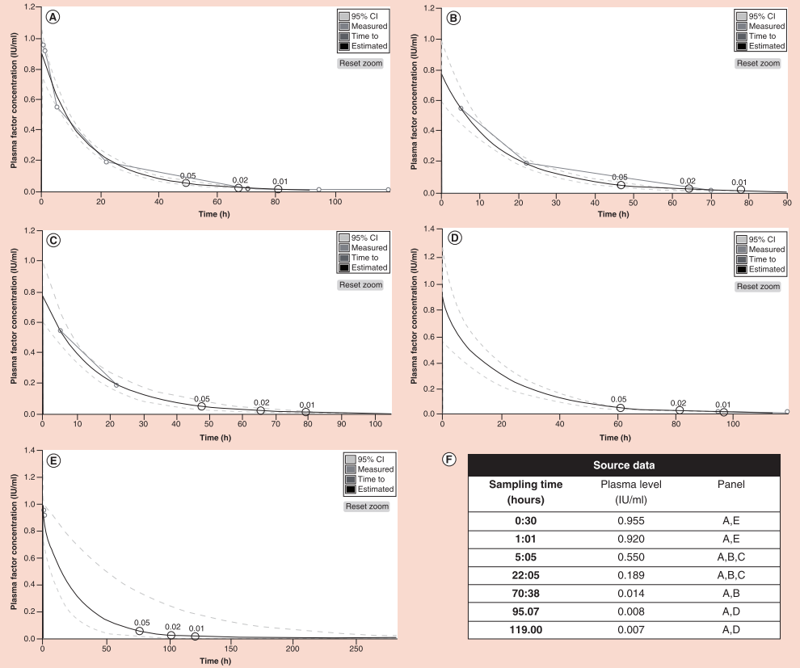
Intersubject variability may be managed using a PopPK approach
Int J Pharmacokinet 2017; 2(2). ISSN 2053-0846 (in press)
Notes:
This is to show value and limits of PopPK in handling variability, and how that depends on which samples are provided.
Message here is that the role for PK in hemophilia is in the variaiblity being large among subjects and small within
The title could be:
‘Handling intersubject variability with a PopPK approach”

Slide 8
Non-inferiority of Kovaltry® to Kogenate® confirmed for PK
LEOPOLD I Part A Crossover Design
FVIII concentration decay curve
PK parameters, geometric means, CS assay
Parameter | Kovaltry® | Kogenate® | P-value
AUC_{0-inf}, U*h/dL | 1889.2 | 1583.9 | 0.003*
AUC_{0-tn}, U*h/dL | 1668.5 | 1453.9 | 0.037*
C_{max}, U/dL | 130.1 | 136.2 | 0.450
MRT, h | 19.3 | 16.5 | <0.0001*
Clearance, dL/h/kg | 0.026 | 0.031 | 0.0003*
t_{1/2} (range), h | 13.8 (7.7-23.7) (14.3 arithm) | 12.0 (6.4-20.5) (12.4 arithm) | 0.002*
100
Kogenate®
BAY 81-8973
Kovaltry®
N=26
N=26
Geometric mean Factor VIII concentration, IU/dL
10
0
8
16
24
32
40
48
Time, h
AUC, area under the curve; C_{max}, maximum activity; CS, chromogenic substrate; MRT, mean residence time; PK, pharmacokinetic; t_{1/2}, half-life. * P=<0.05
Results were consistent for the One-Stage Assay
Shah A, Delesen H, Garger S, et al. Haemophilia 2015; 21(6):766-71.
Kogenate® SmPC: http://www.ema.europa.eu/docs/en_GB/document_library/EPAR__Product_Information/human/000275/WC500044445.pdf
Kovaltry® SmPC: http://www.ema.europa.eu/docs/en_GB/document_library/EPAR_Product_Information/human/003825/WC500202781.pdf
Notes:
The one-stage assay results are also available and consistent. The text at the bottom might suffice to mention.

Slide 9
Kovaltry® has a better PK profile compared with Advate®
PK parameters, geometric means (%CV)
(Chromogenic Assay)
Parameters | Kovaltry® | Advate® | Geometric LS Mean - Kovaltry® / Advate® (95% CI) | P-value
AUC_{0-last} (IU*h/dL) | 2202 (23.9) | 1548 (27.4) | 1.42 (1.36–1.49) | <0.0001*
AUC (IU*h/dL) | 2440 (28.5) | 1646 (31.0) | 1.48 (1.41–1.55) | <0.0001*
C_{max} (IU/dL) | 151 (19.9) | 153 (17.1) | 0.98 (0.95–1.02) | 0.32
CL, dL/h/kg | 0.021 (28.5) | 0.030 (31.0) | 0.67 (0.64–0.71) | <0.0001*
t_{1/2} (hr) | 13.9 (25.0) (9.95–22.2) | 12.0 (23.3) (9.06–17.9) | 1.16 (1.10–1.23) | <0.0001*
N=18
FVIII:C %
Time (Hours)
AUC, area under the curve; C_{max}, maximum activity; CS, chromogenic substrate; MRT, mean residence time; PK, pharmacokinetic; t_{1/2}, half-life. * P=<0.05
®
Kovaltry®
Results were consistent for the One-Stage Assay
Shah A, Solms A, Garmann D, et al. Clin Pharmacokinet. 2016. doi: 10.1007/s40262-016-0492-2. [Epub ahead of print]
Kovaltry® SmPC: http://www.ema.europa.eu/docs/en_GB/document_library/EPAR_Product_Information/human/003825/WC500202781.pdf
Advate® SmPC: http://www.ema.europa.eu/docs/en_GB/document_library/EPAR_-_Product_Information/human/000520/WC500022467.pdf
Notes:
You could say orally:
t1/2 for BAY 81-8973 was 23% higher based on one stage assay and 16% higher based on chromogenic than for rAHF-PFM
t1/2 longer in 16/18 subjects
In LEO I the t1/2 was 10% and 15% longer for BAY 81-8973 compared to rFVIII-FS based on one stage and chromogenic assay respectively
AUC for BAY 81-8973 was 32% higher based on one stage assay and 48% higher based on chromogenic as compared to rAHF-PFM
AUC higher in all 18 subjects based on chromogenic assay and for 15/18 subjects based on one stage assay
In LEO I the AUC was 19% higher for BAY 81-8973 compared to rFVIII-FS based on one stage and chromogenic assay
Cmax is similar for rAHF-PFM and BAY 81-8973
The one-stage assay results are also available and consistent. The text at the bottom might suffice to mention.

Slide 10
Median time to 1 IU/dL was ~18h longer for Kovaltry® vs. Advate® based on 25 IU/kg dose/injection
Median Time to Threshold
Dose, IU/kg | Threshold Level, IU/dL | Kovaltry®, hr | Advate®, hr | Ratio Kovaltry® / Advate® | Difference Kovaltry® / Advate®, hr
25 | 1 | 80.5 | 62.5 | 1.29 | 18
25 | 3 | 59 | 43.5 | 1.36 | 15.5
25 | 5 | 49 | 34.5 | 1.42 | 14.5
40 | 1 | 90 | 71 | 1.27 | 19
40 | 3 | 68.5 | 51.5 | 1.33 | 17
40 | 5 | 58.5 | 43 | 1.36 | 15.5
Shah A, Solms A, Garmann D, et al. Clin Pharmacokinet. 2016. doi: 10.1007/s40262-016-0492-2. [Epub ahead of print]
Kovaltry® SmPC: http://www.ema.europa.eu/docs/en_GB/document_library/EPAR_Product_Information/human/003825/WC500202781.pdf
Advate® SmPC: http://www.ema.europa.eu/docs/en_GB/document_library/EPAR_-_Product_Information/human/000520/WC500022467.pdf

Slide 11
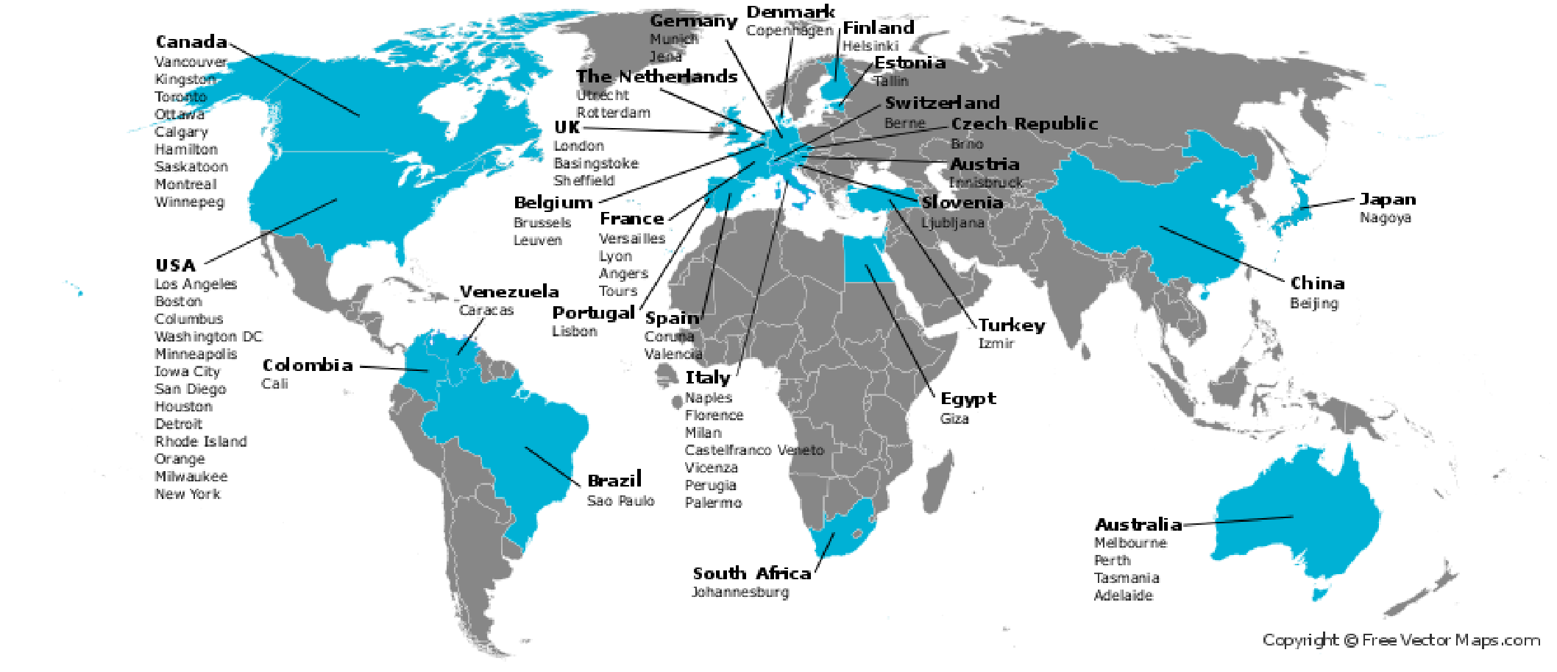
Web-Accessible Population Pharmacokinetics Service–Hemophilia Research Network
Iorio A, et al. Development of a Web-Accessible Population Pharmacokinetic Service–Hemophilia (WAPPS-Hemo): Study Protocol JMIR Res Protoc 2016;5(4):e239 URL: http://www.researchprotocols.org/2016/4/e239/ doi:10.2196/resprot.6558 PMID:27977390

Slide 12
WAPPS: A real-world data project
FVIII plasma level IU/mL
Hours post
20-28
44-52
20-28
44-52
20-28
44-52
Advate®
(n=128)
Kogenate®
(n=60)
Kovaltry®
(n=30)
Iorio A, et al. Development of a Web-Accessible Population Pharmacokinetic Service–Hemophilia (WAPPS-Hemo): Study Protocol JMIR Res Protoc 2016;5(4):e239 URL: http://www.researchprotocols.org/2016/4/e239/ doi:10.2196/resprot.6558 PMID:27977390
Kogenate® SmPC: http://www.ema.europa.eu/docs/en_GB/document_library/EPAR__Product_Information/human/000275/WC500044445.pdf
Kovaltry® SmPC: http://www.ema.europa.eu/docs/en_GB/document_library/EPAR_Product_Information/human/003825/WC500202781.pdf
Advate® SmPC: http://www.ema.europa.eu/docs/en_GB/document_library/EPAR_-_Product_Information/human/000520/WC500022467.pdf
Notes:
The message here is that comparison of different drugs in formal cross-over studies may not translate in observed differences in real world observations (here I plotted measurement obtained via WAPPS, not estimated PKs) –
notwithstanding the differences in half-life from published studies, and the simulations done out of those (the paper you attached), real world data give a slightly different message:
The measured values of plasma levels 24 and 48 hours after the infusion are very close for kogenate and advate, and both are superior to advate.

Slide 13
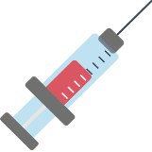
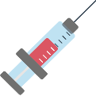
An RTTE model can relate FVIII concentration time profiles to the likelihood to bleed
Compliant
Non-compliant
Observation period
Factor VIII plasma profile
Lower
cumulative
hazard
Factor VIII plasma profile
Higher
cumulative
hazard
The ‘hazard’ (risk of bleeding) and FVIII effect is estimated
The likelihood and timing of a bleeding episode (time to event) can be predicted by using the cumulative hazard
Garmann D, Frede M, Ploeger B and Shah A. New approach in assessing the pharmacokinetic/pharmacodynamic relationship in patients with severe hemophilia A using data from BAY 81-8973 studies. Poster presented at the American Society of Hematology Annual Congress, Orlando, Fl, USA from December 5–8th, 2015.

Slide 14
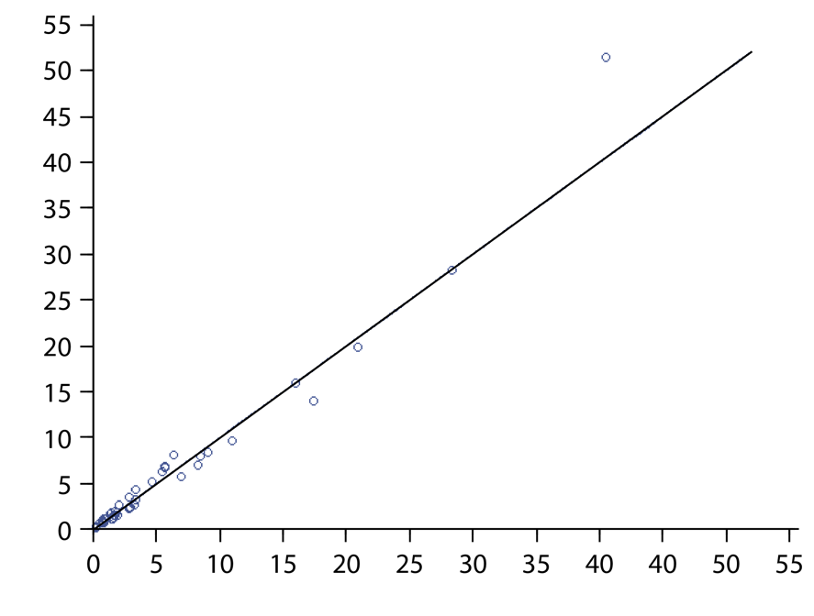
RTTE can be used to predict the effect of a change in dosing frequency
Characteristics of patients treated 3x/week and achieving FVIII >1 IU/dL have been used
The effect of frequency reduction to 2x/week by maintaining >1 IU/dL was predicted
Effect of frequency reduction
A higher dose will be needed to maintain exposure
This dose was calculated by using popPK
Maintaining exposure (>1 IU/dL) while expanding frequency might result in a comparable bleeding rate
With 15–60 IU/kg, maintaining >1IU/dL by 2x/week frequency was only possible in ~1/3 of patients
➔ Is targeting a threshold equal to targeting an acceptable bleeding rate?
Predicted bleeding rate 2x/week
Estimated bleeding rate 3x/week
Garmann D, Frede M, Ploeger B and Shah A. New approach in assessing the pharmacokinetic/pharmacodynamic relationship in patients with severe hemophilia A using data from BAY 81-8973 studies. Poster presented at the American Society of Hematology Annual Congress, Orlando, Fl, USA from December 5–8th, 2015.

Slide 15
References
McEneny-King A, Iorio A, Foster G, Edginton AN. The use of pharmacokinetics in dose individualization of factor VIII in the treatment of hemophilia A. Expert Opin Drug Metab Toxicol 2016; 12: 1313–21.
Iorio A, Keepanasseril A, Foster G, Navarro-Ruan T, McEneny-King A, Edginton AN, Thabane L. Development of a Web-Accessible Population Pharmacokinetic Service—Hemophilia (WAPPS-Hemo): Study Protocol. JMIR Res Protoc; 2016; 5: e239.
McEneny-King A, Foster G, Iorio A, Edginton AN. Data Analysis Protocol for the Development and Evaluation of Population Pharmacokinetic Models for Incorporation Into the Web-Accessible Population Pharmacokinetic Service - Hemophilia (WAPPS-Hemo). JMIR Res Protoc 2016; 5: e232.
Iorio A, McEneny-King A, Foster G, Edginton AN. What is the role for population pharmacokinetics in hemophilia? Int J Pharmacokin 2016; in press.
Shah A, Solms A, Garmann D, et al. Clin Pharmacokinet. 2016. doi: 10.1007/s40262-016-0492-2. [Epub ahead of print]
Shah A, Delesen H, Garger S, et al. Haemophilia. 2015; 21(6): 766-71.

Slide 16
Take home messages
Tailoring treatment in hemophilia should be easier and quicker when using PK to explore individual characteristics in drug disposal
Population PK is an efficient way of reducing the need for sampling and incorporating PK into clinical practice
PK and PopPK support the innovative and incremental contribution of Kovaltry® to the toolbox of hemophilia treaters
Kovaltry® SmPC: http://www.ema.europa.eu/docs/en_GB/document_library/EPAR_Product_Information/human/003825/WC500202781.pdf

Slide 17
Any questions?

Slide 18
Outline
How important
is PK?
How important
is PK?
Prediction of bleeding in hemophilia patients
The art of predicting the risk of bleeding
The art of preventing bleeding
Individuals or clusters
Population pharmacokinetics
Repeated Time To Event (RTTE) analysis
Alfonso Iorio
McMaster University
Hamilton ON Canada
Alfonso Iorio
McMaster University
Hamilton ON Canada
Notes:
any algorithms, influencing factors or art of dosing tools which predict bleeding outcomes in severe hemophilia A and help to cluster patients according to their characteristics and treatment requirements.

