Slide 1


Catastrophic Antiphospholipid Syndrome (CAPS) and
Models of Care for Hemophilia
Clinical Practice Guidelines:
lessons learnt
Dr. Alfonso Iorio, MD, PhD, FRCPC
Health Information Research Unit
Clinical Epidemiology and Biostatistics
McMaster University

Slide 2
The RARE-Bestpractices CPG Project work unit
Objectives:
To define methodological quality standards for BP guidelines in Rare Disease
To pilot test the proposed methods on two guideline for specific rare conditions (CAPS, SCD)
Deliverables:
Methods document
Pai M paper
NHF-McMaster CPG methods
Pilot BP guidelines

Slide 3



Guideline development for rare diseases
Notes:
ALFONSO
I would change this slide to have the reference as a starting point, and our method paper as the ending point (e.g. joined by an arrow), and I would comment on them as two steps of an ongoing process

Slide 4
Why a guideline for CAPS diagnosis and treatment?
CAPS is a very rare disorder
incidence rates have not been published; it is thought to represent <1% of APS patients
CAPS is life-threatening disorder
with available treatment options
Current level of evidence in CAPS reflective of most rare diseases
Notes:
Due to the rarity of the disorder, medical professionals will not encounter a CAPS patient in their careers, but if they do they tend to be inexperienced and seek expert advice

Slide 5
Hemophilia management is complex
hematologist
physiotherapist
hemophilia nurse
arthopathy
hemophilia-specific treatment and management plans
orthopaedic specialists
general practitioner
musculoskeletal health
non hemophilia-related complications
chronic hepatitis C
person with hemophilia
infectious disease specialists
dentition-related complications
HIV infection
dentist
psychosocial support
vocational challenges
psychologist
social stigma
limitations on their activities
social worker
decreased quality of life and life satisfaction
Notes:
(Explain diagram first:) Multiple barriers to achieve good health, various health care providers are able to assist with these different factors…
Care for persons with hemophilia is often complex and requires management beyond the prevention and treatment of bleeding. Consultation with knowledgeable experts of the disorder, such as hematologists and specialized nurses, can be important to develop hemophilia-specific treatment and management plans, as well as other supportive measures. Experts of musculoskeletal health, such as physical therapists, may be required to manage bleeding into joints and chronic joint damage. Psychosocial support may be met by social workers to support persons with hemophilia experiencing limitations on their activities, which can result in social stigma and vocational challenges, and decreased quality of life and life satisfaction. Other supplemental support can include infectious disease specialists to manage viral infections acquired from blood products used in the 1980s, gastroenterologists to manage liver disease associated with hepatitis, dentists for dentition-related complications, and molecular geneticists for carrier detection and prenatal diagnosis. As a result, care for persons with hemophilia is often multidisciplinary and specialized.

Slide 6
Evidence synthesis: Retrieved articles for therapy questions
671 abstracts
632 records excluded
39 articles for full-text screening
32 records excluded
8 articles included
Notes:
Excluded if not CAPS, no diagnosis discussed, <5 case reports, not original work

Slide 7
Evidence synthesis: retrieved articles for diagnosis questions
519 abstracts
498 records excluded
21 articles for full-text screening
*Cervera 2005 - Validation of the preliminary criteria for the classification of catastrophic antiphospholipid syndrome
*CAPS-Registry
20 records excluded
1 article included
Notes:
Excluded if not CAPS, no diagnosis discussed, <5 case reports, not original work

Slide 8
High quality evidence on hemophilia was scarce…
6795 articles screened
50 original studies included
NO systematic reviews!
NO randomized trials!
7 non-rnd comparative studies
19 non-rnd, non-comparative studies
24 “narrative” papers

Slide 9
Challenges and solutions
Paucity of evidence
Lack of critical appraisal skills
Lack of dedicated methodology
 | CAPS | Haemophilia
Indirect evidence |  | 🀐
Standardized expert opinion | 🀐 | 🀐
Ad hoc qualitative study |  | 🀐
Direct use of registry data | 🀐

Slide 10
Challenges and solutions
Paucity of evidence
Lack of critical appraisal skills
Lack of dedicated methodology
 | CAPS | Haemophilia
Indirect evidence |  | 🀐
Standardized expert opinion | 🀐 | 🀐
Ad hoc qualitative study |  | 🀐
Direct use of registry data | 🀐

Slide 11
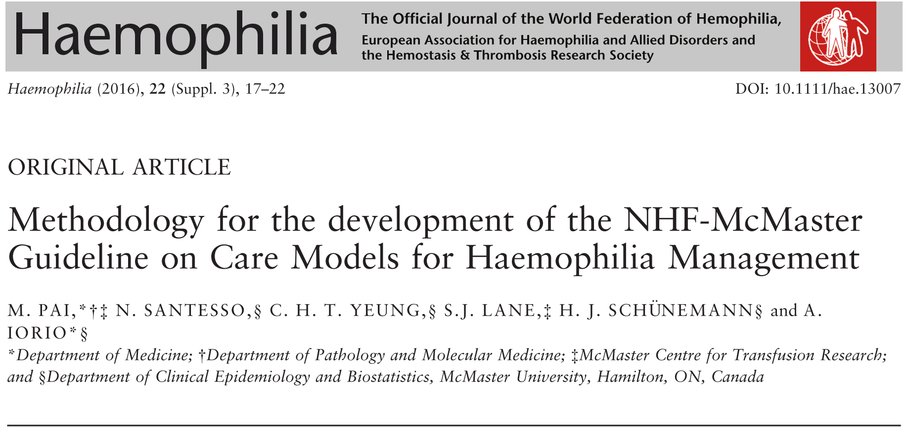
Proposed methodology

Slide 12
Filling in the Gaps: finding appropriate diseases
Parallel systematic searches of other chronic diseases were also conducted (congestive heart failure, chronic obstructive pulmonary disease, asthma, diabetes)
Like hemophilia, these diseases…
Are chronic
Are high resource users
Affect individuals over the life span (for asthma and diabetes)
Deliver care via well established multidisciplinary integrated models
Assessment of directness was performed by the panel on
Population
Interventon
Outcome
Without knowledge of the evidence synthesis results

Slide 13
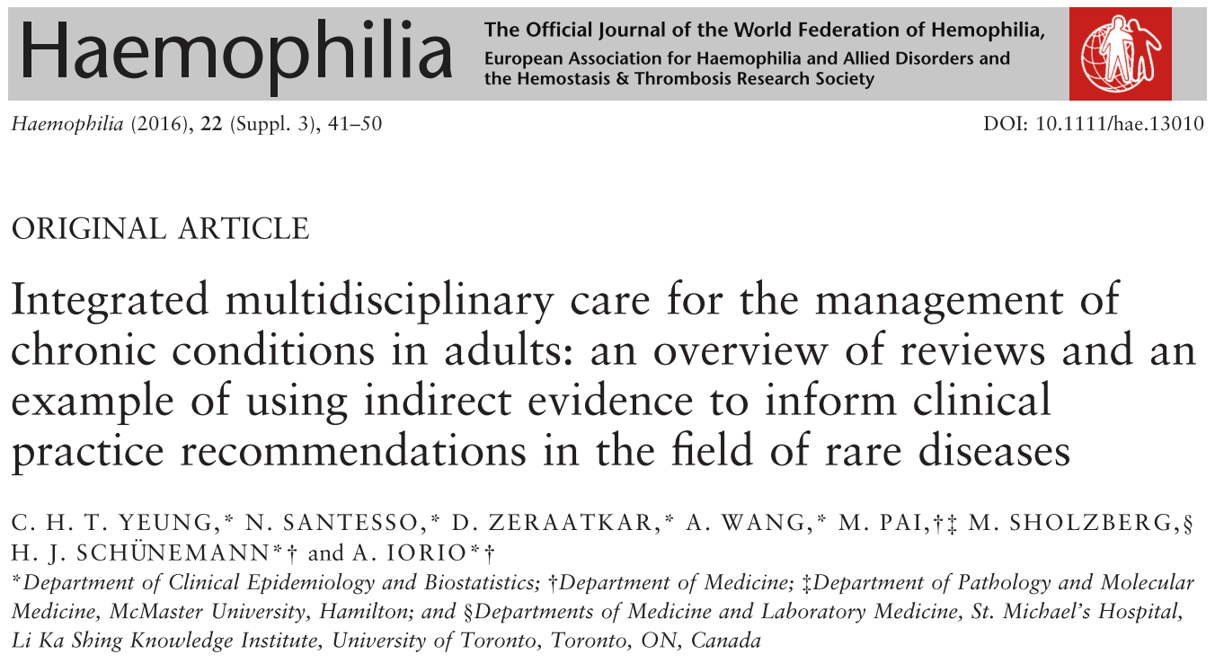
Evidence review
The effect size for the impact of the integrated model of care was a composite of the one from this review of RCTs and comparative observational trials in hemophilia

Slide 14
Challenges and solutions
Paucity of evidence
Lack of critical appraisal skills
Lack of dedicated methodology
 | CAPS | Haemophilia
Indirect evidence |  | 🀐
Standardized expert opinion | 🀐 | 🀐
Ad hoc qualitative study |  | 🀐
Direct use of registry data | 🀐

Slide 15
Systematic Observations
Population (n=55) | Mainly Caucasian middle aged women (approx. 60%) and men, range 20 to 50 years old (with few patients 5 to 13 years old, and up to 75 years old) SLE (approx. 45%) and primary APS (approx. 45%) One report with lungs, brain, and kidney were organs most frequently affected
Intervention | All patients received plasma exchange (with the exception of n=3 (5.5%) patients) Plasma exchange was first line for almost all patients, approx. n=15 (27%) second line (e.g., when anticoagulation and corticosteroids do not control the disease) Type of treatment dependent on severity, response to first line treatment, presence of SLE, etc. Examples of treatment combinations included: Plasma exchange + IVIG (70% of patients) + anticoagulation + corticosteroids + cyclophosphamide (20% of SLE patients) Plasma exchange + anticoagulation + IVIG Plasma exchange + anticoagulation + corticosteroid + cyclophosphamide (30% of patients)

Slide 16
Systematic Observations
Outcome | Large or moderate benefit | Small benefit | No effect | Small harm | Large or moderate harm | No info on this outcome
1. Death | 6 (n=45) | 1 (n=1) | 1 (n=4) |  |  | 3
2. Permanent organ dysfunction (dialysis, lung disease) | 4 (n=24) | 2 (n=20) | 3 (n=6) |  |  | 3
3. Permanent neurologic deficit (stroke, dementia) | 3 (n=13) | 2 (n=16) | 3 (n=12) |  |  | 5
4. Complete recovery (absence of 2 or 3) | 4 (n=28) | 2 (n=10) | 4 (n=17) |  |  | 2
5. Major bleeding (per ISTH criteria) | 3 (n=13) |  | 6 (n=37) |  |  | 3
6. Amputation (digit, extremity) | 2 (n=11) | 2 (n=20) | 2 (n=3) |  |  | 6
7. Thrombosis/ thrombotic event | 3 (n=30) | 2 (n=12) | 3 (n=8) |  |  | 3

Slide 17
Challenges and solutions
Paucity of evidence
Lack of critical appraisal skills
Lack of dedicated methodology
 | CAPS | Haemophilia
Indirect evidence |  | 🀐
Standardized expert opinion | 🀐 | 🀐
Ad hoc qualitative study |  | 🀐
Direct use of registry data | 🀐

Slide 18
Conducting qualitative interviews with key stakeholders
Notes:
I think this is important
It will take 30 seconds - the message is: we used qualitative evidence, but we went through the rigorous process of commissioning a study, having it peer-reviewed and published – evidence was not brought in as “quotes” from informal interviews
OF course, it is qualitative evidence, but it often is
Not a lot of evidence to inform decisions about patient-valued outcomes, equity, acceptability, and feasibility
Study the perspectives of
key stakeholders (29 interviews)
U.S. care models (18 states, 26 centers)

Slide 19
Challenges and solutions
Paucity of evidence
Lack of critical appraisal skills
Lack of dedicated methodology
 | CAPS | Haemophilia
Indirect evidence |  | 🀐
Standardized expert opinion | 🀐 | 🀐
Ad hoc qualitative study |  | 🀐
Direct use of registry data | 🀐

Slide 20
Systematic review results
Should TPE be used as first-line therapy for CAPS?
Outcome, Number of studies | n - TPE | n - No TPE | Relative effect (95% CI) | Absolute effect (95% CI) | Quality
Death n=6 | 34/112 (30.4%) | 97/229 (42.4%) | OR 0.68 (0.41-1.12) | 90 fewer per 1000 (28 more to 192 fewer) | Very low
Permanent organ dysfunction n=2 | 5/7 (71.4%) | 6/17 (35.3%) | OR 5.01 (0.72-34.75) | 379 more per 1000 (71 fewer to 597 more) | Very low
Permanent neurologic dysfunction n=2 | 1/7 (14.3%) | 1/17 (5.9%) | OR 8.00 (0.25-255.75) | 275 more per 1000 (43 fewer to 882 more) | Very low
Complete recovery n=2 | 2/7 (28.6%) | 9/17 (52.9%) | OR 0.27 (0.04-1.85) | 296 fewer per 1000 (146 more to 486 fewer) | Very low
Notes:
The arguments in favour of this method were:
(Most of) the evidence on which the SR’s are performed has been peer-reviewed
Processes of evidence profile generation and evidence-to-decision tables has been well established by GRADE
This is problematic when:
the entirety of the evidence is low-quality or very low-quality
the evidence doesn’t directly address the guideline panel’s questions
there is a rich source of information - i.e. a database available that can provide more direct information than the published evidence
Points to consider:
If databases are not prospectively, systematically collected, they can produce biased estimates, due to potential risks of:
Biased case recruitment
Inability to control for important prognostic factors if data is inconsistently collected
On the other hand, in a disease that most physicians see 0-1 times in their entire career, a database with 500 patients is extremely valuable

Slide 21
Supplementary Data from the CAPS Registry
Of patients receiving PLEX (n=169), 60 died
Of patients not receiving PLEX (n=318), 122 died
OR for mortality = 0.88 [95% CI 0.60, 1.30]
Notes:
The arguments in favour of this method were:
(Most of) the evidence on which the SR’s are performed has been peer-reviewed
Processes of evidence profile generation and evidence-to-decision tables has been well established by GRADE
This is problematic when:
the entirety of the evidence is low-quality or very low-quality
the evidence doesn’t directly address the guideline panel’s questions
there is a rich source of information - i.e. a database available that can provide more direct information than the published evidence
Points to consider:
If databases are not prospectively, systematically collected, they can produce biased estimates, due to potential risks of:
Biased case recruitment
Inability to control for important prognostic factors if data is inconsistently collected
On the other hand, in a disease that most physicians see 0-1 times in their entire career, a database with 500 patients is extremely valuable

Slide 22
Bottom line?
Panel participation?
Panel satisfaction with the process?
Quality of end product

Slide 23
Recommendations
Hemophilia
CAPS
1 | Conditional; moderate
1b | Strong; moderate
2 | Conditional; very low
1 | conditional for / very low
2 | strong for /very low
3 | conditional against / very low
4 | conditional for / very low
5 | conditional for / very low
6 | conditional against / very low
7a 7b | conditional for / very low Strong for / very low
8 | conditional for / very low
9 | neutral / very low
10 | conditional for / very low

Slide 24
Conclusions
EBG can be issued in the field of rare disease without necessarily ending in a crowd of weak recommendation and very low quality evidence
Involvement of panel expert very critical
Don’t stop at published RCT-based evidence
GRADE can support the process

Slide 25
CAPS - Panel
Dr. Ricard Cervera (Barcelona)
Dr. Ignasi Rodriguez Pinto (Barcelona)
Dr. Gerard Espinosa (Barcelona)
Dr. Munther Khamashta (London, UK)
Dr. Francesco Dentali (Insubria, Italy)
Dr. Vittorio Pengo (Padua, Italy)
Dr. Doruk Erkan (New York)
Dr. Jacob Rand (New York)
Dr. Sarah O'Brien (Columbus, Ohio)
Dr. Marc Carrier (Ottawa, Canada)
Dr. Mark Crowther (Hamilton, Canada)
Dr. Karen Moffat (Hamilton, Canada)
Dr. Holger Schunemann (Hamilton, Canada)
Dr. Alfonso Iorio (Hamilton, Canada)
Dr. Chris Hillis (Hamilton, Canada)
Dr. Kim Legault (Hamilton, Canada)
Dr. Thomas Sejersen (Stockholm)
Dr. Joerg Meerpohl (Freiberg)
Dr. Domenica Taruscio (Rome)
Dr. Elie Akl (Beirut)
Ms. Lisa Thom (Patient representative)
Panel Observers
Cristina Morciano (Rome)
Paolo Laricchiuta (Rome)
Cindy Yeung (Hamilton, Canada)
Panel Steering Committee
Dr. Holger Schunemann (Hamilton, Canada)
Dr. Mark Crowther (Hamilton, Canada)
Dr. Alfonso Iorio (Hamilton, Canada)
Dr. Chris Hillis (Hamilton, Canada)
Dr. Kim Legault (Hamilton, Canada)

Slide 26

Hemophilia panel
Mark Skinner
Ellen Riker
Marla Feinstein
Guideline panel members
Menaka Pai
Shannon Lane
Tamara Ruan-Navarro
Nancy Santesso
Alfonso Iorio
Holger Schünemann
Kari Atkinson
Marianne Clancy
Randall Curtis
Sue Geraghty
Alfonso Iorio
Craig Kessler
Nigel Key
Kristy Lee
Jeanne Lusher
Mike Makris
Maria Martins-Lopes
Ruth Mulvany
Holger Schünemann
Michelle Sholzberg
Mark Skinner
Mike Soucie
Doug Stratton
Vicky Whittemore

