Slide 1


Evidence Based Practice
2016 Bi-Regional Annual Conference
Mountain and Western States Regional Hemophilia Treatment Centers
Alfonso Iorio, MD, PhD, FRCPC
McMaster University
Canada

Slide 2
Learning objectives
Understand the NHF/McMaster Clinical Guideline project’s intent, status and next steps.
Identify three evidence based practices we are currently using in HTC clinical care.
Identify at least one area where more evidence is needed.
Determine method of data capture that would facilitate QI approaches.

Slide 3
What are Guidelines?
"Guidelines are recommendations intended to assist providers and recipients of health care and other stakeholders to make informed decisions.
Recommendations may relate to
clinical interventions,
public health activities, or
government policies."
WHO 2003, 2007

Slide 4
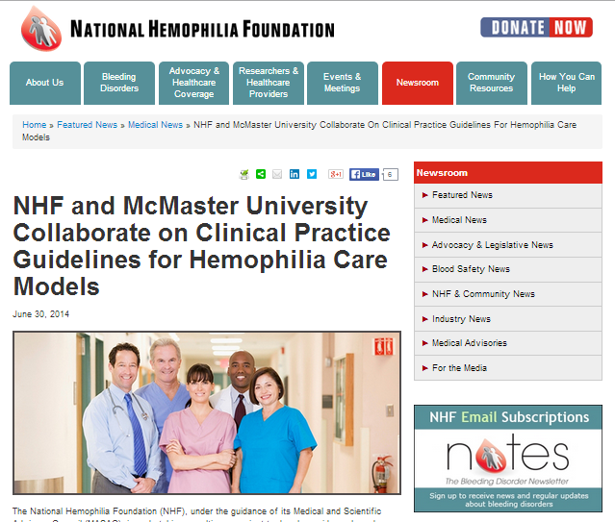

Slide 5
Motivation for Developing Clinical Practice Guidelines in Hemophilia
Mission of MASAC
Changing Healthcare Environment
Hemophilia Strategic Summit – May 2012
Need assessment:
Strengthening Evidence-base for Hemophilia Care
Promote Comprehensive Hemophilia Care
Recommendation: Generate and Maintain Evidence-Based Guidelines
Complete comprehensive assessment of existing guidelines and resolutions
Identify gaps and prioritize standards for updating
Update guidelines following a systematic process

Slide 6
Scoping – 9 priority topics (10/2013)
Laboratory diagnosis
Sustained adult prophylactic factor replacement
Management of aging hemophilia patients / long-term care
Management of MSK complications / related therapies
Management of comorbid conditions
Inhibitor mitigation, treatment, management
Stem cell/gene therapy
Comprehensive care model
Data/evidence needs

Slide 7
Scoping – 9 priority topics (10/2013)
Laboratory diagnosis
Sustained adult prophylactic factor replacement
Management of aging hemophilia patients / long-term care
Management of MSK complications / related therapies
Management of comorbid conditions
Inhibitor mitigation, treatment, management
Stem cell/gene therapy
Comprehensive care model
Data/evidence needs

Slide 8
Why a CPG on Models of care for Hemophilia
importance of a range of coordinated services to most patients with hemophilia
establish a foundation upon which more specific CPGs addressing other aspects of care may be developed.
define comprehensive care as it relates to the haemophilia patient;
specify the coordinated set of diagnostic, therapeutic, and auxiliary services involved
identify best-practices and evidence-based standards of comprehensive / coordinated care for haemophilia treatment centers (HTCs) and individual clinical practices.
The National Haemophilia Program Standards, Evaluation and Oversight Systems in the United States of America, M Skinner, JM Soucie, K McLaughlin, Blood Transfus 2014; 12 Suppl 3: s542-8
Notes:
The initial phase of the CPG initiative addresses the comprehensive care model for haemophilia. In addition to recognizing the importance of a range of coordinated services to most patients with haemophilia, addressing the comprehensive care model as the first evidence-based CPG will establish a foundation upon which more specific CPGs addressing other aspects of care may be developed. The comprehensive care CPG will:
- define comprehensive care as it relates to the haemophilia patient;
- specify the coordinated set of diagnostic, therapeutic, and certain auxiliary and supplemental services that are most important for haemophilia patients across the U.S.;
- identify the range of clinical and non-clinical members of a haemophilia comprehensive care team (including, e.g., social workers, dentists);
- identify best-practices and evidence-based standards of comprehensive/coordinated care for haemophilia treatment centers (HTCs) and individual clinical practices.
NHF foresees that the development of the comprehensive care CPG will provide a catalyst to promote harmonization of care delivery and reduce practice variations among the US HTC system. An agreed evidence-based benchmark would allow for both internal and external evaluation of adherence to best practices and benchmark available services with an HTC. Ultimately will serve as an important starting point for establishment of a US HTC self-audit or accreditation system.

Slide 9
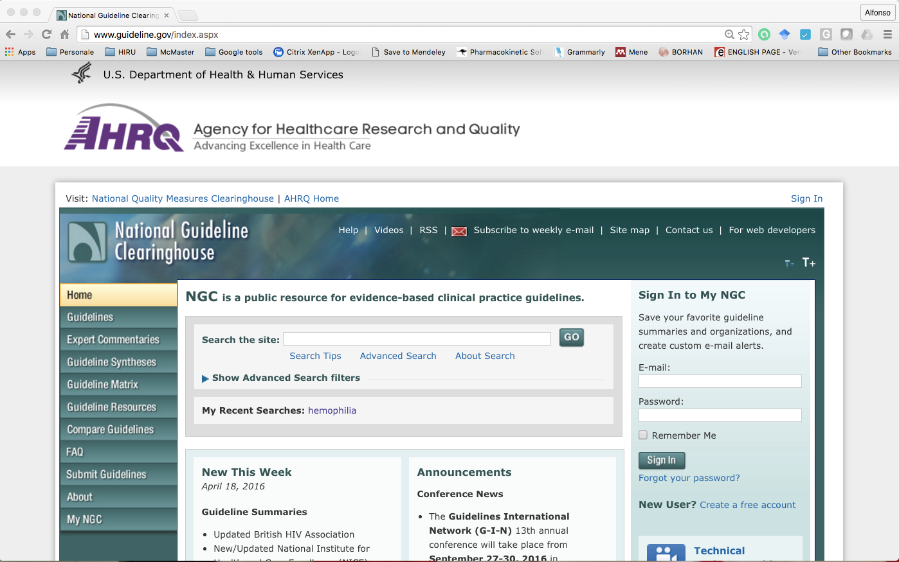
Which kind of CPG?

Slide 10

Project grounded in a transparent, internationally accepted process
Establishing transparency
Management of conflict of interest (COI)
Guideline development group composition
Clinical practice guideline–systematic review intersection
Establishing evidence foundations for and rating strength of recommendations
Articulation of recommendations
External review
Updating

Slide 11
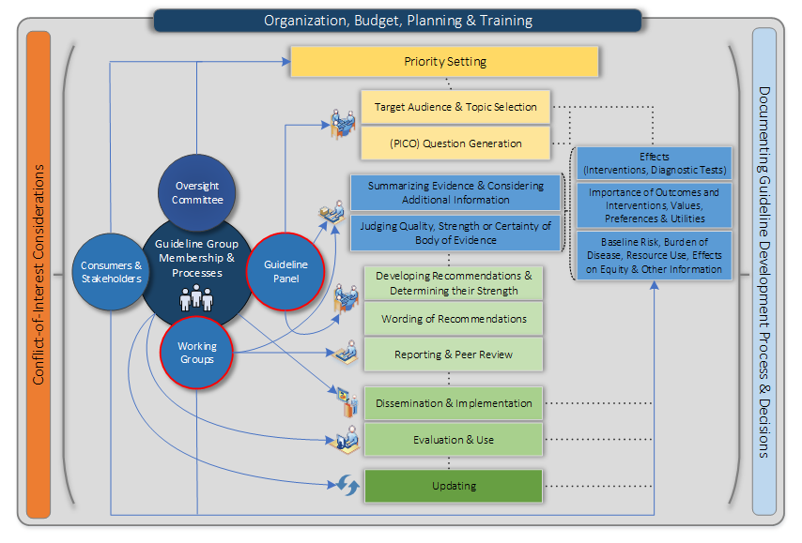
A Systematic Workplan

Slide 12

GRADE can be applied to rare diseases like hemophilia
What is GRADE?
Grading of Recommendations, Assessment, Development and Evaluation
Method of grading quality of evidence and strength of recommendations in guidelines.
Used by over 80 international organizations to produce rigorous, transparent and sensible clinical practice guidelines and other health care recommendations.
Developed by an international working group with over 300 contributors.

Slide 13
GRADE for “dummies”
Appraisal of evidence
Evidence to Recommendations
Study limitations
Precision
Consistency
Directness
Publication bias
Effect size
“Dose effect”
Plausibility
Priority?
Certainty on value of outcome?
Overall certainty?
Large desirable effects?
Small undesirable effects?
Desirable relative to undesirable effects?
Resources required?
Incremental cost relative to net benefits?
Health inequalities?
Acceptability?
Feasibility?
Evidence profile
EtR framework

Slide 14
GRADE for rare diseases

Slide 15
GRADE for rare diseases
3 specific components:
1. Systematic elicitation of expert opinions
2. Use of indirect evidence from other diseases
3. Generation of qualitative evidence as needed

Slide 16
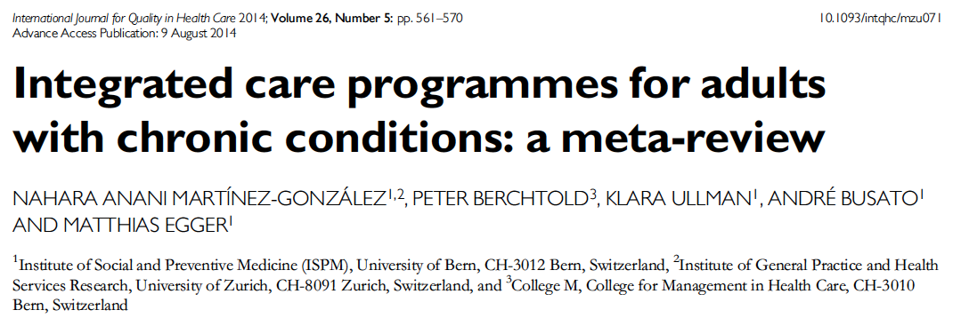
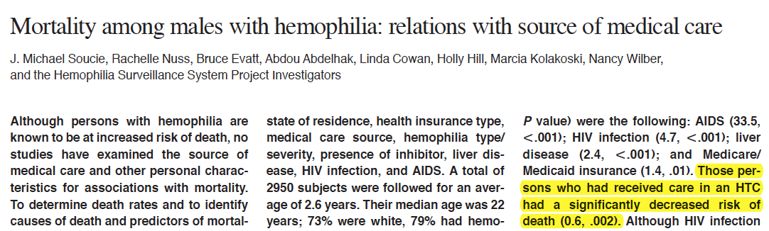
Haemophilia, submitted
Integrated multidisciplinary care for the management of chronic conditions in adults:
an overview of reviews and an example of using indirect evidence to inform
clinical practice recommendations in the field of rare diseases. Cindy Yeung, Nancy Santesso, Dena Zeraatkar, Alice Wang, Menaka Pai, Michelle Sholzberg, Holger J Schünemann, Alfonso Iorio
7 reviews on 3 chronic conditions.
Integrated care results in:
a reduction in mortality
a probable reduction in emergency visits
an improvement in function
little to no difference in quality of life
shorter hospital stays
little to no difference in missed days of school/work
No studies reported educational attainment, or patient adherence and knowledge.

Slide 17
Generating qualitative evidence
Additional information required to make good recommendations:
What outcomes are valued by stakeholders?
What is the impact of different options on health inequities?
What options are acceptable to stakeholders?
What options are feasible to implement?
Qualitative, interview-based study was done to address these issues
Recruitment through NHF website, facebook posts, tweets, and emails to key groups of stakeholders

Slide 18
Guideline Questions in “PICO” Format
P
Population
I
Intervention
C
Comparator
O
Outcome
PICO questions allow us to define clinical questions in terms of a specific patient problem, so we can find clinically relevant evidence in the literature.

Slide 19
Selecting outcomes of interest
Mortality / survival
Missed days from work or school
Number of ER visits
Length of in-patient stay
Quality of life
Functional outcomes - joint damage / joint disease
Educational attainment
Patient adherence
Patient knowledge
Long list generated by consultants
Electronic surveys sent out to stakeholders
Short list presented to panel to review and refine

Slide 20
Final questions
Should integrated care versus non-integrated care be used for people with hemophilia?
For individuals with hemophilia, should a hematologist, a specialized hemophilia nurse, a physical therapist, a social worker, or round-the-clock access to a specialized coagulation laboratory be part of the integrated care team, versus an integrated care team with a lesser complement?

Slide 21
Final recommendations (Q1)
For persons with hemophilia, the Guideline Panel suggests that the integrated care model be used over non-integrated care models.
Conditional recommendation, moderate certainty in the evidence
For persons with hemophilia with inhibitors, and those at high risk for inhibitor development, the Guideline Panel recommends that the integrated care model be used over non-integrated care models
Strong recommendation, moderate certainty in the evidence

Slide 22
Strength of recommendations
Stakeholder | Strong | Conditional
Policy maker | Adopt in most situations | Adoption might involve specific debate
Clinicians | Most patients should receive the intervention | Different patients might require different choices
Patient | Most patients would like to adopt | Many patients, but not all, would adopt

Slide 23
Evidence profiles: mortality
QUALITY ASSESSMENT
No of studies | 1
Study design | observational
Risk of bias | Not serious
Inconsistency | Not serious
Indirectness | Not serious
Imprecision | Not serious
Other considerations | None
NUMBER OF PATIENTS
Integrated care | 149/1979 (7.5%)
Non-integrated care | 86/971 (8.9%)
EFFECT
Relative (95% CI) | 0.60 (0.50-0.80)
Absolute (95% CI) | 35 fewer per 1000 (from 18 fewer to 44 fewer)
Quality | ⨁⨁◯◯ LOW
Notes:
Overall, 67% of identified patients received care in HTCs during the period. Of the remainder, 13% had received care primarily from private physicians or hematologists, 4% primarily from hospital- and nonhospital-based clinics, 8% received care only in hospitals or emergency rooms, and the rest received care from a variety of other sources.

Slide 24
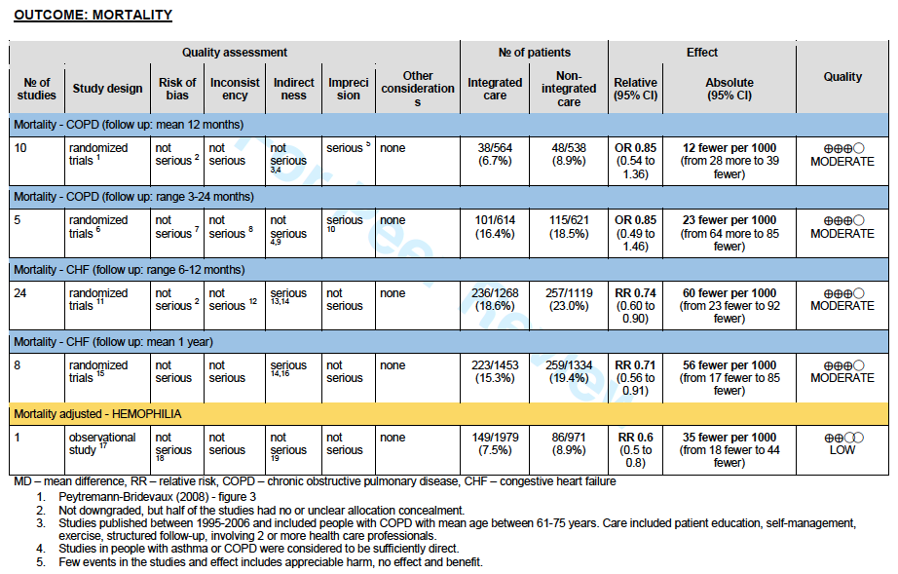
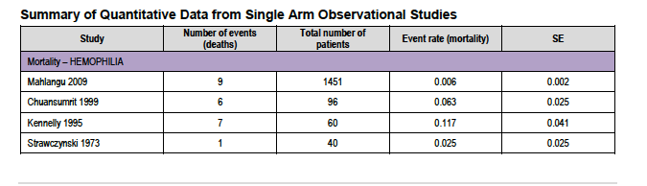

Slide 25
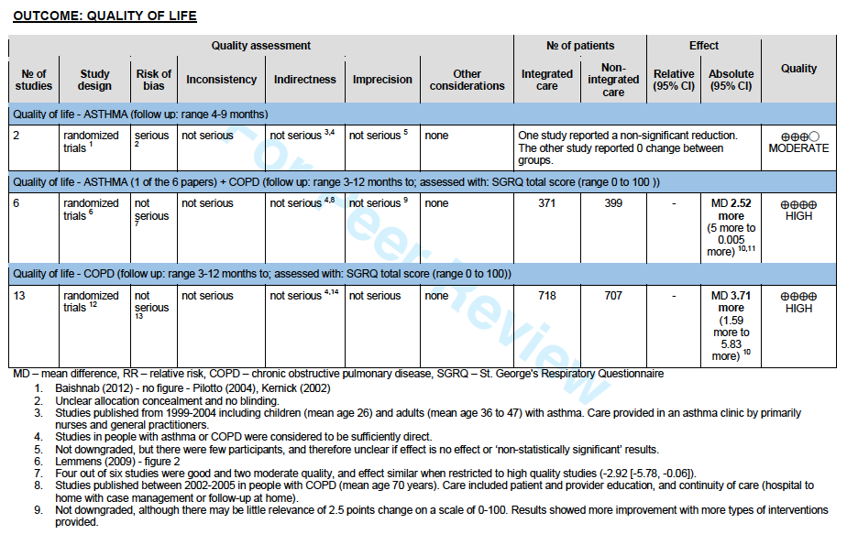

Slide 26
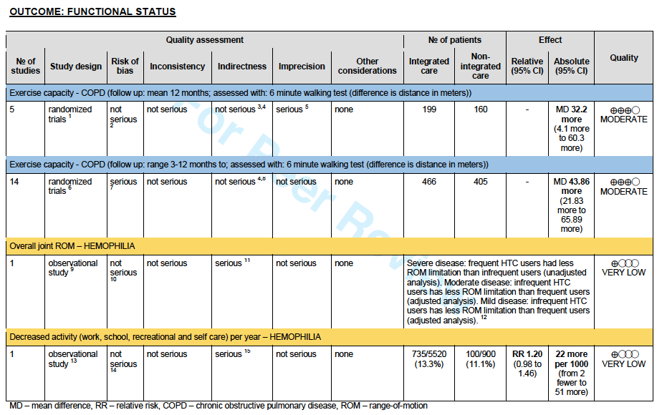

Slide 27
Evidence to Recommendations
CRITERIA | JUDGMENT
Is there a problem priority? | Yes
Is there important uncertainty about how much people value the main outcome? | No
What is the overall certainty of evidence for benefits and harms? | Moderate
Are the desirable anticipated effects large? | Probably yes
Are the undesirable anticipated effects small? | Yes
Are the desirable effects large relative to undesirable anticipated effects small? | Yes
Are the resources required small? | Yes
Is the incremental cost small relative to the net benefits? | Yes
What would be the impact on health inequalities? | Probably reduced
Is the option acceptabe to key stakeholders? | Probably yes
Is the option feasible to implement? | Yes

Slide 28
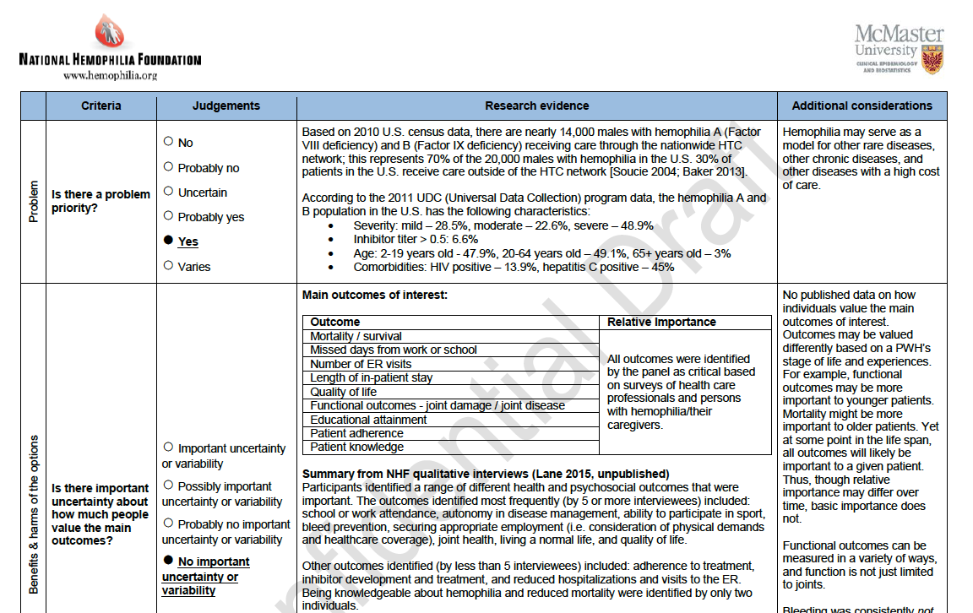
Notes:
Comment on bleedings

Slide 29
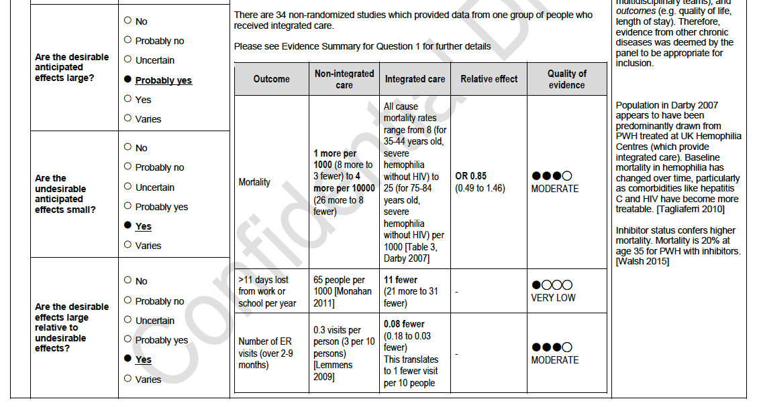
Notes:
Comments on easiness of changing pieces in the process

Slide 30
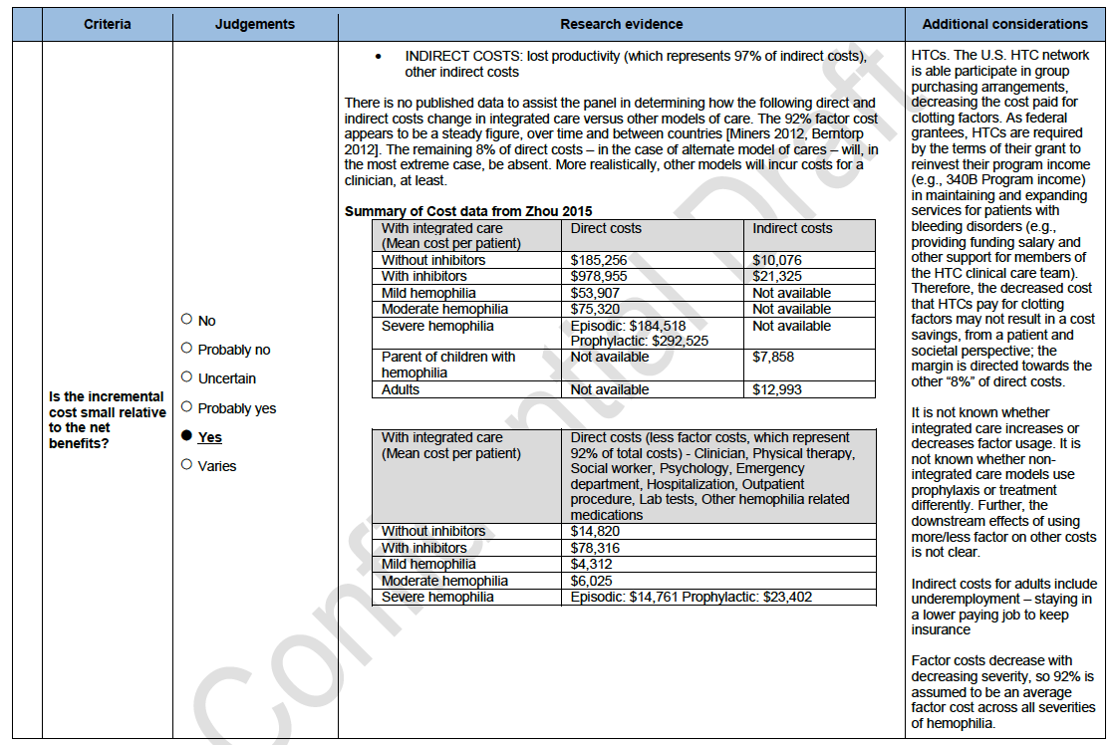

Slide 31
Evidence to Recommendations
CRITERIA | JUDGMENT
Is there a problem priority? | Yes
Is there important uncertainty about how much people value the main outcome? | No
What is the overall certainty of evidence for benefits and harms? | Moderate
Are the desirable anticipated effects large? | Probably yes
Are the undesirable anticipated effects small? | Yes
Are the desirable effects large relative to undesirable anticipated effects small? | Yes
Are the resources required small? | Yes
Is the incremental cost small relative to the net benefits? | Yes
What would be the impact on health inequalities? | Probably reduced
Is the option acceptabe to key stakeholders? | Probably yes
Is the option feasible to implement? | Yes

Slide 32
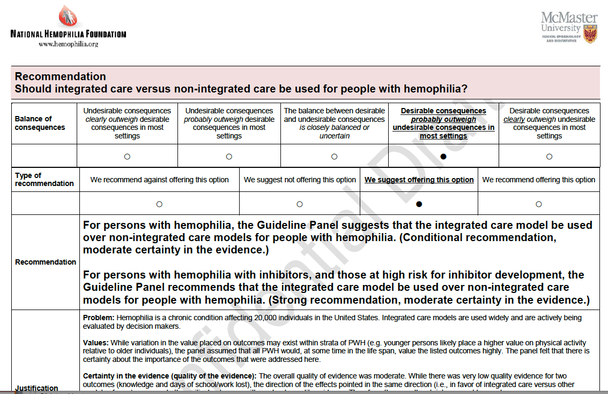

Slide 33
Final recommendations (Q2)
For individuals with hemophilia, the Panel suggests that a hematologist, a specialized hemophilia nurse, a physical therapist, a social worker, and round-the-clock access to a specialized coagulation laboratory be part of the integrated care team, over an integrated care team that does not include all of these components
Conditional recommendation, very low certainty in the evidence

Slide 34
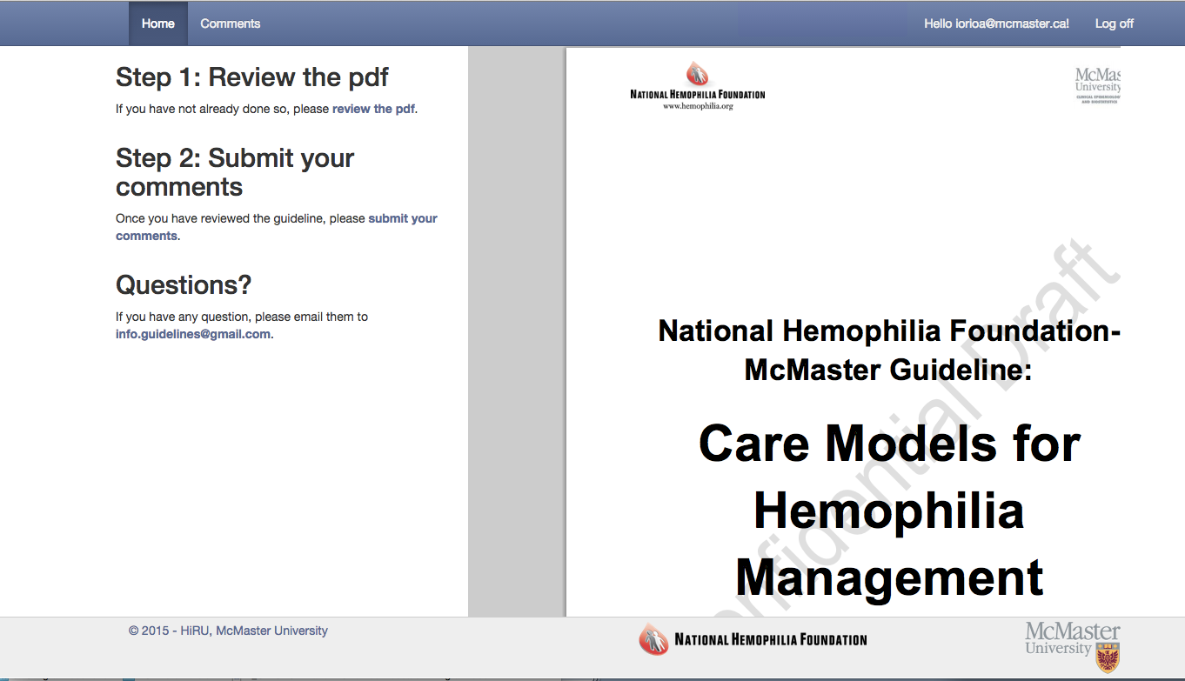
Public commenting

Slide 35
Timeline update
Panel selection, vet COI, 1st panel mtg (Jun 14)
Finalize guideline questions (Jul 14)
Find quantitative evidence (Aug-Nov 14)
Find/Generate qualitative evidence (Sep 14-Jan 15)
Summarize evidence (Feb-Apr 15)
2nd panel mtg (May 2015)
Draft final guideline (Jun-Aug 15)
Stakeholder open comments and peer review (Sep-Oct 15)
Revise guideline report (Nov-Dec 15)
Publish/Disseminate (Early 16)

Slide 36
Publication and dissemination
Poster presented at THSNA
Poster accepted for presentation at WFH
6 articles submitted to Haemophilia
supplement to be available for WFH / NHF in Orlando
Once “Main Guideline Paper” accepted by Haemophilia will submit to National Guidelines Clearinghouse

Slide 37
Evidence-based guidelines support integrated disease management as the optimal model of hemophilia care
Pipe and Kessler
NHF-McMaster Guideline on care models for hemophilia management
Pai et al
Methodology for the development of the NHF-McMaster guideline on care models for hemophilia management
Yeung et al
Care models in the management of hemophilia: a systematic review
Yeung et al
Integrated multidisciplinary care for the management of chronic conditions in adults: an overview of reviews and an example of using indirect evidence to inform clinical practice recommendations in the field of rare diseases.
Yeung et al
Outcomes, Equity, Acceptability and Feasibility: a qualitative study to understand stakeholder perceptions and experiences of a care model for the management of hemophilia in the U.S.
Lane et al

Slide 38
Potential next / follow-on steps
Implementation – standardization of performance metrics (e.g., process heading to self-audit or accreditation for HTCs)
Research – prioritize “high-value” research to fill data gaps or strengthen evidence base
Scoping – initiate another guideline

Slide 39
Where do we go from here? IMPLEMENTATION CONSIDERATIONS
Identify and address barriers to accessing care
Geographic location, race/ethnicity, insurance status, capacity of centres, stable funding streams for centres
Standardize components of integrated care model across the U.S.
Develop and track performance measures to ensure PWH get the resources and care they need
Train, recruit and retain specialized health care team members

Slide 40
Where do we go from here? IMPLEMENTATION CONSIDERATIONS
Formal research into the impact of models of care on patient-important outcomes must continue
How can care models respond to changing natural history of hemophilia and the changing U.S. healthcare system?
Integrated care centres must respond to needs of their patient population in a dynamic way – this will ensure their long-term sustainability

Slide 41
Where do we go from here? RESEARCH PRIORITIES
Qualitative research may address barriers to care, particularly in non-HTC patients.
Can U.S. HTCs build their data collection and analysis capacity, to conduct high quality, well-organized studies?

Slide 42
Where do we go from here? RESEARCH PRIORITIES
Gaps in data exist!
Populations to study:
geriatric populations;
populations with poor access to care;
PWH who access care outside of HTCs.
Interventions to study:
which aspects of the integrated care model are a “value add;”
impact of telemedicine and other remote care delivery systems as an alternative/add-on.

Slide 43
Where do we go from here? RESEARCH PRIORITIES
Gaps in data exist!
Outcomes to study:
cost of care outside of HTCs;
factor utilization within and outside of HTCs;
impact of care on lost days of school/work, educational attainment, employment attainment;
impact of patient characteristics on outcomes.

Slide 44
Implementation - HTC certification systems – optional or optimal choice?
NHF foresees that the development of the comprehensive care CPG will provide a catalyst to promote harmonization of care delivery and reduce practice variations among the US HTC system.
An agreed evidence-based benchmark would allow for both internal and external evaluation of adherence to best practices and benchmark available services with an HTC.
Ultimately, it will serve as an important starting point for establishment of a US HTC self-audit or accreditation system.
The National Haemophilia Program Standards, Evaluation and Oversight Systems in the United States of America, M Skinner, JM Soucie, K McLaughlin, Blood Transfus 2014; 12 Suppl 3: s542-8
Notes:
The initial phase of the CPG initiative addresses the comprehensive care model for haemophilia. In addition to recognizing the importance of a range of coordinated services to most patients with haemophilia, addressing the comprehensive care model as the first evidence-based CPG will establish a foundation upon which more specific CPGs addressing other aspects of care may be developed. The comprehensive care CPG will:
- define comprehensive care as it relates to the haemophilia patient;
- specify the coordinated set of diagnostic, therapeutic, and certain auxiliary and supplemental services that are most important for haemophilia patients across the U.S.;
- identify the range of clinical and non-clinical members of a haemophilia comprehensive care team (including, e.g., social workers, dentists);
- identify best-practices and evidence-based standards of comprehensive/coordinated care for haemophilia treatment centers (HTCs) and individual clinical practices.
NHF foresees that the development of the comprehensive care CPG will provide a catalyst to promote harmonization of care delivery and reduce practice variations among the US HTC system. An agreed evidence-based benchmark would allow for both internal and external evaluation of adherence to best practices and benchmark available services with an HTC. Ultimately will serve as an important starting point for establishment of a US HTC self-audit or accreditation system.

Slide 45
Learning objectives
Understand the NHF/McMaster Clinical Guideline project’s intent, status and next steps.
Identify three evidence based practices we are currently using in HTC clinical care.
Identify at least one area where more evidence is needed.
Determine method of data capture that would facilitate QI approaches.

Slide 46
Acknowledgements for this presentation
Mark Skinner
Menaka Pai and Cindy Yeung
Holger Schunemann, Nancy Santesso
All the panel members
Tamara Navarro, Shannon Lane

Slide 47
Guideline panel members
Kari Atkinson – Parent of PWH, NHF Chapter President
Marianne Clancy – Executive Director of HHT Foundation, patient with a rare disease
Randall Curtis – PWH, hemophilia researcher
Sue Geraghty – Hemophilia nurse
Alfonso Iorio – Canadian hemophilia clinic director
Jeanne Lusher – Former U.S. hemophilia clinic director
Mike Makris – U.K. hemophilia clinic director
Craig Kessler – U.S. hemophilia clinic director
Nigel Key (Clinical Chair) – U.S. hemophilia clinic director
Kristy Lee – Genetic counsellor
Maria Martins-Lopes – Chief Medical Officer, CDMI/Magellan, payer representative
Ruth Mulvany – Physical therapist
Holger Schunemann (Chair) – Clinical epidemiologist, internist
Michelle Sholzberg – Canadian hemophilia physician, American Society of Hematology representative
Mark Skinner – PWH, WFH and NHF Past President
Mike Soucie – Hemophilia researcher, CDC representative
Douglas Stratton – Chairman and CEO, Foundation for Complex Healthcare, payer representative
Vicky Whittemore - Program Director (Epilepsy), NIH/NINDS

Slide 48

Thank you !!!
Download these slides at:
Hemophilia.mcmaster.ca

