Slide 1

for Overall Prognosis
Workshop
Cochrane Colloquium, Seoul
Oct 24 14:00-15:30
Room
Facilitators: Alfonso Iorio, Katrina Williams

Slide 2
Workshop Objectives
How prognosis would fit in the context of decision making
Estimating the baseline risk: evidence on overall prognosis
Dealing with subpopulations: evidence on risk factors
Tailoring to the individual: clinical prediction models
How to apply to the prognostic evidence the basics of GRADEing
5 criteria to decrease confidence:
-RoB, precision, consistency, directness, and publication bias
3 criteria to increase confidence:
-Trend in effect, large effect, plausible bias direction
(How to compile an evidence profile for a SR of prognosis)

Slide 3
Workshop format
5 brainstorming units.
We will work in small group (3-5 persons) on each unit for 5-10 minutes, with a general discussion of 5 min on each one.

Slide 4
Agenda
0-5: intro
5-20: unit 1 The role of baseline risk
20-35: unit 2 The role of prognostic factors
35-45: unit 3 The role of prediction models
45-55: unit 4 Effect modification
55-65: biological break
65-80: unit 5: How GRADEing baseline risk affects GRADEing effectiveness
70-90: Summary

Slide 5
The role of baseline risk of patient important outcomes in medical decision making
Clinical scenario:
Patients with atrial fibrillation (a disease of the heart beat) have an increased risk of stroke (death of a part of the brain).
Anticoagulants reduce the risk of stroke.
You have to decide whether patients with atrial fibrillation and cardiac heart failure (failing heart) deserve treatment with anticoagulants.

Slide 6
The role of baseline risk of patient important outcomes in medical decision making
Balancing benefits and harms requires knowledge of the absolute effects of all relevant benefits and harms
the net balance of benefits and harms is the starting point for a EB recommendation
It requires:
Estimates of benefits and harms from RCTs/SRs of RCTs of effectiveness (usually reported as relative risk)
Estimates of baseline risk, which often come from SR of cohort studies.
Notes:
The risk in the control group from RCTs is not ideal for estimating baseline risk given that trials include highly selected populations not representative of real life patients
Usually decision support tools present more than one level of risk to illustrate a range of absolute effects.

Slide 7
The role of baseline risk of patient important outcomes in medical decision making
Relative risk of stroke in Atrial fibrillation patients (including CHF patients) treated with NOACS compared with untreated = 0.26;
Baseline risk of stroke at 1 year in patients with Atrial fib and CHF not on anticoagulants is 12.6%;
Clue: Absolute risk = (1-Relative risk) x (Baseline Risk)
absolute risk reduction (in 1000 treated patients) = (1-0.26) x (126 per 1000) = 93 fewer per 1000.

Slide 8
The role of baseline risk of patient important outcomes in medical decision making
Questions:
What is your prognostic question?
Is this enough for making a recommendation? If not, what is missing?
How the SR on the risk of stroke has affected your decision?

Slide 9
PICO components
 | Overall prognosis | Risk factor | Prognostic model
P | ☐ | ☐ | ☐
I | ☐ | ☐ | ☐
C | ☐ | ☐ | ☐
O | ☐ | ☐ | ☐
(T) | ☐ | ☐ | ☐
 | Overall prognosis
P | ☑
I | ☐
C | ☐
O | ☑
(T) | (endpoint)

Slide 10
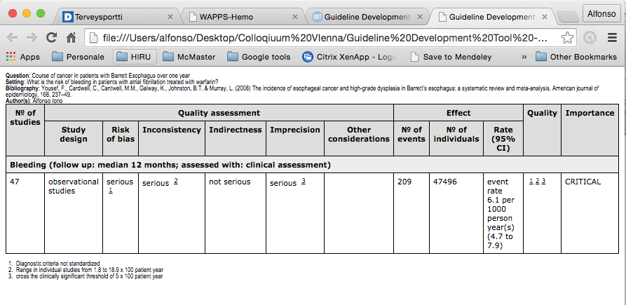
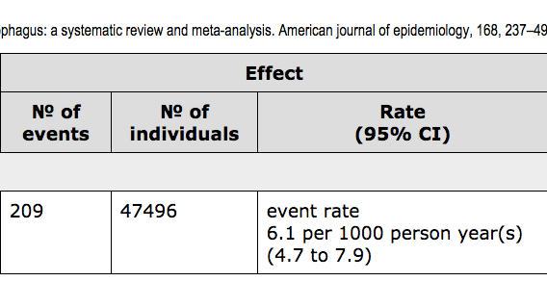
Evidence profile for prognosis

Slide 11
The role of prognostic factors of patient important outcomes in medical decision making
A “specific case” of baseline risk is the stratification of risk
based on one (or more) prognostic factors (characteristics of the individual at the beginning of the intervention).
The effect of the intervention is applied across one (or more) strata of one (or more) prognostic factors
Risk stratification allows tailoring recommendations to different subpopulation (subgroups)
It requires:
Estimates of benefits and harms from RCTs/SRs of RCTs of effectiveness (usually reported as relative risk)
Estimates of risk with/without a risk factor, which often come from SR of cohort studies (or by measures of association between a risk factor (e.g., age, sex) and outcome in the untreated group(s) of a RCT)

Slide 12
The role of prognostic factors of patient important outcomes in medical decision making
Going back to the clinical scenario:
Relative risk of stroke in Atrial fibrillation patients treated with NOACS compared with untreated = 0.26;
Risk of stroke at 1 year in subjects with a previous stroke is 2.2 time higher (data from a SR of observational studies assessing risk factor for recurrent stroke)
Clues: You need absolute measures of risk; ideally the risk in the lower category (e.g. not previous stroke in the example), or the risk in the overall population (average risk, sometimes reported as risk, or as baseline risk)

Slide 13
The role of prognostic factors of patient important outcomes in medical decision making
CASE A: You have the absolute risk in the individuals in one group and the relative risk for the prognostic factor, for example 7% without previous stroke and 2.2 times higher with a previous stroke.
calculate the absolute risk in individuals with prognostic factor = Absolute risk (individuals without)*(Relative risk) = (70 per 1000)*2.2 = 154/1000
calculate the absolute risk reduction in individuals without = (1-0.26)*70 = 52 x1000
calculate the absolute risk reduction in individuals with risk factor = (1-0.26)* 154 = 114 x1000

Slide 14
The role of prognostic factors of patient important outcomes in medical decision making
CASE B: You have the average risk in the population, the relative risk for the prognostic factor, AND the prevalence of the prognostic factor, for example 10%, 2.2 and 40%
Using appropriate formulas (*) you calculate the risk in individuals with and without prognostic factor, and then the corresponding absolute risk reductions;

Slide 15
The role of prognostic factors of patient important outcomes in medical decision making
Kooter AJ, Kostense PJ, Groenewold J, Thijs A, Sattar N, Smulders YM. Risk Prediction in Cardiovascular Medicine The Critical Impact of Risk Factor Prevalence. Circulation 2011; 124: 741–5.

Slide 16
The role of prognostic factors of patient important outcomes in medical decision making
if the average risk is 10%, the relative risk for the prognostic factor 2.2, and the prevalence of the prognostic factor 40%, you will have
149/1000 events in individuals with prognostic factor
68/1000 in those without
absolute reductions of 110/1000 and 50/1000.
For the same average risk and prognostic factor but with a prevalence of 4% you will have
209/1000 events in individuals with prognostic factor
95/1000 in those without
absolute reductions of 155/1000 and 40/1000.
For a prevalence of prognostic factor of 96%, you will have
102/1000 events in individuals with prognostic factor
46/1000 in those without
absolute reductions of 75/1000 and 34/1000.

Slide 17
The role of prognostic factors of patient important outcomes in medical decision making
Questions:
What is your prognostic question?
Is this enough for making a recommendation? If not, what is missing?
How the SR on the risk of stroke has affected your decision?

Slide 18
PICO components
 | Overall prognosis | Risk factor | Prognostic model
P | ☐ | ☐ | ☐
I | ☐ | ☐ | ☐
C | ☐ | ☐ | ☐
O | ☐ | ☐ | ☐
(T) | ☐ | ☐ | ☐
 | Overall prognosis | Risk factor
P | ☑ | ☑
I | ☐ | ☑ (E+)
C | ☐ | ☑ (E-)
O | ☑ | ☑
(T) | (endpoint) | (endpoint)
 | Overall prognosis | Risk factor | Prognostic model
P | ☑ | ☑ | ☑
I | ☐ | ☑ (E+) | ☐
C | ☐ | ☑ (E-) | ☐
O | ☑ | ☑ | ☑
(T) | (endpoint) | (endpoint) | (endpoint)
 | Overall prognosis | Risk factor | Prognostic model
P | ☑ | ☑ | ☑
I | ☐ | ☐ | ☐
C | ☐ | ☐ | ☐
O | ☑ | ☑ | ☑
(T) | (endpoint) | (endpoint) | (endpoint)

Slide 19
The role of prediction models for patient important outcomes in medical decision making
Clinical scenario:
You are responsible to manage patients with atrial fibrillation. A clinical prediction model has been proposed to correlate characteristics of patient with atrial fibrillation with their risk of stroke:
Points | Risk of stroke x 100 patient x year
0 | 1.9
1 | 2.8
2 | 4
3 | 5.9
4 | 8.5
5 | 12.5
6 | 18.2
Characteristic | Points
Myocardial disease | 1
Hypertension | 1
Diabetes | 1
Age > 75 | 1
Previous stroke (2 points) | 2

Slide 20
The role of prediction models for patient important outcomes in medical decision
Could be used to generate specific baseline risks
modeling should be done in a pragmatic but transparent way keeping in mind the clinical timeframe
Guidelines could suggest to use prediction models to calculate, for a specific patient, the risk of a specific outcome (e.g., stroke) based on that patient’s individual characteristics (i.e., previous event)
Guideline developers may propose decision aids to individualize the use of the recommendation by using prediction models

Slide 21
The role of prediction models for patient important outcomes in medical decision
Questions:
what is the underlying prognostic question?
How would you use this type of evidence in making a recommendation?

Slide 22
PICO components
 | Overall prognosis | Risk factor | Prognostic model
P | ☐ | ☐ | ☐
I | ☐ | ☐ | ☐
C | ☐ | ☐ | ☐
O | ☐ | ☐ | ☐
(T) | ☐ | ☐ | ☐
 | Overall prognosis | Risk factor | Prognostic model
P | ☑ | ☑ | ☑
I | ☐ | ☑ (E+) | ☑
C | ☐ | ☑ (E-) | ☑
O | ☑ | ☑ | ☑
(T) | (endpoint) | (endpoint) | (endpoint)
 | Overall prognosis | Risk factor | Prognostic model
P | ☑ | ☑ | ☑
I | ☐ | ☑ (E+) | ☐
C | ☐ | ☑ (E-) | ☐
O | ☑ | ☑ | ☑
(T) | (endpoint) | (endpoint) | (endpoint)
 | Overall prognosis | Risk factor | Prognostic model
P | ☑ | ☑ | ☑
I | ☐ | ☐ | ☐
C | ☐ | ☐ | ☐
O | ☑ | ☑ | ☑
(T) | (endpoint) | (endpoint) | (endpoint)

Slide 23
Differentiating between risk stratification and effect modification
Clinical scenario:
Some of the patients with atrial fibrillation also have to had one of their heart valve replaced with a mechanical device.
Their risk of stroke is much higher.
A recent randomized controlled trial showed that one recently introduced anticoagulant, very effective to reduce stroke in atrial fibrillation, is not effective in these specific class of patients.

Slide 24
Differentiating between risk stratification and effect modification
Subgroups may reflect baseline risk differences – in that case, the relative effect of treatment will be the same across subgroups. This is what we have discussed in unit 2
Subgroups may reflect a different treatment effect in different (groups of) individuals – in that, the relative effect will vary across subgroups
In the latter case:
the **characteristic** defining the subgroup is called effect modifier or predictive factor (meaning predictive of response to treatment)
the test for interaction between treatment and the **characteristic** is significant
the evidence to be used and appraised for decision making is better based on RCTs
In a guideline, this would typically lead to different relative effects, separate evidence profiles, and potentially different recommendations.

Slide 25
Differentiating between risk stratification and effect modification
Questions:
Which evidence would convince you that having a mechanical valve is a predictor of treatment response?
Which evidence would convince you that having a mechanical valve is a risk factor for stroke but not a predictor of treatment response?

Slide 26
How does the GRADEing baseline risk affect the GRADEing effectiveness?
Clinical scenario (similar to 1):
Patients with atrial fibrillation (a disease of the heart beat) have an increased risk of stroke (death of a part of the brain).
Anticoagulants reduce the risk of stroke (meta-analysis of RCTs, including a subgroup analysis of severe cardiac heart failure NYHS=4, very high confidence in the effect).
Patients with atrial fibrillation and cardiac heart failure showed a variable risk of stroke recurrence in a recent large meta-analysis of observational studies (low confidence in the estimate).
You have to decide whether patients with atrial fibrillation and cardiac heart failure deserve treatment with anticoagulants.

Slide 27
Confidence
high
3
1
Treatment
effect
1
2
Low confidence
High confidence
Baseline risk

Slide 28
How does the GRADEing baseline risk affect the GRADEing effectiveness?
Clinical scenario (similar to 2):
Patients with atrial fibrillation (a disease of the heart beat) have an increased risk of stroke (death of a part of the brain).
Anticoagulants reduce the risk of stroke, including a small subgroup of patient with recent stroke (meta-analysis of RCTs, very high confidence in the effect).
Subjects with a previous stroke have a higher risk of stroke, independently of the time lapsed since the stroke (high confidence in the risk estimate).
You have to decide whether patients with atrial fibrillation and previous stroke deserve treatment with anticoagulants.

Slide 29
Confidence
high
3
1
Treatment
effect
1
2
Low confidence
High confidence
Prognostic factor

Slide 30
Intersection between prognosis and interventions
Role of prognostic evidence in health care decisions making
Treatment effect framework | Prognostic evidence
Baseline risk | Overall prognosis
Subgroup analysis | Prognostic factor
Decision algorithm/policy/implementation | Prognostic model

Slide 31
Thank you

