Slide 1
EBManagement of hemophilia: Building the blocks for comparative EBMeffectiveness in Canada and beyond: CBDR, CHESS, WAPPS, and PROBE
McMaster Hemophilia Research Group
http://hemophilia.mcmaster.ca
Alfonso Iorio, MD, PhD

Slide 2
Objectives
1. Rationale for prophylaxis of joint bleeding in hemophilia
2. “Precision” medicine for hemophilia: sources of variability
3. Predicting the risk of bleeding on prophylaxis, including assessment of individual pharmacokinetics
4. Outcome measures: PRO/PCR in hemophilia, including assessment of serious adverse events

Slide 3

Clinical Epidemiology in Hemophilia
CBDR
CHESS
WAPPS-Hemo
NHF Guideline program
PASS IPD
ISTH SSC
CHESS = Canadian Hemophilia Surveillance System;
WAPPS-Hemo = Web Application for Population Pharmacokinetic Service
PASS = Post Marketing Surveillance Studies
NHF = National Hemophilia Foundation (US)

Slide 6
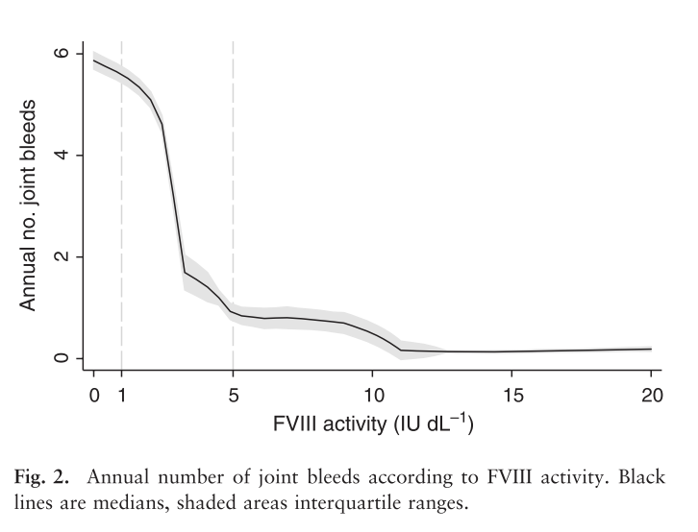
Factor levels and bleeding
Clinical severity of haemophilia A: Does the classification of the 1950s still stand?
den Uijl IEM, Mauser Bunschoten EP, Roosendaal G, et al. Haemophilia 2011;17:849–53.

Slide 7
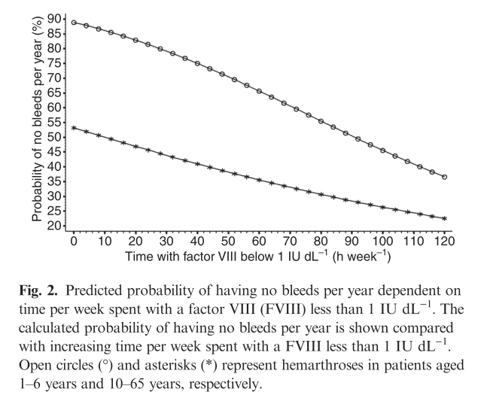
Factor levels and bleeding
Collins PW, et al.
J Thromb Haemost 2010;8:269–75.

Slide 8
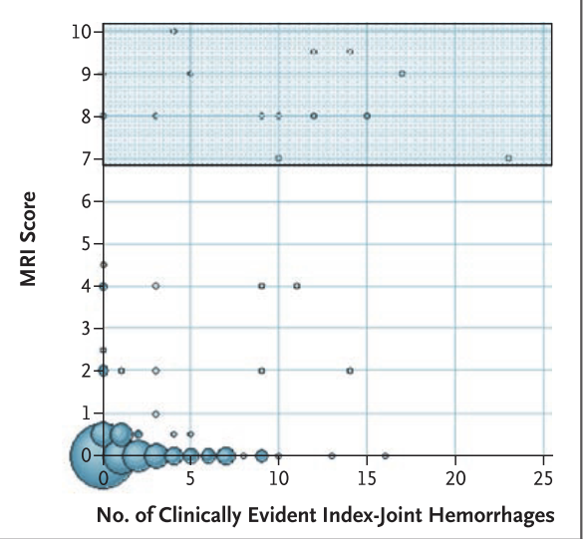
Manco-Johnson, et al N Engl J Med 2007;357:535-44

Slide 9
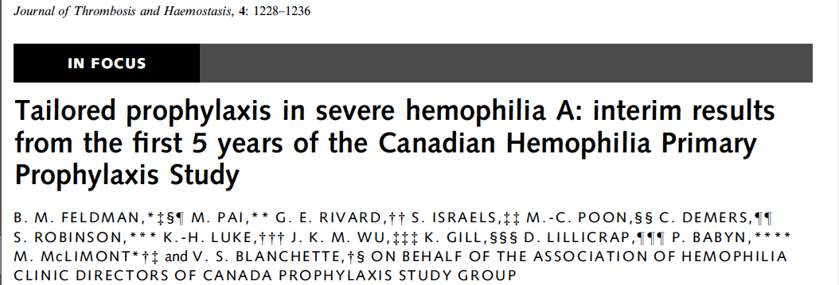
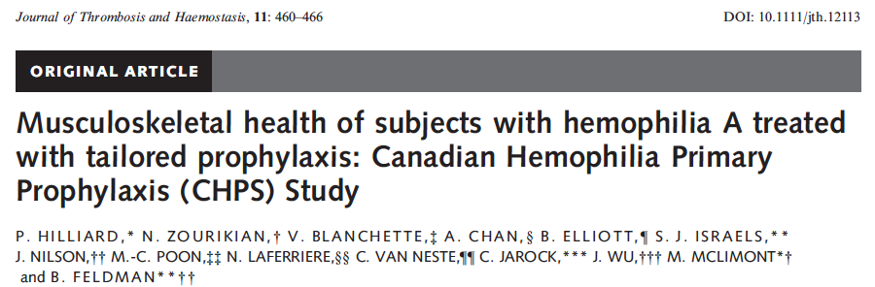
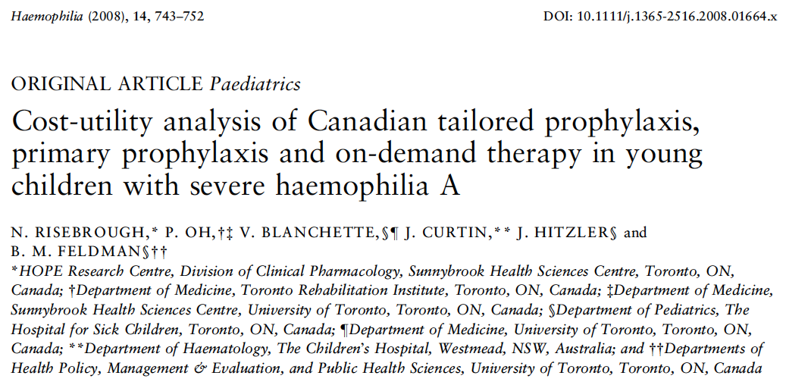
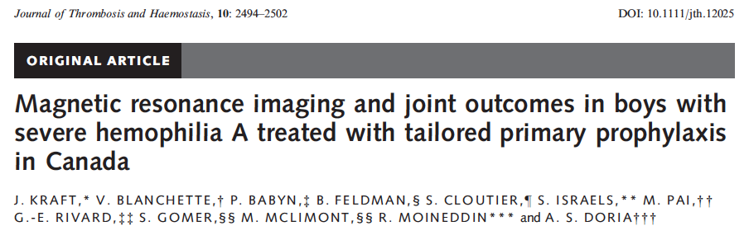
New era?

Slide 10

Bottom line
PK
Carcao, M. & Iorio, A. (2015) Individualizing Factor Replacement Therapy in Severe Hemophilia. Seminars in Thrombosis and Hemostasis, 41, 864–871.

Slide 12
Results
sABR ≤9.21
sABR >9.21
Age at Enrollment (years)

Slide 13
PK analysis: Classical study design
Concentration (linear scale)
Time (linear scale)

Slide 14
Plasma Drug Disposition after a Single IV bolus
Peak, C_{max}, Recovery
CL 1.725
V1 9.560
k 0.055
Half-life (h) 12.5
Concentration (%)
AUC
Half-life
Trough
Time (hours)

Slide 15
Key concepts for green molecule:
1. Green molecule: Longer terminal half-life
2. Green molecule: Earlier start of terminal phase
3. Green molecule: Earlier time to critical concentration
Log plasma concentration
Time (hours)

Slide 16
Individual PK can be estimated by using popPK based structural model and variability information
Concentration (linear scale)
Time (linear scale)

Slide 17
Classical PK estimation
patient |  |  | 1 | 2 | 3 | 4 | 5
dose/kg |  |  | 55 | 59 | 56 | 53.1 | 50.9
dose |  |  | 3405 | 4086 | 5448 | 4767 | 4920
one-comp |  | V | 2985.97 | 2629 | 4217.305 | 3887.61 | 3676.66
 |  | k | 0.001052 | 0.001309 | 0.001089 | 0.001238 | 0.000796
 |  | HL (min) | 659 | 529 | 636 | 559 | 871
 |  | HL (h) | 10.98 | 8.82 | 10.60 | 9.32 | 14.52
 |  | C(0) approx D/V | 1.14 | 1.55 | 1.29 | 1.23 | 1.34
two-comp |  | A | 0.486937 | 1.274402 | 0.476461 | 0.934315 | 0.987822
 |  | B | 0.726386 | 0.302367 | 0.8767 | 0.303577 | 0.379788
 |  | alpha | 0.004996 | 0.001823 | 0.004597 | 0.001656 | 0.001333
 |  | beta | 0.000532 | 0.000315 | 0.000645 | 0.000528 | 0.000207
 |  | alphaHL | 138 | 380 | 150 | 418 | 519
 |  | betaHL | 1302 | 2197 | 1074 | 1312 | 3342
 |  | Hlbeta (h) | 21.70 | 36.62 | 17.90 | 21.87 | 55.70
{data on file, Alfonso Iorio)
Notes:
These are five random samples analized by one and two compartment model

Slide 18
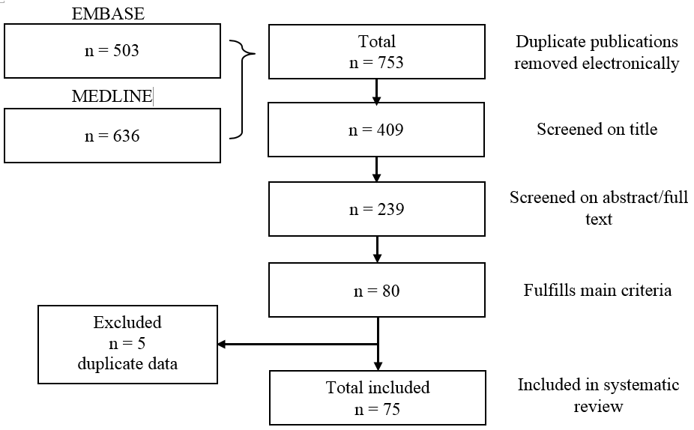
Systematic Review of the Published Evidence on the Pharmacokinetic Characteristics of Factor VIII and IX Concentrates
Xi M et al. Blood 2014; 124 (21) Abs.

Slide 19
SR of the Published Evidence on the Pharmacokinetic Characteristics of Factor VIII and IX Concentrates
Factor | Class | Studies | Patients | Half-life (h)
FVIII | Wild type | 30 | 790 | 7.82- 19.2
 | BDD | 12 | 339 | 7.5 – 17.7
 | EHL | 3 | 106 | 11.5 – 23.8
FIX | Wild type | 22 | 492 | 12.9 - 36
 | EHL | 6 | 106 | 53.5 – 110.4
Xi M et al. Blood 2014; 124 (21) Abs.

Slide 20
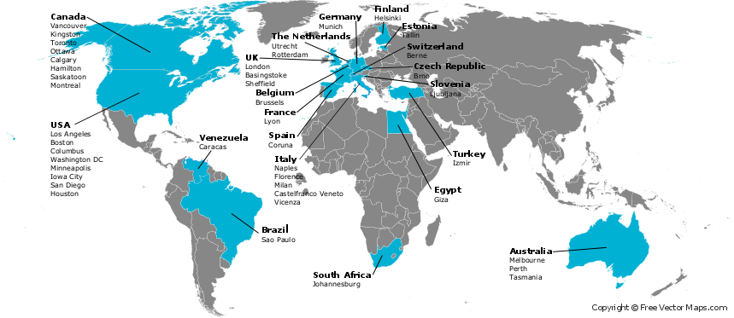
The WAPPS network
The Development of the Web-based Application for the Population Pharmacokinetic Service – Hemophilia (WAPPS-Hemo) – Phase1.
ClinicalTrials.gov Identifier: NCT02061072. Available at: https://clinicaltrials.gov/ct2/show/NCT02061072.

Slide 21
On file PK studies
Cohort | Number of subjects | Number of PKs
Derivation | > 750 | > 1200
Validation | 240 | 275
On-going | 321 | 362
Total | >1200 | >1800

Slide 22
Single patient data
Web-application
Estimating PK for single individuals on the base of 2-4 samples
Single patient report

Slide 23
Estimating PK for single individuals on the base of 2-4 samples
Single patient data
Web-application
Online PPK engine
(NONMEM)
Single patient report

Slide 24
Estimating PK for single individuals on the base of 2-4 samples
Brand specific Source individual PK data
Single patient data
Control files for bayesian individual estimation
Web-application
Online PPK engine
(NONMEM)
Offline PPK modeling
Product 1
Product 2
Product 3
Product 4
Product 5
Others..
Brand specific PPK models
Single patient report

Slide 25
Brand specific Source individual PK data
Single patient data
patients
patients
patients
Control files for bayesian individual estimation
Web-application
Online PPK engine
(NONMEM)
Offline PPK modeling
Product 1
Product 2
Product 3
Product 4
Product 5
Others..
Brand specific PPK models
Single patient report

Slide 26
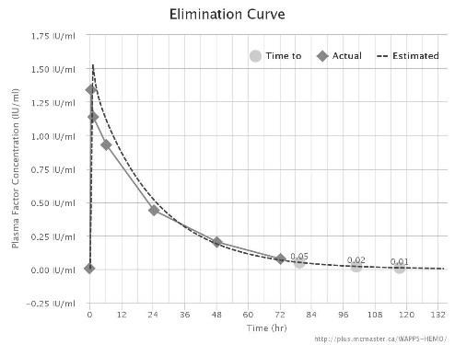
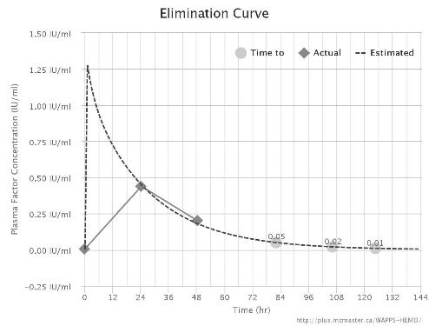
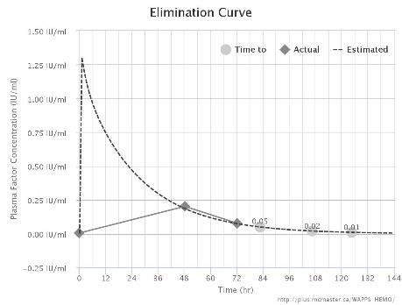
Advate
Points term HL time to 0.02
All 16.5 101
48-72 18 106 4 g
24-48 18.5 106

Slide 27
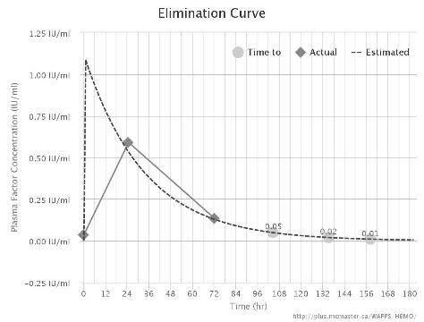
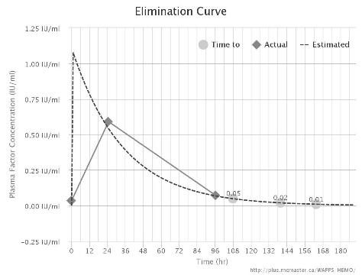
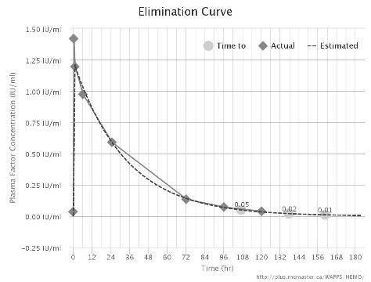
Advate
Points term HL time to 0.02
All 16.5 101
48-72 18 106 4 g
24-48 18.5 106
Eloctate
Points term HL time to 0.02
24-72 23 135
24-96 24 139 5 ½ g
All 23 137

Slide 28
Practicalities: Optimal sampling time – Factor VIII
Recommended times
4, 24 and 48 h
Alternatives
8, 30 h
24 h alone
Re-analysis of data from 41 FVIII PK studies
sampling at 4, 24 and 48 h equivalent to 7–10 samples
for the design of alternate-day dosing schedules.
Sampling at
8 & 30 h
24 h alone
gave useful but less accurate results
Bjorkman S. Limited blood sampling for pharmacokinetic dose tailoring of FVIII in the prophylactic treatment of haemophilia A. Haemophilia 2010; 16: 597–605.

Slide 29
Notes:
Comment on one vs two compartment modelling

Slide 30
Practicalities: Optimal sampling time – Factor IX
Recommended times
48-54, 72-78 h
(anytime during day 2 and 3)
A population pharmacokinetic model and sparse factor IX (FIX) levels may be used in dose individualization.
FIX sampling schedules for dose individualization were explored and compared with fixed doses.
Individual FIX doses were acceptably predicted with only two samples drawn post dose (days 2 and 3).
Pharmacokinetic dose individualization resulted in better target attainment than a fixed-dose regimen.
1. Brekkan A, Berntorp E, Jensen K, et al. Population Pharmacokinetics of Plasma-Derived Factor IX: Procedures for Dose Individualization. J Thromb Haemost 2016; n/a – n/a.

Slide 31
1. Brekkan A, Berntorp E, Jensen K, et al. Population Pharmacokinetics of Plasma-Derived Factor IX: Procedures for Dose Individualization. J Thromb Haemost 2016; n/a – n/a.

Slide 32
Practicalities
FVIII washout is not needed for estimating pharmacokinetics.
Five FVIII half-lives would correspond to up to 5 days in prophylaxis patients.
The Bayesian analysis can be performed on data from practically any dosing schedule.
Doses and times of preceding infusions must be known for at least five half-lives (after which <3% of a dose remains in the body) before the study infusion.
Residual above baseline can be modeled as well
Three compartment models are needed to define the PK of both pdFIX and rFIX

Slide 33
http://www.chess-ca.org/

Slide 34


Slide 35
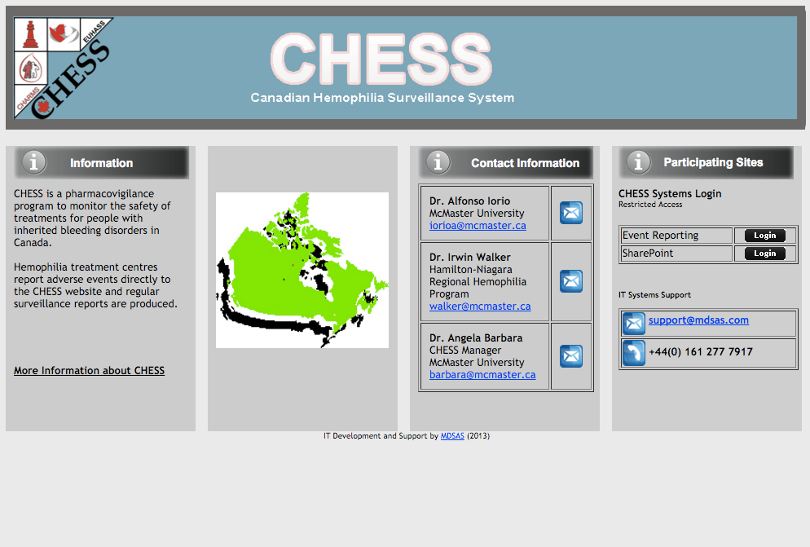

Slide 36
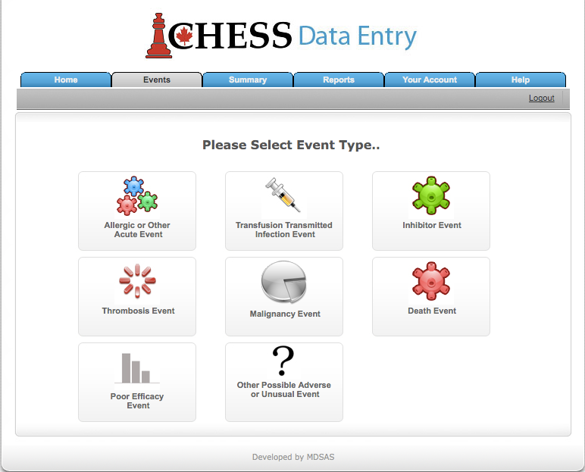

Slide 37
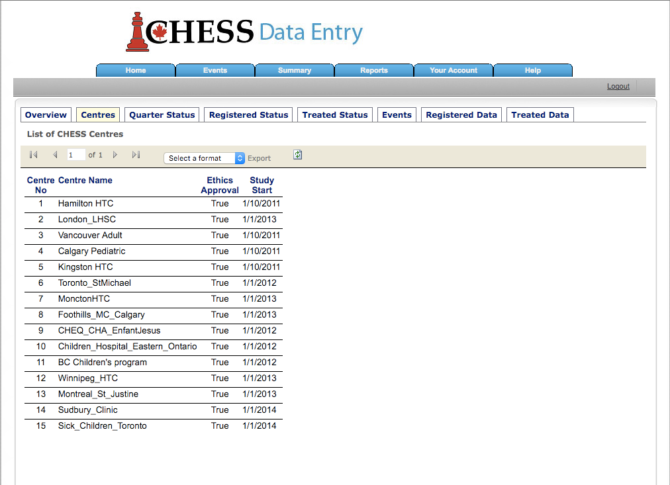
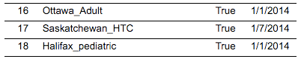

Slide 38
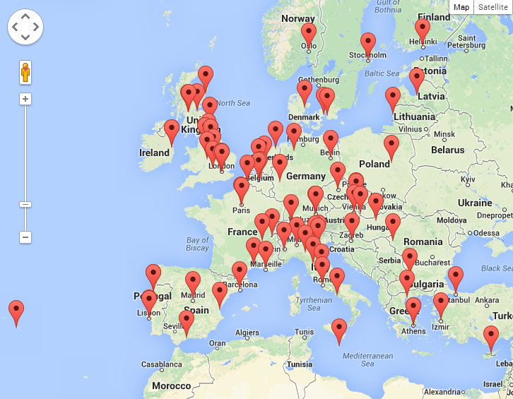
EUHASS Participating Centres

Slide 39
EUHASS Patients Under Surveillance Oct 2011- Dec 2012
 | Total | Severe | Concentrate treated during the year
Haemophilia A | 14,901 | 6,378 | 8,099
Haemophilia B | 3,152 | 1,137 | 1,608
Other bleeding disorders | 14,606 | 1,757 | 2,050
Total | 32,659 | 9,272 | 11,757

Slide 40
Adverse Events Reported
 | Year 1 | Year 2 | Year 3 | Year 4
Centres reporting | 50 | 64 | 74 | 75
Allergic/Acute reactions | 26 | 28 | 29 | 18
Transfusion-transmitted infections | 0 | 0 | 0 | 0
Inhibitors – first occurrence | 50 | 47 | 54 | 54
Inhibitors – recurrence | 6 | 11 | 7 | 4
Thrombosis within 30 days of concentrate | 13 | 15 | 13 | 22
Thrombosis with no concentrate in 30 days | 9 | 10 | 8 | 14
Malignancies | 32 | 52 | 57 | 67
Deaths | 48 | 66 | 89 | 121
TOTAL | 184 | 229 | 257 | 300

Slide 41
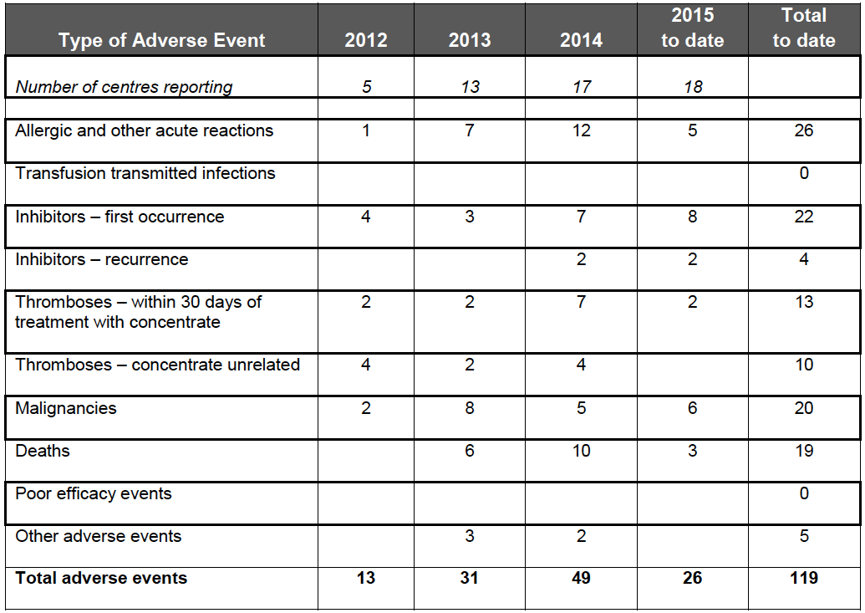

Slide 42


Slide 43
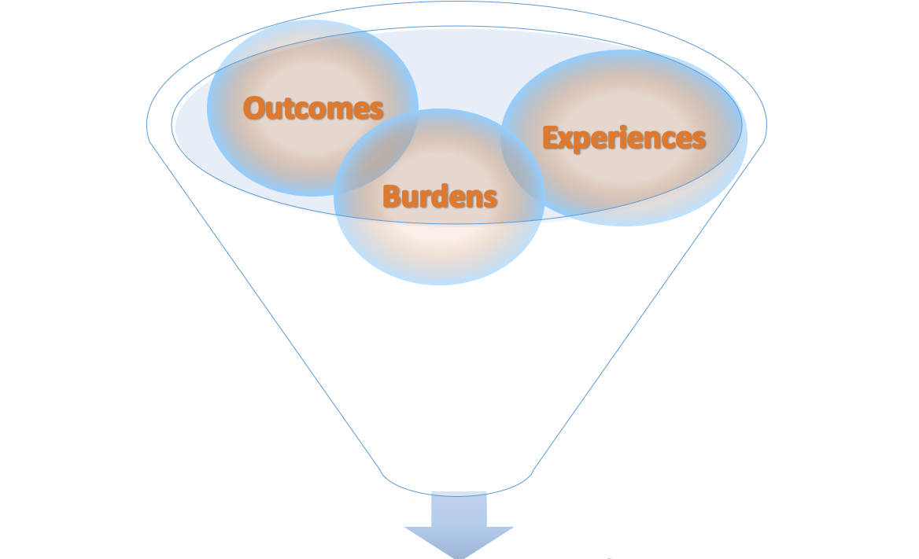


Collect, collate and interpret patient-centered experiential data
Evidence-based arguments grounded in real-world patient experiences

Slide 44
Acknowledgments: Global Investigator Team
Principal Investigator:
Mark Skinner JD, Institute for Policy Advancement Ltd. (US)
Co-Investigators:
Randall Curtis MBA, Factor VIII Computing (US)
Neil Frick MS, National Hemophilia Foundation (US)
Alfonso Iorio MD Ph.D. FRCPC, McMaster University,
Michael Nichol Ph.D., University of Southern California, School of Policy and Planning Development (US)
Declan Noone, Irish Haemophilia Society (Ireland)
Brian O’Mahony, Irish Haemophilia Society, Trinity College Dublin (Ireland)
David Page, Canadian Hemophilia Society (Canada)
Jeff Stonebraker Ph.D., North Carolina State University, Poole College of Management (US)
Notes:
A global team of Investigators with diversity of professional and academic credentials* (e.g., quality of life study design, medical, epidemiology, quantitative analysis, legal and health care development) has been assembled.

Slide 45
Multi-phase Project
Phase 1 (2014-2015) – Develop Questionnaire
Test understanding of questionnaire content and clarity
Assess methodology and in-country implementation feasibility
Establish core analytics
Phase 2 (2015-2016) – Pilot Assessment
Validate proof of concept
Pilot web platform
Assess reproducibility (Test:Retest)
Establish analytic controls / population comparators
Phase 3 (2016-Beyond) – Global Implementation
Real-world roll-out
Complement and enhance the utility of national registries or WFH Global Survey data
Measure impact of country development initiatives

Slide 46
Time to Completion
Time to Completion | 0-15 minutes | 16-20 minutes | 21-25 minutes | 26-30 minutes | More than 30 minutes
Number of Respondents (N=665) | 474 | 115 | 42 | 18 | 16
Percentage | 71.28% | 17.29% | 6.32% | 2.71% | 2.41%
Notes:
Seventeen mid-to highly developed countries participated in the Phase 1 feasibility assessment (Fig 1).
Phase 1 field work is complete with 704 responses recorded (117.33% of study objective) (Fig 2) including 379 FVIII PWH, 86 FIX PWH, 212 not personally effected with a bleeding disorder and 27 other / unknown bleeding disorder (Fig 3).
Primary outcomes include: response rate, percent complete responses, time to completion, cost per completed survey
Preliminary analysis indicates the study methodology is feasible and time to completion has met study objectives of 0-15 minutes (Fig 4).

Slide 47
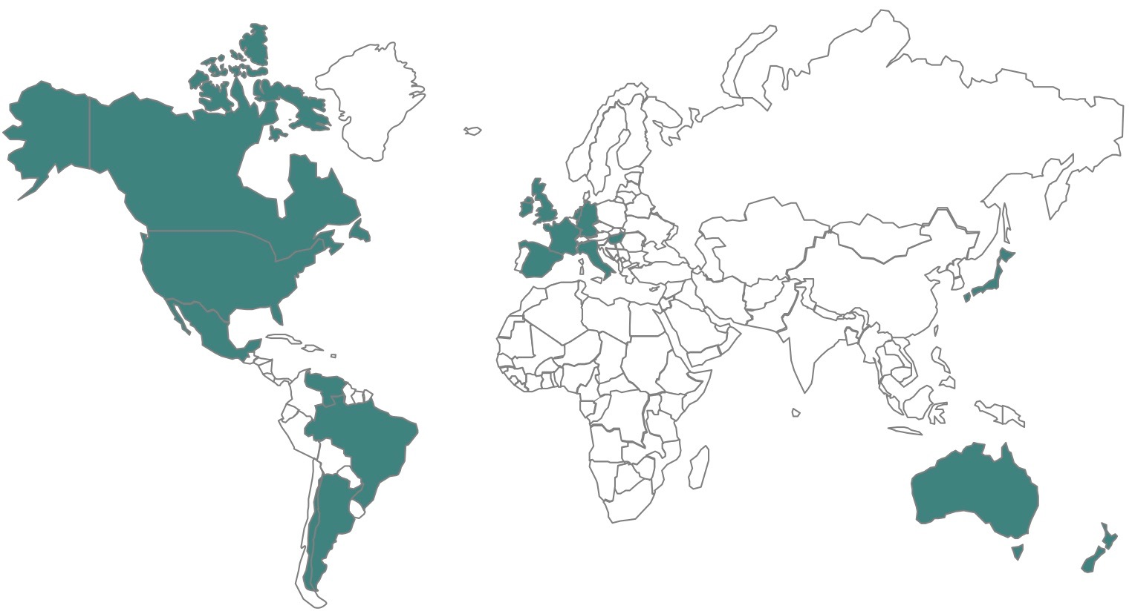
Participating Countries – Phase 1
Argentina (Cordoba Chapter), Australia, Brazil, Canada, France, Germany, Hungary, Ireland, Italy, Japan, Mexico, Netherlands, New Zealand, Spain, United States, Venezuela
Phase 1 Participating Countries: Argentina (Cordoba Chapter), Australia, Brazil, Canada, France, Germany, Hungary, Ireland, Italy, Japan, Mexico, The Netherlands, Spain, United States, Venezuela
Notes:
Seventeen mid-to highly developed countries participated in the Phase 1 feasibility assessment (Fig 1).
Phase 1 field work is complete with 704 responses recorded (117.33% of study objective) (Fig 2) including 379 FVIII PWH, 86 FIX PWH, 212 not personally effected with a bleeding disorder and 27 other / unknown bleeding disorder (Fig 3).
Primary outcomes include: response rate, percent complete responses, time to completion, cost per completed survey
Preliminary analysis indicates the study methodology is feasible and time to completion has met study objectives of 0-15 minutes (Fig 4).

Slide 48
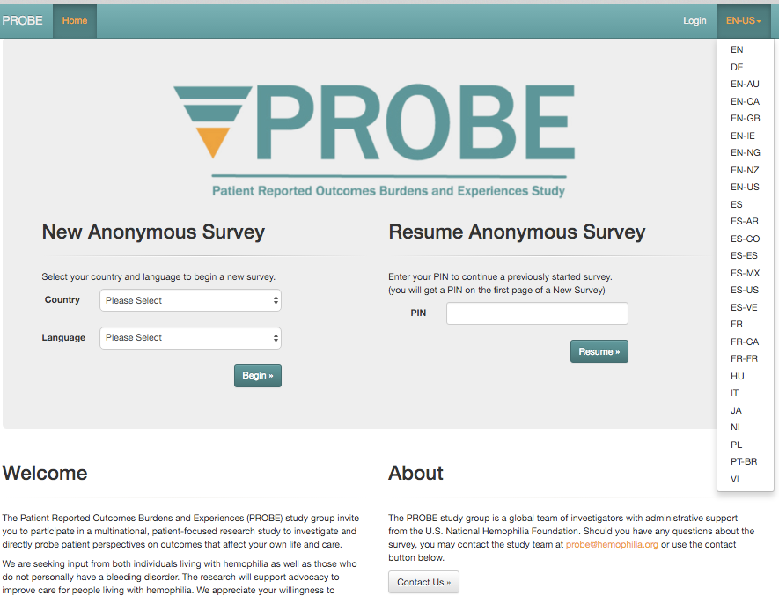

Slide 49
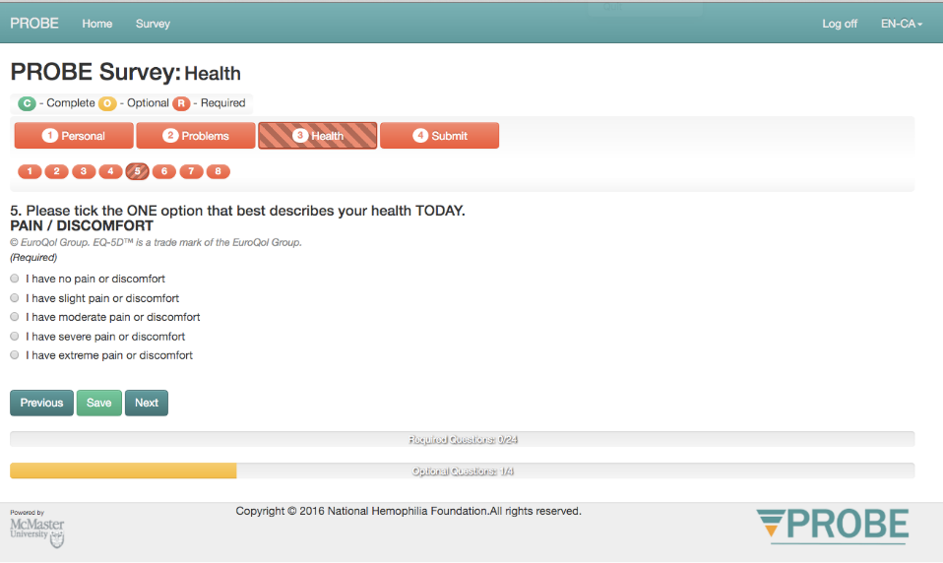

Slide 50
The “concept” of comparison
Dimension | Country | Control | Mild | Mod | Severe
EQ5D-5L | A (some prophy) | .894 | .788 | .801 | .590
 | B (no prophy) | .897 | .788 | .788 | .676
Chronic pain | A (some prophy) | 28% | 53% | 68% | 78%
 | B (no prophy) | 30% | 56% | 70% | 86%
PROBE Investigators unpublished data not for citation
Notes:
Example of the PROBE exercise
Use the first one for the comparison prophy / no prophy
Use the second for the comparison patients toward controls.

Slide 51
The “concept” of comparison
Dimension | Country | Control | Mild | Mod | Severe
EQ5D-5L | A (some prophy) | .894 | .788 | .801 | .590
 | B (no prophy) | .897 | .788 | .788 | .676
 |  |  |  |  | -.086
Chronic pain | A (some prophy) | 28% | 53% | 68% | 78%
 | B (no prophy) | 30% | 56% | 70% | 86%
PROBE Investigators unpublished data not for citation
Notes:
Example of the PROBE exercise
Use the first one for the comparison prophy / no prophy
Use the second for the comparison patients toward controls.

Slide 52
The “concept” of comparison
Dimension | Country | Control | Mild | Mod | Severe
EQ5D-5L | A (some prophy) | .894 | .788 | .801 | .590
 | B (no prophy) | .897 | .788 | .788 | .676
 |  |  |  |  | -.086
Chronic pain | A (some prophy) | 28% | 53% | 68% | 78%
 | B (no prophy) | 30% | 56% | 70% | 86%
 |  |  |  |  | +56%
PROBE Investigators unpublished data not for citation
Notes:
Example of comparative assessment using the PROBE phase I data
Use the first one for the comparison prophy / no prophy
Use the second for the comparison patients / controls.

Slide 53
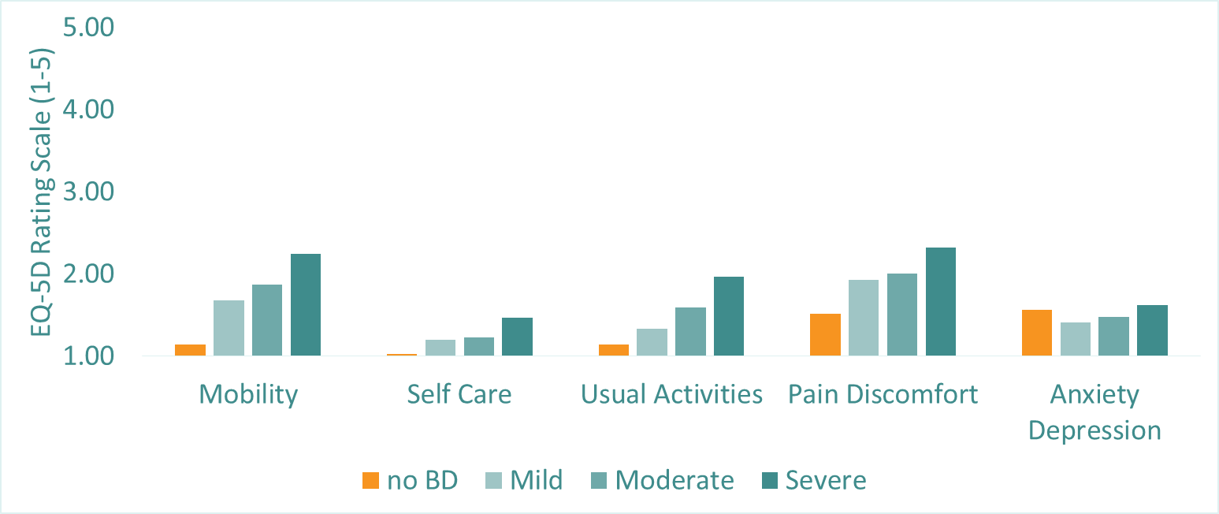
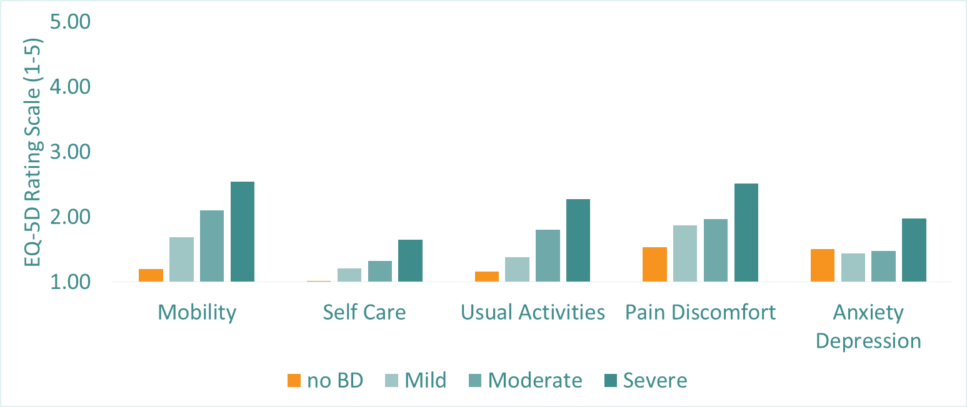
EQ-5D Domains
Anxiety & Depression
With Some Prophylaxis
Without Prophylaxis
PROBE Investigators unpublished data not for citation

Slide 54
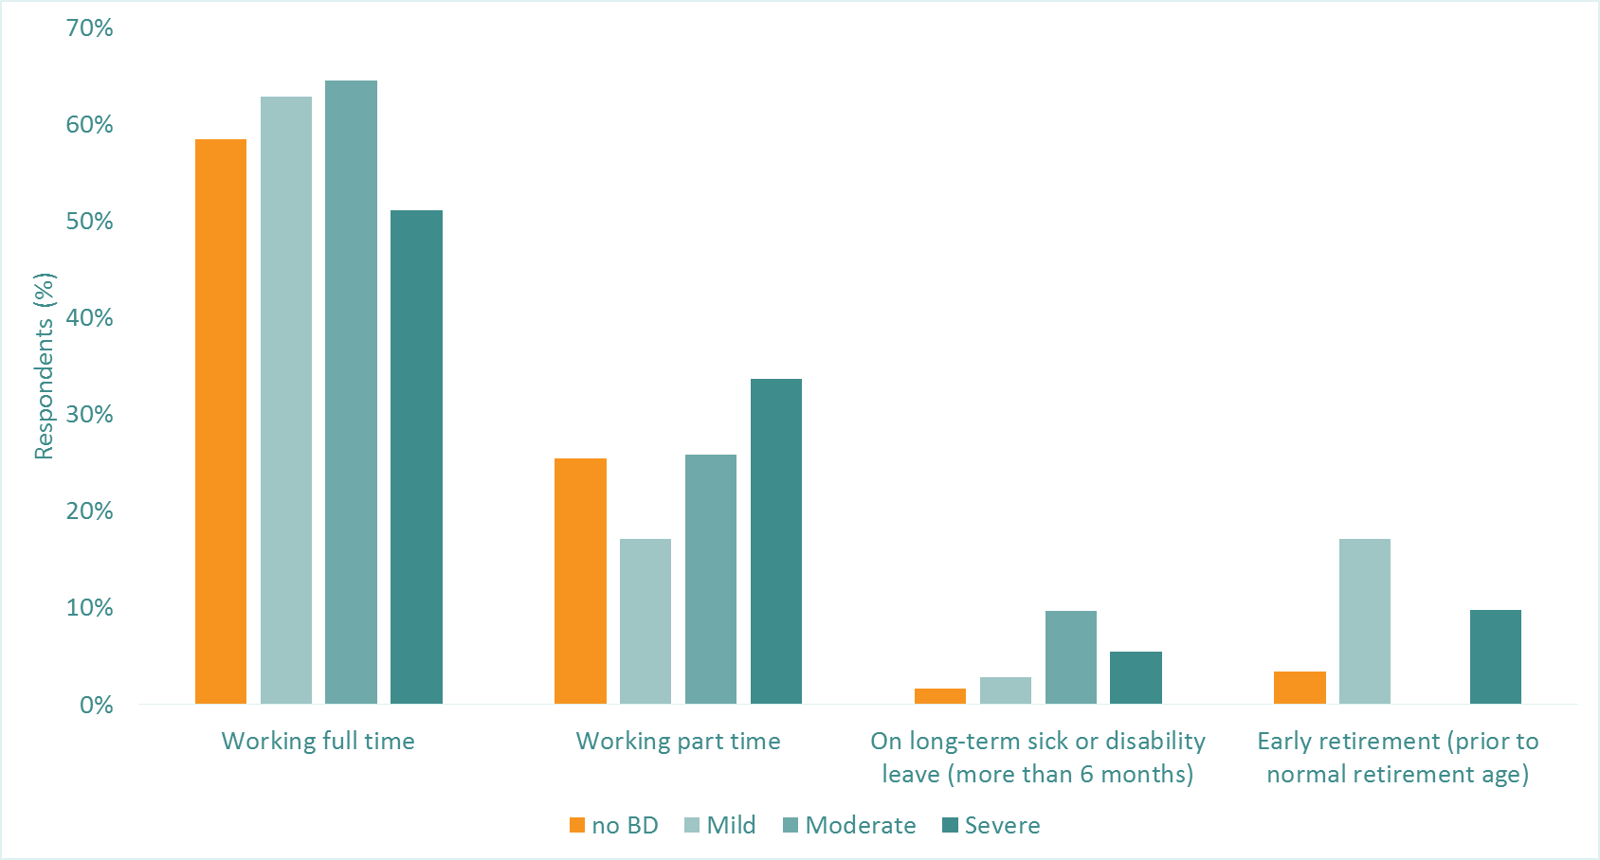
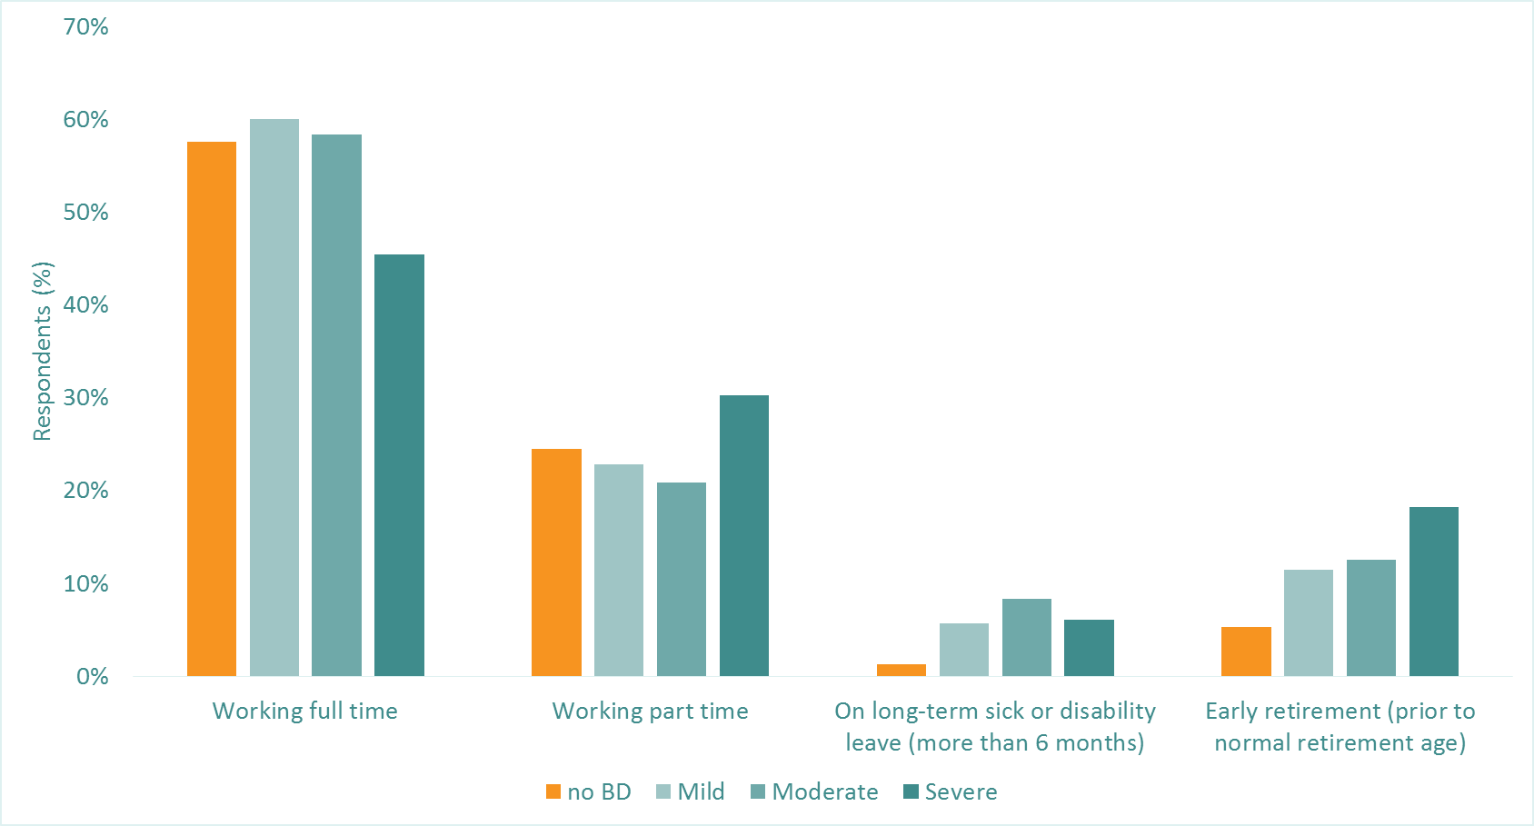
Employment Status
Early Retirement
With Some Prophylaxis
Without Prophylaxis
PROBE Investigators unpublished data not for citation

Slide 55
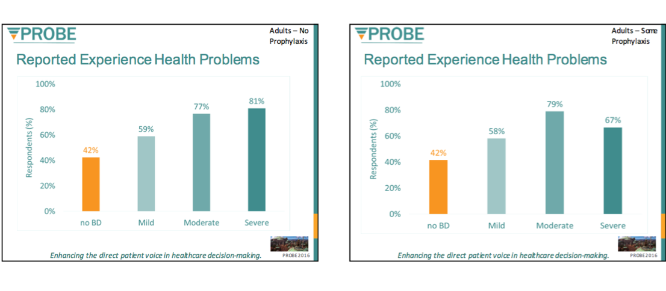
In the past 12 months, have you experienced any problems related to your health?
Without Prophylaxis
With Some Prophylaxis
PROBE Investigators unpublished data not for citation

Slide 56
Repeated time to event analysis

Slide 57





Patient history prior to individual bleeding episodes contains relevant information
Compliant
Sports
Compliant
Non-compliant
Time
The challenge is to utilize data on individual history of a patient prior to the bleeding episode
Including this information will improve the understanding of the risk of bleeding

Slide 58
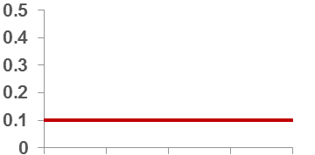
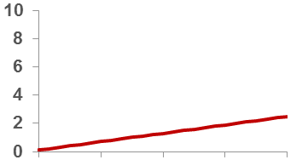
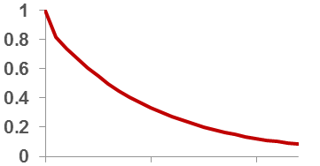
A RTTE model utilizes individual history data of a patient
Observation period
Bleeding rate determined by
Hazard (risk) to bleed
hazard rate
time ->
cumulative
hazard
….is integrated over time
(cumulative hazard)
time ->
probability
not to bleed
determines the probability
not to bleed (survive)
time ->
Everything influencing the hazard (sports, factor VIII) will influence the probability of a bleed occurring
*No real estimates were used for this example

Slide 59







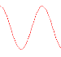
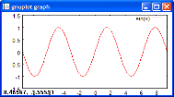



A RTTE model can relate FVIII concentration time profiles to the likelihood to bleed
Compliant
Non-compliant
Observation period
Factor VIII plasma profile
Lower
cumulative
hazard
Factor VIII plasma profile
Higher
cumulative
hazard
The ‘hazard’ (risk of bleeding) and FVIII effect is estimated
The likelihood and timing of a bleeding episode (time to event) can be predicted by using the cumulative hazard

Slide 60
Conclusions
Individual doses to achieve exposure (threshold) can be calculated by popPK methods
PK-guided dosing may be used to reduce the dosing frequency while maintaining similar exposure
PK-guided dosing alone may be of limited use to target an acceptable bleeding rate
To achieve an optimized individual treatment outcome, both the exposure information and individual bleeding risk (‘phenotype’) needs to be considered
RTTE is a method which combines exposure information from population PK modelling and likelihood of bleedings and can include any further information
Notes:
RTTE This method can be used to simulate and predict the result of a clinical trial

Slide 61
Questions’ time
Thank you for participation

