Slide 1
CBDR Report
Rendezvous ‘17 , Toronto
Dr. Alfonso Iorio - Chair, CBDR-C

Slide 2
Objective
CBDR project status
  Centers
  Patients
  MyCBDR
Governance
Data and reporting
  Third party reporting
  National registry level data reporting
CBDR-R
Technical roadmap

Slide 3
Objective
CBDR project status
  Centers
  Patients
  MyCBDR
Governance
Data and reporting
  Third party reporting
  National registry level data reporting
CBDR-R
Technical roadmap

Slide 4
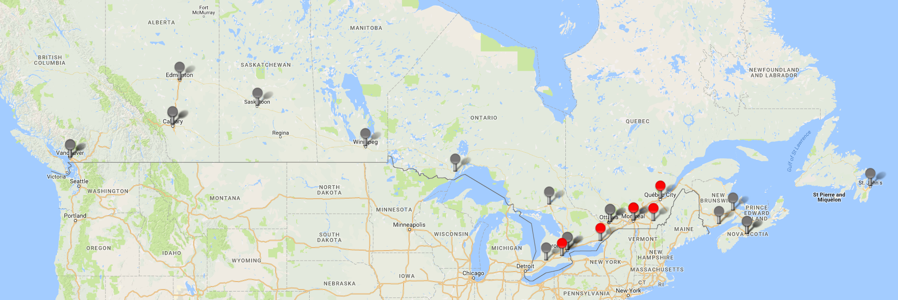
Timeline April 2016
Notes:
Grey is yet to be live. Red is live

Slide 5
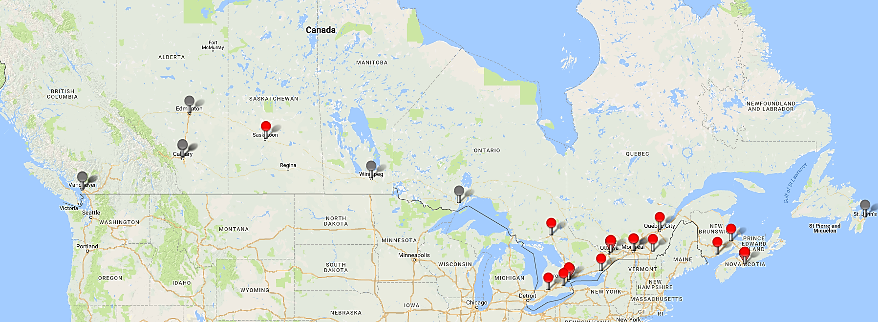
Time Line -Now
Notes:
Grey is yet to be live. Red is live

Slide 6
Center Progress – April 2016 vs May 2017

Slide 7
Patient and User Statistics
CBDR
  3731 patients registered
    Sick Kids and Quebec still to register about 2000 pts.
  1294 patients consented
  752 MyCBDR
  90 clinical users
Notes:
Last year -1481 patients record ( 449 consented) 40 users
MyCBDR – 404, 383 users

Slide 8
Log in

Slide 9
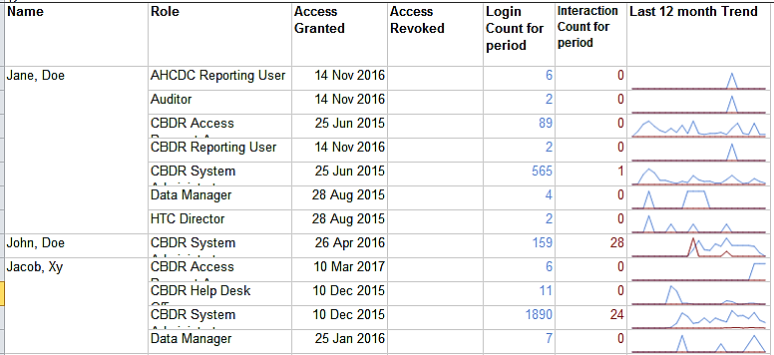
User logs in trend
Notes:
Last year -1481 patients record (449 consented) 40 users
MyCBDR – 404, 383 users

Slide 10

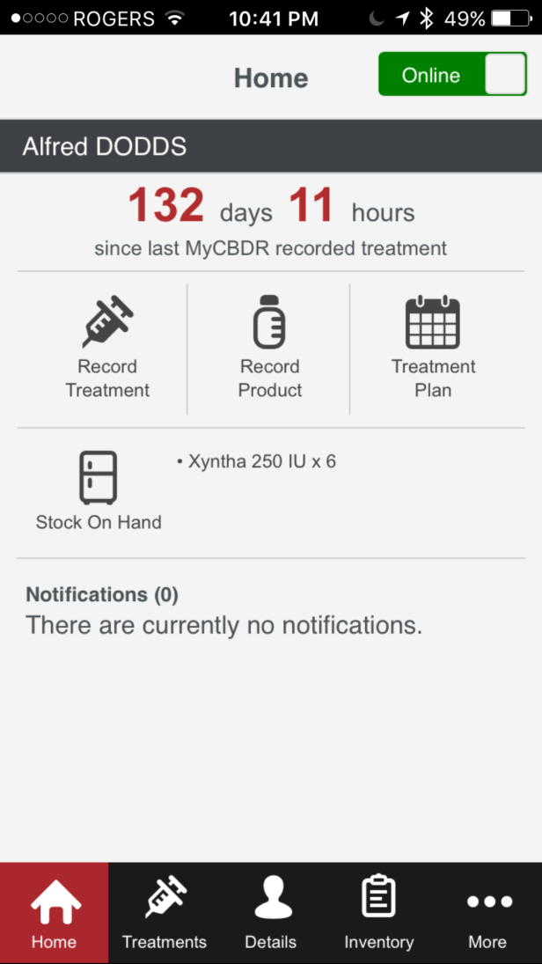

MyCBDR/CBDR V3.5 – French app
Notes:
French app – this image will be replaced with a screenshot of the actual app

Slide 11
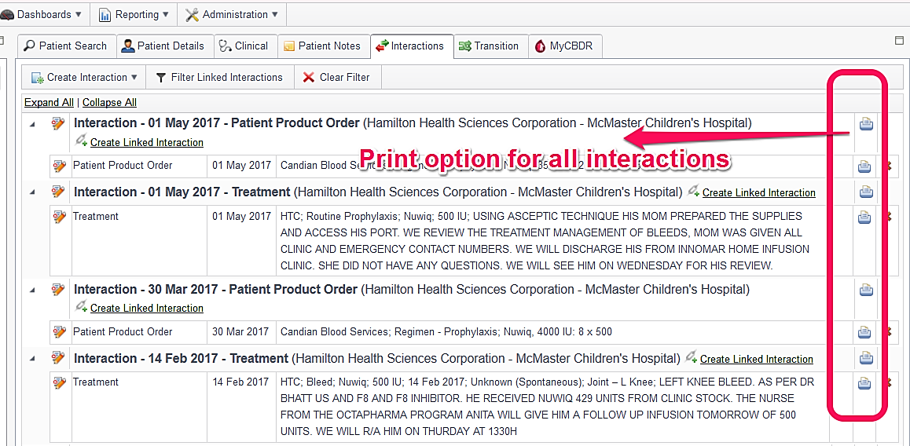
CBDR Version 3.4
Notes:
Version 3.4

Slide 12
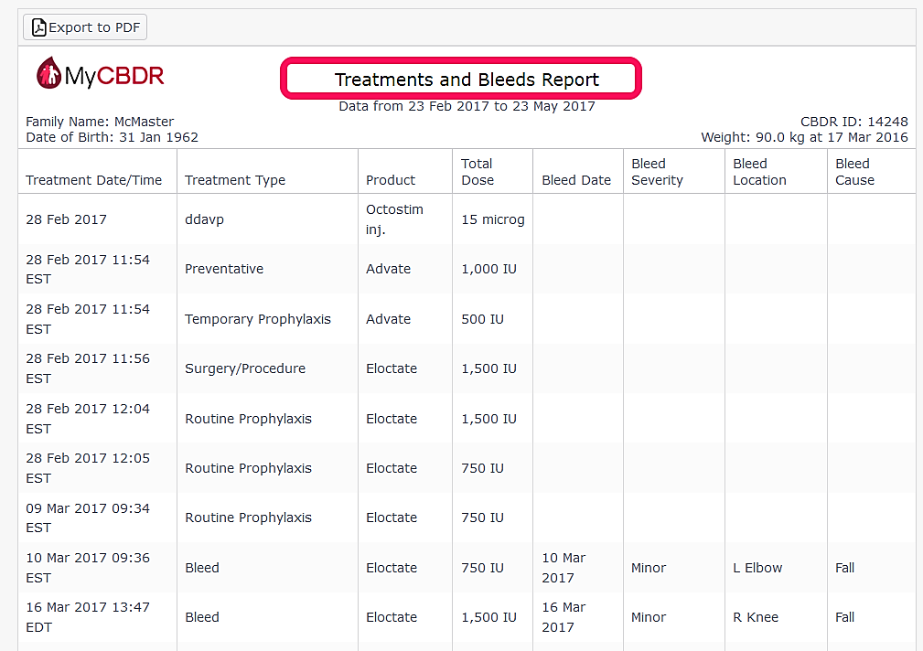
CBDR V 3.4
Notes:
Version 3.4 – treatment and bleed report in pdf, word and csv for patients

Slide 13
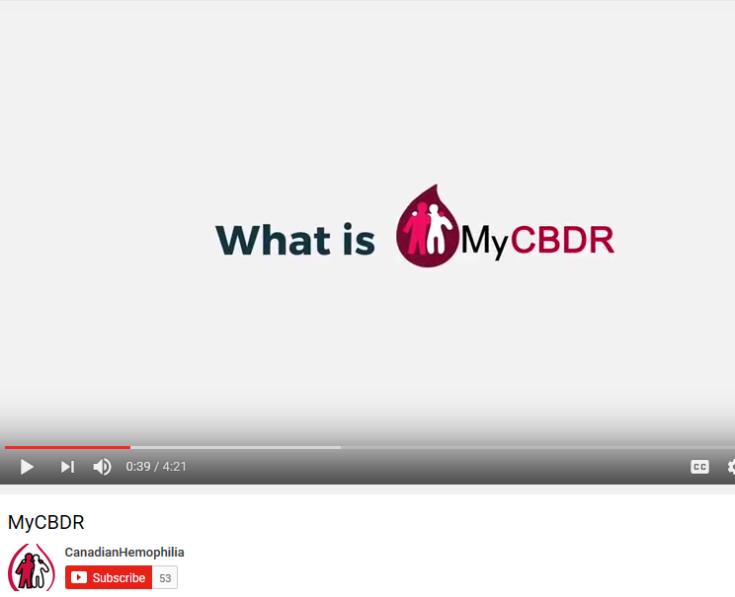
Promotional Materials by CHS
Notes:
Screen grab of youtube video

Slide 14


Bilingual Help Desk
Notes:
Images:
http://businessguideottawa.ca/wp-content/uploads/2016/02/French-Translation.jpg
http://siteassets.pagecloud.com/dts-tech/images/Help-Desk-Image-ID-c1bb886f-73c6-452d-fe4b-c2c298c492a3.png?nocache=cceb6810-e7f5-4c70-d1a4-970528859036

Slide 15
Objective
CBDR project status
  Centers
  Patients
  MyCBDR
Governance
Data and reporting
  Third party reporting
  National registry level data reporting
CBDR-R
Technical roadmap

Slide 16
Three levels of CBDR governance
CBDR – C (formerly CHARMS committee).
Stakeholder advisory group – formalised in April 2016
Canada- Australia bilateral committee

Slide 17
CBDR Governance Map
AHCDC
CBDR-C
Bilateral committee
Allied Professions
CBDR-SAG
CHS
NBA

Slide 18
Key Activities
CBDR-C – meets 2nd Monday of every month
Stake-holder Advisory Group - meets 3rd Tuesday of every month
NBA – McMaster review calls – Monthly and adhoc
Other (provincial administrators, privacy officers, legal, research coordinators, support sessions) -adhoc
Notes:
Take away

Slide 19
CBDR-Stakeholder Advisory Group
Members
  Kay Decker (CANHC) - Chair
  Lisa Thibeault(CANHC)
  Claude Meilleur (CANHC)
  Nancy Hodgkins (CANHC)
  Karen Strike (CPHC)
  Julia Brooks (CPHC)
  Hulda Niv (CSWHC)
  David Page (CHS)
  John Schmidtke (CHS)
  Theresa Almonte (Data manager)
  AHCDC delegate

Slide 20
Objective
CBDR project status
  Centers
  Patients
  MyCBDR
Governance
Data and reporting
  Third party reporting
  National registry level data reporting
CBDR-R
Technical roadmap

Slide 21
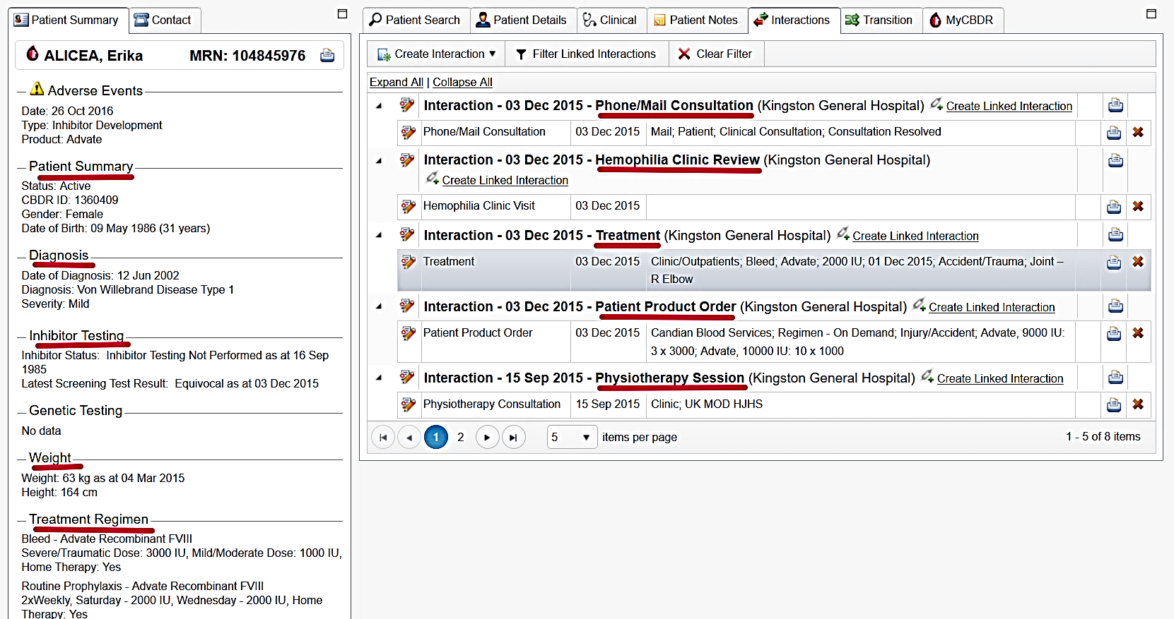
Data - Variety
Notes:
As intro
Four Vs of CBDR data
Velocity: Real time updation.
Variety: Demography to PK - full range of bleeding disorder data.
Veracity: Quality validated data.
Volume: approx. 300 interactions per day
This slide: CBDR data covers entire gamut – from demography to pharmacokinetics to genetics

Slide 22
Data Volume by Source
Notes:
Interactions entered in last 12 months

Slide 23
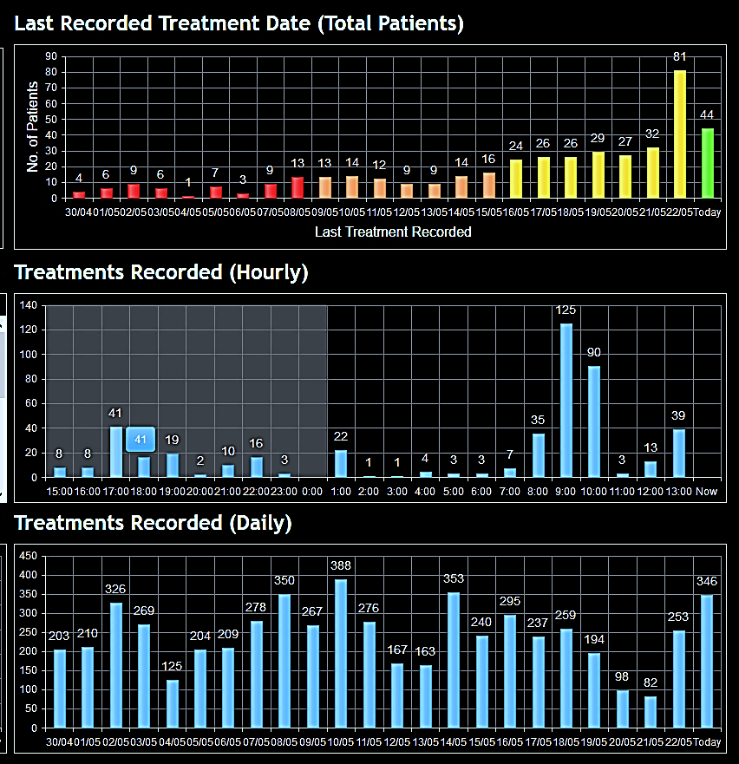
Data Velocity and
Volume
Notes:
Data updated in real time

Slide 24
Fifth V - Value
Flows from the 4Vs
Laying foundation for value addition and innovation in Hemophilia care in Canada.

Slide 25
Duplicate Patient Merge
  First Name/Last Name reversed.
    Charles, John 10/15/2007 Center ABC
    John, Charles 10/15/2007 Center ABC
  Birthdates – month and day reversed.
    Smith, John 03/05/2009 Center DEF
    Smith, John 05/03/2009 Center DEF
  Misspelled names.
    Jones, Joanna 07/01/2000 Center GHI
    Jones, Joanne 07/01/2000 Center GHI
Notes:
The Help Desk will contact the center with the duplicate patients to determine the correct spelling and birthdates. Once confirmed the records can be merged into one retaining the data from both accounts.
This function is only available to CBDR System Administrators.

Slide 26
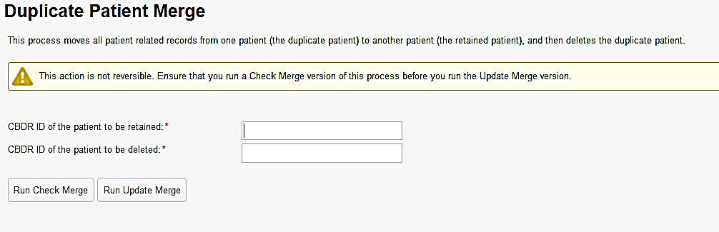
Notes:
The Duplicate Patient Merge routine provides a Check process, to be run first to ensure that the Merge process provides the expected results. An Output Log is displayed on the screen.
Only when you are sure that the Merge process will do as expected, should you run the Update process.
Warning Merging a patient is a non-reversible operation.
To run the Check Merge process, enter the CBDR ID of the patient record to be retained and the CBDR ID of the patient record to be deleted, and click on the Run Check Merge button.
To run the Update Merge process, enter the CBDR ID of the patient record to be retained and the CBDR ID of the patient record to be deleted, and click on the Run Update Merge button.

Slide 27
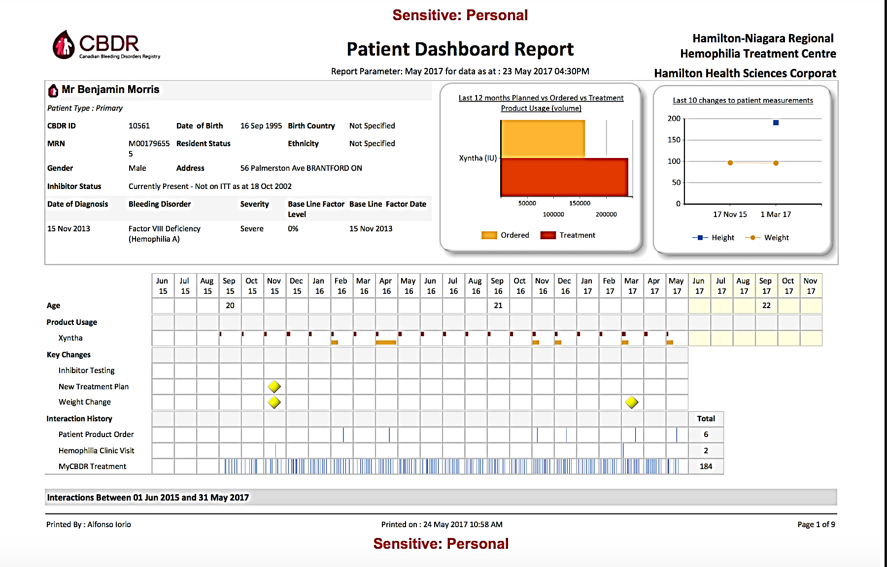
Routine Use of CBDR
21 y.o., severe HA on Xyntha prophylaxis
In 2016 reports 5 bleeds (all right elbow)
Total prescribed: 312,000 / 2016 (60 IU/kg)
Total ordered: 240,000 /2016 → 77% (46 IU/kg)
Total reported: 208,000 /2014 → 87% (40 IU/kg)
HJHS: 8; 6 for R elbow, 1 each for ankles

Slide 28
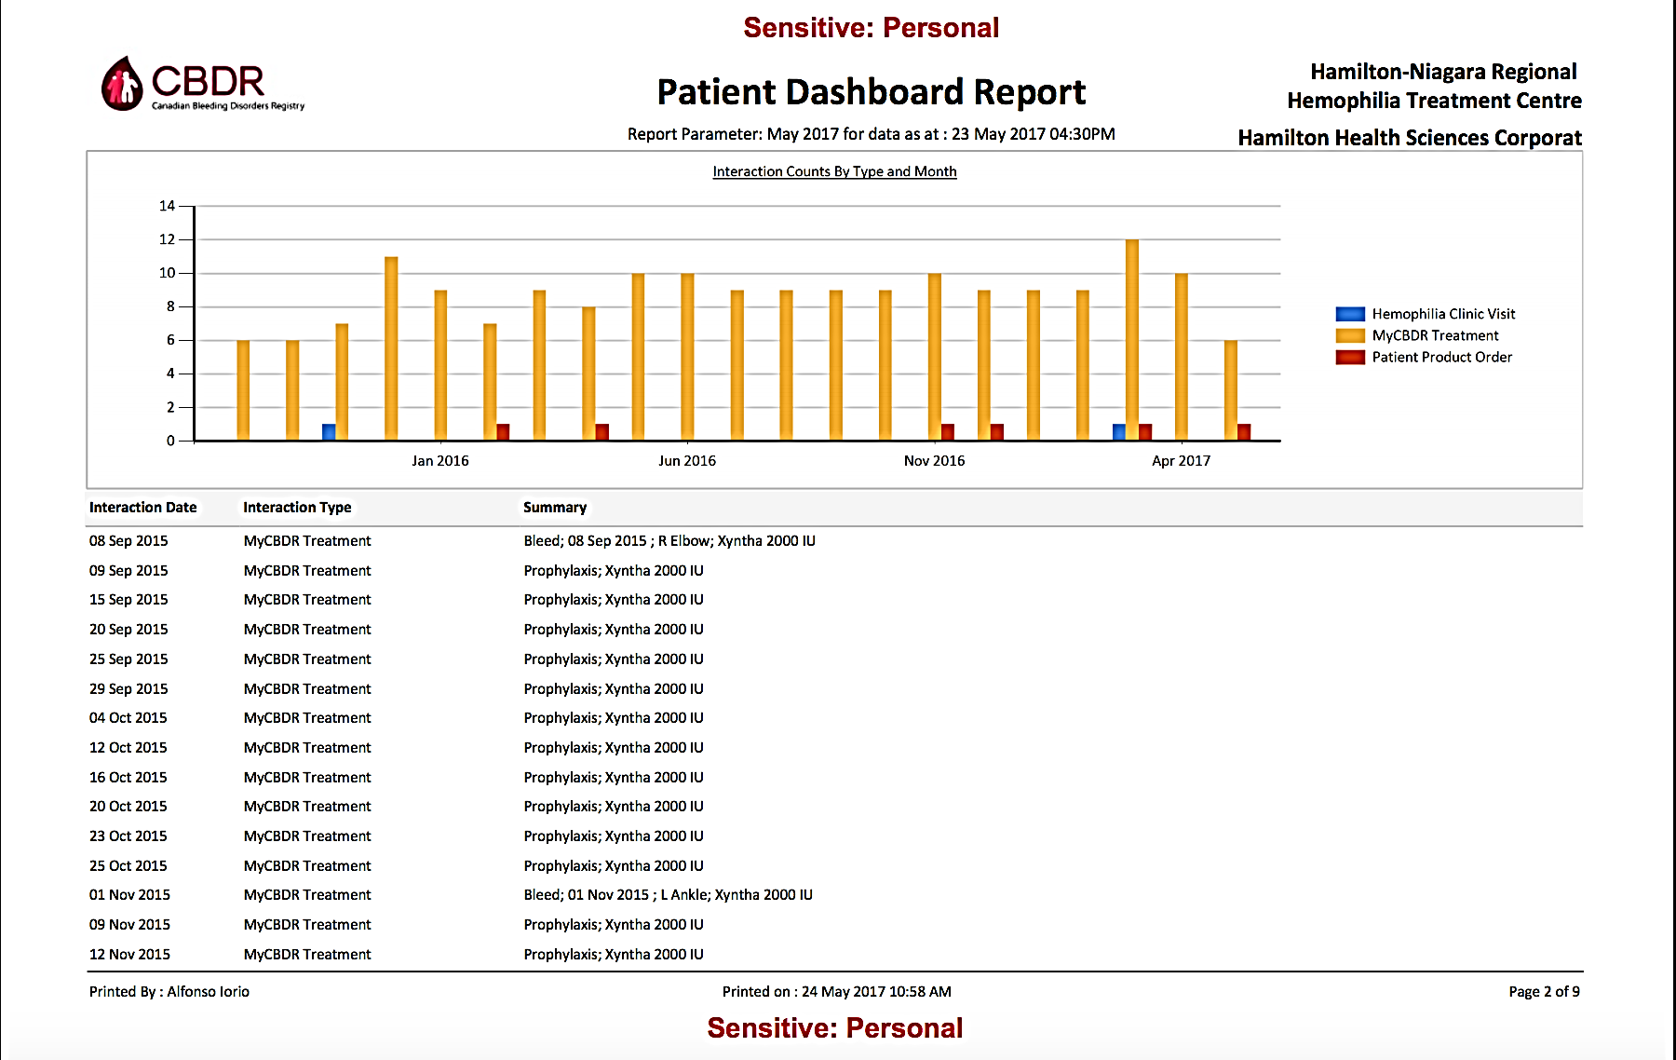

Slide 29
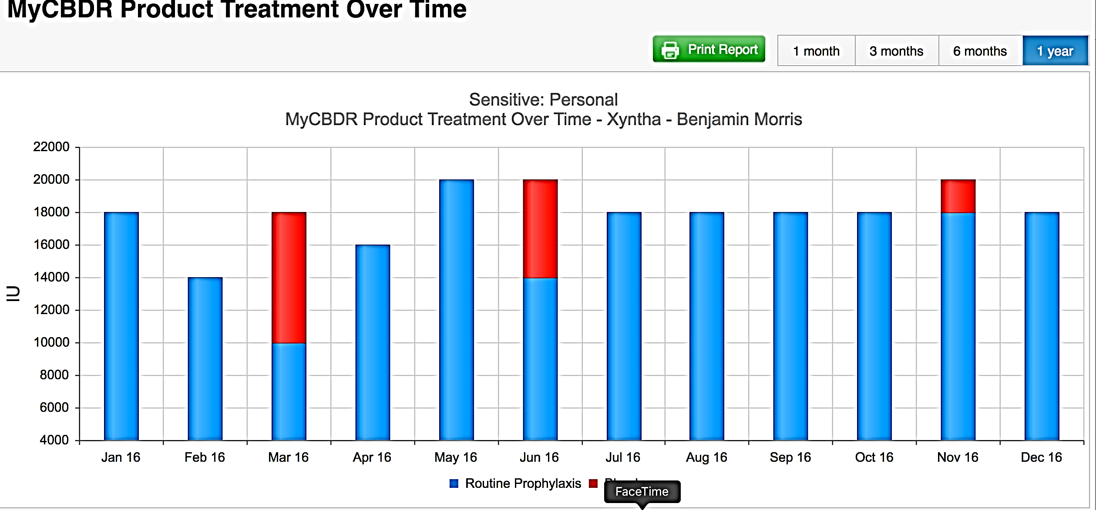
Notes:
Blue: routine prophylaxis
Red: bleeds

Slide 30
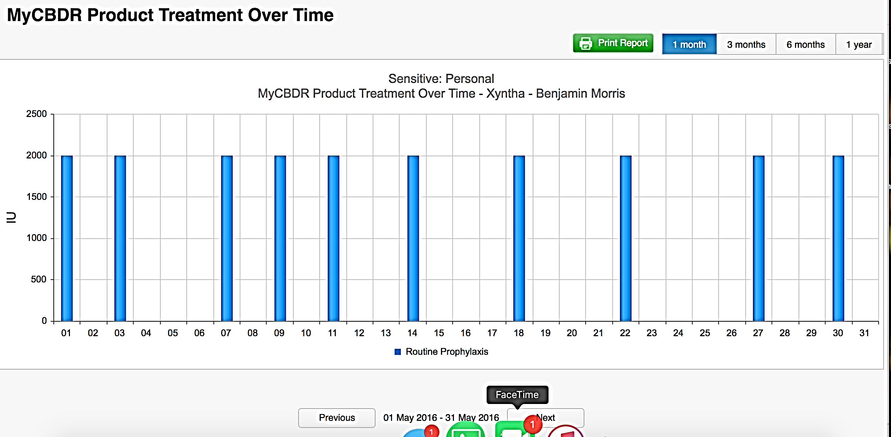

Slide 31
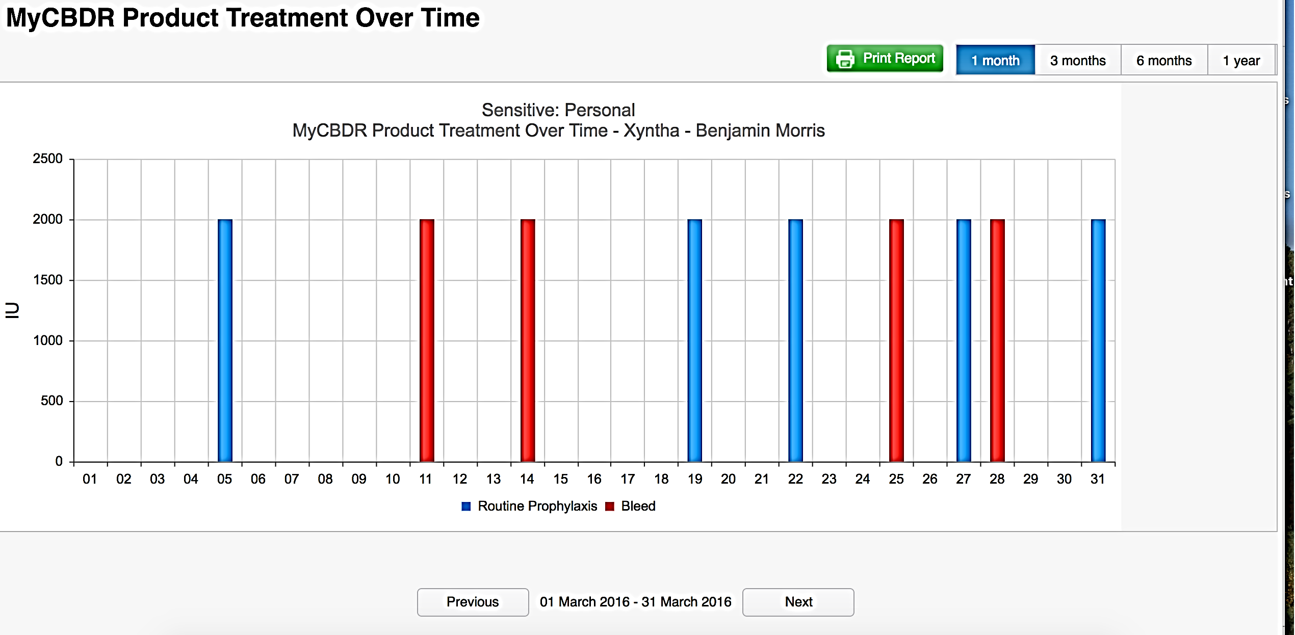

Slide 32
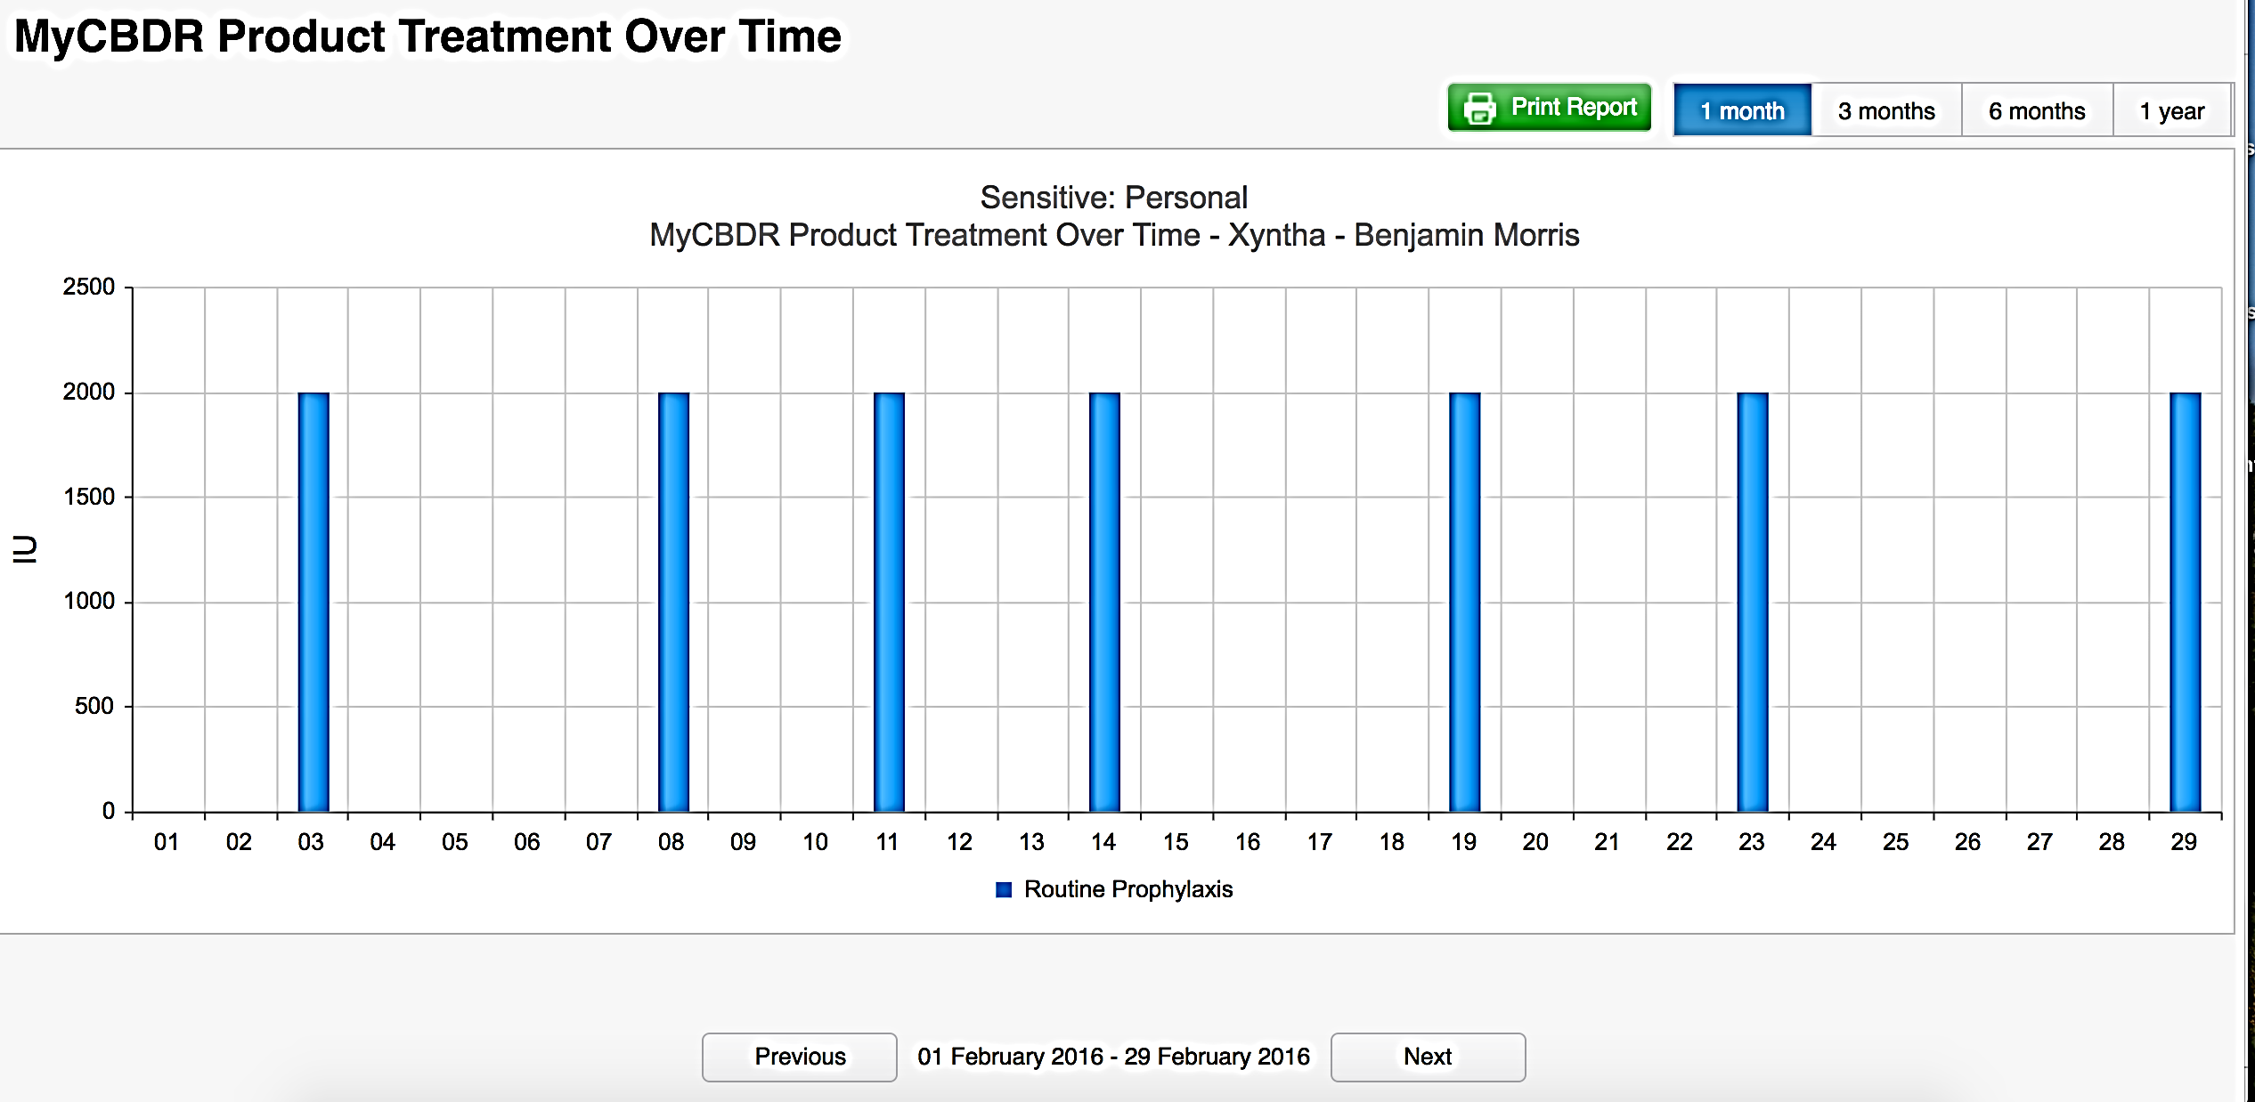

Slide 33
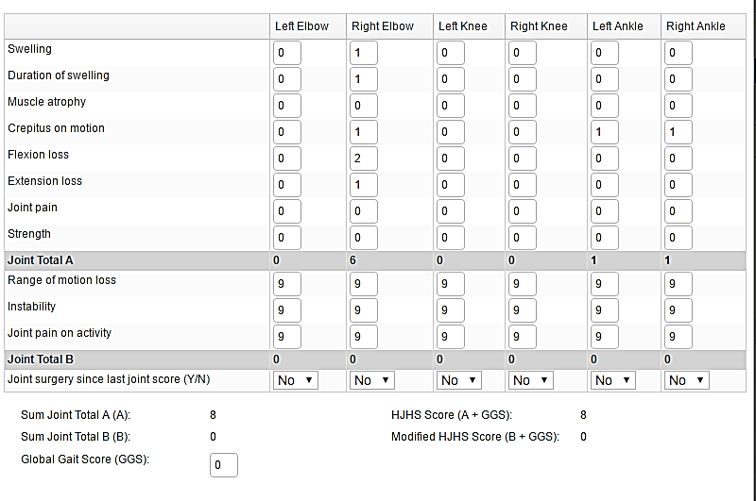

Slide 34
Third Party Data Requests

Slide 35
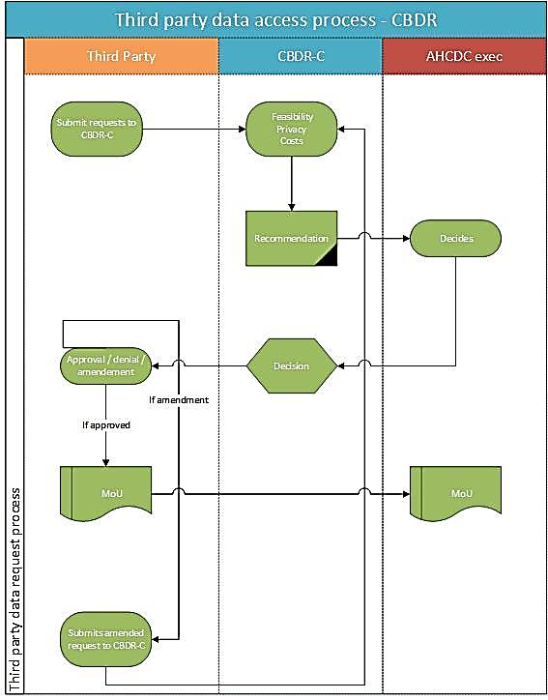

Slide 36
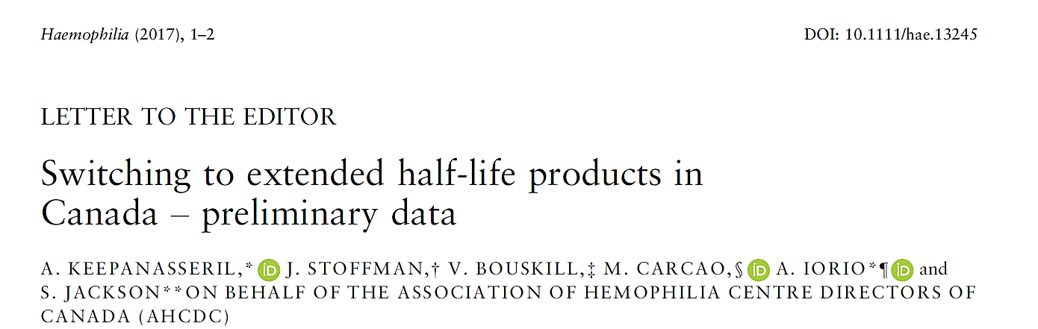
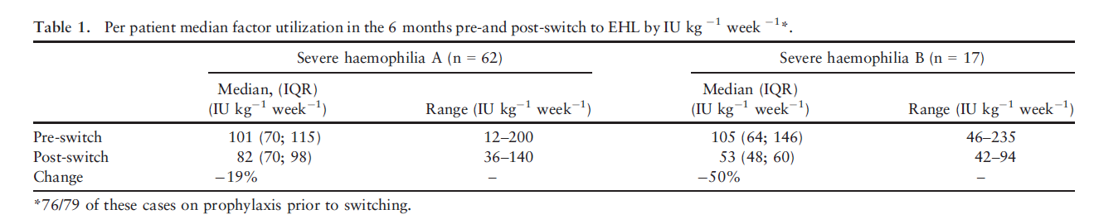
Third Party Data Access

Slide 37

Data Requests
Biogen – approved and executed
Roche – in process
Pfizer – pre-submission
Novo – pre-submission
Notes:
Image:
https://mobilemarketingwatch.com/wp-content/uploads/2016/03/data-1.jpg

Slide 38
Harmonizing Registry Data
Challenges
  CHR and CBDR reconciliation
Process
  Data checking by matching and querying, manual reconciliation
  Statistician @ McMaster
Discrepancies
  Incomplete and / non transfer of legacy data transfer

Slide 39
CBDR vs CHR for Hem and vWD
Notes:
With 16 centers in CBDR the coverage should be 64% of national numbers. However the actual coverage for the main three diagnoses – Hem A, B and Vwd is 30 percentage. Discrepancy is because of Quebec not registering non home care patients yet, SickKids starting from scratch. Moncton, Sudbury and QE2 data transfer is in process. Additionally Montreal children’s and St John NB havent transferred CHARMS data. So in reality only 11 centers have contributed CHARMS data out of which three quebec centers have contributed partial data. So 11/25 centers is 44 percent and we have now covered 30 perentage. There is a discrepency of approx 2700 patients. There are also approximately 500 very old patients in CHR that need to be accounted for, some duplicates also.
For Hem A and B severe – 64% of the total is already in CBDR, more than expected given the status of CHARMS data but probably a holding center effect. Milds and Vwd are the huge misses. Both will improve with the ongoing migration but most likely will not be matched as you rightly pointed out

Slide 40
Objective
CBDR project status
  Centers
  Patients
  MyCBDR
Governance
Data and reporting
  Third party reporting
  National registry level data reporting
CBDR-R
Technical roadmap

Slide 41
CBDR-R
Criterium | Value
Hemophilia A | A
Severity | severe
Age | >18
HJHS | >13
Bleeds | >6
Patient | Eligibility
CBDR-01 | Y
CBDR-02 | Y
CBDR-03 | N
CBDR-04 | N
CBDR-05 | Y

Slide 42
CBDR-R
Patient | Eligibility
CBDR-01 | Y
CBDR-02 | Y
CBDR-05 | Y
CBDR-18 | Y
Patient | Enrolled
CBDR-01 | Y
CBDR-02 | Y
CBDR-05 | N
CBDR-18 | Y

Slide 43
CBDR-R
CBDR
Ad-hoc
data

Slide 44
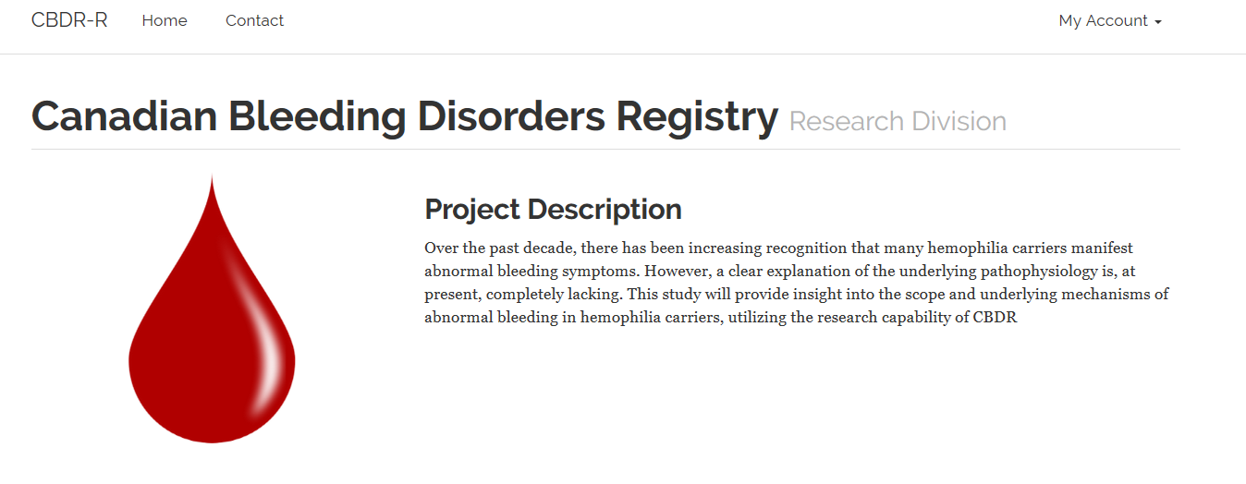
CBDR-R Upcoming Studies
Currently running CHIC
CHIMPS (Dr. Moorehead)
ECHO (Bayer)
Hemophilia burden of illness (Roche)

Slide 45
Objective
CBDR project status
  Centers
  Patients
  MyCBDR
Governance
Data and reporting
  Third party reporting
  National registry level data reporting
CBDR-R
Technical roadmap

Slide 46

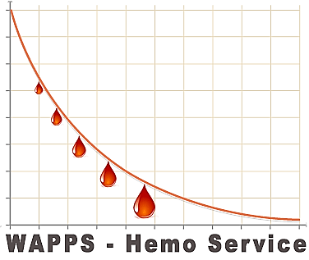
Technical Roadmap
Genetics – directly by Kingston lab (to be piloted)
WAPPS PK integration (planning stage)
CHESS reports integration (planning stage)

Slide 47

Thank you!
Notes:
Image
http://seanheritage.com/wp-content/uploads/2014/01/questions.jpg

