Slide 1
The NHF-McMaster guidelines on models of care in hemophilia
Rendezvous ‘17 , Toronto
Alfonso Iorio

Slide 2
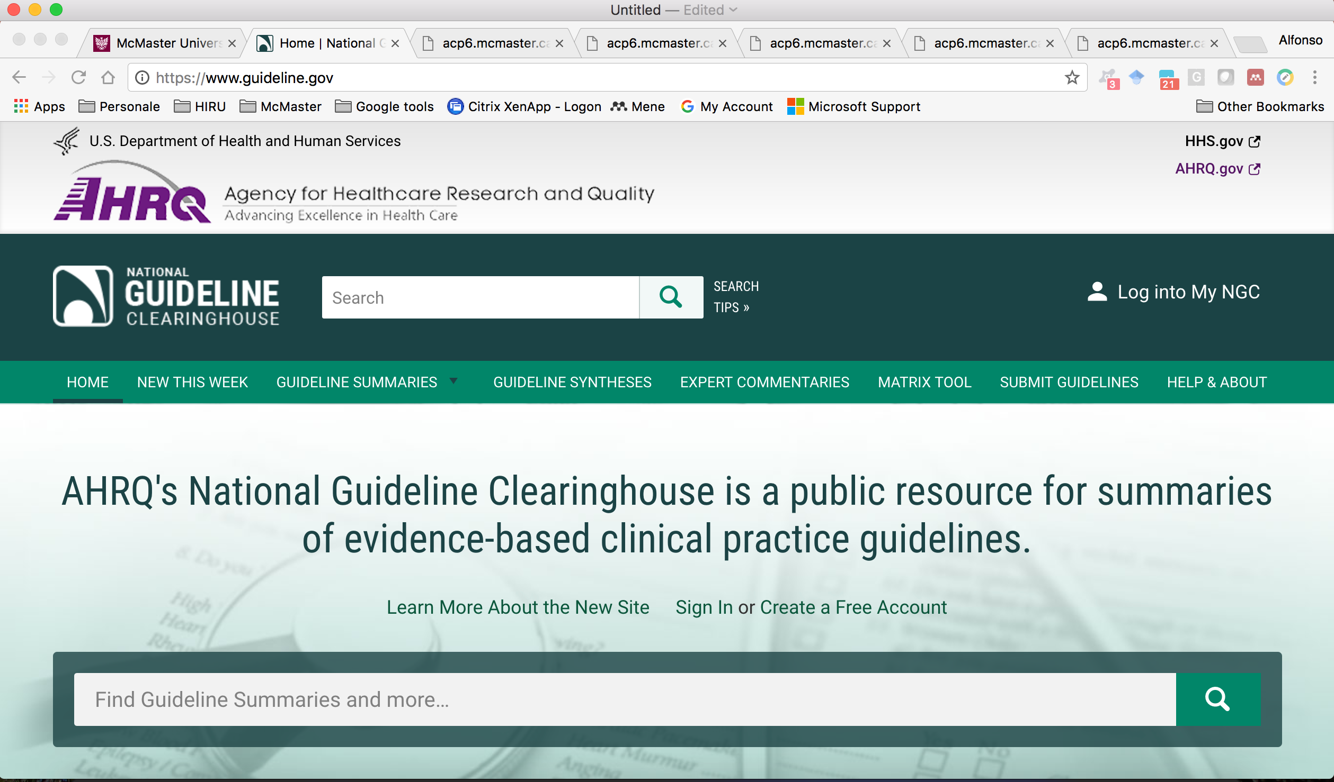

Slide 3
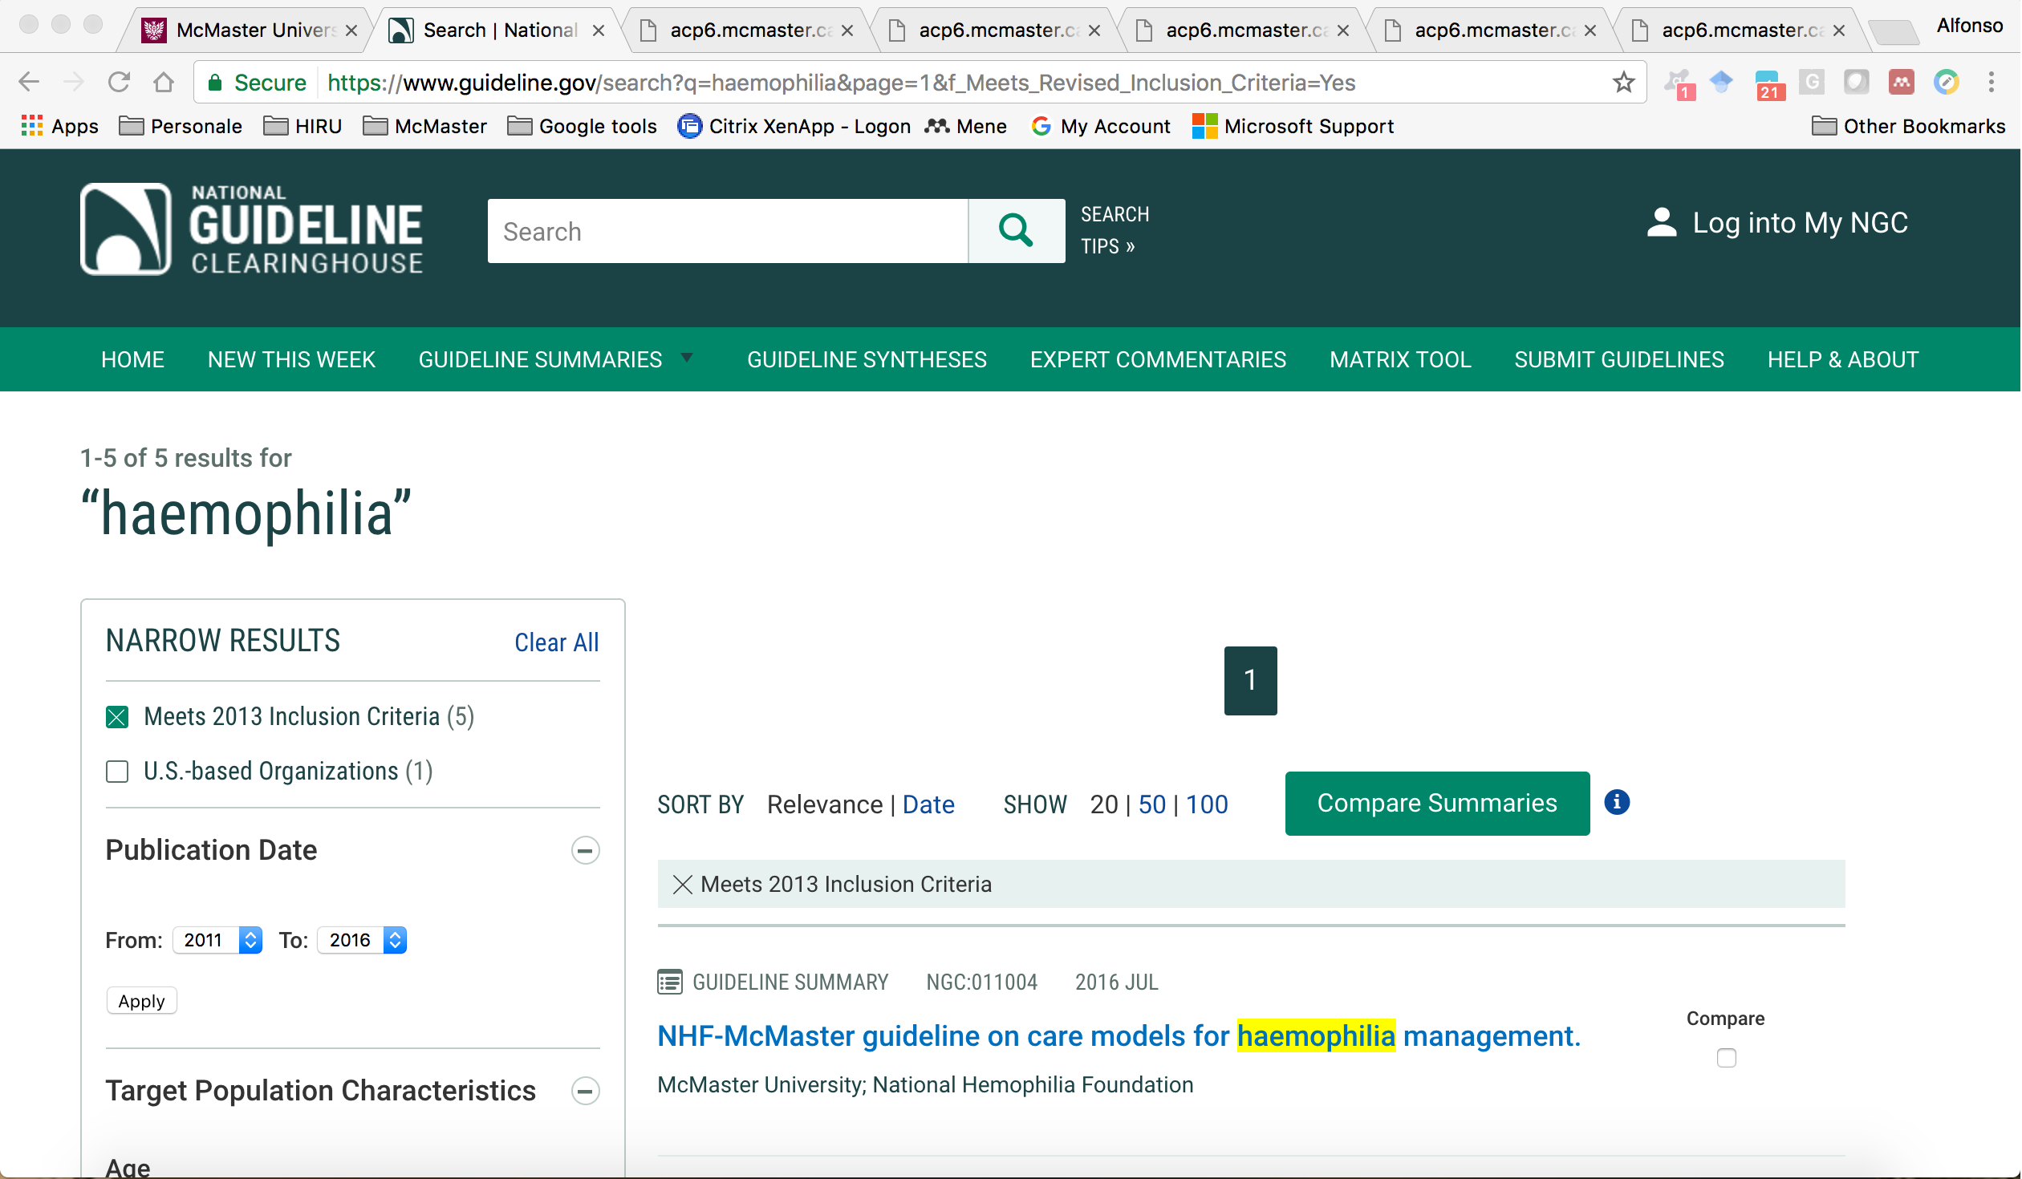

Slide 4

Notes:
Can the hemophilia community ignore the FDA/HTA requirements and needs, claiming to be a rare and different disease, which does not require proof of effect and measures of value? Can we continue claiming that we do not need to prove that parachute works, and no matter how much they costs we want them?

Slide 5
Why would the hemophilia community embrace EBC?
Evolving scenario - challenges
Hemophilia
has been a prototype
has been the betrayal of the dream of a cure for a male’s disease in the roaring ‘60es of the infinite power of progress
Many more rare diseases with more expensive treatment
learning to advocate for their treatment in absence of alternatives
Different economical models landing on the stage

Slide 6
Why would the hemophilia community embrace EBC?
Evolving scenario - opportunities
Hemophilia
Strong and widespread network of HTC, NMO, patients
Rare, but sizeable disease
many less patients studied that one could
Long tradition of collaboration among all relevant stakeholders
Notes:
We have to stop fighting HTA processes, we have to learn their languages
We have to stop support the claim of diversity, other less fortunate will soon make the case they are more diverse than us
We have to stop fighting evidence agencies, and collaborate to learn and speak their language
We have to stop targeting only the usual journals – we have to build credibility on journals which are trusted by the HTA/reimbursement agencies – self referentiality will not pay for much longer.

Slide 7
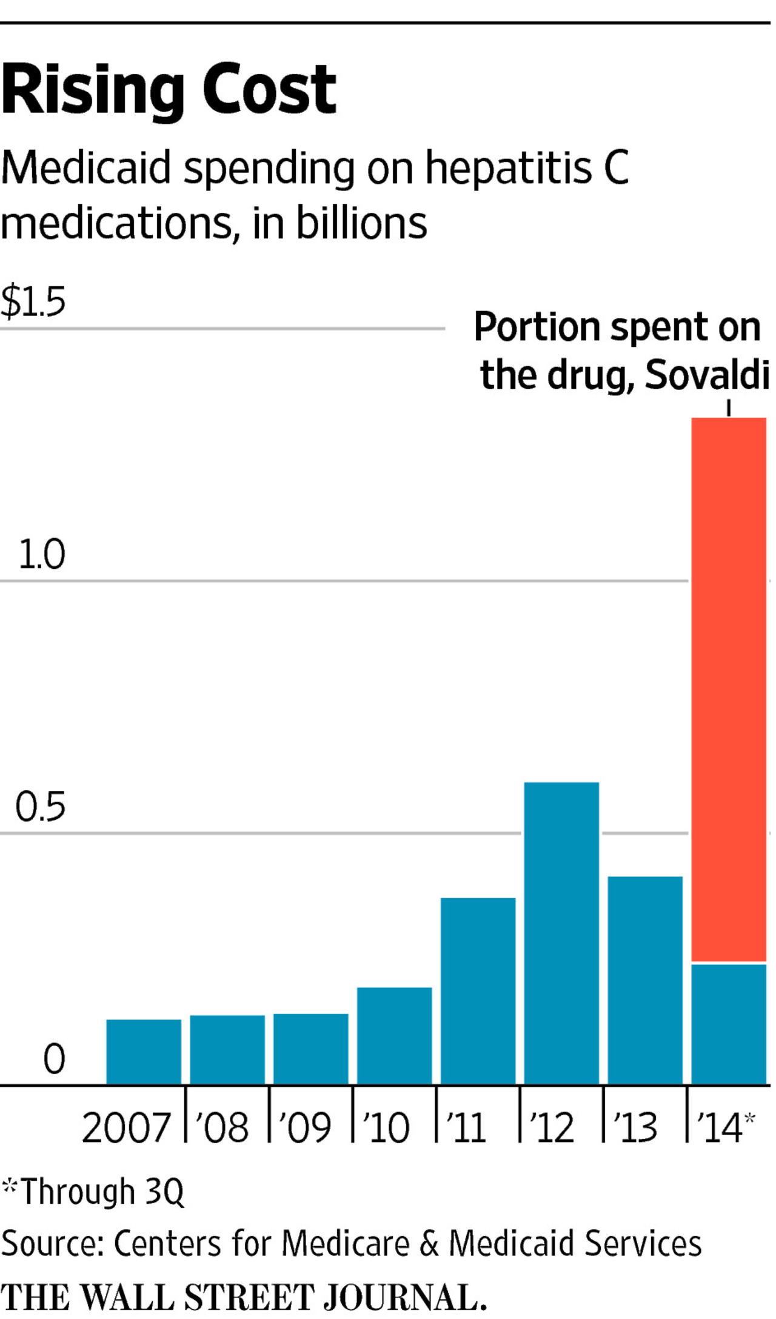
Mc Carthy M. New drug for hepatitis C contributes to 13% rise in spending on prescription drugs in US. BMJ. 2015;350:h2055.
Cost effective, but also would cost an additional $65 billion over the next 5 years
Chatwal J et al. Ann Intern Med. 2015;162:397-406.
By JOSEPH WALKER April 8, 2015 4:37 p.m. ET
Notes:
It is not a matter of ethics, or anyways we have to deal with the ethics of capitalisms and profitability
It makes the case clear – even when the treatment has a proven dramatic effect = CURE – still you may need evidence to make the case for the affordable value
We will come back hopefully soon with gene therapy for hemophilia
The process by which drug manufacturers set their prices remains unclear. A spokesman for Gilead responded to a query by Medscape with the following statement: "We believe the price of Sovaldi and Harvoni reflects the value of these medicines. Unlike long-term or indefinite treatments for other chronic diseases, Sovaldi and Harvoni offer a cure with as little as eight weeks of treatment for many patients taking Harvoni."
Similarly, a spokeswoman for AbbVie also cited the fact that these drugs are offering a "high certainty of a cure with notably low rates of discontinuation and relapse." She further stated in an email exchange that the company took a number of factors into account when determining the treatment's price, "including the benefits of the therapy to patients, overall market dynamics, cost-effectiveness of treatment, and the value that it brings to off-setting short-term and long-term healthcare costs.”
Cost-effectiveness and budget impact of hepatitis C virus treatment with sofosbuvir and ledipasvir in the United States. Chhatwal J et al. Ann Intern Med. 2015;162:397-406.

Slide 8
List of Cochrane Reviews and trials
11 completed reviews
6 reviews included 28 RCTs
1007 patients were randomized
Notes:
Prophylaxis
Bypassing agents
Surgical bleeding
Exercise
Pyscosocial internvetion
ITI

Slide 9
RCTs on secondary prophylaxis
Manco-Johnson
Powell
Aronstam
+ 467
valentino
valentino
Aronstam
Morfini
Malanghu
Kavakli
Publication year
Notes:
Are underpowered trial useless and unethical – yes they are
But not more than paying for treatments that may or may not be different
There would be enough patients to prove impact on adherence, QoL, bleeds
The entire HCS of the US (I am citing the US not as a model, but meaning that if even the US, with the craziest and less affordable health care system ever have got it, it should be right) is moving toward a outcome based reimbursement – the first time you may say let’s go, we will not measure and nothing will happen, but the second time you will not be given a chance

Slide 10
HTA in hemophilia
Swedish Council on Health Technology Assessment. Treatment of Hemophilia A and B and von Willebrand Disease (2011).
http://http://sbu.se/upload/Publikationer/Content0/1/Blodarsjuka/Treatment%20of%20Hemophilia%20A%20and%20B.pdf
Accessed February 2, 2016.
IQWIG Rapid Report
https://www.iqwig.de/download/A13-07_Executive-Summary_Treatment-of-patients-with-haemophilia.pdf
Accessed February 2, 2016.
Notes:
Comments on what is here what is there
Berntorp E, Astermark J, Baghaei F et al. Treatment of hemophilia A and B and von Willebrand disease. Summary and conclu- sions of a systematic review as part of a Swedish health technology assessment. Haemophilia 2012; 18: 158–65.

Slide 11
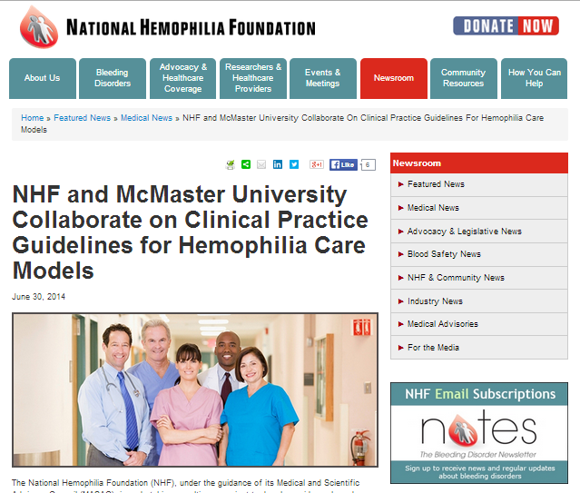

Slide 12
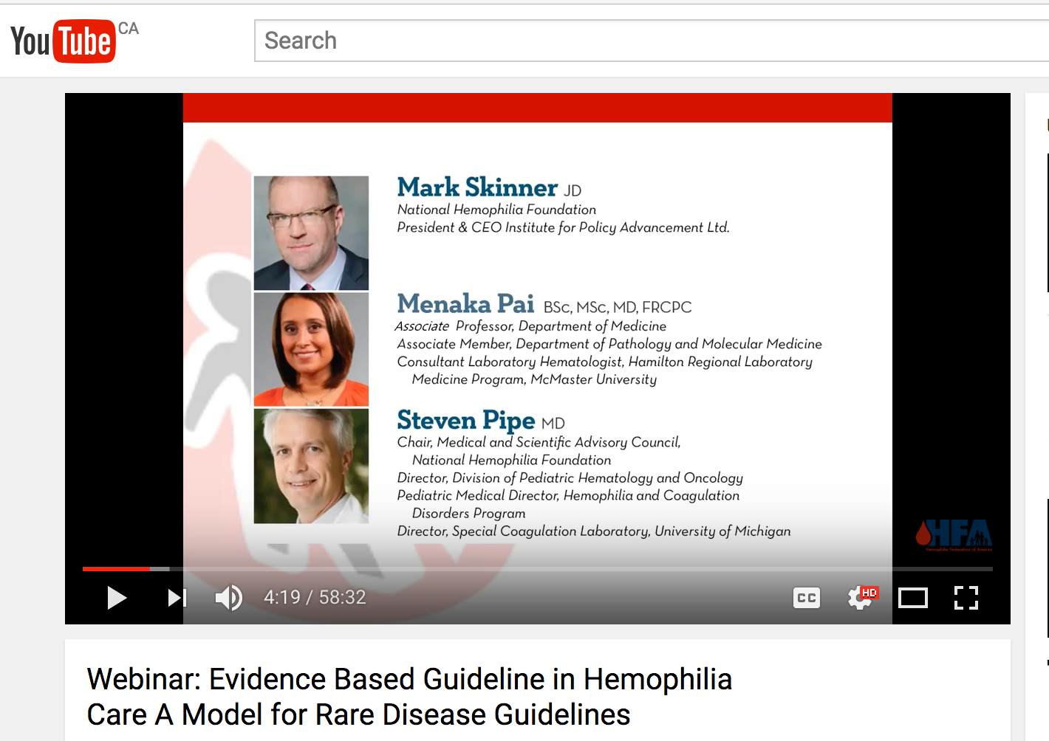

Slide 13

GRADE can be applied to rare diseases like hemophilia
What is GRADE?
Grading of Recommendations, Assessment, Development and Evaluation
Method of grading quality of evidence and strength of recommendations in guidelines.
Used by over 80 international organizations to produce rigorous, transparent and sensible clinical practice guidelines and other health care recommendations.
Developed by an international working group with over 300 contributors.

Slide 14
GRADE for “dummies”
Appraisal of evidence
Evidence to Recommendations
Study limitations
Precision
Consistency
Directness
Publication bias
Effect size
“Dose effect”
Plausibility
Priority?
Certainty on value of outcome?
Overall certainty?
Large desirable effects?
Small undesirable effects?
Desirable relative to undesirable effects?
Resources required?
Incremental cost relative to net benefits?
Health inequalities?
Acceptability?
Feasibility?
Evidence profile
EtR framework

Slide 15
Question generation
Draft questions generated by consultants
Electronic surveys sent out to stakeholders
Questions presented to panel to review and refine

Slide 16
Selecting outcomes of interest
Mortality / survival
Missed days from work or school
Number of ER visits
Length of in-patient stay
Quality of life
Functional outcomes - joint damage / joint disease
Educational attainment
Patient adherence
Patient knowledge
Long list generated by consultants
Electronic surveys sent out to stakeholders
Short list presented to panel to review and refine

Slide 17
GRADE for rare diseases

Slide 18
GRADE for rare diseases
3 specific components:
1. Systematic elicitation of expert opinions
2. Use of indirect evidence from other diseases
3. Generation of qualitative evidence as needed

Slide 19
Strength of recommendations
Stakeholder | Strong | Conditional
Policy maker | Adopt in most situations | Adoption might involve specific debate
Clinicians | Most patients should receive the intervention | Different patients might require different choices
Patient | Most patients would like to adopt | Many patients, but not all, would adopt

Slide 20
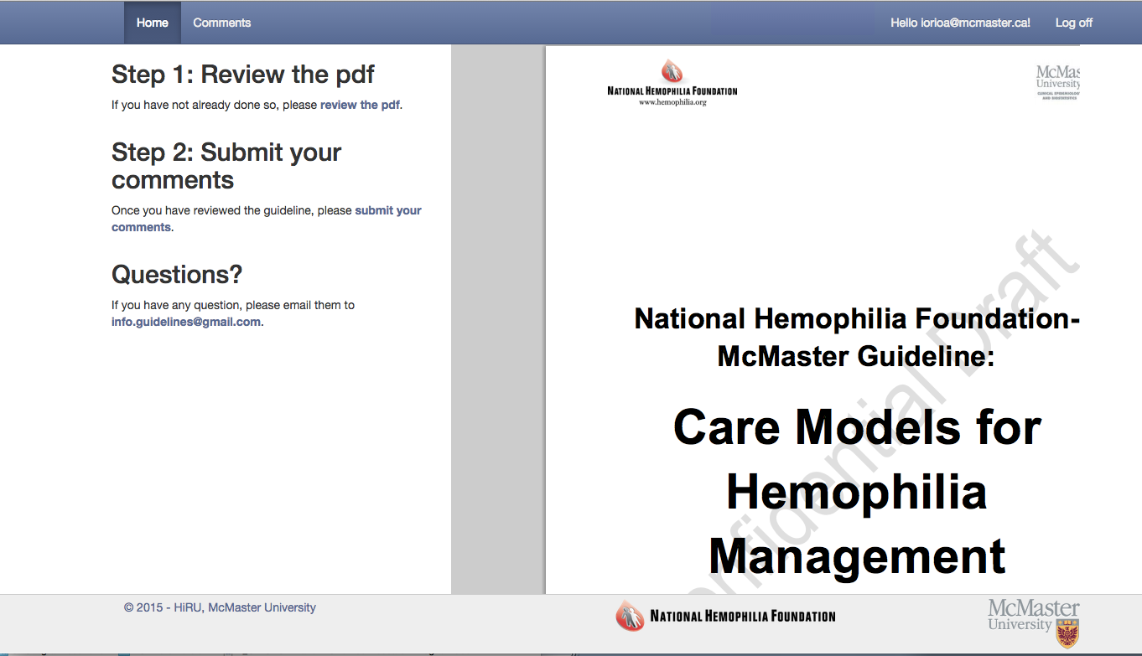
Public commenting

Slide 21
Evidence-based guidelines support integrated disease management as the optimal model of hemophilia care
Pipe and Kessler
NHF-McMaster Guideline on care models for hemophilia management
Pai et al
Methodology for the development of the NHF-McMaster guideline on care models for hemophilia management
Yeung et al
Care models in the management of hemophilia: a systematic review
Yeung et al
Integrated multidisciplinary care for the management of chronic conditions in adults: an overview of reviews and an example of using indirect evidence to inform clinical practice recommendations in the field of rare diseases.
Yeung et al
Outcomes, Equity, Acceptability and Feasibility: a qualitative study to understand stakeholder perceptions and experiences of a care model for the management of hemophilia in the U.S.
Lane et al

Slide 22
Guideline panel members
Kari Atkinson – Parent of PWH, NHF Chapter President
Marianne Clancy – Executive Director of HHT Foundation, patient with a rare disease
Randall Curtis – PWH, hemophilia researcher
Sue Geraghty – Hemophilia nurse
Alfonso Iorio – Canadian hemophilia clinic director
Jeanne Lusher – Former U.S. hemophilia clinic director
Mike Makris – U.K. hemophilia clinic director
Craig Kessler – U.S. hemophilia clinic director
Nigel Key (Clinical Chair) – U.S. hemophilia clinic director
Kristy Lee – Genetic counsellor
Maria Martins-Lopes – Chief Medical Officer, CDMI/Magellan, payer representative
Ruth Mulvany – Physical therapist
Holger Schunemann (Chair) – Clinical epidemiologist, internist
Michelle Sholzberg – Canadian hemophilia physician, American Society of Hematology representative
Mark Skinner – PWH, WFH and NHF Past President
Mike Soucie – Hemophilia researcher, CDC representative
Douglas Stratton – Chairman and CEO, Foundation for Complex Healthcare, payer representative
Vicky Whittemore - Program Director (Epilepsy), NIH/NINDS

Slide 23

Thank you!
Notes:
Image
http://seanheritage.com/wp-content/uploads/2014/01/questions.jpg

