Slide 1
Inhibitor reporting standardization in previously treated patients
Alfonso Iorio
ISTH SSC – Factor VIII/IX
Saturday June 20, 2015 Room 10:20 Room: 718

Slide 2
Disclosures for A. Iorio
Shareholder | None
Grant / Research Support | Funds managed via Institution (Bayer, Baxter, BioGen, NovoNordisk, Octapharma)
Consultant | Funds managed via Institution (Pfizer, Bayer, Biogen)
Employee | McMaster University
Paid Instructor | None
Speaker bureau | None
Other | PI of the WAPPS project Chair of the Data&Demographics Committee WFH, CFGD RG Cochrane Collaboration Editor

Slide 3
Working group
Guidance for authors of manuscripts reporting inhibitor cases developed in previously treated haemophilia patients (PTPs)
Alfonso Iorio, Francesco Bernardi, David Lillicrap, Michael Makris, Flora Peyvandi, Frits Rosendaal

Slide 4

Working group
Guidance for authors of manuscripts reporting inhibitor cases developed in previously treated haemophilia patients (PTPs)
Alfonso Iorio, Francesco Bernardi, David Lillicrap, Michael Makris, Flora Peyvandi, Frits Rosendaal
THIS IS ABOUT REPORTING CASE CHARACTERISTICS
THIS IS NOT ABOUT STUDY DESIGN FOR INHIBITOR RATES

Slide 5
Background
Knowledge about
Determinants and natural history
Clinical relevance
for inhibitors developing in PTPs is very limited
Why interest in inhibitors in PTP?
PTPs are considered the best model to assess immunogenicity of factor VIII molecules
Rates in PTPs have been used to compare different molecules

Slide 6
Random reflections
Rates in PTPs are very hard to compare
“Claims” of differences can impair tender process
Meaningful use of rates requires additional information about the clinical relevance of inhibitors events
Knowledge about risk factors (or simply patterns) may lead to prevention of avoidable cases

Slide 7
Determinants of inhibitors development in previously treated hemophilia A patients
Alfonso Iorio
Oral presentation OR 144
Tuesday June 23 2015, 8:45 Room 801

Slide 8
Evidence search
Author guidelines for case reports:
62 of 142 reviewed journals (including 10 journals that focus on case reports)
PubMed yielded 1,155 publications
20 papers were selected and 8 more added by manual searching

Slide 9
From authors’ instructions
Novelty and rarity are welcome but not necessarily required (NEJM)
This is in line with the concept that you can learn by summing up the information provided by a series of n-of-1 case studies
Adverse drug reactions are a premiere category of cases worthy of being reported
(Annals of Internal Medicine)

Slide 10
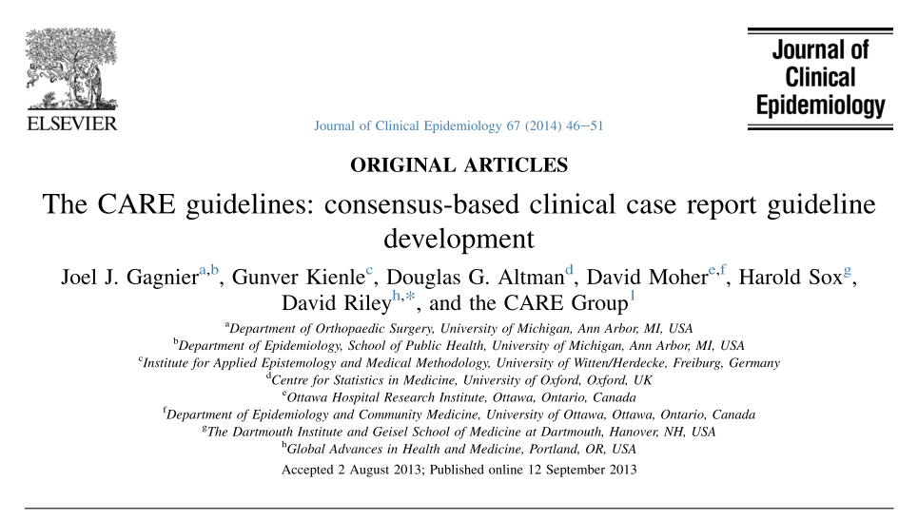

Slide 11
Items for reporting
- Patient information
Exposure
risk factors
Ethnicity
Family history of inhibitors (**)
Gene mutation
Clinical findings
Clinical presentation vs asymptomatic
Clinical significance of the inhibitor
Complications
Timeline
Date of diagnosis
Age at diagnosis (**)
Age at first lifetime exposure to factor concentrate
Date of last switch in factor concentrate (if any) (**)
Diagnostic assessment
First titre level, test used and cut-off (**)
Peak titre level (**)
Last know titre (**)
Therapeutic intervention
Treatment adopted (**)
Use of bypassing agents
Follow up and outcomes
Length of follow up (**)
Persisentence ((**)

Slide 12
Items for reporting
- Patient information
Exposure
Risk factors
Ethnicity
Family history of inhibitors (**)
Gene mutation
Clinical findings
Clinical presentation vs asymptomatic
Clinical significance of the inhibitor
Complications
Timeline
Date of diagnosis
Age at diagnosis (**)
Age at first lifetime exposure to factor concentrate
Date of last switch in factor concentrate (if any) (**)

Slide 13
Items for reporting
Therapeutic intervention
Treatment adopted (**)
Use of bypassing agents
Follow up and outcomes
Length of follow up (**)
Persisentence ((**)
Diagnostic assessment
First titre level, test used and cut-off (**)
Peak titre level (**)
Last know titre (**)

Slide 14
Recommendation
We recommend that for each case of inhibitor development reported in a published paper, a paragraph or a table is included in the main publication reporting as a minimum the underlined data fields in {Table 1}.
We recommend transparent reporting when any of the suggested information is not available (i.e. missing or unknown).
We recommend that particular care is used in reporting dates
clearly identify a reference time point
Dissemination and implementation

Slide 15

Thank you !!!
Questions time!!
Download these slides at:
Hemophilia.mcmaster.ca

