Slide 1
WAPPS project (web accessible pharmacokinetics service)
Alfonso Iorio
ISTH SSC Factor VIII/IX
Sunday June 21st 2015 9:40 Room 718

Slide 2
Disclosures for A. Iorio
Shareholder | None
Grant / Research Support | Funds managed via Institution (Bayer, Baxter, BioGen, NovoNordisk, Octapharma)
Consultant | Funds managed via Institution (Pfizer, Bayer, Biogen)
Employee | McMaster University
Paid Instructor | None
Speaker bureau | None
Other | PI of the WAPPS project Chair of the Data&Demographics Committee WFH, CFGD RG Cochrane Collaboration Editor

Slide 3
A population approach to hemophilia pharmacokinetics. WAPPS: a web-service for bayesian post hoc estimation
Alfonso Iorio
Abstract Symposium AS 122
Wednesday June 24 2015, 16:55 Room 701

Slide 4
WAPPS
patients
patients
patients
Brand specific Source individual PK data
Single patient data
Control files for Bayesian individual estimation
Web application
PPK engine
(NONMEM)
Offline PPK modeling
Advate®
Kogenate®
BeneFix®
Alprolix®
Brand-specific PPK models
Eloctate®
Others…
Single patient report

Slide 5
Validation cohort: Age distribution
Total cases | 477
Min - max | 4.3 – 71.5
Media +/- SD | 32.2 +/- 13.8
Median (25 – 75) | 29 (21.4 – 42.6)
10th percentile | 16

Slide 6
PPK MODELS
Drug | Cl | V1 | V2 | K10 | K12 | K21
Advate | 0.25 | 2.87 | 0.81 | 0.0862 | 0.2770 | 0.9778
Kogenate | 0.18 | 2.90 | 0.84 | 0.0613 | 0.0344 | 0.1193
Xyntha | 0.33 | 4.52 | 0.89 | 0.0737 | 0.3899 | 1.9869
Eloctate | 0.16 | 3.40 | 0.52 | 0.0470 | 0.5512 | 3.6285
Benefix | 0.51 | 8.81 | 6.56 | 0.058 | 0.1306 | 0.1753
Alprolix | 0.22 | 7.21 | 4.35 | 0.0302 | 0.3487 | 0.5784
 |  |  | V3 | K13 | K31
Alprolix |  |  | 13.79 | 0.0257 | 0.0134
Cl = ml/min; Volume = L

Slide 7
FACTOR VIII PPK half-life
Drug | Terminal HL | MRT (Plasma) | MRT (body)
Advate, hrs (95% CI) | 10.5 (5 – 16) | 8 (3 – 12) | 10 (5 – 15)
Kogenate, hrs (95% CI) | 16 (6 – 27) | 11 (4 – 18) | 14.5 (5 – 24)
Xyntha, hrs (95% CI) | 11 (8 – 14) | 9.5 (6 – 13) | 11 (8 – 14.5)
Eloctate, hrs (95% CI) | 17 (6 – 26) | 15 (3 – 26) | 17 (6 – 28)

Slide 8
FACTOR IX PPK
Drug | Terminal HL | MRT (Plasma) | MRT (body)
Benefix, hrs (95% CI) | 23 (12 – 34) | 12 (7 – 17) | 21 (12 – 29)
Alprolix, hrs (95%, CI) | 116 (65 – 167) | 23 (12 -34) | 81 (48 – 113)

Slide 9
“Time to” critical concentrations
Concentrate | 0.05 | 95 % CI | 0.02 | 95 % CI | 0.01 | 95 % CI
Advate | 44 | 21-67 | 58 | 28-88 | 68 | 33 - 104
Kogenate | 62 | 24 – 101 | 84 | 32 – 136 | 100 | 38 – 163
Xyntha | 41 | 24 – 59 | 56 | 35 – 77 | 67 | 44 – 91
Eloctate | 70 | 20 – 120 | 93 | 28 – 158 | 110 | 34 – 186
Benefix | 44 | 30 – 57 | 74 | 47 – 100 | 96 | 59 – 133
Alprolix | 75 | 42 – 109 | 191 | 93 – 289 | 307 | 179 – 434
Benefix 100 | 66 | 43 – 108 | 96 | 59 – 133 | 119 | 71 - 167
Levels as IU/mL – time as hours

Slide 10
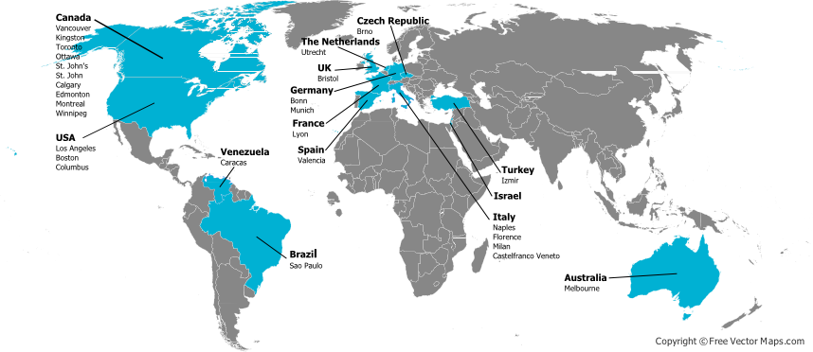
The WAPPS network

Slide 11
Validation cohort
Emoclot | 16
FANHDI | 7
Aafact | 17
Kogenate | 62
Helixate | 23
Recombinate | 20
Advate | 41
Xyntha | 30
Benefix | 1
Others | 40
221 patients
257 kinetics

Slide 12
Patient 1 – Factor IX 50 U/kg
Terminal half-life (hr) | 20.5
Time to 0.05 IU/ml (hr,95% CI) | 46.5 (41.5–51.5)
Time to 0.02 IU/ml (hr,95% CI) | 73.75 (65.25–83.25)
Time to 0.01 IU/ml (hr,95% CI) | 94.5 (81.25–107.5)
0.50 IU/ml
0.40 IU/ml
0.30 IU/ml
Plasma Factor Concentration (IU/ml)
0.20 IU/ml
0.10 IU/ml
0.00 IU/ml
0.05
-0.10 IU/ml
0
12
24
36
48
Time (hr)
60

Slide 13
Potential clinical use
P 1
P 1 – 2 s
P 2 – 2 s
P 2
Terminal Half-life (hr) | 20.5
Time to 0.05 IU/ml (95% CI) | 46.5 (41.5–51.5)
Time to 0.02 IU/ml (95% CI) | 73.75 (64.25–83.25)
Time to 0.01 IU/ml (95% CI) | 94.5 (81.25–107.5)
23.0
42 (34.25–49.75)
72.25 (56–88.25)
95.25 (71.25–119
25.5
34.75 (26.75–42.5)
68 (51.75–84.5)
93.75 (65.5–122
26.0
35 (30–39.75)
68.75 (58.25–79.5)
95 (75.75–114.25)

Slide 14
Does this matter to F8/9 SSC?
The WAPPS network is welcoming research projects
We are collecting info on laboratory tests, and we plan to explore their impact on PK/PPK
We foresee need for standardization in the field

Slide 15
Thank you !!!
Join the WAPPS network at:
www.wapps-hemo.org
Download these slides at:
Hemophilia.mcmaster.ca

