Slide 1
A population approach to hemophilia pharmacokinetics. WAPPS: a web-service for bayesian post hoc estimation
Alfonso Iorio
Abstract Symposium AS 122
Wednesday June 24 2015, 16:55 Room 701

Slide 2
Disclosures for A. Iorio
Shareholder | None
Grant / Research Support | Funds managed via Institution (Bayer, Baxter, BioGen, NovoNordisk, Octapharma)
Consultant | Funds managed via Institution (Pfizer, Bayer, Biogen)
Employee | McMaster University
Paid Instructor | None
Speaker bureau | None
Other | PI of the WAPPS project Chair of the Data&Demographics Committee WFH, CFGD RG Cochrane Collaboration Editor

Slide 3
BacKGround

Slide 4
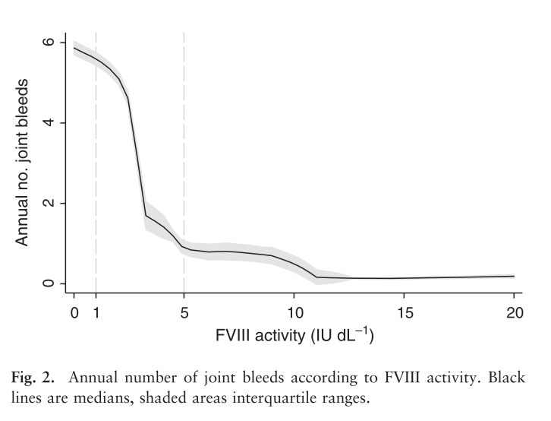
Factor levels and bleeding
Clinical severity of haemophilia A: Does the classification of the 1950s still stand?
den Uijl IEM, Mauser Bunschoten EP, Roosendaal G, et al. Haemophilia 2011;17:849–53.

Slide 5
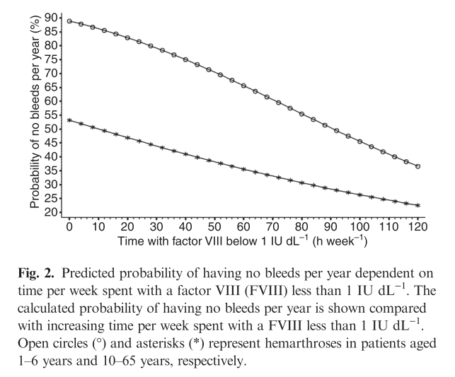
Factor levels and bleeding
Collins PW, et al.
J Thromb Haemost 2010;8:269–75.

Slide 6
PHARMACOKINETIC CHARACTERISTICS OF FACTOR VIII AND IX CONCENTRATES – A SYSTEMATIC REVIEW
75 articles
2050 patients included in PK analyses.
38 on factor VIII concentrates
HL(hr) for
wild type 7.8 to 19.2,
BDD 7.5 to 17.9
prolonged HL 11.5 to 23.1
25 on factor IX concentrates.
HL(hr) for
wild type 12.9 to 36.0 ,
prolonged HL 53.5 to 110.4
Xi M, Navarro-Ruan T, Mammen S, Blanchette V, Hermans C, Morfini M, Collins P, Fischer K, Neufeld EJ, Young G, Kavakli K, Radossi P, Dunn A, Thabane L, Iorio A for the WAPPS study group - PO262-MON.

Slide 7
A story of two tails..
Unpublished data, 1 single molecule
Estimated terminal t1/2 (hr)
Individual case

Slide 8
AIM

Slide 9
AIM of the project
implement a population PK engine for all FVIII / FIX concentrates and make it available online
provide support to PK estimation in hemophilia based on flexible reduced set of data point (2-3 post infusion samples)

Slide 10
PK ESTIMATION
Concentration in blood is a biomarker for concentration at site of action
Are we able to measure PK?
PK parameters are not directly measured
While you can measure C_{through} in blood directly, you can’t measure Clearance and Volume

Slide 11
Population pharmacokinetic
Is it reliable, precise, accurate?
11 data points classic PK
PEAK & TROUGH
PRECISION, ACCURACY

Slide 12
Population pharmacokinetic

Slide 13
Population pharmacokinetic

Slide 14
Population pharmacokinetic

Slide 15
Population PK
Two main applications:
Drug oriented (derivation phase)
Estimating the PK properties of a drug using sparse data from a population of subjects
Patient oriented (estimation phase)
Estimating the PK in one individual using sparse data from the subject and a population model

Slide 16
Materials and Methods

Slide 17
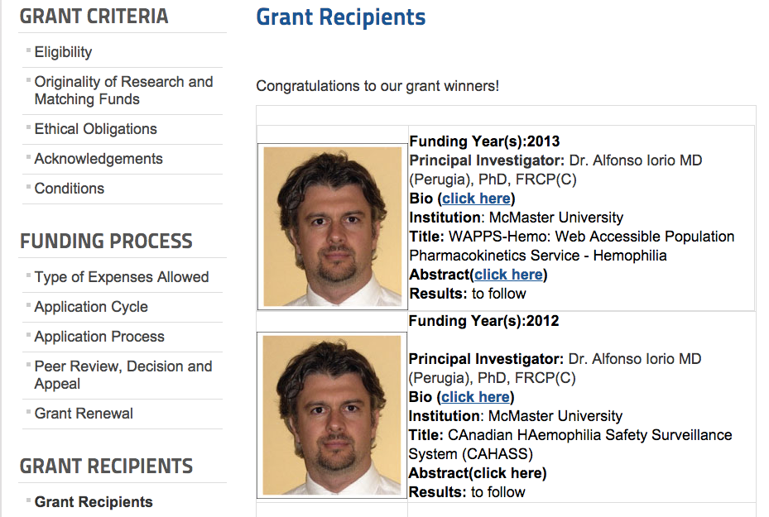
Funding support

Slide 18
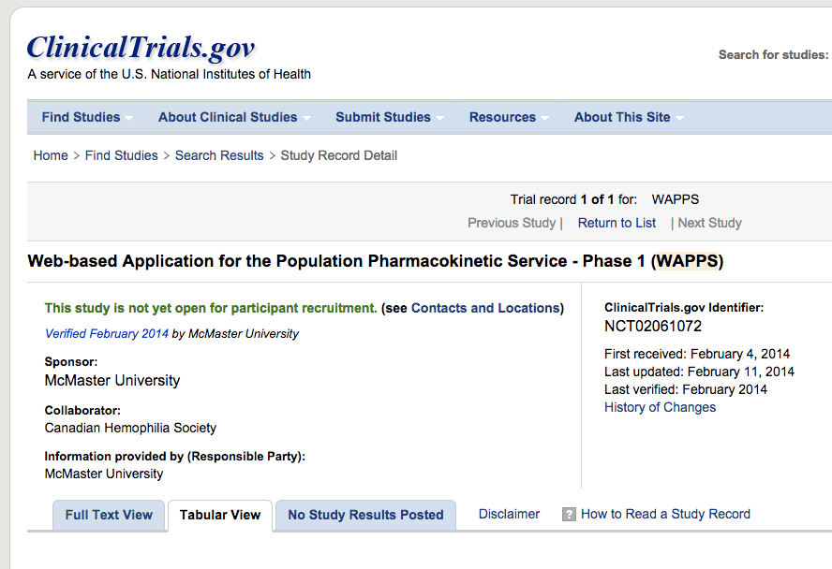
Trial registration

Slide 19
The WAPPS core team
PI: Iorio, Alfonso and Hermans, Cedric
Advisory Committee: Blanchette, Victor; Collins, Peter; Morfini, Massimo;
Project coordinator: Navarro, Tamara
Information Technology: Cotoi, Chris; Hobson, Nicholas; McKibbon, Ann;
Pharmacokinetics: Edginton, Andrea;
Statistics: Foster, Gary; Thabane, Lehana;
Consultant: Bauer, Rob (Consultant at ICON)
Literature service, data entry: Xi, Mengchen; Mammen, Sunil; Yang, Basil;
User testing: Bargash, Islam

Slide 20
Single patient data
Web-application
Estimating PK for single individuals on the base of 2-4 samples
Single patient report

Slide 21
Estimating PK for single individuals on the base of 2-4 samples
Single patient data
Web-application
Online PPK engine
(NONMEM)
Single patient report

Slide 22
Estimating PK for single individuals on the base of 2-4 samples
Brand specific Source individual PK data
Single patient data
Control files for bayesian individual estimation
Web-application
Online PPK engine
(NONMEM)
Offline PPK modeling
ADVATE
KOGENATE
BENEFIX
ALPROLIX
ELOCTATE
Others..
Brand specific PPK models
Single patient report

Slide 23
Brand specific Source individual PK data
Single patient data
patients
patients
patients
Control files for bayesian individual estimation
Web-application
Online PPK engine
(NONMEM)
Offline PPK modeling
ADVATE
KOGENATE
BENEFIX
ALPROLIX
ELOCTATE
Others..
Brand specific PPK models
Single patient report

Slide 24
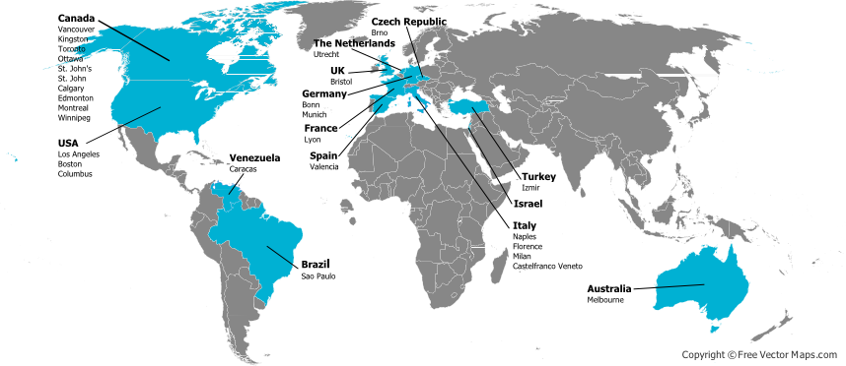
The WAPPS network

Slide 25
The network
Active centers
US Guy Young
TU Kaan Kavakli
US Ellis J. Neufeld
CA Shannon Jackson
IT Paolo Radossi
CA Paula James
CE Jan Blatny
CA Jerry Teitel
VZ Arlette Ruiz-Sàez
NL Kathleen Fischer
US Amy Dunn
CA Victor Blanchette
D Rainer Kobelt
In process
CA Alan Tinmouth
CA MacGregor Steele
UK Savita Rangarajan
SA Johnny Mahlangu
IT Alberto Tosetto
D Cristoph Bidlingmaier
IT Giancarlo Castaman
SL Barbara Faganel Kotnik
US Craig Kessler
47 more attended the introductory webinar

Slide 26
Reporting
Disclaimer: This is a research service under development, not yet validated for clinical practice use. Any use of the results of the population pharmacokinetic estimation in the care of individual patients is not recommended and cannot be considered part of the service in this phase. The local investigator is solely responsible for any such use.

Slide 27
Published models
Drug | Refs | Comp
Advate | Bjorkmann, Eur J Clin Pharm, 2009; Blood, 2013; JTH 2010 | 2
Alprolix | Diao, Clin Pharmacokinet 2014 | 3
Eloctate | Nestorov I, Clin Pharm in Drug Dev 2014 | 2
Xyntha | Karafoulidou, Eur J Clin Pharmacol 2009 | 2

Slide 28
Modeling: Base Structural Model
Estimation
Method
Residual
Variability
Model
Parameters
Assessment
Type
IIV
FO
FOCE
FOCEI
Laplacian
Additive
CCV
Exponential
FOCE
1-cmt
Additive
CCV
Additive+CCV
Log Error
1-cmt
Cl
Vol
OBJF
Diagnostic
plots
Exponential
Additive + CCV
Cl
Vol
Notes:
Base compartment model – using CONCENTRATION and DOSE – we are estimate our two parameters of interest – clearance and volume
Objective function is based on extended least squares
Note: FOCEI is the current standard method for NONMEM analyses
FO – first order estimation; FOCE – first order conditional estimation;
FOCEI – first order conditional estimation interaction
Laplaian

Slide 29
Parametrization
Systemic clearance is assumed to be a random effect
Clearance and volume are assumed to be independent, which reduces the number of parameters in the covariance matrix

Slide 30
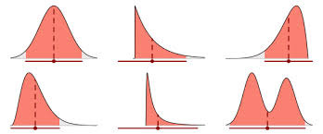
Individual estimation
Post-modelling bayesian individual estimation
Sparse data from a subject are modeled iteratively with priors from the population distribution
Credibility intervals around the estimates are generated

Slide 31
RESULTS - MODELLING

Slide 32
Source data
 | Subjects | Replicates | n | Kinetics
Brand
A | 40 | 21 | 1 | 61
B | 80 | 58 | 4 | 312
C | 30 | 30 | 2 | 90
D | 167 | 30 | 1 | 197
E | 25 | - | - | 25
F | 129 | 20 | 1 | 149
Total | 471 | 159 |  | 834

Slide 33
Age distribution

Slide 34
Derivation cohort: Age distribution
Total | 477
Min - max | 4.3 – 71.5
Media +/- SD | 32.2 +/- 13.8
Median (25 – 75 PCT) | 29 (21.4 – 42.6)
10th percentile | 16

Slide 35
Classical PK estimation
patient |  |  | 1 | 2 | 3 | 4 | 5
dose/kg |  |  | 55 | 59 | 56 | 53.1 | 50.9
dose |  |  | 3405 | 4086 | 5448 | 4767 | 4920
one-comp |  | V | 2985.97 | 2629 | 4217.305 | 3887.61 | 3676.66
 |  | k | 0.001052 | 0.001309 | 0.001089 | 0.001238 | 0.000796
 |  | HL (min) | 659 | 529 | 636 | 559 | 871
 |  | HL (h) | 10.98 | 8.82 | 10.60 | 9.32 | 14.52
 |  | C(0) approx D/V | 1.14 | 1.55 | 1.29 | 1.23 | 1.34
two-comp |  | A | 0.486937 | 1.274402 | 0.476461 | 0.934315 | 0.987822
 |  | B | 0.726386 | 0.302367 | 0.8767 | 0.303577 | 0.379788
 |  | alpha | 0.004996 | 0.001823 | 0.004597 | 0.001656 | 0.001333
 |  | beta | 0.000532 | 0.000315 | 0.000645 | 0.000528 | 0.000207
 |  | alphaHL | 138 | 380 | 150 | 418 | 519
 |  | betaHL | 1302 | 2197 | 1074 | 1312 | 3342
 |  | Hlbeta (h) | 21.70 | 36.62 | 17.90 | 21.87 | 55.70

Slide 36
WAPPS models
Drug | Type | Class | Gen ctrl | Pref Mod (Comp) | Alt model (Comp) | Active
Advate | F8 | R-wild | N | 2 | 1 | Y
Alprolix | F9 | R-long | N | 3 | 2 | Y
BenefIX | F9 | R-wild | N | 2 | -- | Y
Eloctate | F8 | R-long | N | 2 | 2 | Y
Humate P | F8 | PD | Y | 2 | 1 | Y
Kogenate | F8 | R-wild | N | 2 | 1 | Y
Wilate | F8 | PD | Y | 2 | 1 | Y
Xyntha | F8 | R-BDD | N | 2 | -- | Y

Slide 37
PPK MODELS
Drug | Cl | V1 | V2 | K10 | K12 | K21
Advate | 0.25 | 2.87 | 0.81 | 0.0862 | 0.2770 | 0.9778
Kogenate | 0.18 | 2.90 | 0.84 | 0.0613 | 0.0344 | 0.1193
Xyntha | 0.33 | 4.52 | 0.89 | 0.0737 | 0.3899 | 1.9869
Eloctate | 0.16 | 3.40 | 0.52 | 0.0470 | 0.5512 | 3.6285
Benefix | 0.51 | 8.81 | 6.56 | 0.058 | 0.1306 | 0.1753
Alprolix | 0.22 | 7.21 | 4.35 | 0.0302 | 0.3487 | 0.5784
 |  |  | V3 | K13 | K31
Alprolix |  |  | 13.79 | 0.0257 | 0.0134

Slide 38
FACTOR VIII PPK half-life
Drug | Terminal HL | MRT (Plasma) | MRT (body)
Advate, hrs (95% CrI) | 10.5 (5 – 16) | 8 (3 – 12) | 10 (5 – 15)
Kogenate, hrs (95% CrI) | 16 (6 – 27) | 11 (4 – 18) | 14.5 (5 – 24)
Xyntha, hrs (95% CrI) | 11 (8 – 14) | 9.5 (6 – 13) | 11 (8 – 14.5)
Eloctate, hrs (95% CrI) | 17 (6 – 26) | 15 (3 – 26) | 17 (6 – 28)

Slide 39
FACTOR IX PPK
Drug | Terminal HL | MRT (Plasma) | MRT (body)
Benefix, hrs (95% CrI) | 23 (12 – 34) | 12 (7 – 17) | 21 (12 – 29)
Alprolix, hrs (95%, CrI) | 116 (65 – 167) | 23 (12 -34) | 81 (48 – 113)

Slide 40
“Time to” critical concentrations
Concentrate | 0.05 | 95 % CrI | 0.02 | 95 % CrI | 0.01 | 95 % CrI
Advate | 44 | 21-67 | 58 | 28-88 | 68 | 33 - 104
Kogenate | 62 | 24 – 101 | 84 | 32 – 136 | 100 | 38 – 163
Xyntha | 41 | 24 – 59 | 56 | 35 – 77 | 67 | 44 – 91
Eloctate | 70 | 20 – 120 | 93 | 28 – 158 | 110 | 34 – 186
Benefix | 44 | 30 – 57 | 74 | 47 – 100 | 96 | 59 – 133
Alprolix | 75 | 42 – 109 | 191 | 93 – 289 | 307 | 179 – 434
Benefix 100 | 66 | 43 – 108 | 96 | 59 – 133 | 119 | 71 - 167
Levels as IU/mL – time as hours

Slide 41
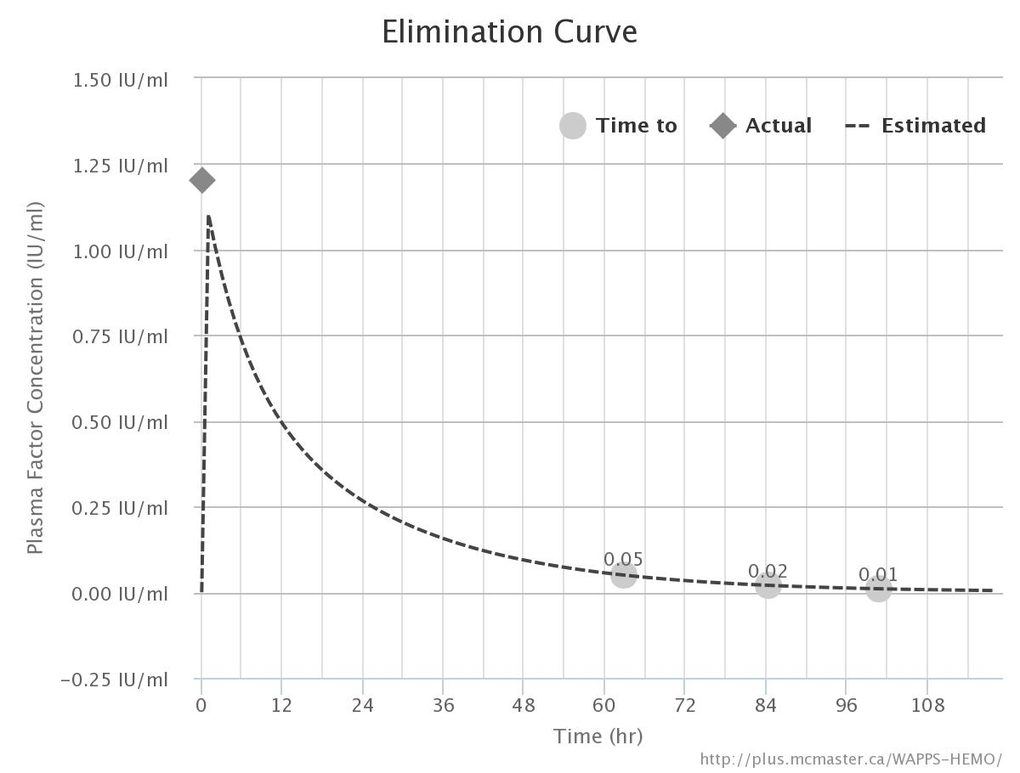
Kogenate 50 IU/kg

Slide 42
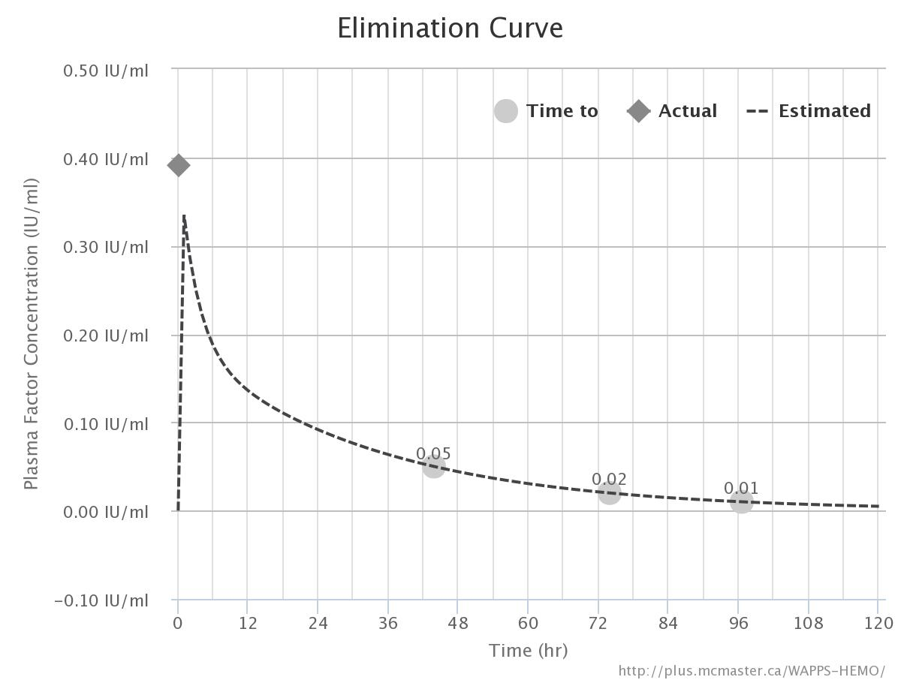
BenefIX 50 IU/kg

Slide 43
RESULTS – INDIVIDUAL ESTIMATION RICH VS SPARSE DATA SAMPLE

Slide 44
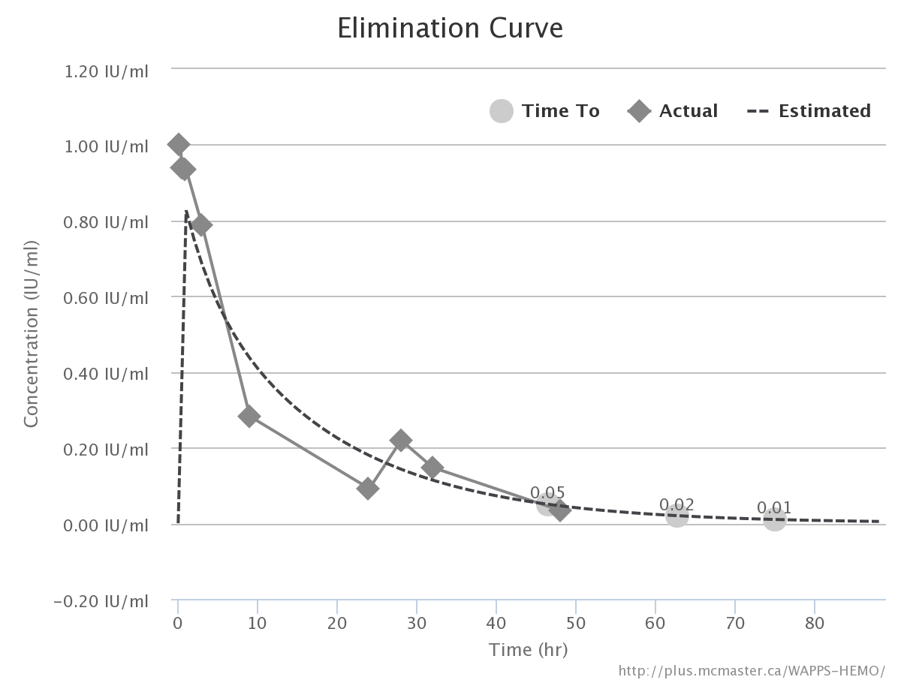
Bayesian estimate, rich data
Estimate | X | 95% CrI
Terminal HL (hr) | 12 | (10.5 – 13)
Time (hr) to UI/mL
0.05 | 46.5 | (39.75 - 53.25)
0.02 | 62.75 | (53.5 – 72)
0.01 | 75 | (63.5 – 86.25)

Slide 45
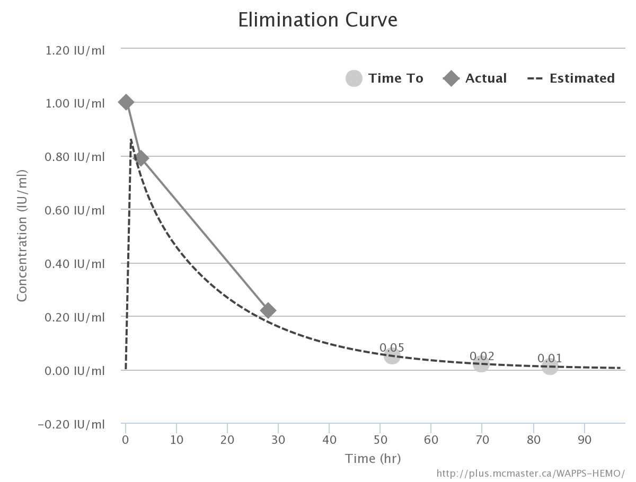

Slide 46
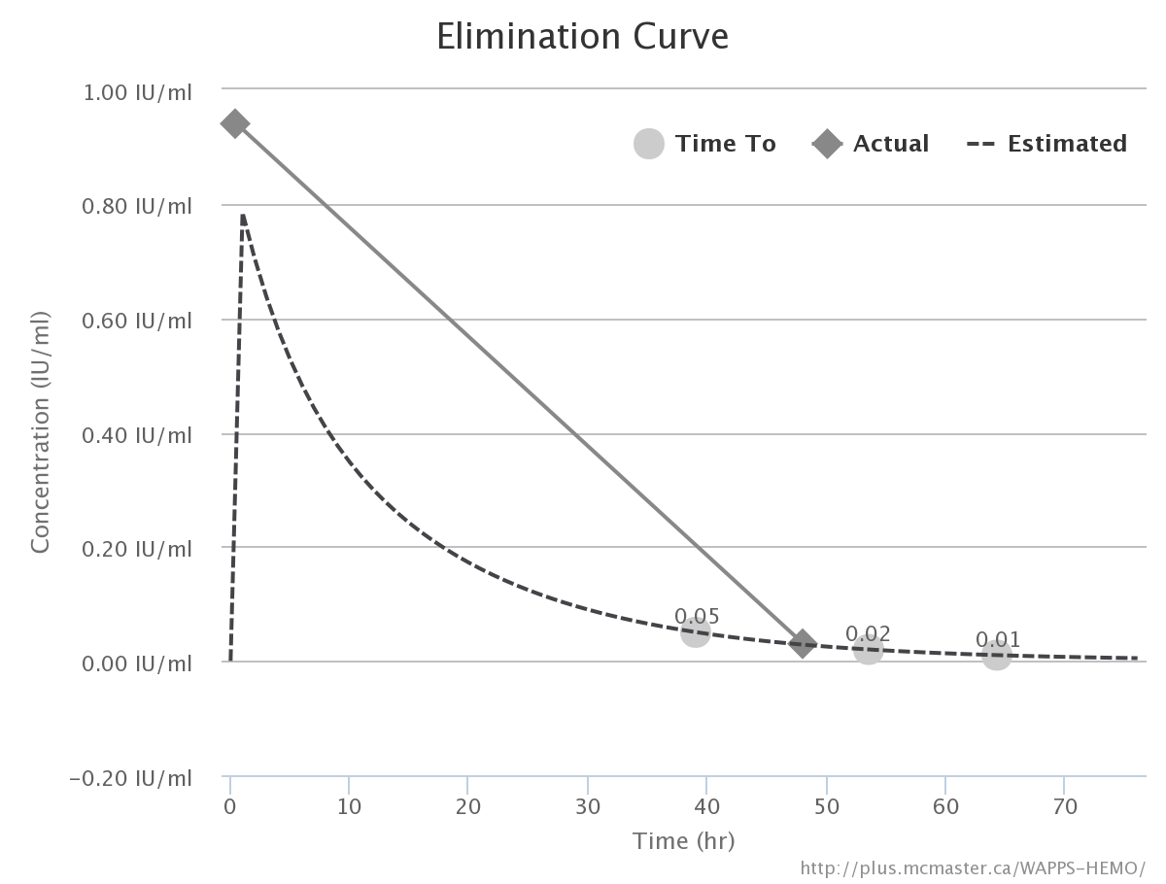

Slide 47
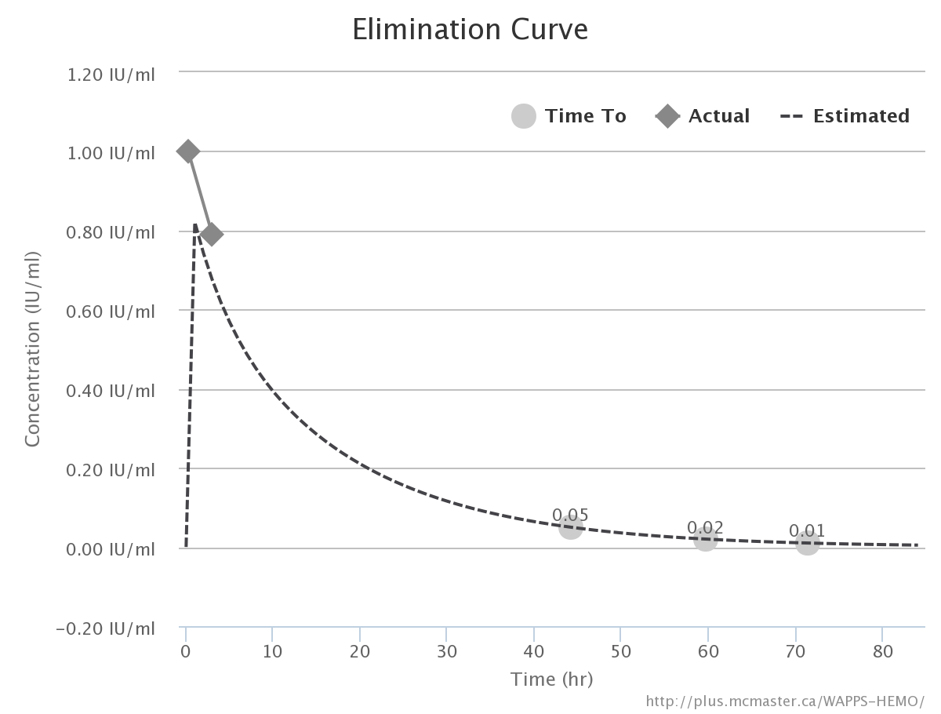

Slide 48
Reduced sampling sets
Samples | HL | 0.05 | 0.02 | 0.01
0:15 → 48 | 12 | 46.5 (38.75 - 53.25) | 62.75 (53.5 – 72) | 75 (63.5 – 86.25)
0:15, 3, 28 | 13.5 | 52.5 (36.75 – 67.75) | 70 (49.25 – 90.5) | 83.25 (58.75 – 107.75)
0:30, 48 | 11.0 | 39 (31.15-46.75) | 53.5 (44 – 63) | 64.5 (53.25 – 73.5)
0:15, 3 | 11.5 | 44.25 (22.5 – 66) | 59.75 (32 – 87.25) | 71.5 (39.25 – 103.75)

Slide 49
RESULTS – SENSITIVITY

Slide 50
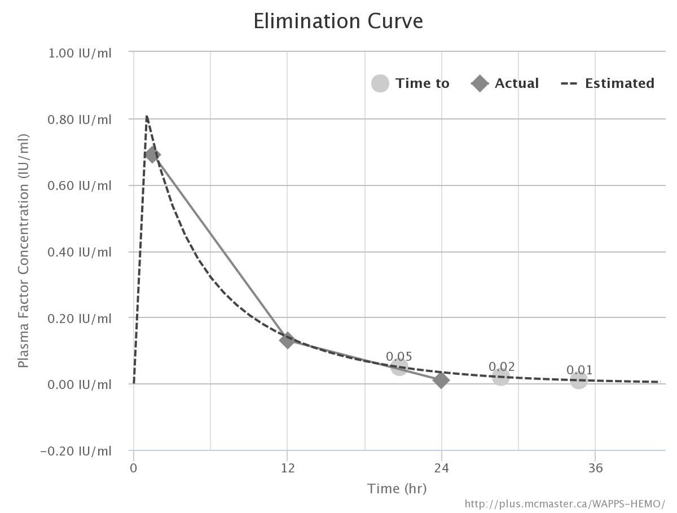
Patient with fast clearance
Time | [C]
1:30 | 0.69
12:00 | 0.13
24:00 | <0.01
HL (t) = 5.5 hours
(CrI 5.0 – 7.5)

Slide 51
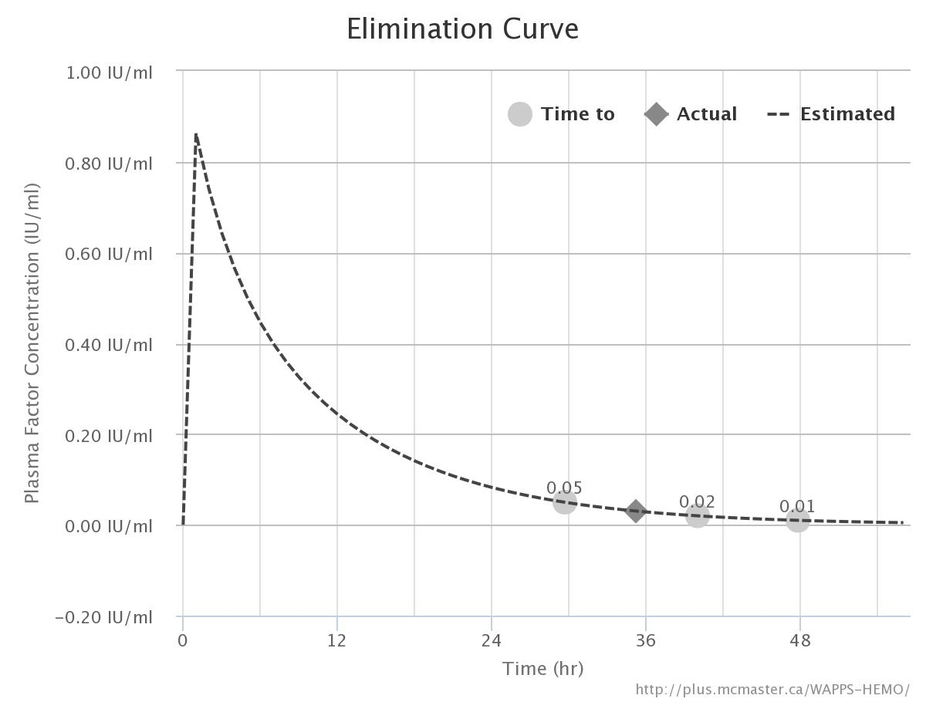
Patient after ITI
Time | [C]
35:08 | 0.03
HL (t) = 7.5 hours
(CrI 6.5 – 9.5)

Slide 52
RESULTS – PERFORMANCE, TESTING AND VALIDATION

Slide 53
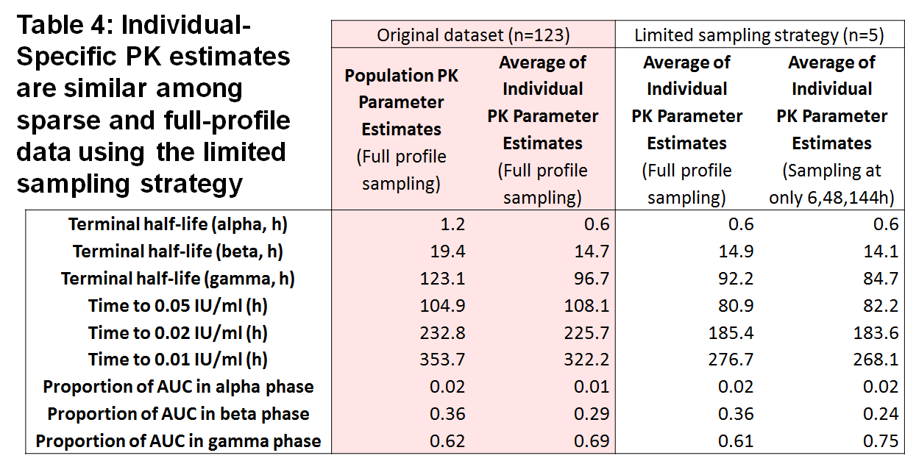
Internal Validation: bootstrap

Slide 54
Validation cohort
Emoclot | 16
FANHDI | 7
Aafact | 17
Kogenate | 62
Helixate | 23
Recombinate | 20
Advate | 41
Xyntha | 30
Others | 41
221 patients
257 kinetics

Slide 55
CONCLUSION AND FUTURE DEVELOPMENTS

Slide 56
PPK assisted estimate
It feasible - Is it reliable, precise, accurate?
11 data points classic PK
PEAK & TROUGH
PRECISION, ACCURACY

Slide 57
External validation
Step I: prediction on sparse data for new patients
Reference: full set for the same patient
Index measure: difference, ratio, predictive value
Step II: prediction on sparse data for new patients
Reference: Prospective verification in the same patient
Index measure: agreement difference, ratio, predictive value
Step III: prediction on sparse data for new patients
Comparison: “guess” from the treater on the same data
Index measure: agreement difference, ratio, predictive value

Slide 58
Future steps
Release of the multilingual interface
Optimal sampling time analysis
Development of a regimen simulation module

Slide 59
AKnowledgments
The WAPPS core team
The WAPPS network members
Bayer, Biogen, Kedrion, Octapharma, Pfizer.

Slide 60
Thank you !!!
Join the WAPPS network at:
www.wapps-hemo.org
Download these slides at:
Hemophilia.mcmaster.ca

