Slide 1
Special session #10:
GRADE: the past 15 and next … years
for prognostic evidence
Alfonso Iorio, MD, PhD
Dept. of Clinical Epidemiology & Biostatistics,
McMaster University
Notes:
1

Slide 2
Objectives
Role of prognostic evidence in guiding health care decisions
Intersections between evidence on prognosis and evidence on the effect of interventions
Experience and guidance (to date) in applying GRADE to prognostic evidence
Future directions (to .. morrow)

Slide 3
What is prognosis?
Risk (likelihood, probability) of future events
Greek προγνωσις: knowing in advance
“understanding” the future is a common need of humans:
Will it snow today?
Will the Maple Leafs win the Stanley Cup?
Will I get to the airport on time?

Slide 4
Relevance of prognosis
Discovery and design
Preclinical
development
Health care delivery
definition
audits
targets
Knowledge
translation
Early clinical
phases
PROGNOSIS
sizing
priorities
Health Service
Research
Late clinical
Trials
HTA
Re-edited from a PROGRESS course slide
Notes:
This is possibly why we did not focus so intensively on prognosis before hand

Slide 5
Prognostic questions
What is the risk of first stroke in patients with diabetes mellitus?
What is the risk of falls in patients with Alzheimer?
Does age (or osteoporosis) affect the risk of bone fractures in postmenopausal women?
Which characteristics identify ICU patients at risk of ventilator associated pneumonia?
Does the APACHE II score at admission to ICU predict in-hospital mortality?

Slide 6
PROGNOSTIC study designs
Epistemological framework (PROGRESS group)
Overall prognosis research
Prognostic factor research
Prognostic model research
(Stratified medicine research)

Slide 7
PICO components
 | Overall prognosis | Risk factor | Prognostic model
P | ☐ | ☐ | ☐
I | ☐ | ☐ | ☐
C | ☐ | ☐ | ☐
O | ☐ | ☐ | ☐
(T) | ☐ | ☐ | ☐
 | Overall prognosis | Risk factor | Prognostic model
P | ☑ | ☑ | ☑
I | ☐ | ☑ (E+) | ☑
C | ☐ | ☑ (E-) | ☐✔ (IS)
O | ☑ | ☑ | ☑
(T) | (endpoint) | (endpoint) | (endpoint)
 | Overall prognosis | Risk factor | Prognostic model
P | ☑ | ☑ | ☑
I | ☐ | ☑ (E+) | ☐
C | ☐ | ☑ (E-) | ☐
O | ☑ | ☑ | ☑
(T) | (endpoint) | (endpoint) | (endpoint)
 | Overall prognosis | Risk factor | Prognostic model
P | ☑ | ☑ | ☑
I | ☐ | ☐ | ☐
C | ☐ | ☐ | ☐
O | ☑ | ☑ | ☑
(T) | (endpoint) | (endpoint) | (endpoint)

Slide 8
Diagnosis versus Prognosis
Start point
“Test”
End point
(+)
(+)
(-)
Health status
(+)
(-)
(-)
0
Time
“n”
Notes:
Clear prognostic setting: Duration of pain and functional limitation after a ankle fracture
I assess the condition now (startpoint) and observe the event rate in the future
Pure diagnosis: I do a lab test today, and I decide you have/you don’t have a disease.
2 “borderline” conditions, logically clear but in practice potentially complicated
I calculate the PPV/NPV or LR of a dimer test to diagnose DVT using the rate of events at 30 days.
I use a test to identify a risk condition, for which I then study the prognosis.
Deficiency some enzyne / thrombophilic defect

Slide 9
SR and MA
More or less standard approaches
Often including NRS/NCS
Requiring judging appropriateness of pooling
Some technical problems:
Assessment of heterogeneity
Accounting for empty cells

Slide 10
Risk of bias
Inconsistency
Imprecision
Indirectness
Publication bias
high
moderate
OVERALL PROGNOSIS
low
Large effect
Dose-response
„Antagonistic bias”
very low
Notes:
Inclusion criteria of RCT which limits generalizability
Decline participation in RCT d/t worse prognosis
Inconsistency:
Effect estimate, CI and relation to clinically important threshold
Limitation with using I2: very large number of individual with narrow CI
Small sample size (publication with high effect and ? Marker for methodological limitations)
Imprecision:
Width of CI and position to clinical important threshold
Indirectness:
Population and outcome correlate to the ones we are studying
Publication bias:
Small studies where pt don’t do well less likely to get published
Begg’s test not egger’s test may more appropriate

Slide 11
Study design
In the field of prognosis a body of longitudinal cohort studies initially provides high confidence
Even using evidence from a RCT, you would use a single arm at a time, in a non comparative fashion
Randomization does not add value
The RCT setting and process can indeed:
Select patients and reduce applicability
Selection may be associated to prognosis
Large pragmatic RCT are less likely to be flawed

Slide 12
Bleeding risk on warfarin
Study design | Risk estimate
Large pragmatic RCT | 3.09 (2.20 – 3.36)
Moderate size RCT | 1.80 (1.36 – 2.50)
Observational trials | 2.68 (1.75 – 4.40)
Lopes LC, et al. Clin Pharmacol Ther 2013;94:367–75

Slide 13
Risk of bias assessment
BMJ Iorio A, et al. 2015;350:h870

Slide 14
RoB Assessment Tools
TRIPOD
PROBAST
QUIPS
Acrobat-NR
M - NOS

Slide 15
Risk of cancer in Barrett esophagus
Study characteristic | N of studies | I²
All | 47 | 66% (55 – 75)
Standardized diagnosis | 14 | 0%
Not standardized | 33 | 75% (60 – 80)
Yousef, F. American journal of epidemiology, 2008, 168, 237–49.
Notes:
Firstly, small sample size is more subject to publication bias because decisions to submit or publish small studies may be driven to a greater extent by the results than is true of large studies. Secondly, small sample size may be a marker for difficult to detect methodological deficien- cies that increase bias.

Slide 16
Risk of cancer in Barrett esophagus
Small study effect
Study characteristic | N of studies | Estimate (x 1000 pt y)
All | 47 | 6.1 (4.7 – 7.9)
Large | 23 | 4.4 (3.4 – 5.7)
Small | 24 | 11.6 (8.4- 16)
Yousef, F. Am J Epidemiol, 2008, 168, 237–49.
Notes:
Firstly, small sample size is more subject to publication bias because decisions to submit or publish small studies may be driven to a greater extent by the results than is true of large studies. Secondly, small sample size may be a marker for difficult to detect methodological deficiencies that increase bias.

Slide 17
Inconsistency
Assessed looking at heterogeneity:
variability in point estimates
extent of overlap in confidence intervals
where point estimates lie in relation to decision thresholds.
Notes:
Please note that large non comparative studies will always generate lareg I2 vlaues.

Slide 18
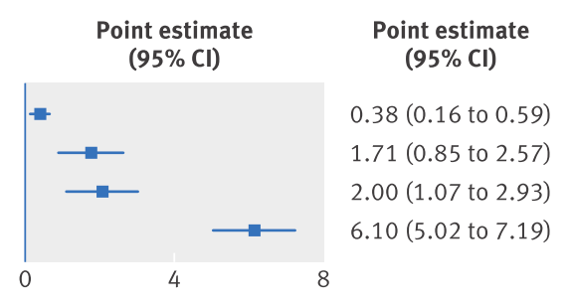
Risk of HCV in hemodialysis
Rich | HCV<15%
Rich | HCV>15%
Poor | HCV<15%
Poor | HCV>15%
Su Y. Hemodial Int 2013;17:532–41.

Slide 19
Use of sensitivity analysis
It explains variability:
Due to methodological quality of the studies (→ RoB)
e.g. diagnostic inaccuracy / small study effect
Due to population characteristics (→ Inconsistency)
HCV prevalence
In both cases:
Helps identifying the right subset of studies to use
Please note:
Do not double count
Do not downgrade if you chose to use a subset
Notes:
This is complex, and it goes back to risk of bias

Slide 20
Indirectness
As in the setting of treatment:
Population
Risk of suicide in patient with eating disorders, with most study allowing psychiatric comorbidities
Arcelus, J. Arch Gen Psych,2012 68, 724–31.
Outcome
HCV infection diagnosed in old study with less sensitive methods, which would not be the one used today in the western world
Su Y. Hemodial Int 2013;17:532–41.

Slide 21
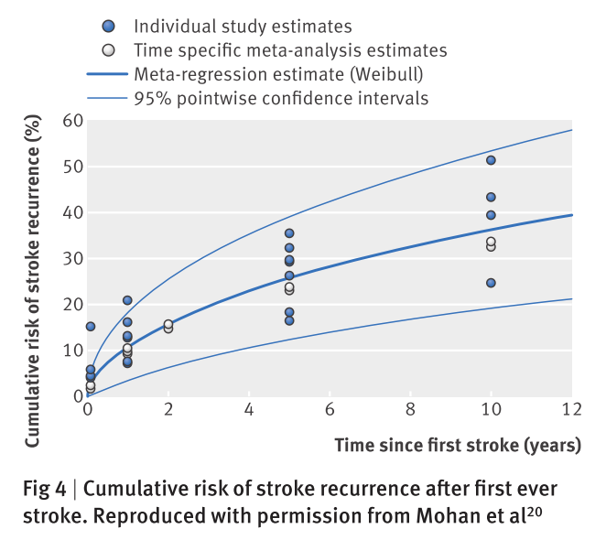

Slide 22
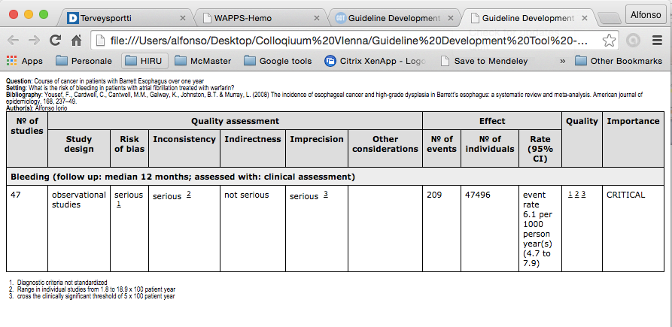
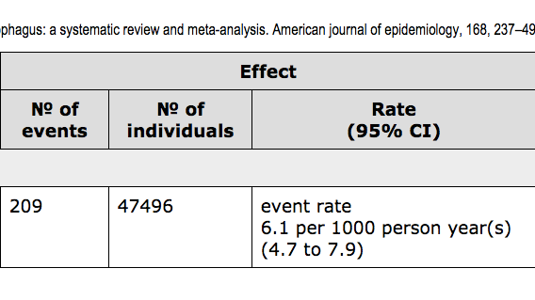
Evidence profile for prognosis

Slide 23
Definitions of levels of evidence for typical risk of broadly defined population
Quality level | Definition
High | We are very confident that the true prognosis (probability of future of future events) lies close to that of the estimate
Moderate | We are moderately confident that the true prognosis (probability of future of future events) is likely to be close to the estimate, but there is possibility that it is substantially different
Low | Our confidence in the estimate is limited: the true prognosis (probability of future events) may be substantially different from the estimate
Very low | We have very little confidence in the estimate: the true prognosis (probability of future events) is likely to be substantially different from the estimate
BMJ 2015;350:h870
Notes:
Tipical case where a sinlge high quality trial can be highly downgraded

Slide 24
Intersection between prognosis and interventions
Role of prognostic evidence in health care decisions making
Treatment effect framework | Prognostic evidence
Baseline risk | Overall prognosis
Subgroup analysis | Prognostic factor
Decision algorithm/policy/implementation | Prognostic model

Slide 25
Impact of assessing the confidence in estimates of the baseline risk in AT9 GL
Non fatal stroke in Atrial fibrillation patients
4.2 % in 6 RCT (90es) vs 2.1 % (contemporary databases)
Risk of VTE in women undergoing IVF
4.1 % (95% CI 1.1 – 13.7)
4 to 110 events prevented for 1000 treated
Risk of VTE after neurosurgery
2.1 %; assuming a RR = 0.56:
9/1000 less non fatal VTE with LMWH (but +11 ICH)
Range 0% to 10% → 44/1000 less VTE
Risk of stoke in Afib CHADS2 =1
2.2% (old) vs 1.2 (new) → 15 vs 8 per 1000 (and close to the old estimate of 0 = 0.4)
Spencer, F.A. et al. BMJ 2013, 345, e7401–e7401.
Notes:
Afib Trials in the 90es enrolled less than 10% of patients
IVF Estimated in 49 women

Slide 26
Assessment of prognostic risk factors
Research design
Phase of investigation
Risk of bias
Inconsistency
Imprecision
Indirectness
Publication bias
Risk of bias
Inconsistency
Imprecision
Indirectness
Publication bias
Large effect
Dose-response
Plausible bias
Large effect
Dose-response
------
Huguet, A., et al. Systematic Reviews, 2013, 2, 71.
Notes:
I do not enter the classifictaion of phases of investigations and their relationships to the risk of bias.
The authors refer to Phase I (identification of candidate predictors), II (validation of known predictors) and III (confirmation of pathways) for prognostic studies as setting different starting points for the quality of evidence.

Slide 27
Assessment of prognostic risk factors
RoB
QUIPS domains
Inconsistency
only one study – no pooled analysis
Indirectness
referral bias in population selection (only tertiary centers)
risk factors considered (only depression and not mental illnesses more in general)
specific outcome (migraine instead than headache)
Imprecision
number of events in relationship to number of predictors analyzed
Publication bias
Always assume
Huguet, A. et al. Systematic Reviews, 2013, 2, 71.
Notes:
I do not enter the classificaion of phases of investigations and their relationships to the risk of bias.
The authors refer to Phase I (identification of candidate predictors), II (validation of known predictors) and III (confirmation of pathways) for prognostic studies as setting different starting points for the quality of evidence.
Inconsistency (only one study for a specific question – no pooled analysis)
Indirectness: referral bias in population selection (only tertiary centers), in the risk factors considered (only depression and not mental illnesses more in general), in the specific outcome (migraine instead than headache)
Usual aspects plus number of events in relationship to number of predictors analyzed
Always download if not demonstrated the contraty – large confirmation studies! Example where 4 large early phase studies concluded 3:1 – attention not to double count design.

Slide 28
Assessment of prognostic risk factors
The evidence profile proposed is very transparent, yet very complex:
Organized by predictor, not outcome
Phase of investigation
Counts of studies for/neutral/against
at univariate and multivariate
Dimensions to increase
No numeric estimate of the “effect”
Huguet, A., et al. Systematic Reviews, 2013, 2, 71.
Notes:
I do not enter the classificaion of phases of investigations and their relationships to the risk of bias.
The authors refer to Phase I (identification of candidate predictors), II (validation of known predictors) and III (confirmation of pathways) for prognostic studies as setting different starting points for the quality of evidence.
Inconsistency (only one study for a specific question – no pooled analysis)
Indirectness: referral bias in population selection (only tertiary centers), in the risk factors considered (only depression and not mental illnesses more in general), in the specific outcome (migraine instead than headache)
Usual aspects plus number of events in relationship to number of predictors analyzed
Always download if not demonstrated the contraty – large confirmation studies! Example where 4 large early phase studies concluded 3:1 – attention not to double count design.

Slide 29
Future directions
Overall prognosis
Continuous data
Reproducibility, applicability
Risk factor prognosis
Guidance paper on dichotomous data
Prognostic models
Hyerarchical integration into the GL process

Slide 30
Overview Cochrane Prognostic Methods Group (PMG) Workshops
Thank you !
PMG Workshop | Facilitators | When?
Using the CHARMS checklist for SR | Carl Moons and Lotty Hooft | 4 October, Sunday: 16.00 to 17.30
Assessing RoB using the QUIPS tool | Jill Hayden and Carl Moons | 5 October, Monday: 14.00 to 15.30
Assessing RoB of PROBAST tool | Robert Wolff, Penny Whiting and Carl Moons | 5 October, Monday: 16.00 to 17.30
MA/SR of prognostic studies | Thomas Debray and Carl Moons | 6 October, Tuesday: 11.00 to 12.30
GRADE for SR of overall prognosis | A Iorio, E Matovinovic, and J Hayden | 7 October, Wednesday: 14.00 to 15.30
IPD/MA of prediction modelling studies | Thomas Debray and Hans Reitsma | 7 October, Wednesday: 14.00 to 15.30

